Slide 1

StudyMafia.Org
THE CAP SELLER
AND
THE MONKEYS
Submitted To: Submitted By:
Studymafia.org Studymafia.org

Slide 2
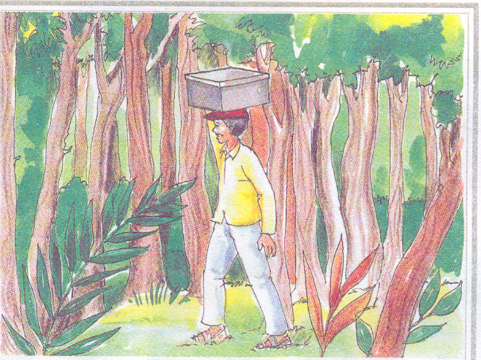

One bright sunny morning a cap seller was passing through the forest with a box full of caps. It became very hot.

Slide 3
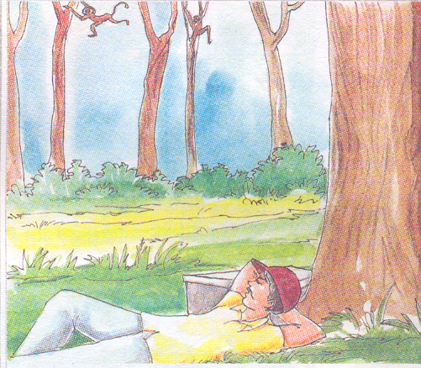
The cap seller got very tired. So he sat down under a tree to relax.
He closed his eyes and went to sleep.

Slide 4
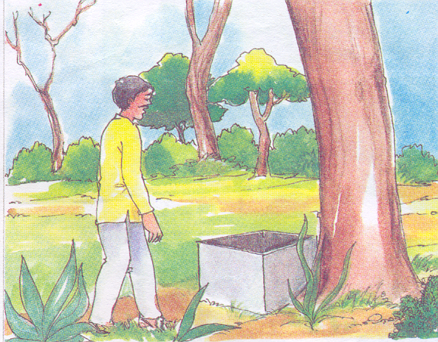
When he got up, he found the box open and all his caps missing.

Slide 5
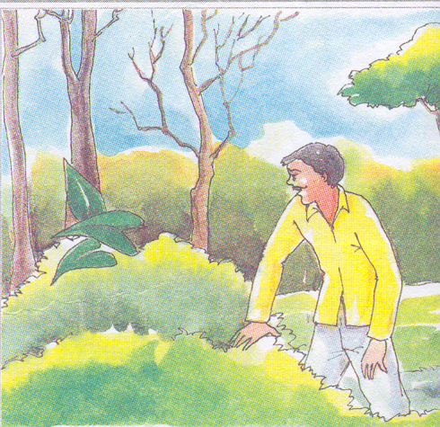
He started looking around for the caps.

Slide 6
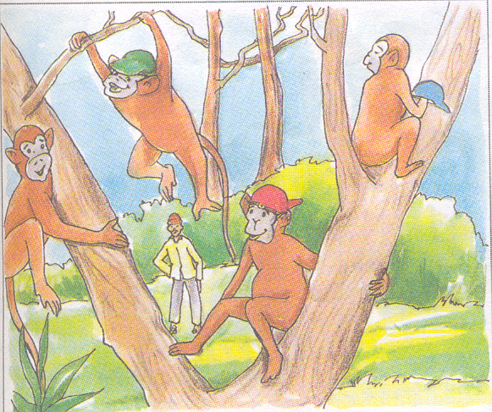
He looked up and found some monkeys wearing the caps. He got very angry.

Slide 7
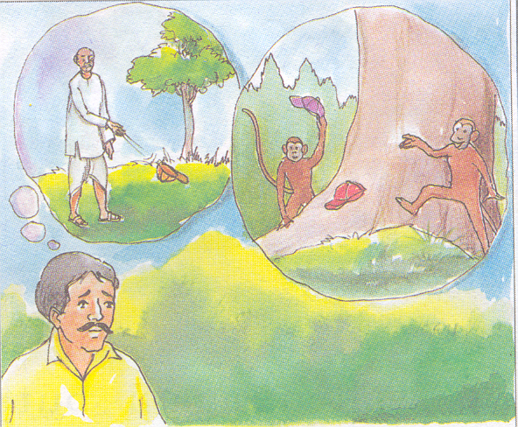
This reminded him of the situation that his grandfather had once faced.

Slide 8
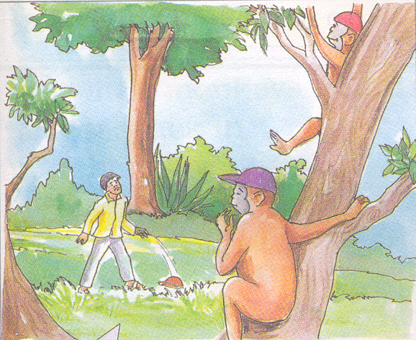
Hey Monkeys!
Look Here. See, what I’m doing.
So he took his cap off and threw it on the ground.

Slide 9
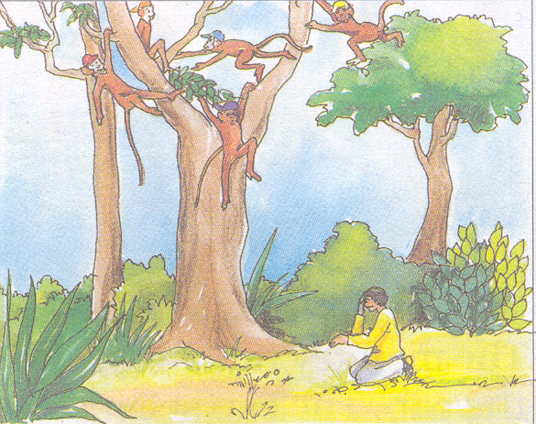
The caps seller waited for quite sometime for the monkeys to copy him but they didn’t.
The cap seller repeated his action and shouted even louder.

Slide 10
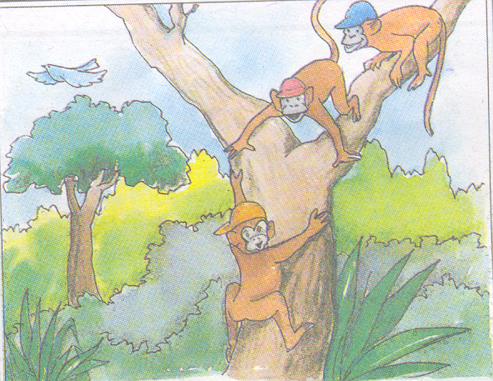
He waited again but nothing happened. Then one of the monkey came down and said.

Slide 11
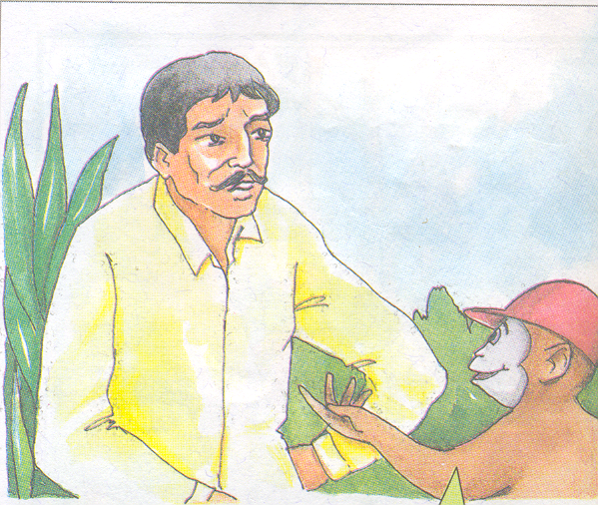
Do you think only your grandfather told you about that incident? Our grandfather also told us about it and asked us not to react foolishly.

Slide 12
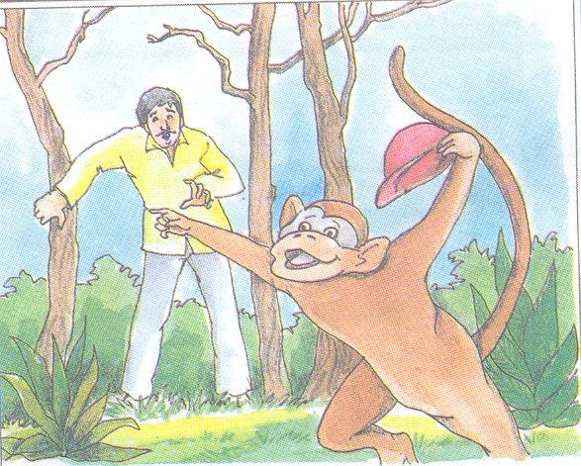
The monkey ran away with the cap. The cap seller was Shocked!

Slide 13
Moral
"Don't do always what was done yesterday. Assimilate the learning of past actions, think differently and act wisely". If you want tomorrow to be better than yesterday and today, then don't do the same, what you have done till now.

Slide 14
References
Studymafia.org
Seminarppt.com
Google.com

Slide 15
Thanks

