Slide 1
StudyMafia.Org
Surgical Asepsis
Submitted To: Submitted By:
Studymafia.org Studymafia.org

Slide 2
Table Contents
Definition
Introduction
Principles of Surgical Asepsis
Conclusion
2
Notes:
SAY: Before we wrap up the course, let’s review what we have learned today.
During this course, we have
<READ the bullets from the slide.>
GO to next slide.

Slide 3
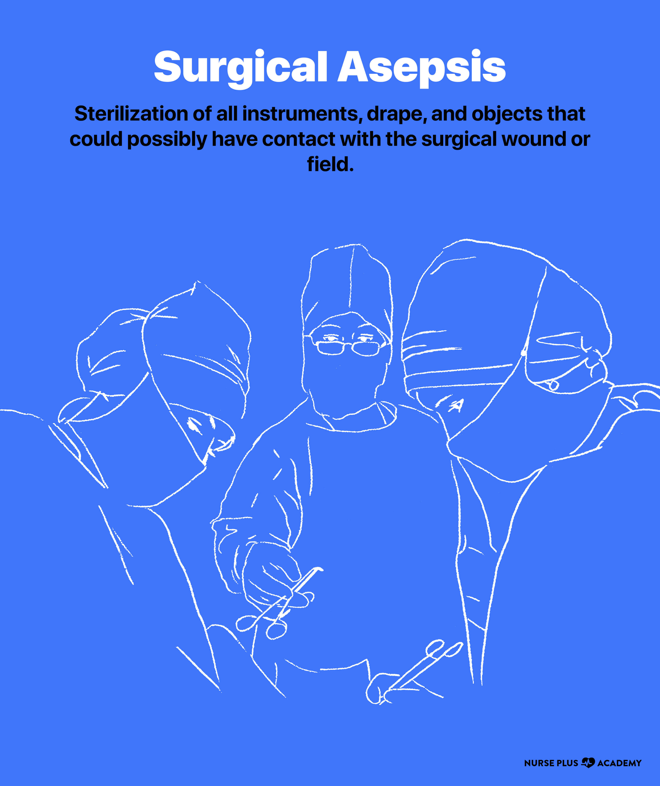
Definition
Surgical asepsis, also called “aseptic/sterile technique,” eliminates microorganisms before they can enter an open surgical wound or contaminate a sterile field.
3
Notes:
SAY: Before we wrap up the course, let’s review what we have learned today.
During this course, we have
<READ the bullets from the slide.>
GO to next slide.

Slide 4
Introduction
Surgical asepsis is always practiced in operating rooms, special procedure or diagnostic areas, burn units, and in labor and delivery areas.
It is also used during invasive procedures at the bedside, such as inserting chest tubes, central lines, and catheters. Surgical asepsis is one of the two types of asepsis; medical asepsis is the other.
4
Notes:
SAY: Before we wrap up the course, let’s review what we have learned today.
During this course, we have
<READ the bullets from the slide.>
GO to next slide.

Slide 5
5
Notes:
SAY:
The purpose of epidemiology in public health practice is to
discover the agent, host, and environmental factors that affect health;
determine the relative importance of causes of illness, disability, and death;
identify those segments of the population that have the greatest risk from specific causes of ill health; and
evaluate the effectiveness of health programs and services in improving population health.
GO to next slide.

Slide 6
Principles of Surgical Asepsis
Antisepsis
Prevention of sepsis by exclusion, destruction, or inhibition of growth or multiplication of microorganisms from body tissues and fluids.
Asepsis
Absence of microorganisms that cause disease.
●●●
6
Notes:
SAY:
The purpose of epidemiology in public health practice is to
discover the agent, host, and environmental factors that affect health;
determine the relative importance of causes of illness, disability, and death;
identify those segments of the population that have the greatest risk from specific causes of ill health; and
evaluate the effectiveness of health programs and services in improving population health.
GO to next slide.

Slide 7
Principles of Surgical Asepsis
Antiseptics
Inorganic chemical compounds that combat sepsis by inhibiting the growth of microorganisms without necessarily killing them. Used primarily on skin to stop the growth of resident flora.
Aseptic technique
Method to prevent contamination by microorganisms.
●●●
7
Notes:
SAY:
The purpose of epidemiology in public health practice is to
discover the agent, host, and environmental factors that affect health;
determine the relative importance of causes of illness, disability, and death;
identify those segments of the population that have the greatest risk from specific causes of ill health; and
evaluate the effectiveness of health programs and services in improving population health.
GO to next slide.

Slide 8
Principles of Surgical Asepsis
Cross-contamination
Transmission of microorganisms from patient to patient or from inanimate object to patient.
Decontamination
Cleaning and disinfecting or sterilizing processes carried out to make contaminated items safe to handle.
Disinfection
Chemical or mechanical (friction) destruction of pathogens.
●●●
8
Notes:
SAY:
The purpose of epidemiology in public health practice is to
discover the agent, host, and environmental factors that affect health;
determine the relative importance of causes of illness, disability, and death;
identify those segments of the population that have the greatest risk from specific causes of ill health; and
evaluate the effectiveness of health programs and services in improving population health.
GO to next slide.

Slide 9
Principles of Surgical Asepsis
Barrier
A material used to reduce or inhibit the migration or transmission of microorganisms in the environment: personnel attire and gowns, furniture and patient drapes, equipment and supply packaging, and ventilating filters.
Contaminated
Carrying or infected by microorganisms.
●●●
9
Notes:
SAY:
The purpose of epidemiology in public health practice is to
discover the agent, host, and environmental factors that affect health;
determine the relative importance of causes of illness, disability, and death;
identify those segments of the population that have the greatest risk from specific causes of ill health; and
evaluate the effectiveness of health programs and services in improving population health.
GO to next slide.

Slide 10
Principles of Surgical Asepsis
Irreducible minimum
Microbial burden cannot get any lower. Item is sterile to its highest degree.
Spatial relationships
Awareness of sterile, unsterile, clean, and contaminated areas, objects, and individuals and their proximity to each other.
Sterile
Free of living organisms.
●●●
10
Notes:
SAY:
The purpose of epidemiology in public health practice is to
discover the agent, host, and environmental factors that affect health;
determine the relative importance of causes of illness, disability, and death;
identify those segments of the population that have the greatest risk from specific causes of ill health; and
evaluate the effectiveness of health programs and services in improving population health.
GO to next slide.

Slide 11
Principles of Surgical Asepsis
Standard precautions
Procedures followed to protect personnel from contact with the blood and body fluids of patients.
Sterile field
Area around the site of incision into tissue or the site of introduction of an instrument into a body orifice that has been prepared using sterile supplies and equipment.
●●●
11
Notes:
SAY:
The purpose of epidemiology in public health practice is to
discover the agent, host, and environmental factors that affect health;
determine the relative importance of causes of illness, disability, and death;
identify those segments of the population that have the greatest risk from specific causes of ill health; and
evaluate the effectiveness of health programs and services in improving population health.
GO to next slide.

Slide 12
Principles of Surgical Asepsis
Sterile technique
Method by which contamination with microorganisms is prevented to maintain sterility throughout the surgical procedure.
Terminal sterilization and disinfection
Procedures carried out for the destruction of pathogens at the end of the surgical procedure in the operating room (OR) after the patient has been removed.
12
Notes:
SAY:
The purpose of epidemiology in public health practice is to
discover the agent, host, and environmental factors that affect health;
determine the relative importance of causes of illness, disability, and death;
identify those segments of the population that have the greatest risk from specific causes of ill health; and
evaluate the effectiveness of health programs and services in improving population health.
GO to next slide.

Slide 13
Conclusion
Surgical asepsis is the absence of all microorganisms within any type of invasive procedure.
Sterile technique is a set of specific practices and procedures performed to make equipment and areas free from all microorganisms and to maintain that sterility (BC Centre for Disease Control, 2010).
13
Notes:
SAY:
The purpose of epidemiology in public health practice is to
discover the agent, host, and environmental factors that affect health;
determine the relative importance of causes of illness, disability, and death;
identify those segments of the population that have the greatest risk from specific causes of ill health; and
evaluate the effectiveness of health programs and services in improving population health.
GO to next slide.

Slide 14
References
Google.com
Wikipedia.org
Studymafia.org
Slidespanda.com

Slide 15
Thanks To StudyMafia.org

