Slide 1
StudyMafia.Org
Robotic Surgery
Submitted To: Submitted By:
Studymafia.org Studymafia.org

Slide 2
Table Contents
Definition
Introduction
Why Robotic Surgery
Types of Robotic Surgery
Advantages of Robotic Surgery
Conclusion
2
Notes:
SAY: Before we wrap up the course, let’s review what we have learned today.
During this course, we have
<READ the bullets from the slide.>
GO to next slide.

Slide 3
Definition
Robotic surgery, also called robot-assisted surgery, allows doctors to perform many types of complex procedures with more precision, flexibility and control than is possible with conventional techniques.
3
Notes:
SAY: Before we wrap up the course, let’s review what we have learned today.
During this course, we have
<READ the bullets from the slide.>
GO to next slide.

Slide 4
Introduction
Robotic surgery is usually associated with minimally invasive surgery — procedures performed through tiny incisions. It is also sometimes used in certain traditional open surgical procedures.
The most widely used clinical robotic surgical system includes a camera arm and mechanical arms with surgical instruments attached to them. The surgeon controls the arms while seated at a computer console near the operating table.
4
Notes:
SAY: Before we wrap up the course, let’s review what we have learned today.
During this course, we have
<READ the bullets from the slide.>
GO to next slide.

Slide 5
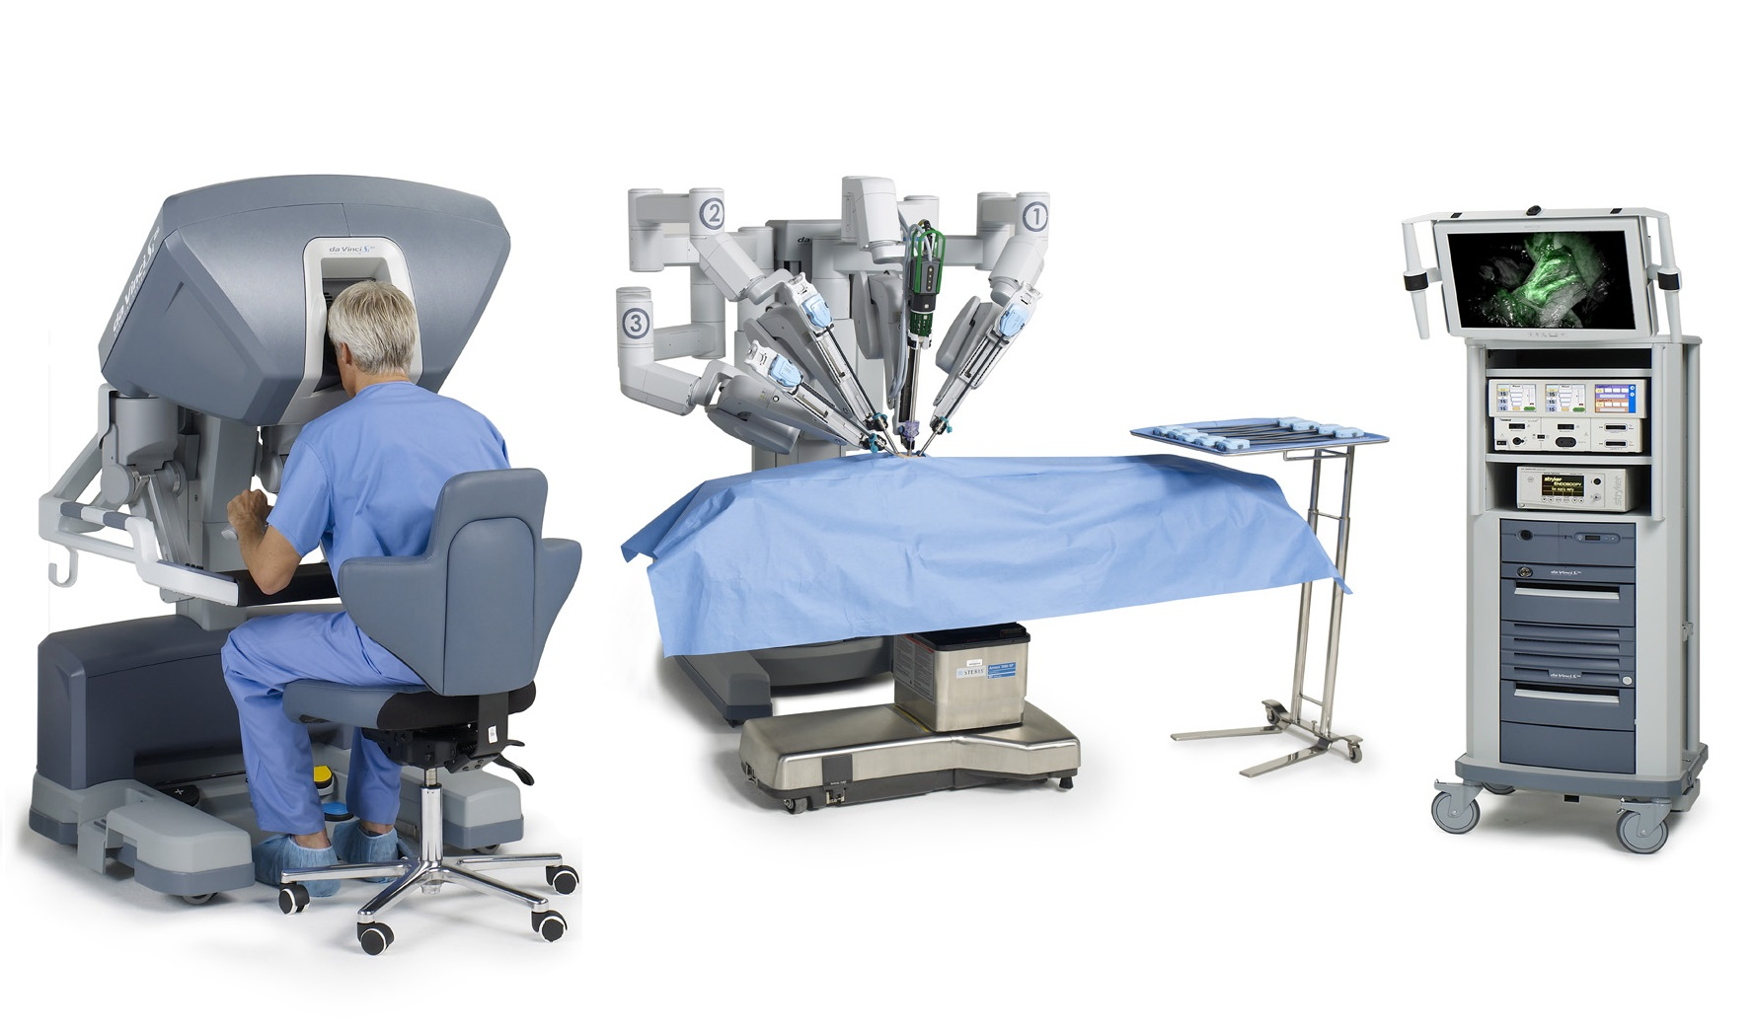
5
Notes:
SAY:
The purpose of epidemiology in public health practice is to
discover the agent, host, and environmental factors that affect health;
determine the relative importance of causes of illness, disability, and death;
identify those segments of the population that have the greatest risk from specific causes of ill health; and
evaluate the effectiveness of health programs and services in improving population health.
GO to next slide.

Slide 6
Why Robotic Surgery?
Surgeons who use the robotic system find that for many procedures it enhances precision, flexibility and control during the operation and allows them to better see the site, compared with traditional techniques.
Using robotic surgery, surgeons can perform delicate and complex procedures that may be difficult or impossible with other methods.
●●●
6
Notes:
SAY:
The purpose of epidemiology in public health practice is to
discover the agent, host, and environmental factors that affect health;
determine the relative importance of causes of illness, disability, and death;
identify those segments of the population that have the greatest risk from specific causes of ill health; and
evaluate the effectiveness of health programs and services in improving population health.
GO to next slide.

Slide 7
Why Robotic Surgery?
Often, robotic surgery makes minimally invasive surgery possible. The benefits of minimally invasive surgery include:
Fewer complications, such as surgical site infection
Less pain and blood loss
Shorter hospital stay and quicker recovery
Smaller, less noticeable scars
●●●
7
Notes:
SAY:
The purpose of epidemiology in public health practice is to
discover the agent, host, and environmental factors that affect health;
determine the relative importance of causes of illness, disability, and death;
identify those segments of the population that have the greatest risk from specific causes of ill health; and
evaluate the effectiveness of health programs and services in improving population health.
GO to next slide.

Slide 8
Why Robotic Surgery?
Robotic surgery isn't an option for everyone. Talk with your doctor about the benefits and risks of robotic surgery and how it compares with other techniques, such as other types of minimally invasive surgery and conventional open surgery.
Robotic surgery may not be available at medical centers in your geographic location.
8
Notes:
SAY:
The purpose of epidemiology in public health practice is to
discover the agent, host, and environmental factors that affect health;
determine the relative importance of causes of illness, disability, and death;
identify those segments of the population that have the greatest risk from specific causes of ill health; and
evaluate the effectiveness of health programs and services in improving population health.
GO to next slide.

Slide 9
Types of Robotic Surgery
Robotic kidney surgery might be required when one kidney or a part of a kidney needs to be removed.
In traditional open surgery, a large incision, up to eight inches, might be required in order for the surgery to be performed.
●●●
9
Notes:
SAY:
The purpose of epidemiology in public health practice is to
discover the agent, host, and environmental factors that affect health;
determine the relative importance of causes of illness, disability, and death;
identify those segments of the population that have the greatest risk from specific causes of ill health; and
evaluate the effectiveness of health programs and services in improving population health.
GO to next slide.

Slide 10
Types of Robotic Surgery
Robotic gynaecological surgery means less pain after surgery and lesser blood loss. In traditional surgery, there is significant pain involved in any gynaecological surgery and there is usually physical trauma connected to the surgery as well.
Moreover, large incisions are made in open surgery and this means longer recovery process.
●●●
10
Notes:
SAY:
The purpose of epidemiology in public health practice is to
discover the agent, host, and environmental factors that affect health;
determine the relative importance of causes of illness, disability, and death;
identify those segments of the population that have the greatest risk from specific causes of ill health; and
evaluate the effectiveness of health programs and services in improving population health.
GO to next slide.

Slide 11
Types of Robotic Surgery
Robotic gallbladder surgery includes cholecystectomy which means removing the gallbladder. With the help of robotic surgical systems, surgeons can now perform the surgery with a single incision.
This means fewer scars and the healing time is much lesser because of the lesser loss of blood compared to open surgery.
●●●
11
Notes:
SAY:
The purpose of epidemiology in public health practice is to
discover the agent, host, and environmental factors that affect health;
determine the relative importance of causes of illness, disability, and death;
identify those segments of the population that have the greatest risk from specific causes of ill health; and
evaluate the effectiveness of health programs and services in improving population health.
GO to next slide.

Slide 12
Types of Robotic Surgery
Robotic colorectal surgery might be required in the case when a patient requires colectomy or has other conditions such as a benign tumour.
Using robotic surgical systems, surgeons can better perform colon surgeries that were deemed impossible in the past.
12
Notes:
SAY:
The purpose of epidemiology in public health practice is to
discover the agent, host, and environmental factors that affect health;
determine the relative importance of causes of illness, disability, and death;
identify those segments of the population that have the greatest risk from specific causes of ill health; and
evaluate the effectiveness of health programs and services in improving population health.
GO to next slide.

Slide 13
Advantages of Robotic Surgery
The surgeon has a better view of what is happening during the operation which enables him/her/them to see better and make better decisions.
Robotic surgeries always mean less tissue damage for the patient which helps in faster recovery.
There are fewer chances of getting an infection when Robotic Surgery is performed with smaller incisions.
●●●
13
Notes:
SAY:
The purpose of epidemiology in public health practice is to
discover the agent, host, and environmental factors that affect health;
determine the relative importance of causes of illness, disability, and death;
identify those segments of the population that have the greatest risk from specific causes of ill health; and
evaluate the effectiveness of health programs and services in improving population health.
GO to next slide.

Slide 14
Advantages of Robotic Surgery
Patients experience lesser pain during Robotic Surgery due to the incisions that are much smaller compared to traditional surgery.
There is minimal blood loss when Robotic Surgery is performed and this means lesser blood transfusions are required as a result.
The surgeon has better access to the area where the operation is taking place because of the high-resolution camera that is used to show real-time images of the area.
●●●
14
Notes:
SAY:
The purpose of epidemiology in public health practice is to
discover the agent, host, and environmental factors that affect health;
determine the relative importance of causes of illness, disability, and death;
identify those segments of the population that have the greatest risk from specific causes of ill health; and
evaluate the effectiveness of health programs and services in improving population health.
GO to next slide.

Slide 15
Advantages of Robotic Surgery
Robotic surgeries allow complex surgeries to be performed that aren’t possible with traditional methods.
Robotic surgeries provide faster recovery times and fewer chances of infections for incisions that are much smaller.
The scars are less visible when robotic surgeries are performed when compared to traditional surgeries.
●●●
15
Notes:
SAY:
The purpose of epidemiology in public health practice is to
discover the agent, host, and environmental factors that affect health;
determine the relative importance of causes of illness, disability, and death;
identify those segments of the population that have the greatest risk from specific causes of ill health; and
evaluate the effectiveness of health programs and services in improving population health.
GO to next slide.

Slide 16
Advantages of Robotic Surgery
Robotic surgeries mean fewer complications due to surgery. Although there might be complications, the likelihood is much smaller.
There is no need to stay for a long time at the hospital. In traditional methods, you might be required to stay for weeks but in most robotic surgeries that’s not the case.
The surgeon has better flexibility and dexterity compared to traditional methods as s/he has clearer visuals.
16
Notes:
SAY:
The purpose of epidemiology in public health practice is to
discover the agent, host, and environmental factors that affect health;
determine the relative importance of causes of illness, disability, and death;
identify those segments of the population that have the greatest risk from specific causes of ill health; and
evaluate the effectiveness of health programs and services in improving population health.
GO to next slide.

Slide 18
Conclusion
Robotic surgery, also called robot-assisted surgery, allows doctors to perform many types of complex procedures with more precision, flexibility and control than is possible with conventional techniques.
18
Notes:
SAY:
The purpose of epidemiology in public health practice is to
discover the agent, host, and environmental factors that affect health;
determine the relative importance of causes of illness, disability, and death;
identify those segments of the population that have the greatest risk from specific causes of ill health; and
evaluate the effectiveness of health programs and services in improving population health.
GO to next slide.

Slide 19
References
Google.com
Wikipedia.org
Studymafia.org
Slidespanda.com

Slide 20
Thanks To StudyMafia.org

