Slide 1
StudyMafia.Org
Planning In Management
Submitted To: Submitted By:
Studymafia.org Studymafia.org

Slide 2
Table Contents
Definition
Introduction
About Planning in Management
Types of Planning
Importance of Planning
Conclusion
2
Notes:
SAY: Before we wrap up the course, let’s review what we have learned today.
During this course, we have
<READ the bullets from the slide.>
GO to next slide.

Slide 3
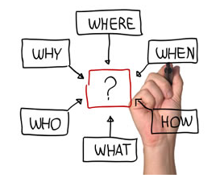
Definition
Planning is the function of management that involves setting objectives and determining a course of action for achieving those objectives.
3
Notes:
SAY: Before we wrap up the course, let’s review what we have learned today.
During this course, we have
<READ the bullets from the slide.>
GO to next slide.

Slide 4
About Planning in Management
Planning requires that managers be aware of environmental conditions facing their organization and forecast future conditions. It also requires that managers be good decision makers.
Planners must then attempt to forecast future conditions. These forecasts form the basis for planning.
4
●●●
Notes:
SAY: Before we wrap up the course, let’s review what we have learned today.
During this course, we have
<READ the bullets from the slide.>
GO to next slide.

Slide 5
About Planning in Management
Planning is a process consisting of several steps.
The process begins with environmental scanning which simply means that planners must be aware of the critical contingencies facing their organization in terms of economic conditions, their competitors, and their customers.
5
●●●
Notes:
SAY: Before we wrap up the course, let’s review what we have learned today.
During this course, we have
<READ the bullets from the slide.>
GO to next slide.

Slide 6
About Planning in Management
Planners must establish objectives, which are statements of what needs to be achieved and when. Planners must then identify alternative courses of action for achieving objectives.
After evaluating the various alternatives, planners must make decisions about the best courses of action for achieving objectives. They must then formulate necessary steps and ensure effective implementation of plans.
6
Notes:
SAY: Before we wrap up the course, let’s review what we have learned today.
During this course, we have
<READ the bullets from the slide.>
GO to next slide.

Slide 7
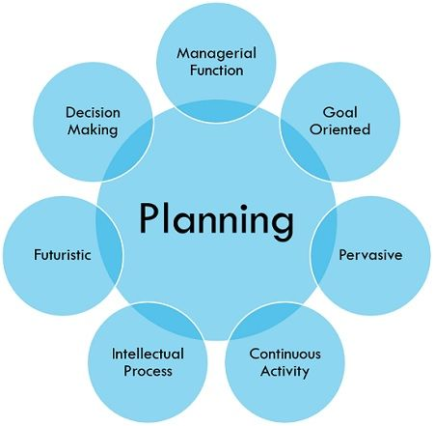
7
Notes:
SAY:
The purpose of epidemiology in public health practice is to
discover the agent, host, and environmental factors that affect health;
determine the relative importance of causes of illness, disability, and death;
identify those segments of the population that have the greatest risk from specific causes of ill health; and
evaluate the effectiveness of health programs and services in improving population health.
GO to next slide.

Slide 8
Types of Planning
Strategic planning
It involves analyzing competitive opportunities and threats, as well as the strengths and weaknesses of the organization, and then determining how to position the organization to compete effectively in their environment.
●●●
8
Notes:
SAY:
The purpose of epidemiology in public health practice is to
discover the agent, host, and environmental factors that affect health;
determine the relative importance of causes of illness, disability, and death;
identify those segments of the population that have the greatest risk from specific causes of ill health; and
evaluate the effectiveness of health programs and services in improving population health.
GO to next slide.

Slide 9
Types of Planning
Tactical planning
It is intermediate-range (one to three years) planning that is designed to develop relatively concrete and specific means to implement the strategic plan.
Middle-level managers often engage in tactical planning.
●●●
9
Notes:
SAY:
The purpose of epidemiology in public health practice is to
discover the agent, host, and environmental factors that affect health;
determine the relative importance of causes of illness, disability, and death;
identify those segments of the population that have the greatest risk from specific causes of ill health; and
evaluate the effectiveness of health programs and services in improving population health.
GO to next slide.

Slide 10
Types of Planning
Operational planning
It generally assumes the existence of organization-wide or subunit goals and objectives and specifies ways to achieve them.
Operational planning is short-range (less than a year) planning that is designed to develop specific action steps that support the strategic and tactical plans.
●●●
10
Notes:
SAY:
The purpose of epidemiology in public health practice is to
discover the agent, host, and environmental factors that affect health;
determine the relative importance of causes of illness, disability, and death;
identify those segments of the population that have the greatest risk from specific causes of ill health; and
evaluate the effectiveness of health programs and services in improving population health.
GO to next slide.

Slide 11
Types of Planning
Contingency Planning
Also known as ‘special planning’, it is used for situations when changes cannot be foreseen. It is that ‘what if’ scenario that a business manager needs to consider so that the company does not face losses.
That ‘what if’ scenario can be loss of data in a data security firm, failed product in the market, etc.
●●●
11
Notes:
SAY:
The purpose of epidemiology in public health practice is to
discover the agent, host, and environmental factors that affect health;
determine the relative importance of causes of illness, disability, and death;
identify those segments of the population that have the greatest risk from specific causes of ill health; and
evaluate the effectiveness of health programs and services in improving population health.
GO to next slide.

Slide 12
Importance of Planning
Establishes Direction
Planning is all about creating objectives and meeting them without any hassle. When you plan well, you have clarity on what it will take to achieve the goals.
In a formal or informal organisation, proper planning gives the group or team direction for meeting the objectives.
●●●
12
Notes:
SAY:
The purpose of epidemiology in public health practice is to
discover the agent, host, and environmental factors that affect health;
determine the relative importance of causes of illness, disability, and death;
identify those segments of the population that have the greatest risk from specific causes of ill health; and
evaluate the effectiveness of health programs and services in improving population health.
GO to next slide.

Slide 13
Importance of Planning
Removes Risks
Planning removes risks involved in the decisions you make. Sometimes, plans are made to withstand unforeseen circumstances.
By anticipating risks in the planning process, you can reduce uncertainties in the future.
●●●
13
Notes:
SAY:
The purpose of epidemiology in public health practice is to
discover the agent, host, and environmental factors that affect health;
determine the relative importance of causes of illness, disability, and death;
identify those segments of the population that have the greatest risk from specific causes of ill health; and
evaluate the effectiveness of health programs and services in improving population health.
GO to next slide.

Slide 14
Importance of Planning
Improves Efficiency
In an organisation, planning also looks into what can be done better and cost-effectively.
Without planning, a department may unknowingly utilise too many resources.
14
Notes:
SAY:
The purpose of epidemiology in public health practice is to
discover the agent, host, and environmental factors that affect health;
determine the relative importance of causes of illness, disability, and death;
identify those segments of the population that have the greatest risk from specific causes of ill health; and
evaluate the effectiveness of health programs and services in improving population health.
GO to next slide.

Slide 16
Conclusion
Planning is the function of management that involves setting objectives and determining a course of action for achieving those objectives.
Planning requires that managers be aware of environmental conditions facing their organization and forecast future conditions.
16
Notes:
SAY:
The purpose of epidemiology in public health practice is to
discover the agent, host, and environmental factors that affect health;
determine the relative importance of causes of illness, disability, and death;
identify those segments of the population that have the greatest risk from specific causes of ill health; and
evaluate the effectiveness of health programs and services in improving population health.
GO to next slide.

Slide 17
References
Google.com
Wikipedia.org
Studymafia.org
Slidespanda.com

Slide 18
Thanks To StudyMafia.org

