Slide 1
StudyMafia.Org
Information and Communication Technology (ICT)
Submitted To: Submitted By:
Studymafia.org Studymafia.org

Slide 2
Table Contents
Definition
Introduction
Components of ICT
Impact of ICT
Significance of ICT
Conclusion
2
Notes:
SAY: Before we wrap up the course, let’s review what we have learned today.
During this course, we have
<READ the bullets from the slide.>
GO to next slide.

Slide 3
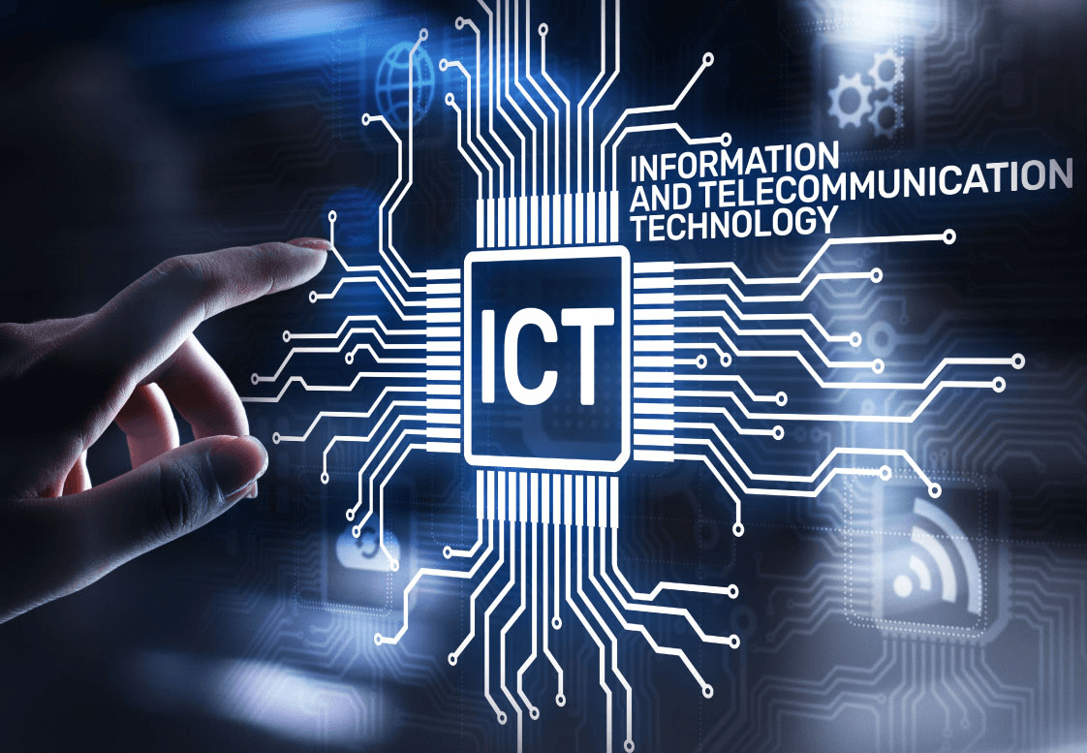
Definition
ICT, or information and communications technology (or technologies), is the infrastructure and components that enable modern computing.
3
Notes:
SAY: Before we wrap up the course, let’s review what we have learned today.
During this course, we have
<READ the bullets from the slide.>
GO to next slide.

Slide 4
Introduction
Although there is no single, universal definition of ICT, the term is generally accepted to mean all devices, networking components, applications and systems that combined allow people and organizations (i.e., businesses, nonprofit agencies, governments and criminal enterprises) to interact in the digital world.
4
Notes:
SAY: Before we wrap up the course, let’s review what we have learned today.
During this course, we have
<READ the bullets from the slide.>
GO to next slide.

Slide 5
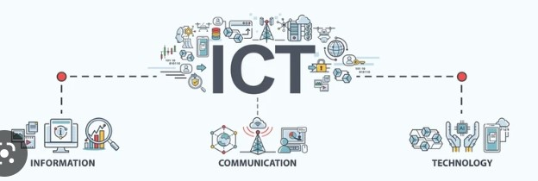
5
Notes:
SAY:
The purpose of epidemiology in public health practice is to
discover the agent, host, and environmental factors that affect health;
determine the relative importance of causes of illness, disability, and death;
identify those segments of the population that have the greatest risk from specific causes of ill health; and
evaluate the effectiveness of health programs and services in improving population health.
GO to next slide.

Slide 6
Components of an ICT System
ICT encompasses both the internet-enabled sphere as well as the mobile one powered by wireless networks.
It also includes antiquated technologies, such as landline telephones, radio and television broadcast -- all of which are still widely used today alongside cutting-edge ICT pieces such as artificial intelligence and robotics.
●●●
6
Notes:
SAY:
The purpose of epidemiology in public health practice is to
discover the agent, host, and environmental factors that affect health;
determine the relative importance of causes of illness, disability, and death;
identify those segments of the population that have the greatest risk from specific causes of ill health; and
evaluate the effectiveness of health programs and services in improving population health.
GO to next slide.

Slide 7
Components of an ICT System
ICT is sometimes used synonymously with IT (for information technology); however, ICT is generally used to represent a broader, more comprehensive list of all components related to computer and digital technologies than IT.
The list of ICT components is exhaustive, and it continues to grow.
●●●
7
Notes:
SAY:
The purpose of epidemiology in public health practice is to
discover the agent, host, and environmental factors that affect health;
determine the relative importance of causes of illness, disability, and death;
identify those segments of the population that have the greatest risk from specific causes of ill health; and
evaluate the effectiveness of health programs and services in improving population health.
GO to next slide.

Slide 8
Components of an ICT System
Some components, such as computers and telephones, have existed for decades. Others, such as smartphones, digital TVs and robots, are more recent entries.
ICT commonly means more than its list of components, though. It also encompasses the application of all those various components.
8
Notes:
SAY:
The purpose of epidemiology in public health practice is to
discover the agent, host, and environmental factors that affect health;
determine the relative importance of causes of illness, disability, and death;
identify those segments of the population that have the greatest risk from specific causes of ill health; and
evaluate the effectiveness of health programs and services in improving population health.
GO to next slide.

Slide 9
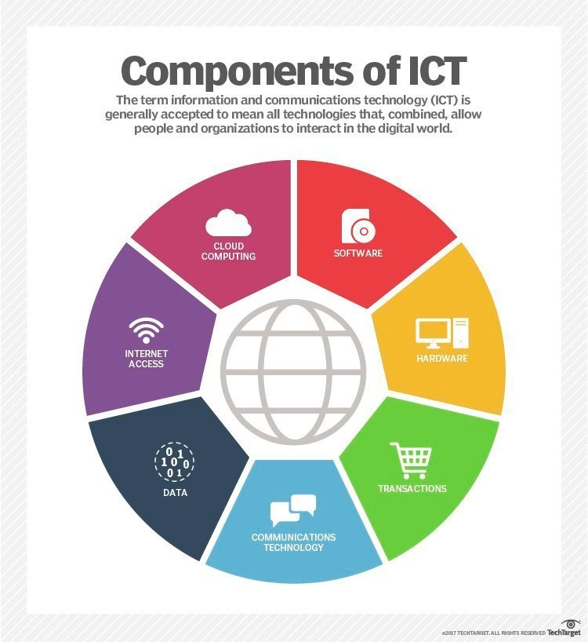
9
Notes:
SAY:
The purpose of epidemiology in public health practice is to
discover the agent, host, and environmental factors that affect health;
determine the relative importance of causes of illness, disability, and death;
identify those segments of the population that have the greatest risk from specific causes of ill health; and
evaluate the effectiveness of health programs and services in improving population health.
GO to next slide.

Slide 10
Impact of ICT
ICT is leveraged for economic, societal and interpersonal transactions and interactions. ICT has drastically changed how people work, communicate, learn and live.
Moreover, ICT continues to revolutionize all parts of the human experience as first computers and now robots do many of the tasks once handled by humans.
●●●
10
Notes:
SAY:
The purpose of epidemiology in public health practice is to
discover the agent, host, and environmental factors that affect health;
determine the relative importance of causes of illness, disability, and death;
identify those segments of the population that have the greatest risk from specific causes of ill health; and
evaluate the effectiveness of health programs and services in improving population health.
GO to next slide.

Slide 11
Impact of ICT
For example, computers once answered phones and directed calls to the appropriate individuals to respond; now robots not only can answer the calls, but they can often more quickly and efficiently handle callers' requests for services.
●●●
11
Notes:
SAY:
The purpose of epidemiology in public health practice is to
discover the agent, host, and environmental factors that affect health;
determine the relative importance of causes of illness, disability, and death;
identify those segments of the population that have the greatest risk from specific causes of ill health; and
evaluate the effectiveness of health programs and services in improving population health.
GO to next slide.

Slide 12
Impact of ICT
ICT's importance to economic development and business growth has been so monumental, in fact, that it's credited with ushering in what many have labeled the Fourth Industrial Revolution.
ICT also underpins broad shifts in society, as individuals en masse are moving from personal, face-to-face interactions to ones in the digital space.
●●●
12
Notes:
SAY:
The purpose of epidemiology in public health practice is to
discover the agent, host, and environmental factors that affect health;
determine the relative importance of causes of illness, disability, and death;
identify those segments of the population that have the greatest risk from specific causes of ill health; and
evaluate the effectiveness of health programs and services in improving population health.
GO to next slide.

Slide 13
Impact of ICT
For all its revolutionary aspects, though, ICT capabilities aren't evenly distributed.
Simply put, richer countries and richer individuals enjoy more access and thus have a greater ability to seize on the advantages and opportunities powered by ICT.
●●●
13
Notes:
SAY:
The purpose of epidemiology in public health practice is to
discover the agent, host, and environmental factors that affect health;
determine the relative importance of causes of illness, disability, and death;
identify those segments of the population that have the greatest risk from specific causes of ill health; and
evaluate the effectiveness of health programs and services in improving population health.
GO to next slide.

Slide 14
Impact of ICT
Consider, for example, some findings from the World Bank. In 2016, it stated that more than 75% of people worldwide have access to a cellphone.
However, internet access through either mobile or fixed Broadband remains prohibitively expensive in many countries due to a lack of ICT infrastructure.
14
Notes:
SAY:
The purpose of epidemiology in public health practice is to
discover the agent, host, and environmental factors that affect health;
determine the relative importance of causes of illness, disability, and death;
identify those segments of the population that have the greatest risk from specific causes of ill health; and
evaluate the effectiveness of health programs and services in improving population health.
GO to next slide.

Slide 15
Significance of ICT
They range from highly automated businesses processes that have cut costs, to the big data revolution where organizations are turning the vast trove of data generated by ICT into insights that drive new products and services, to ICT-enabled transactions such as internet shopping and telemedicine and social media that give customers more choices in how they shop, communicate and interact.
●●●
15
Notes:
SAY:
The purpose of epidemiology in public health practice is to
discover the agent, host, and environmental factors that affect health;
determine the relative importance of causes of illness, disability, and death;
identify those segments of the population that have the greatest risk from specific causes of ill health; and
evaluate the effectiveness of health programs and services in improving population health.
GO to next slide.

Slide 16
Significance of ICT
The digitization of data, the expanding use of high-speed internet and the growing global network together have led to new levels of crime, where so-called bad actors can hatch electronically enabled schemes or illegally gain access to systems to steal money, intellectual property or private information or to disrupt systems that control critical infrastructure.
16
Notes:
SAY:
The purpose of epidemiology in public health practice is to
discover the agent, host, and environmental factors that affect health;
determine the relative importance of causes of illness, disability, and death;
identify those segments of the population that have the greatest risk from specific causes of ill health; and
evaluate the effectiveness of health programs and services in improving population health.
GO to next slide.

Slide 17
Conclusion
“ICT” means Information and Communication Technology and refers to the combination of manufacturing and services industries that capture, transmit and display data and information electronically
17
Notes:
SAY:
The purpose of epidemiology in public health practice is to
discover the agent, host, and environmental factors that affect health;
determine the relative importance of causes of illness, disability, and death;
identify those segments of the population that have the greatest risk from specific causes of ill health; and
evaluate the effectiveness of health programs and services in improving population health.
GO to next slide.

Slide 18
References
Google.com
Wikipedia.org
Studymafia.org
Slidespanda.com

Slide 19
Thanks To StudyMafia.org

