Slide 1
StudyMafia.Org
Complementary Feeding
Submitted To: Submitted By:
Studymafia.org Studymafia.org

Slide 2
Table Contents
Definition
Introduction
Complementary Feeding
About Complementary Feeding
Consistency of Complementary Feeding
Nutrient Composition of Complementary Foods
Conclusion
2
Notes:
SAY: Before we wrap up the course, let’s review what we have learned today.
During this course, we have
<READ the bullets from the slide.>
GO to next slide.

Slide 3
Definition
Around the age of 6 months, an infant’s need for energy and nutrients starts to exceed what is provided by breast milk, and complementary foods are necessary to meet those needs.
3
Notes:
SAY: Before we wrap up the course, let’s review what we have learned today.
During this course, we have
<READ the bullets from the slide.>
GO to next slide.

Slide 4
Introduction
An infant of this age is also developmentally ready for other foods. This transition is referred to as complementary feeding.
If complementary foods are not introduced around the age of 6 months, or if they are given inappropriately, an infant’s growth may falter.
4
Notes:
SAY: Before we wrap up the course, let’s review what we have learned today.
During this course, we have
<READ the bullets from the slide.>
GO to next slide.

Slide 5
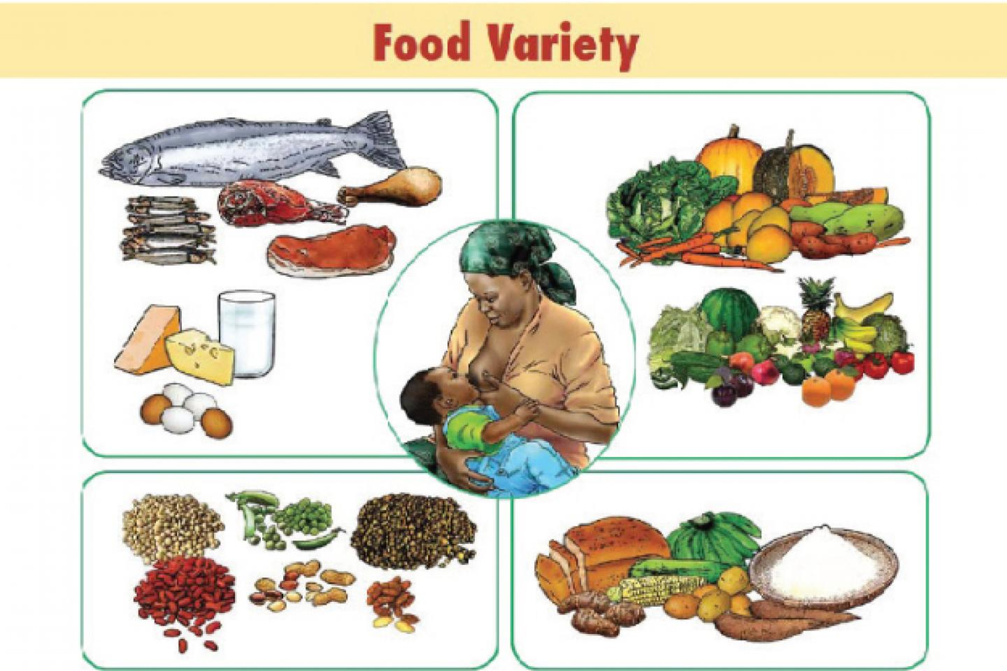
5
Notes:
SAY:
The purpose of epidemiology in public health practice is to
discover the agent, host, and environmental factors that affect health;
determine the relative importance of causes of illness, disability, and death;
identify those segments of the population that have the greatest risk from specific causes of ill health; and
evaluate the effectiveness of health programs and services in improving population health.
GO to next slide.

Slide 6
Complementary Feeding
Ensuring that infants nutritional needs are met requires that complementary foods be:
timely – meaning that they are introduced when the need for energy and nutrients exceeds what can be provided through exclusive breastfeeding;
adequate – meaning that they provide sufficient energy, protein and micronutrients to meet a growing child’s nutritional needs;
●●●
6
Notes:
SAY:
The purpose of epidemiology in public health practice is to
discover the agent, host, and environmental factors that affect health;
determine the relative importance of causes of illness, disability, and death;
identify those segments of the population that have the greatest risk from specific causes of ill health; and
evaluate the effectiveness of health programs and services in improving population health.
GO to next slide.

Slide 7
Complementary Feeding
safe – meaning that they are hygienically stored and prepared, and fed with clean hands using clean utensils and not bottles and teats;
properly fed – meaning that they are given consistent with a child’s signals of appetite and satiety, and that meal frequency and feeding are suitable for age.
7
Notes:
SAY:
The purpose of epidemiology in public health practice is to
discover the agent, host, and environmental factors that affect health;
determine the relative importance of causes of illness, disability, and death;
identify those segments of the population that have the greatest risk from specific causes of ill health; and
evaluate the effectiveness of health programs and services in improving population health.
GO to next slide.

Slide 8
About Complementary Feeding
Breastfeeding provides the ideal food during the first 6 months of life.
Complementary feeding starts when breast milk is no longer sufficient by itself, where the target age is for 6–23 months.
The gap between nutritional requirement and amount obtained from breast milk increases with age.
●●●
8
Notes:
SAY:
The purpose of epidemiology in public health practice is to
discover the agent, host, and environmental factors that affect health;
determine the relative importance of causes of illness, disability, and death;
identify those segments of the population that have the greatest risk from specific causes of ill health; and
evaluate the effectiveness of health programs and services in improving population health.
GO to next slide.

Slide 9
About Complementary Feeding
For energy, 200, 300, and 550 kcal per day is expected to be covered by complementary foods at 6–8, 9–11, and 12–23 months, respectively.
In addition, the complementary foods must provide relatively large proportions of micronutrients such as iron, zinc, phosphorus, magnesium, calcium, and vitamin B6.
●●●
9
Notes:
SAY:
The purpose of epidemiology in public health practice is to
discover the agent, host, and environmental factors that affect health;
determine the relative importance of causes of illness, disability, and death;
identify those segments of the population that have the greatest risk from specific causes of ill health; and
evaluate the effectiveness of health programs and services in improving population health.
GO to next slide.

Slide 10
About Complementary Feeding
Thus, homemade complementary foods remain commonly used. Even when based on an improved recipe, however, unfortified plant-based complementary foods provide insufficient key micronutrients (especially, iron, zinc, and calcium) during the age of 6–23 months.
Thus, this review assessed complementary feeding practice and recommendation and reviewed the level of adequacy of homemade complementary foods.
10
Notes:
SAY:
The purpose of epidemiology in public health practice is to
discover the agent, host, and environmental factors that affect health;
determine the relative importance of causes of illness, disability, and death;
identify those segments of the population that have the greatest risk from specific causes of ill health; and
evaluate the effectiveness of health programs and services in improving population health.
GO to next slide.

Slide 11
Consistency of Complementary Feeding
The minimum age at which infants develop the ability to swallow particular type of food is highly dependent on their level of neuromuscular development.
Thus, failure to account such abilities for mastication and swallowing when preparing and serving diets to infants may result in consumption of only trivial amount or extended feeding time
11
Notes:
SAY:
The purpose of epidemiology in public health practice is to
discover the agent, host, and environmental factors that affect health;
determine the relative importance of causes of illness, disability, and death;
identify those segments of the population that have the greatest risk from specific causes of ill health; and
evaluate the effectiveness of health programs and services in improving population health.
GO to next slide.

Slide 12
Nutrient Composition of
Complementary Feeding
Energy Requirement
Complementary foods are expected to have sufficient energy density to provide a growing child with adequate daily energy requirement.
Energy density is the number of kilocalories of energy in certain food per milliliter per gram of that food. Breast milk contains an energy density of about 0.7 kcal/ml.
●●●
12
Notes:
SAY:
The purpose of epidemiology in public health practice is to
discover the agent, host, and environmental factors that affect health;
determine the relative importance of causes of illness, disability, and death;
identify those segments of the population that have the greatest risk from specific causes of ill health; and
evaluate the effectiveness of health programs and services in improving population health.
GO to next slide.

Slide 13
Nutrient Composition of
Complementary Feeding
Protein Requirement
Protein makes important nutrient composition in complementary foods. They are major sources of essential amino acids and energy at times of energy deprivation.
Adequate supply of dietary protein is vital for maintaining cellular function and integrity and for ensuring normalcy of health and growth.
●●●
13
Notes:
SAY:
The purpose of epidemiology in public health practice is to
discover the agent, host, and environmental factors that affect health;
determine the relative importance of causes of illness, disability, and death;
identify those segments of the population that have the greatest risk from specific causes of ill health; and
evaluate the effectiveness of health programs and services in improving population health.
GO to next slide.

Slide 14
Nutrient Composition of
Complementary Feeding
Fats/Lipids Requirement
Dietary fats constitute an important portion of nutrients obtained from foods. For infants and young children, they are source of energy, essential fatty acids, and fat soluble vitamins (A, D, E, and K).
In addition, dietary fats have an important role in promoting good health and enhancing the sensory qualities of the foods.
●●●
14
Notes:
SAY:
The purpose of epidemiology in public health practice is to
discover the agent, host, and environmental factors that affect health;
determine the relative importance of causes of illness, disability, and death;
identify those segments of the population that have the greatest risk from specific causes of ill health; and
evaluate the effectiveness of health programs and services in improving population health.
GO to next slide.

Slide 15
Nutrient Composition of
Complementary Feeding
Carbohydrates
Starch is likely to be a major constituent of many complimentary foods for older infants and young children.
To ensure that its energy value is realized, this starch should be provided in a readily digestible form. Increasing the intake of dietary fibers increases stool bulk, causes flatulence, and decreases appetite.
●●●
15
Notes:
SAY:
The purpose of epidemiology in public health practice is to
discover the agent, host, and environmental factors that affect health;
determine the relative importance of causes of illness, disability, and death;
identify those segments of the population that have the greatest risk from specific causes of ill health; and
evaluate the effectiveness of health programs and services in improving population health.
GO to next slide.

Slide 16
Nutrient Composition of
Complementary Feeding
Micronutrients
Micronutrients are essential for growth, development, and prevention of illness in young children.
Adequate intakes of micronutrients, such as iron, zinc, and calcium, are important for ensuring optimal health, growth, and development of infants and young children.
16
Notes:
SAY:
The purpose of epidemiology in public health practice is to
discover the agent, host, and environmental factors that affect health;
determine the relative importance of causes of illness, disability, and death;
identify those segments of the population that have the greatest risk from specific causes of ill health; and
evaluate the effectiveness of health programs and services in improving population health.
GO to next slide.

Slide 18
Conclusion
Around the age of 6 months, an infant's need for energy and nutrients starts to exceed what is provided by breast milk, and complementary foods are necessary to meet those needs.
An infant of this age is also developmentally ready for other foods. This transition is referred to as complementary feeding.
18
Notes:
SAY:
The purpose of epidemiology in public health practice is to
discover the agent, host, and environmental factors that affect health;
determine the relative importance of causes of illness, disability, and death;
identify those segments of the population that have the greatest risk from specific causes of ill health; and
evaluate the effectiveness of health programs and services in improving population health.
GO to next slide.

Slide 19
References
Google.com
Wikipedia.org
Studymafia.org
Slidespanda.com

Slide 20
Thanks To StudyMafia.org

