Slide 1
StudyMafia.Org
Business Software
Submitted To: Submitted By:
Studymafia.org Studymafia.org

Slide 2
Table Contents
Definition
Types of Business Software
Benefits of Business Software
Conclusion

Slide 3
BUSINESS MANAGEMENT SOFTWARE

Slide 4
What is business management software?
Business managemnent software is a widely used term, and has been applied to various different types of software systems.
However, a true business management system will be one that streamlines and manages most, if not all, aspects of business operations as an end-to-end, all-in-one solution.
For this reason it is often used interchangeably with the term "ERP software"

Slide 5
Types of business management software
Word processing software
Spreadsheet software
Database software
Presentation software
Project management software
Document management software

Slide 6
Word processing software
People use word processing software every day to develop documents such as letters, memos, reports, mailing labels, newsletters, and web pages.
Most word processing software allows users to incorporate graphical images, such as digital photos and clip art, in documents.
You can use word processing software to define the size of the paper on which to print and specify the margins.
Allows users to type words in paragraph continually without enter key at the end of each line.
Word processing software typically includes a spelling checkers, which reviews the spelling of individual words, section of a document, or the entire document.
EXAMPLE : MS WORD, WORD PRO.

Slide 7
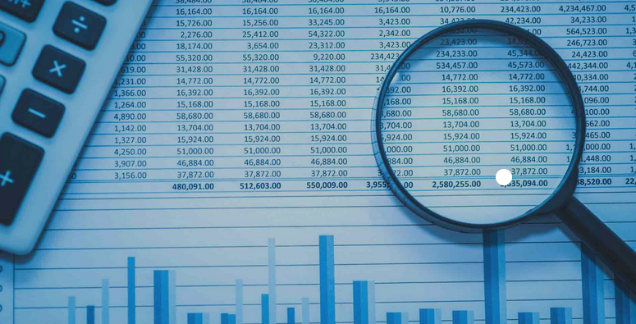
Spreadsheet software
Allows users to organize data in rows and columns and perform calculations on the data.
A spreadsheet file is similar to a notebook that can contain more than 1,000 related individual worksheets.
Data is organized vertically in columns and horizontally in rows on each worksheet.
Each worksheet usually can have more than 16,000 columns and 1 million rows.
Cells may contain three types of data : labels, values, and formulas.
Many of the worksheet cells contain a number, called a value, that can be used in a calculation.
Spreadsheet software’s capability of recalculating data also makes it a valuable budgeting, forecasting, and decision making tool.
Another standard feature of spreadsheet software is charting, which depicts the data in graphical form.
EXAMPLE : MICROSOFT EXCEL, GOOGLE WORKSHOP

Slide 8
Database software
A database is a collection of data organized in a manner that allows access, retrieval, and use of that data.
Database software is application software that allows users to create, access, and manage a database.
A database consists of a collection of tables, organized in rows and columns.
Each row called a record, contains data about a given person, product, object, or event.
Each column, called a field, contains a specific category of data within a record.
EXAMPLE : SQL SERVER, MONGODB.

Slide 9
Presentation software
Presentation software is application software that allows users to create visuals aids for presentations to communicate ideas, messages, and other information to a group.
The presentation can be viewed as slides, sometimes called a slide show that are displayed on a large monitor or on a projection screen.
When building a presentation, users can set the slide timing so that the presentation automatically displays the next slide after a preset delay.
Presentation software allows you to apply special effects to the transition between slides.
EXAMPLE : POWER POINT, SLIDES.

Slide 10
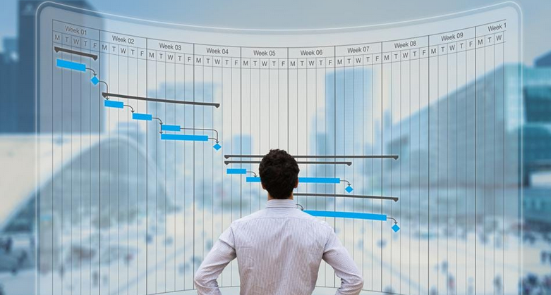
Project management software
Project management software allows a user to plan, schedule, track, and analyze the events, resources, and costs of a project.
Project management software helps user manage project variables, allowing them to complete a project on time and within budget.
EXAMPLE : SMARTSHEET.

Slide 11
Document management software
Document management software provides a means for sharing, distributing, and searching through documents by converting them into a format that can be viewed by any user.
The converted document, which mirrors the original document’s appearance, can be viewed and printed without the software that created the original document.
EXAMPLES : Google Drive, Dropbox Business

Slide 12
Benefits of using business management software
These are the benefits of using business management software for better decision making:
Ensures Visibility
Helps Increase Revenue
Automation Saves Time
Software helps identify trends
Helps in benchmarking
Helps track progress

Slide 13
Automated Workflows
The benefits of workflow automation are wide-reaching. Not only will the processes that you’re automating be improved, but your productivity in other areas will increase as well.
If you’re spending less time manually entering, checking, and duplicating data sets because your all-in-one business management software is capable of automating that process, you’ll be able to focus more on creative, high level tasks that require more human attention.

Slide 14
Eliminate Need For Internal IT Expertise
All of your employees should be operating, communicating, and sharing documents under the same umbrella of security. With a dedicated software support team ready to work toward your businesses specific goals and needs, you’ll be prepared for any technical malaise that comes your way.

Slide 15
Save Money (Not Just On Software)
One of the biggest benefits of all-in-one business software is the cost savings. The software savings are apparent—paying a predetermined monthly rate for a single software allows you to spend less on various other disconnected software solutions.

Slide 16
Scalability
Growth arrives quickly—it pays to be prepared ahead of time. Though your business may not be bringing in billions of dollars annually, your all-in-one business management software can function the same as the solutions that those companies use.

Slide 17
conclusion
The primary purpose of software is to turn data into Information. When that data is processed into sets according to context, it provides information. Data refers to raw input that when processed or arranged makes meaningful output. Information is usually the processed outcome of data.

Slide 18
References
Google.com
Wikipedia.org
Studymafia.org
Slidespanda.com

Slide 19
Thanks To StudyMafia.org

