Slide 1
StudyMafia.Org
Biomechanics of Shoulder Joint
Submitted To: Submitted By:
Studymafia.org Studymafia.org

Slide 2
Table Contents
Definition
Introduction
Biomechanics of Shoulder
About Shoulder Joint Mechanics
Conclusion
2
Notes:
SAY: Before we wrap up the course, let’s review what we have learned today.
During this course, we have
<READ the bullets from the slide.>
GO to next slide.

Slide 3
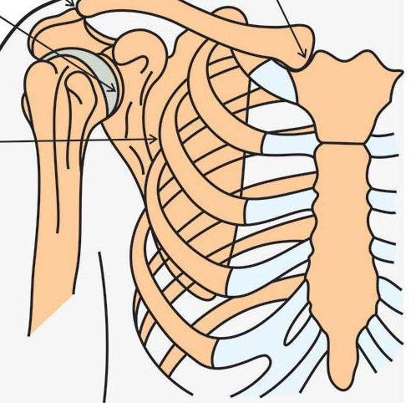
Definition
The shoulder area is infamously known to be one of the most complex regions of the body to evaluate and rehabilitate.
3
Notes:
SAY: Before we wrap up the course, let’s review what we have learned today.
During this course, we have
<READ the bullets from the slide.>
GO to next slide.

Slide 4
Introduction
Due to the multiple joints involved during shoulder movement, it is prudent to refer to the area of the shoulder complex.
To effectively rehabilitate a shoulder injury in clinical practice, it is important to have a functional knowledge of the underlying biomechanics of the shoulder complex.
4
Notes:
SAY: Before we wrap up the course, let’s review what we have learned today.
During this course, we have
<READ the bullets from the slide.>
GO to next slide.

Slide 5
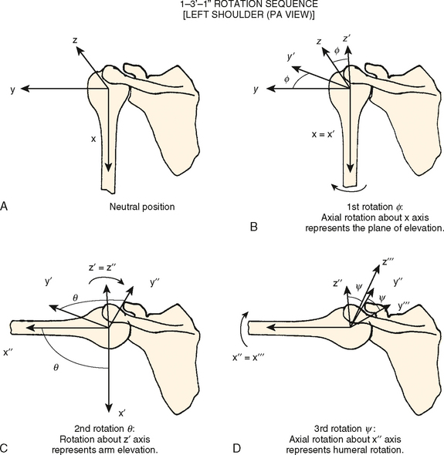
5
Notes:
SAY:
The purpose of epidemiology in public health practice is to
discover the agent, host, and environmental factors that affect health;
determine the relative importance of causes of illness, disability, and death;
identify those segments of the population that have the greatest risk from specific causes of ill health; and
evaluate the effectiveness of health programs and services in improving population health.
GO to next slide.

Slide 6
Biomechanics of Shoulder
Glenohumeral (GH) Joint
--- Arthrokinematics
Spin (pure flexion and extension)
Inferior glide (Abduction)
Superior glide (Adduction)
Posterior glide (Medial rotation)
Anterior glide (Lateral rotation
●●●
6
Notes:
SAY:
The purpose of epidemiology in public health practice is to
discover the agent, host, and environmental factors that affect health;
determine the relative importance of causes of illness, disability, and death;
identify those segments of the population that have the greatest risk from specific causes of ill health; and
evaluate the effectiveness of health programs and services in improving population health.
GO to next slide.

Slide 7
Biomechanics of Shoulder
Glenohumeral (GH) Joint
The natural arthrokinematics of the GH joint of the shoulder complex during an open-chain movement supports various directional glides of the humeral head within the glenoid fossa.
Del Maso and colleagues have estimated that a maximum of 7.5 mm of upward translation of the humeral head may occur during range of motion movements.
●●●
7
Notes:
SAY:
The purpose of epidemiology in public health practice is to
discover the agent, host, and environmental factors that affect health;
determine the relative importance of causes of illness, disability, and death;
identify those segments of the population that have the greatest risk from specific causes of ill health; and
evaluate the effectiveness of health programs and services in improving population health.
GO to next slide.

Slide 8
Biomechanics of Shoulder
Glenohumeral (GH) Joint
The success of a coordinated movement of the humeral head with normalized arthrokinematics, avoiding an impingement situation, requires the harmonious co-contraction of the RC tendons.
Abnormal glenohumeral translations have been linked to pathological shoulders and it has been suggested to be a contributing factor for shoulder pain and discomfort, and may also lead to the damage of encompassing structures.
●●●
8
Notes:
SAY:
The purpose of epidemiology in public health practice is to
discover the agent, host, and environmental factors that affect health;
determine the relative importance of causes of illness, disability, and death;
identify those segments of the population that have the greatest risk from specific causes of ill health; and
evaluate the effectiveness of health programs and services in improving population health.
GO to next slide.

Slide 9
Biomechanics of Shoulder
Acromioclavicular (AC) Joint
The AC joint is a diarthrodial and synovial joint. It allows for axial rotations and antero-posterior glides.
Because there are not direct attachements of muscles to the joint, all movements are passive and initiated by movements at other joints (such as the ST joint).
●●●
9
Notes:
SAY:
The purpose of epidemiology in public health practice is to
discover the agent, host, and environmental factors that affect health;
determine the relative importance of causes of illness, disability, and death;
identify those segments of the population that have the greatest risk from specific causes of ill health; and
evaluate the effectiveness of health programs and services in improving population health.
GO to next slide.

Slide 10
Biomechanics of Shoulder
Osteokinematics
Flexion / extension
Abduction / adduction
Medial / lateral rotation
Arthrokinematics
Posterior / anterior spin
Inferior / superior spin
Anterior / posterior glide
●●●
10
Notes:
SAY:
The purpose of epidemiology in public health practice is to
discover the agent, host, and environmental factors that affect health;
determine the relative importance of causes of illness, disability, and death;
identify those segments of the population that have the greatest risk from specific causes of ill health; and
evaluate the effectiveness of health programs and services in improving population health.
GO to next slide.

Slide 11
Biomechanics of Shoulder
Scapulothoracic (ST) Joint
Scapulothoracic complex movements:
Elevation and protraction = anterior elevation
Elevation and retraction = posterior elevation
Depression and protraction = anterior depression
Depression and retraction = posterior depression
●●●
11
Notes:
SAY:
The purpose of epidemiology in public health practice is to
discover the agent, host, and environmental factors that affect health;
determine the relative importance of causes of illness, disability, and death;
identify those segments of the population that have the greatest risk from specific causes of ill health; and
evaluate the effectiveness of health programs and services in improving population health.
GO to next slide.

Slide 12
Biomechanics of Shoulder
Scapulothoracic (ST) Joint
The movement of the scapula along the thoracic cage also directly influences the biomechanics of the shoulder complex as a whole, and can moreover predispose the development of impingement syndrome.
The healthy movement of the scapula along the thorax during arm elevation includes protraction, posterior tilting, and lateral rotation, depending on the plane of movement.
12
Notes:
SAY:
The purpose of epidemiology in public health practice is to
discover the agent, host, and environmental factors that affect health;
determine the relative importance of causes of illness, disability, and death;
identify those segments of the population that have the greatest risk from specific causes of ill health; and
evaluate the effectiveness of health programs and services in improving population health.
GO to next slide.

Slide 13
About Shoulder Joint Biomechanics
The pathological kinematics of the ST joint include, but are not limited to:
Increased medial rotation
Decreased superior rotation, and
Decreased posterior tilting
●●●
13
Notes:
SAY:
The purpose of epidemiology in public health practice is to
discover the agent, host, and environmental factors that affect health;
determine the relative importance of causes of illness, disability, and death;
identify those segments of the population that have the greatest risk from specific causes of ill health; and
evaluate the effectiveness of health programs and services in improving population health.
GO to next slide.

Slide 14
About Shoulder Joint Biomechanics
These movement alterations are believed to increase the proximity of the rotator cuff tendons to the coracoacromial arch or glenoid rim,however, there are still points of contention as to how the movement pattern deviations directly contribute to the reduction of the subacromial space.
●●●
14
Notes:
SAY:
The purpose of epidemiology in public health practice is to
discover the agent, host, and environmental factors that affect health;
determine the relative importance of causes of illness, disability, and death;
identify those segments of the population that have the greatest risk from specific causes of ill health; and
evaluate the effectiveness of health programs and services in improving population health.
GO to next slide.

Slide 15
About Shoulder Joint Biomechanics
For the sake of clarification, the current literature differentiates between an internal impingement and an external impingement.
An impingement that involves a decreased space towards the coracoacromial arch is said to be an external impingement, whereas an internal impingement involves the glenoid rim,[18] and can be associated with a GH instability
●●●
15
Notes:
SAY:
The purpose of epidemiology in public health practice is to
discover the agent, host, and environmental factors that affect health;
determine the relative importance of causes of illness, disability, and death;
identify those segments of the population that have the greatest risk from specific causes of ill health; and
evaluate the effectiveness of health programs and services in improving population health.
GO to next slide.

Slide 16
About Shoulder Joint Biomechanics
Regardless of the classification, the dysfunctional shoulder mechanisms can further the progression of rotator cuff disease and must therefore be understood as a neuromuscular impairment.
The neuromuscular control of the scapula relies on the balanced team-work between the global movers and the fine-tuning stabilizing muscles of the shoulder complex
\
16
Notes:
SAY:
The purpose of epidemiology in public health practice is to
discover the agent, host, and environmental factors that affect health;
determine the relative importance of causes of illness, disability, and death;
identify those segments of the population that have the greatest risk from specific causes of ill health; and
evaluate the effectiveness of health programs and services in improving population health.
GO to next slide.

Slide 17
Conclusion
The biomechanics of the shoulder are highly complex. First, it is composed of four joints (glenohumeral, acromioclavicular, scapulothoracic, and sternoclavicular).
The glenohumeral joint has six degrees of freedom and is the most mobile joint in the human body, allowing the hand to reach a wide range of positions.
17
Notes:
SAY:
The purpose of epidemiology in public health practice is to
discover the agent, host, and environmental factors that affect health;
determine the relative importance of causes of illness, disability, and death;
identify those segments of the population that have the greatest risk from specific causes of ill health; and
evaluate the effectiveness of health programs and services in improving population health.
GO to next slide.

