Slide 1
StudyMafia.Org
Hybridoma Technology
Submitted To: Submitted By:
Studymafia.org Studymafia.org

Slide 2
Table Contents
Definition
Introduction
History of Hybridoma Technology
Steps in Hybridoma Technology
Applications of Hybridoma Technology
Conclusion
2
Notes:
SAY: Before we wrap up the course, let’s review what we have learned today.
During this course, we have
<READ the bullets from the slide.>
GO to next slide.

Slide 3
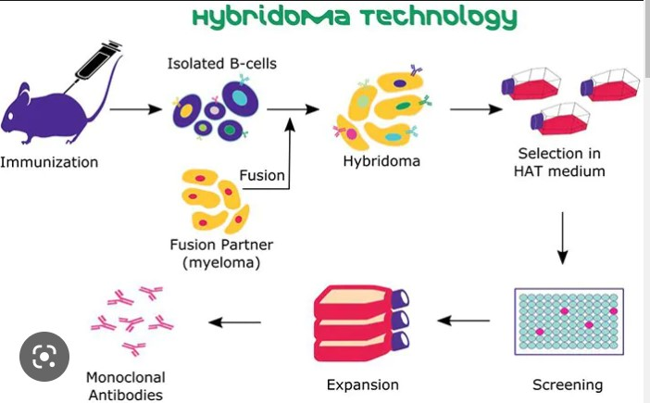
Definition
Hybridoma technology is a well-established method to produce monoclonal antibodies (mAbs) specific to antigens of interest.
3
Notes:
SAY: Before we wrap up the course, let’s review what we have learned today.
During this course, we have
<READ the bullets from the slide.>
GO to next slide.

Slide 4
Introduction
Hybridoma cell lines are formed via fusion between a short-lived antibody-producing B cell and an immortal myeloma cell.
Each hybridoma constitutively expresses a large amount of one specific mAb, and favored hybridoma cell lines can be cryopreserved for long-lasting mAb production.
4
Notes:
SAY: Before we wrap up the course, let’s review what we have learned today.
During this course, we have
<READ the bullets from the slide.>
GO to next slide.

Slide 5
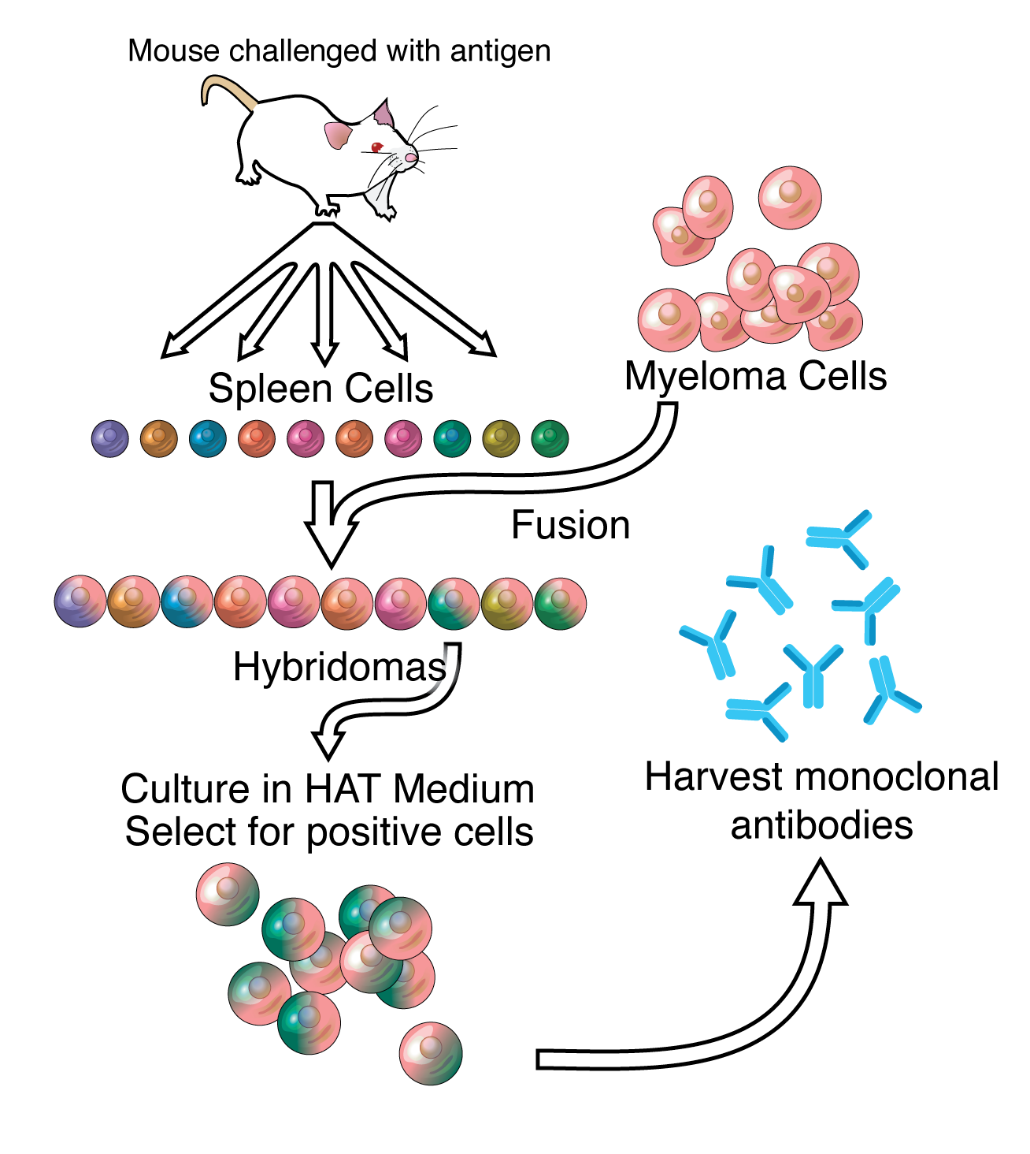
5
Notes:
SAY:
The purpose of epidemiology in public health practice is to
discover the agent, host, and environmental factors that affect health;
determine the relative importance of causes of illness, disability, and death;
identify those segments of the population that have the greatest risk from specific causes of ill health; and
evaluate the effectiveness of health programs and services in improving population health.
GO to next slide.

Slide 6
History of Hybridoma Technology
Hybridoma technology was discovered in 1975 by two scientists, Georges Kohler and Cesar Milstein.
They wanted to create immortal hybrid cells by fusing normal B cells from immunized mice with their myeloma cells.
For incidental reasons, they had all the requirements fulfilled and it worked in the first attempt.
●●●
6
Notes:
SAY:
The purpose of epidemiology in public health practice is to
discover the agent, host, and environmental factors that affect health;
determine the relative importance of causes of illness, disability, and death;
identify those segments of the population that have the greatest risk from specific causes of ill health; and
evaluate the effectiveness of health programs and services in improving population health.
GO to next slide.

Slide 7
History of Hybridoma Technology
By cloning individual hybrid cells, they established the first hybridoma cell lines which can produce single type of antibody specific to the specific antigen.
Their discovery is considered one of the greatest breakthroughs in the field of biotechnology.
For the past decades, hybridomas have fueled the discovery and production of antibodies for a multitude of applications.
7
Notes:
SAY:
The purpose of epidemiology in public health practice is to
discover the agent, host, and environmental factors that affect health;
determine the relative importance of causes of illness, disability, and death;
identify those segments of the population that have the greatest risk from specific causes of ill health; and
evaluate the effectiveness of health programs and services in improving population health.
GO to next slide.

Slide 8
Steps in Hybridoma Technology
Hybridoma technology is composed of several technical procedures, including antigen preparation, animal immunization, cell fusion, hybridoma screening and subcloning, as well as characterization and production of specific antibodies.
●●●
8
Notes:
SAY:
The purpose of epidemiology in public health practice is to
discover the agent, host, and environmental factors that affect health;
determine the relative importance of causes of illness, disability, and death;
identify those segments of the population that have the greatest risk from specific causes of ill health; and
evaluate the effectiveness of health programs and services in improving population health.
GO to next slide.

Slide 9
Steps in Hybridoma Technology
Cell fusion
Polyethylene glycol (PEG) and electrofusion are commonly used to induce cell fusion in hybridoma production.
PEG fuses the plasma membranes of adjacent myeloma and/or antibody-secreting cells, forming a single cell with two or more nuclei.
●●●
9
Notes:
SAY:
The purpose of epidemiology in public health practice is to
discover the agent, host, and environmental factors that affect health;
determine the relative importance of causes of illness, disability, and death;
identify those segments of the population that have the greatest risk from specific causes of ill health; and
evaluate the effectiveness of health programs and services in improving population health.
GO to next slide.

Slide 10
Steps in Hybridoma Technology
Hybridoma screening
Even in the most efficient hybridoma fusions, only about 1% of the starting cells are fused, and only about 1 in 105 form viable hybrids. This leaves a large number of unfused cells still in culture.
The cells from the immunized animal (antibody secreting cell) do not continue to grow in tissue culture and so do not confuse further work
●●●
10
Notes:
SAY:
The purpose of epidemiology in public health practice is to
discover the agent, host, and environmental factors that affect health;
determine the relative importance of causes of illness, disability, and death;
identify those segments of the population that have the greatest risk from specific causes of ill health; and
evaluate the effectiveness of health programs and services in improving population health.
GO to next slide.

Slide 11
Steps in Hybridoma Technology
mAb production
Hybridoma antibodies can be produced in vitro and in vivo.
For production of monoclonal antibodies in vitro, hybridomas are expanded by transfer to 24 well tissue culture plates followed by 25 cm2 flask and a 75 cm2 flask containing suitable medium.
11
Notes:
SAY:
The purpose of epidemiology in public health practice is to
discover the agent, host, and environmental factors that affect health;
determine the relative importance of causes of illness, disability, and death;
identify those segments of the population that have the greatest risk from specific causes of ill health; and
evaluate the effectiveness of health programs and services in improving population health.
GO to next slide.

Slide 12
Applications of Hybridoma Technology
mAb therapeutics
Compared with other biologics, mAbs are able to maintain an extremely high affinity towards their target.
Due to this high affinity and specificity, researchers began investigating the therapeutic potential of mAbs as metabolic activators, inhibitors and immuno-modulators.
●●●
12
Notes:
SAY:
The purpose of epidemiology in public health practice is to
discover the agent, host, and environmental factors that affect health;
determine the relative importance of causes of illness, disability, and death;
identify those segments of the population that have the greatest risk from specific causes of ill health; and
evaluate the effectiveness of health programs and services in improving population health.
GO to next slide.

Slide 13
Applications of Hybridoma Technology
In vivo diagnostics
In vivo diagnostics are a noninvasive way for clinicians to diagnose disease progression through analysis of biomarkers within the body rather than through biologic samples inside a laboratory.
Most antibody-based in vivo diagnostics are used for highly specific imaging
13
Notes:
SAY:
The purpose of epidemiology in public health practice is to
discover the agent, host, and environmental factors that affect health;
determine the relative importance of causes of illness, disability, and death;
identify those segments of the population that have the greatest risk from specific causes of ill health; and
evaluate the effectiveness of health programs and services in improving population health.
GO to next slide.

Slide 14
Conclusion
Hybridoma technology is one of the most common methods used to produce monoclonal antibodies.
In this process, antibody-producing B lymphocytes are isolated from mice after immunizing the mice with specific antigen and are fused with immortal myeloma cell lines to form hybrid cells, called hybridoma cell lines.
14
Notes:
SAY:
The purpose of epidemiology in public health practice is to
discover the agent, host, and environmental factors that affect health;
determine the relative importance of causes of illness, disability, and death;
identify those segments of the population that have the greatest risk from specific causes of ill health; and
evaluate the effectiveness of health programs and services in improving population health.
GO to next slide.

Slide 15
References
Google.com
Wikipedia.org
Studymafia.org
Slidespanda.com

Slide 16
Thanks To StudyMafia.org

