Slide 1
StudyMafia.Org
Types of Network
Submitted To: Submitted By:
Studymafia.org Studymafia.org

Slide 2
Table Contents
Introduction
Types Of Network
Conclusion
2
Notes:
SAY: Before we wrap up the course, let’s review what we have learned today.
During this course, we have
<READ the bullets from the slide.>
GO to next slide.

Slide 3
Introduction
A computer network is a group of computers linked to each other that enables the computer to communicate with another computer and share their resources, data, and applications.
Computer networking refers to interconnected computing devices that can exchange data and share resources with each other.
3
Notes:
SAY: Before we wrap up the course, let’s review what we have learned today.
During this course, we have
<READ the bullets from the slide.>
GO to next slide.

Slide 4
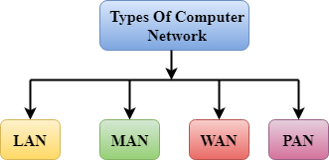
4
Notes:
SAY:
The purpose of epidemiology in public health practice is to
discover the agent, host, and environmental factors that affect health;
determine the relative importance of causes of illness, disability, and death;
identify those segments of the population that have the greatest risk from specific causes of ill health; and
evaluate the effectiveness of health programs and services in improving population health.
GO to next slide.

Slide 5
Types of Network
LAN(Local Area Network)
Local Area Network is a group of computers connected to each other in a small area such as building, office.
LAN is used for connecting two or more personal computers through a communication medium such as twisted pair, coaxial cable, etc.
●●●
5
Notes:
SAY:
The purpose of epidemiology in public health practice is to
discover the agent, host, and environmental factors that affect health;
determine the relative importance of causes of illness, disability, and death;
identify those segments of the population that have the greatest risk from specific causes of ill health; and
evaluate the effectiveness of health programs and services in improving population health.
GO to next slide.

Slide 6
Types of Network
PAN(Personal Area Network)
Personal Area Network is a network arranged within an individual person, typically within a range of 10 meters.
Personal Area Network is used for connecting the computer devices of personal use is known as Personal Area Network.
●●●
6
Notes:
SAY:
The purpose of epidemiology in public health practice is to
discover the agent, host, and environmental factors that affect health;
determine the relative importance of causes of illness, disability, and death;
identify those segments of the population that have the greatest risk from specific causes of ill health; and
evaluate the effectiveness of health programs and services in improving population health.
GO to next slide.

Slide 7
Types of Network
MAN(Metropolitan Area Network)
A metropolitan area network is a network that covers a larger geographic area by interconnecting a different LAN to form a larger network.
Government agencies use MAN to connect to the citizens and private industries.
In MAN, various LANs are connected to each other through a telephone exchange line.
●●●
7
Notes:
SAY:
The purpose of epidemiology in public health practice is to
discover the agent, host, and environmental factors that affect health;
determine the relative importance of causes of illness, disability, and death;
identify those segments of the population that have the greatest risk from specific causes of ill health; and
evaluate the effectiveness of health programs and services in improving population health.
GO to next slide.

Slide 8
Types of Network
WAN(Wide Area Network)
A Wide Area Network is a network that extends over a large geographical area such as states or countries.
A Wide Area Network is not limited to a single location, but it spans over a large geographical area through a telephone line, fibre optic cable or satellite links.
●●●
8
Notes:
SAY:
The purpose of epidemiology in public health practice is to
discover the agent, host, and environmental factors that affect health;
determine the relative importance of causes of illness, disability, and death;
identify those segments of the population that have the greatest risk from specific causes of ill health; and
evaluate the effectiveness of health programs and services in improving population health.
GO to next slide.

Slide 9
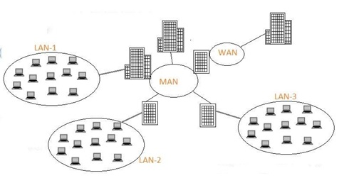

Slide 10
Types of Network
Campus Area Network (CAN) :
CAN is bigger than a LAN but smaller than a MAN. This is a type of computer network which is usually used in places like a school or college.
This network covers a limited geographical area that is, it spreads across several buildings within the campus.
●●●
10
Notes:
SAY:
The purpose of epidemiology in public health practice is to
discover the agent, host, and environmental factors that affect health;
determine the relative importance of causes of illness, disability, and death;
identify those segments of the population that have the greatest risk from specific causes of ill health; and
evaluate the effectiveness of health programs and services in improving population health.
GO to next slide.

Slide 11
Types of Network
Storage Area Network (SAN) :
SAN is a type of computer network that is high speed and connects groups of storage devices to several servers. This network does not depend on LAN or WAN.
Instead, a SAN moves the storage resources from the network to its own high-powered network. A SAN provides access to block-level data storage.
●●●
11
Notes:
SAY:
The purpose of epidemiology in public health practice is to
discover the agent, host, and environmental factors that affect health;
determine the relative importance of causes of illness, disability, and death;
identify those segments of the population that have the greatest risk from specific causes of ill health; and
evaluate the effectiveness of health programs and services in improving population health.
GO to next slide.

Slide 12
Types of Network
System Area Network (SAN) :
A SAN is a type of computer network that connects a cluster of high-performance computers. It is a connection-oriented and high bandwidth network.
A SAN is a type of LAN that handles high amounts of information in large requests. This network is useful for processing applications that require high network performance.
●●●
12
Notes:
SAY:
The purpose of epidemiology in public health practice is to
discover the agent, host, and environmental factors that affect health;
determine the relative importance of causes of illness, disability, and death;
identify those segments of the population that have the greatest risk from specific causes of ill health; and
evaluate the effectiveness of health programs and services in improving population health.
GO to next slide.

Slide 13
Types of Network
Passive Optical Local Area Network (POLAN) :
A POLAN is a type of computer network which is an alternative to a LAN.
POLAN uses optical splitters to split an optical signal from a single strand of single mode optical fibre to multiple signals to distribute users and devices. In short, POLAN is a point to multipoint LAN architecture.
●●●
13
Notes:
SAY:
The purpose of epidemiology in public health practice is to
discover the agent, host, and environmental factors that affect health;
determine the relative importance of causes of illness, disability, and death;
identify those segments of the population that have the greatest risk from specific causes of ill health; and
evaluate the effectiveness of health programs and services in improving population health.
GO to next slide.

Slide 14
Types of Network
Enterprise Private Network (EPN) :
EPN is a type of computer network mostly used by businesses that want a secure connection over various locations to share computer resources.
14
Notes:
SAY:
The purpose of epidemiology in public health practice is to
discover the agent, host, and environmental factors that affect health;
determine the relative importance of causes of illness, disability, and death;
identify those segments of the population that have the greatest risk from specific causes of ill health; and
evaluate the effectiveness of health programs and services in improving population health.
GO to next slide.

Slide 15
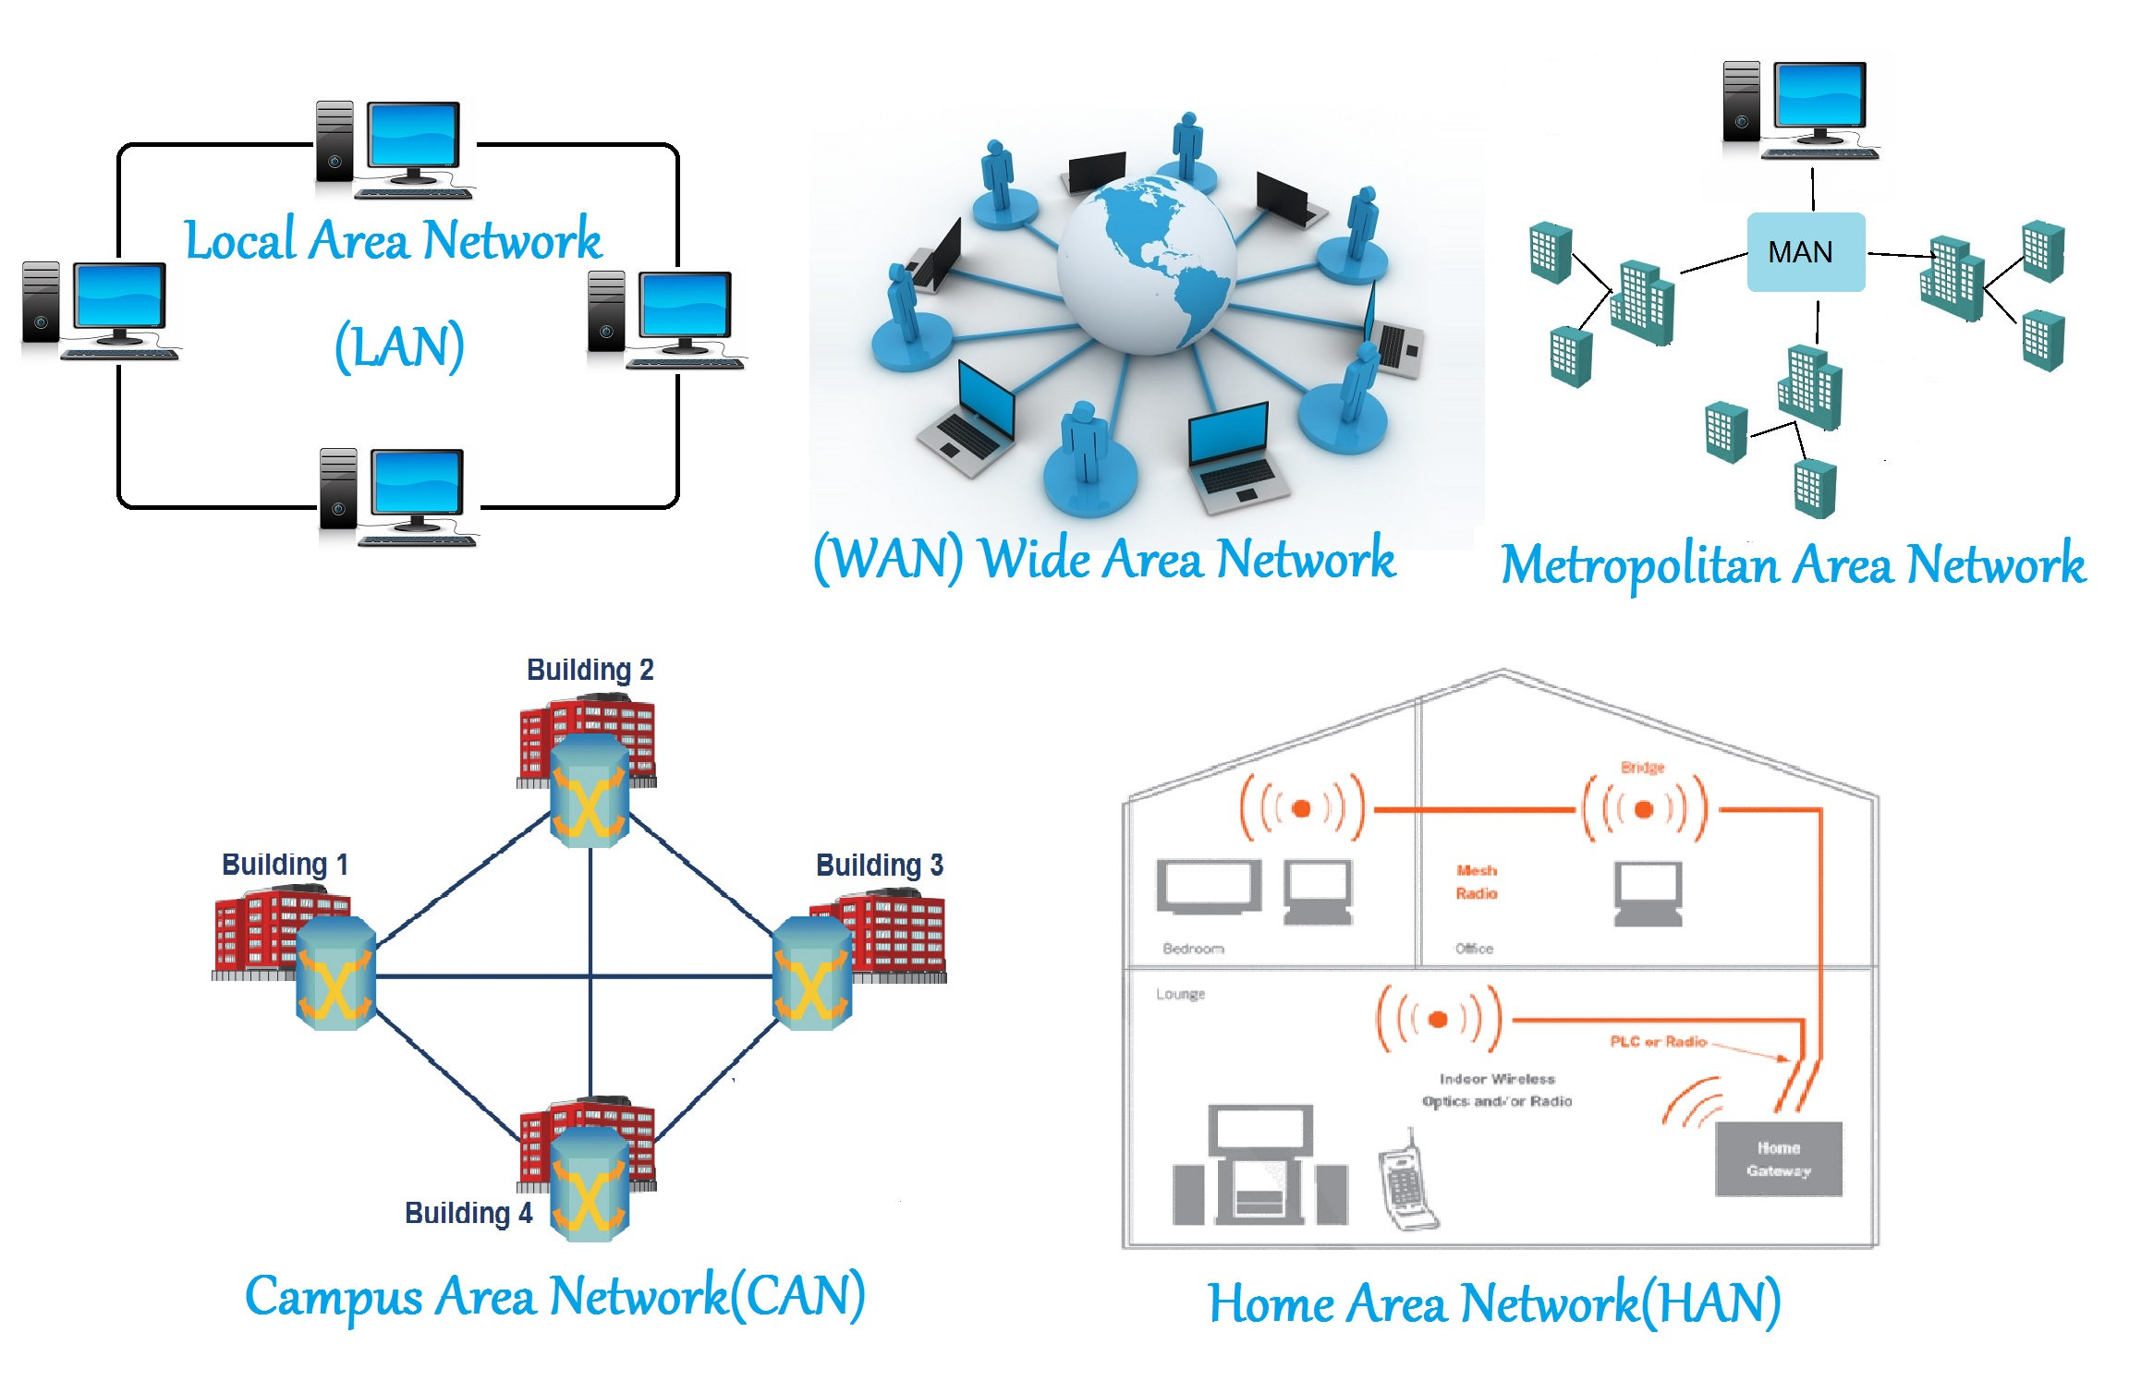

Slide 16
Conclusion
The right networking solution can help your business grow and evolve.
Not only does it allow staff to share information effortlessly, increasing productivity and efficiency, other benefits include cost-effectiveness, storage efficiency, flexibility, and data security.
16
Notes:
SAY:
The purpose of epidemiology in public health practice is to
discover the agent, host, and environmental factors that affect health;
determine the relative importance of causes of illness, disability, and death;
identify those segments of the population that have the greatest risk from specific causes of ill health; and
evaluate the effectiveness of health programs and services in improving population health.
GO to next slide.

Slide 17
References
Google.com
Wikipedia.org
Studymafia.org
Slidespanda.com

Slide 18
Thanks To StudyMafia.org

