Slide 1
StudyMafia.Org
Types of
Fermentation
Submitted To: Submitted By:
Studymafia.org Studymafia.org

Slide 2
Table Contents
Definition
Introduction
Types of Fermentation
Advantages of Fermentation
Conclusion
2
Notes:
SAY: Before we wrap up the course, let’s review what we have learned today.
During this course, we have
<READ the bullets from the slide.>
GO to next slide.

Slide 3
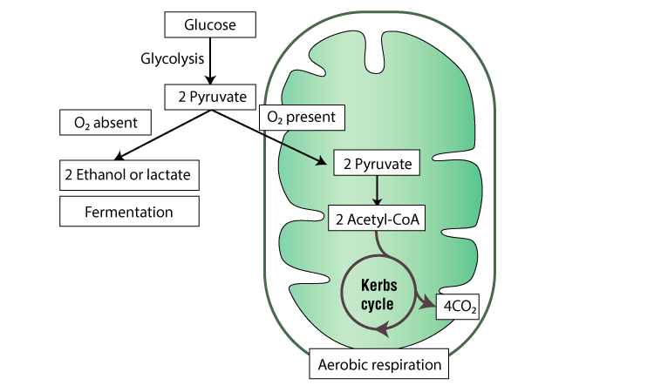
Definition
Fermentation is an enzyme catalysed, metabolic process whereby organisms convert starch or sugar to alcohol or an acid anaerobically releasing energy. The science of fermentation is called “zymology”.
3
Notes:
SAY: Before we wrap up the course, let’s review what we have learned today.
During this course, we have
<READ the bullets from the slide.>
GO to next slide.

Slide 4
Introduction
Fermentation is an anaerobic biochemical process. In fermentation, the first process is the same as cellular respiration, which is the formation of pyruvic acid by glycolysis where net 2 ATP molecules are synthesised.
In the next step, pyruvate is reduced to lactic acid, ethanol or other products. Here NAD+ is formed which is re-utilized back in the glycolysis process.
4
Notes:
SAY: Before we wrap up the course, let’s review what we have learned today.
During this course, we have
<READ the bullets from the slide.>
GO to next slide.

Slide 5
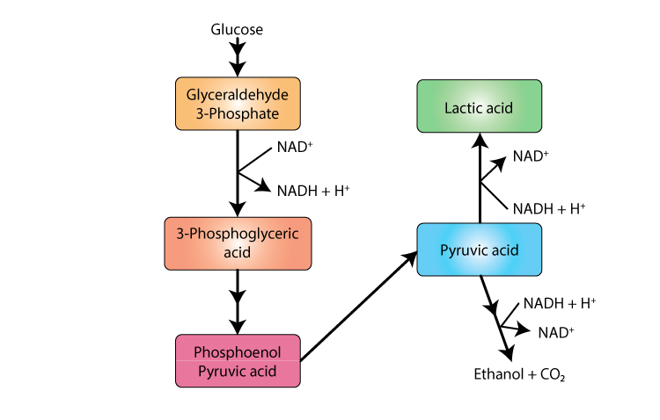
5
Notes:
SAY: Before we wrap up the course, let’s review what we have learned today.
During this course, we have
<READ the bullets from the slide.>
GO to next slide.

Slide 6
Types of Fermentation
Lactic Acid Fermentation
Lactic acid is formed from pyruvate produced in glycolysis. NAD+ is generated from NADH. Enzyme lactate dehydrogenase catalyses this reaction. Lactobacillus bacteria prepare curd from milk via this type of fermentation.
During intense exercise when oxygen supply is inadequate, muscles derive energy by producing lactic acid, which gets accumulated in the cells causing fatigue.
●●●
6
Notes:
SAY:
The purpose of epidemiology in public health practice is to
discover the agent, host, and environmental factors that affect health;
determine the relative importance of causes of illness, disability, and death;
identify those segments of the population that have the greatest risk from specific causes of ill health; and
evaluate the effectiveness of health programs and services in improving population health.
GO to next slide.

Slide 7
Types of Fermentation
Alcohol Fermentation
This is used in the industrial production of wine, beer, biofuel, etc. The end product is alcohol and CO2. Pyruvic acid breaks down into acetaldehyde and CO2 is released.
In the next step, ethanol is formed from acetaldehyde. NAD+ is also formed from NADH, utilized in glycolysis. Yeast and some bacteria carry out this type of fermentation.
●●●
7
Notes:
SAY:
The purpose of epidemiology in public health practice is to
discover the agent, host, and environmental factors that affect health;
determine the relative importance of causes of illness, disability, and death;
identify those segments of the population that have the greatest risk from specific causes of ill health; and
evaluate the effectiveness of health programs and services in improving population health.
GO to next slide.

Slide 8
Types of Fermentation
Acetic acid Fermentation
Vinegar is produced by this process. This is a two-step process.
The first step is the formation of ethyl alcohol from sugar anaerobically using yeast.
In the second step, ethyl alcohol is further oxidized to form acetic acid using acetobacter bacteria. Microbial oxidation of alcohol to acid is an aerobic process.
●●●
8
Notes:
SAY:
The purpose of epidemiology in public health practice is to
discover the agent, host, and environmental factors that affect health;
determine the relative importance of causes of illness, disability, and death;
identify those segments of the population that have the greatest risk from specific causes of ill health; and
evaluate the effectiveness of health programs and services in improving population health.
GO to next slide.

Slide 9
Types of Fermentation
Ethanol Fermentation
In ethanol fermentation, the pyruvate produced through glycolysis is converted to ethanol and carbon dioxide in two steps.
First, the pyruvate releases carbon dioxide to form a two-carbon compound called acetaldehyde. Next, acetaldehyde is reduced by NADH to ethanol, thereby regenerating the NAD+ for use in glycolysis.
●●●
9
Notes:
SAY:
The purpose of epidemiology in public health practice is to
discover the agent, host, and environmental factors that affect health;
determine the relative importance of causes of illness, disability, and death;
identify those segments of the population that have the greatest risk from specific causes of ill health; and
evaluate the effectiveness of health programs and services in improving population health.
GO to next slide.

Slide 10
Types of Fermentation
Butyric acid Fermentation
This type of fermentation is characteristic of obligate anaerobic bacteria of genus clostridium. This occurs in retting of jute fibre, rancid butter, tobacco processing and tanning of leather.
Butyric acid is produced in the human colon as a product of dietary fibre fermentation. It is an important source of energy for colorectal epithelium.
Notes:
SAY:
The purpose of epidemiology in public health practice is to
discover the agent, host, and environmental factors that affect health;
determine the relative importance of causes of illness, disability, and death;
identify those segments of the population that have the greatest risk from specific causes of ill health; and
evaluate the effectiveness of health programs and services in improving population health.
GO to next slide.

Slide 11
Advantages of Fermentation
Using suitable microorganisms and specified conditions different kinds of fermentation products are formed namely:-
Wine
Beer
Biofuels
Yoghurt
Pickles
Bread
Sour foods containing lactic acid
●●●
11
Notes:
SAY:
The purpose of epidemiology in public health practice is to
discover the agent, host, and environmental factors that affect health;
determine the relative importance of causes of illness, disability, and death;
identify those segments of the population that have the greatest risk from specific causes of ill health; and
evaluate the effectiveness of health programs and services in improving population health.
GO to next slide.

Slide 12
Advantages of Fermentation
Fermentation can make food nutritious, digestible and flavoured. There are many benefits of consuming fermented food.
It improves digestion and helps to maintain intestinal bacteria
It has an anti-cancer effect.
Improves immune system
Reduces lactose intolerance
12
Notes:
SAY:
The purpose of epidemiology in public health practice is to
discover the agent, host, and environmental factors that affect health;
determine the relative importance of causes of illness, disability, and death;
identify those segments of the population that have the greatest risk from specific causes of ill health; and
evaluate the effectiveness of health programs and services in improving population health.
GO to next slide.

Slide 13
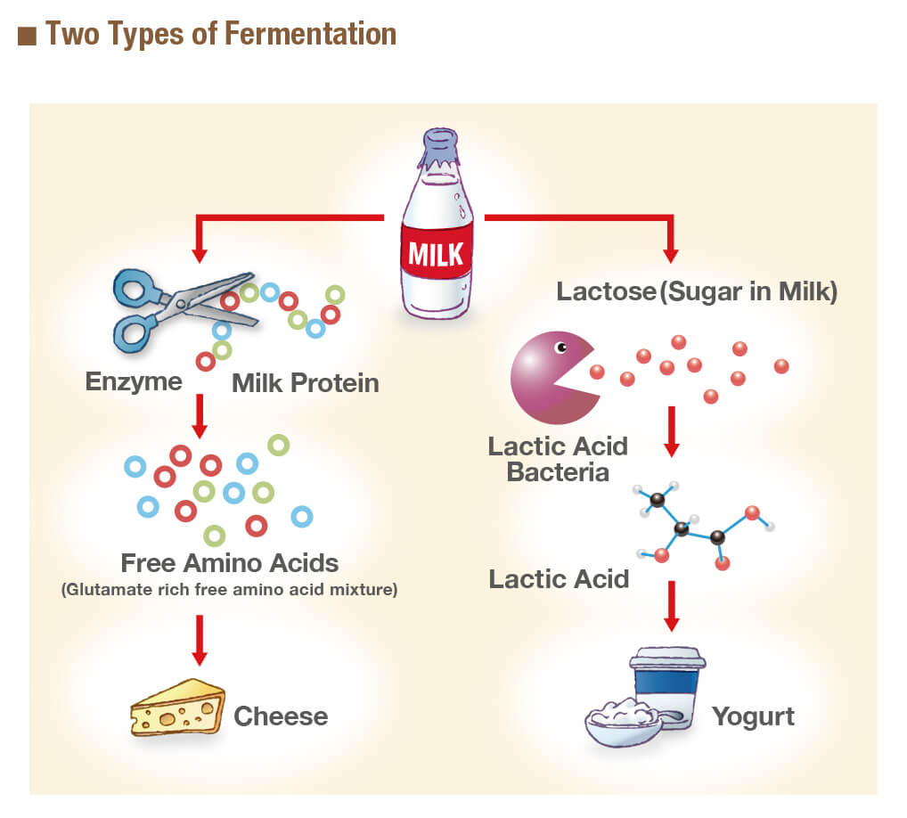

Slide 14
Conclusion
Fermentation is a metabolic process that produces chemical changes in organic substrates through the action of enzymes.
In biochemistry, it is narrowly defined as the extraction of energy from carbohydrates in the absence of oxygen.
14
Notes:
SAY:
The purpose of epidemiology in public health practice is to
discover the agent, host, and environmental factors that affect health;
determine the relative importance of causes of illness, disability, and death;
identify those segments of the population that have the greatest risk from specific causes of ill health; and
evaluate the effectiveness of health programs and services in improving population health.
GO to next slide.

Slide 15
References
Google.com
Wikipedia.org
Studymafia.org
Slidespanda.com

Slide 16
Thanks To StudyMafia.org

