Slide 1
StudyMafia.Org
Types Of Elisa
Submitted To: Submitted By:
Studymafia.org Studymafia.org

Slide 2
Content
What is an ELISA?
Types of ELISA
Direct
Indirect
Sandwich
Competitive
Principle
Conclusion

Slide 3
What is an ELISA?
ELISA stands for enzyme-linked immunoassay. It is a commonly used laboratory test to detect antibodies in the blood.
An antibody is a protein produced by the body’s immune system when it detects harmful substances, called antigens.
ELISA is an effective and widely used technique in microbiology and virology—in particular, for investigating infectious pathogens.

Slide 4
Types of ELISAs
The four main types of ELISAs are
Direct
Indirect
Sandwich
Competitive

Slide 5
Direct ELISA
In a direct ELISA, an antigen or sample is immobilized directly on the plate and a conjugated detection antibody binds to the target protein.
Substrate is then added, producing a signal that is proportional to the amount of analyte in the sample. Since only one antibody is used in a direct ELISA, they are less specific than a sandwich ELISA.
When to Use: Assessing antibody affinity and specificity. Investigating blocking/inhibitory interactions.

Slide 6
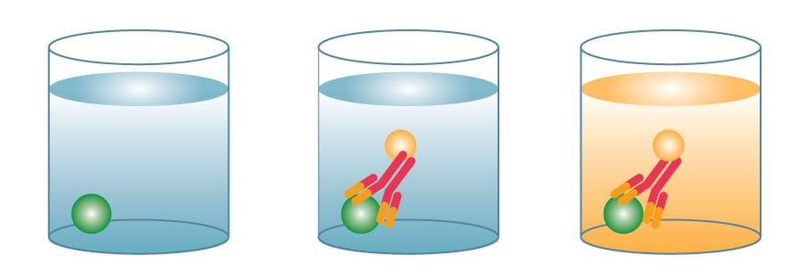
Advantages:
Fast and simple protocol
Disadvantages:
Less specific since you are only using 1 antibody.
Potential for high background if all proteins from a sample are immobilized in well.

Slide 7
Indirect ELISA
An indirect ELISA is similar to a direct ELISA in that an antigen is immobilized on a plate, but it includes an additional amplification detection step.
First, an unconjugated primary detection antibody is added and binds to the specific antigen. A conjugated secondary antibody directed against the host species of the primary antibody is then added.
Substrate then produces a signal proportional to the amount of antigen bound in the well.
When to Use: Measuring endogenous antibodies.

Slide 8
Advantages:
Amplification using a secondary antibody
Disadvantages:
Potential for cross-reactivity caused by secondary antibody

Slide 9
Sandwich ELISA
Sandwich ELISAs are the most common type of ELISA. Two specific antibodies are used to sandwich the antigen, commonly referred to as matched antibody pairs.
Capture antibody is coated on a microplate, sample is added, and the protein of interest binds and is immobilized on the plate.
A conjugated-detection antibody is then added and binds to an additional epitope on the target protein. Substrate is added and produces a signal that is proportional to the amount of analyte present in the sample.
Sandwich ELISAs are highly specific, since two antibodies are required to bind to the protein of interest.
When to Use: Determining analyte concentration in a biological sample.

Slide 10
Advantages:
Highest specificity and sensitivity
Compatible with complex sample matrices
Disadvantages:
Longer protocol
Challenging to develop

Slide 11
Competitive ELISA
Competitive ELISAs are commonly used for small molecules, when the protein of interest is too small to efficiently sandwich with two antibodies. Similar to a sandwich ELISA, a capture antibody is coated on a microplate.
Instead of using a conjugated detection antibody, a conjugated antigen is used to complete for binding with the antigen present in the sample.
The more antigen present in the sample, the less conjugated antigen will bind to the capture antibody.
Substrate is added and the signal produced is inversely proportional to the amount of protein present in the sample.

Slide 12
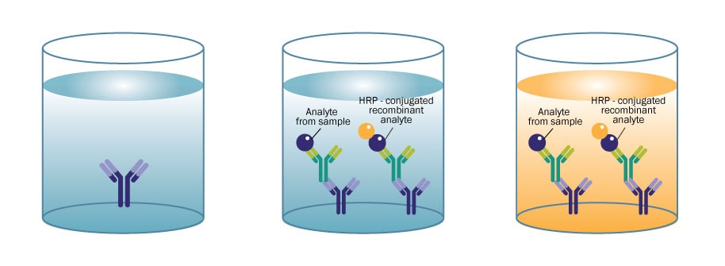
When to Use: Determining concentrations of a small molecules and hormones.
Advantages:
Ability to quantitate small molecules
Disadvantages:
Less specific since you are only using 1 antibody
Requires a conjugated antigen

Slide 13
Principle of ELISA
ELISA works on the principle that specific antibodies bind the target antigen and detect the presence and quantity of antigens binding.
In order to increase the sensitivity and precision of the assay, the plate must be coated with antibodies with high affinity.
ELISA can provide a useful measurement of antigen-antibody concentration.

Slide 14
Conclusion
ELISA test is an innovation in biomedical research field as it gives most accurate results.
It has many advantages over other methods in terms of sensitivity, specificity and in terms of cost.
It detects almost all types of biological molecules in the given sample at very low concentrations and quantities.
ELISA remains an important tool in both clinical and basic research, as well as in clinical diagnostics although it has its own disadvantages and limitations.

Slide 15
References
Google.com
Wikipedia.org
Studymafia.org
Slidespanda.com

Slide 16
Thanks To StudyMafia.org

