Slide 1
StudyMafia.Org
Steroids
Submitted To: Submitted By:
Studymafia.org Studymafia.org

Slide 2
Table Contents
Definition
Introduction
Types of Steroids
How are Steroids Given?
When are Steroids Given?
Working of Steroids
Benefits of Steroids
Side Effects of Steroids
Conclusion
2
Notes:
SAY: Before we wrap up the course, let’s review what we have learned today.
During this course, we have
<READ the bullets from the slide.>
GO to next slide.

Slide 3
Definition
Commonly referred to as steroids, corticosteroids are a type of anti-inflammatory drug.
3
Notes:
SAY: Before we wrap up the course, let’s review what we have learned today.
During this course, we have
<READ the bullets from the slide.>
GO to next slide.

Slide 4
Introduction
Corticosteroids are man-made drugs that closely resemble cortisol, a hormone that your adrenal glands produce naturally.
Corticosteroids are often referred to by the shortened term "steroids." Corticosteroids are different from the male hormone-related steroid compounds that some athletes abuse.
4
Notes:
SAY: Before we wrap up the course, let’s review what we have learned today.
During this course, we have
<READ the bullets from the slide.>
GO to next slide.

Slide 5
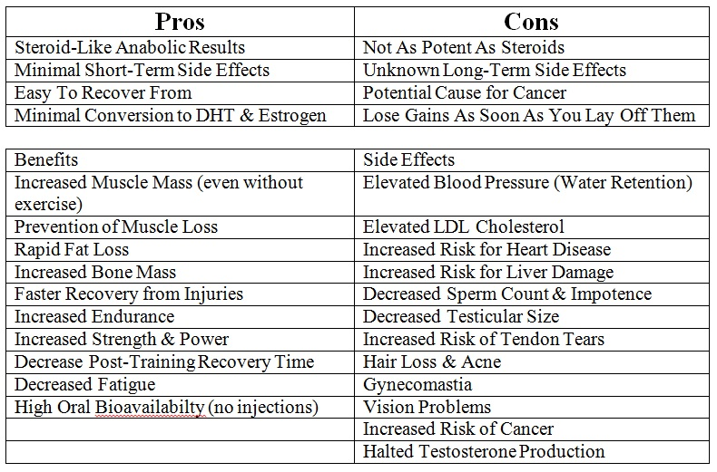
5
Notes:
SAY: Before we wrap up the course, let’s review what we have learned today.
During this course, we have
<READ the bullets from the slide.>
GO to next slide.

Slide 6
Types of Steroids
Some corticosteroid medicines include cortisone, prednisone and methylprednisolone.
Prednisone is the most commonly used type of steroid to treat certain rheumatologic diseases (like rheumatoid arthritis or lupus).
6
Notes:
SAY:
The purpose of epidemiology in public health practice is to
discover the agent, host, and environmental factors that affect health;
determine the relative importance of causes of illness, disability, and death;
identify those segments of the population that have the greatest risk from specific causes of ill health; and
evaluate the effectiveness of health programs and services in improving population health.
GO to next slide.

Slide 7
How are Steroids Given?
Steroid medications are available in several forms that vary in how easily they dissolve or how long they stay in the body.
Steroids might be given locally, to the precise place where a problem exists, or systemically, which means throughout the "system" or body.
●●●
7
Notes:
SAY:
The purpose of epidemiology in public health practice is to
discover the agent, host, and environmental factors that affect health;
determine the relative importance of causes of illness, disability, and death;
identify those segments of the population that have the greatest risk from specific causes of ill health; and
evaluate the effectiveness of health programs and services in improving population health.
GO to next slide.

Slide 8
How are Steroids Given?
Examples of local steroid treatments include joint injections, eye drops, ear drops and skin creams.
Systemic steroid treatments include oral medicines (given by mouth) or medicine that is delivered directly into a vein (intravenously or IV) or muscle (intramuscularly).
●●●
8
Notes:
SAY:
The purpose of epidemiology in public health practice is to
discover the agent, host, and environmental factors that affect health;
determine the relative importance of causes of illness, disability, and death;
identify those segments of the population that have the greatest risk from specific causes of ill health; and
evaluate the effectiveness of health programs and services in improving population health.
GO to next slide.

Slide 9
How are Steroids Given?
Systemic steroids circulate through the bloodstream to various body sites.
When possible, local steroid treatments are prescribed instead of systemic steroids to reduce the risk of side effects.
9
Notes:
SAY:
The purpose of epidemiology in public health practice is to
discover the agent, host, and environmental factors that affect health;
determine the relative importance of causes of illness, disability, and death;
identify those segments of the population that have the greatest risk from specific causes of ill health; and
evaluate the effectiveness of health programs and services in improving population health.
GO to next slide.

Slide 10
When are Steroids Given?
Steroids are used to treat many conditions in which the body’s defense system doesn’t work properly and causes tissue damage. Steroids may be the main therapy for certain diseases.
For other conditions, steroids might only be used sparingly or when other measures have not been successful.
●●●
10
Notes:
SAY:
The purpose of epidemiology in public health practice is to
discover the agent, host, and environmental factors that affect health;
determine the relative importance of causes of illness, disability, and death;
identify those segments of the population that have the greatest risk from specific causes of ill health; and
evaluate the effectiveness of health programs and services in improving population health.
GO to next slide.

Slide 11
When are Steroids Given?
Steroids are used in the treatment for certain rheumatologic inflammatory conditions, such as:
Systemic vasculitis (inflammation of blood vessels).
Myositis (inflammation of muscle).
Rheumatoid arthritis (chronic inflammatory arthritis).
Systemic lupus erythematosus (a generalized disease caused by abnormal immune system function).
11
Notes:
SAY:
The purpose of epidemiology in public health practice is to
discover the agent, host, and environmental factors that affect health;
determine the relative importance of causes of illness, disability, and death;
identify those segments of the population that have the greatest risk from specific causes of ill health; and
evaluate the effectiveness of health programs and services in improving population health.
GO to next slide.

Slide 12
Working of Steroids
Steroids work by decreasing inflammation and reducing the activity of the immune system.
Inflammation is a process in which the body's white blood cells and chemicals can protect against infection and foreign substances such as bacteria and viruses.
In certain diseases, however, the body's defense system (immune system) doesn't function properly.
●●●
12
Notes:
SAY:
The purpose of epidemiology in public health practice is to
discover the agent, host, and environmental factors that affect health;
determine the relative importance of causes of illness, disability, and death;
identify those segments of the population that have the greatest risk from specific causes of ill health; and
evaluate the effectiveness of health programs and services in improving population health.
GO to next slide.

Slide 13
Working of Steroids
This might cause inflammation to work against the body's tissues and cause damage. Signs of inflammation include:
Redness.
Warmth.
Swelling.
Pain.
●●●
13
Notes:
SAY:
The purpose of epidemiology in public health practice is to
discover the agent, host, and environmental factors that affect health;
determine the relative importance of causes of illness, disability, and death;
identify those segments of the population that have the greatest risk from specific causes of ill health; and
evaluate the effectiveness of health programs and services in improving population health.
GO to next slide.

Slide 14
Working of Steroids
Steroids reduce the production of chemicals that cause inflammation. This helps keep tissue damage as low as possible.
Steroids also reduce the activity of the immune system by affecting the way white blood cells work.
14
Notes:
SAY:
The purpose of epidemiology in public health practice is to
discover the agent, host, and environmental factors that affect health;
determine the relative importance of causes of illness, disability, and death;
identify those segments of the population that have the greatest risk from specific causes of ill health; and
evaluate the effectiveness of health programs and services in improving population health.
GO to next slide.

Slide 15
Benefits of Steroids
When inflammation threatens to damage critical body organs, steroids can be organ-saving and in many instances, life-saving.
For example, steroids may prevent the worsening of kidney inflammation, which could lead to kidney failure in people who have lupus or vasculitis.
For these patients, steroid therapy might eliminate the need for kidney dialysis or transplantation.
●●●
15
Notes:
SAY:
The purpose of epidemiology in public health practice is to
discover the agent, host, and environmental factors that affect health;
determine the relative importance of causes of illness, disability, and death;
identify those segments of the population that have the greatest risk from specific causes of ill health; and
evaluate the effectiveness of health programs and services in improving population health.
GO to next slide.

Slide 16
Benefits of Steroids
Low doses of steroids might provide significant relief from pain and stiffness for people with rheumatoid arthritis.
Short-term use of higher doses of steroids might help a person recover from a severe flare-up of arthritis.
16
Notes:
SAY:
The purpose of epidemiology in public health practice is to
discover the agent, host, and environmental factors that affect health;
determine the relative importance of causes of illness, disability, and death;
identify those segments of the population that have the greatest risk from specific causes of ill health; and
evaluate the effectiveness of health programs and services in improving population health.
GO to next slide.

Slide 17
Side Effects of Steroids
The chance of side effects depends on the dose, type of steroid and length of treatment. Some side effects are more serious than others. Common side effects of systemic steroids include:
Increased appetite.
Weight gain.
Changes in mood.
●●●
17
Notes:
SAY:
The purpose of epidemiology in public health practice is to
discover the agent, host, and environmental factors that affect health;
determine the relative importance of causes of illness, disability, and death;
identify those segments of the population that have the greatest risk from specific causes of ill health; and
evaluate the effectiveness of health programs and services in improving population health.
GO to next slide.

Slide 18
Side Effects of Steroids
Muscle weakness.
Blurred vision.
Increased growth of body hair.
Easy bruising.
Lower resistance to infection.
Swollen, "puffy" face.
Acne.
Osteoporosis (bone weakening disease)
●●●
18
Notes:
SAY:
The purpose of epidemiology in public health practice is to
discover the agent, host, and environmental factors that affect health;
determine the relative importance of causes of illness, disability, and death;
identify those segments of the population that have the greatest risk from specific causes of ill health; and
evaluate the effectiveness of health programs and services in improving population health.
GO to next slide.

Slide 19
Side Effects of Steroids
Onset of, or worsening of, diabetes.
Onset of, or worsening of, high blood pressure.
Stomach irritation.
Nervousness, restlessness.
Difficulty sleeping.
Cataracts or glaucoma.
Water retention, swelling.
19
Notes:
SAY:
The purpose of epidemiology in public health practice is to
discover the agent, host, and environmental factors that affect health;
determine the relative importance of causes of illness, disability, and death;
identify those segments of the population that have the greatest risk from specific causes of ill health; and
evaluate the effectiveness of health programs and services in improving population health.
GO to next slide.

Slide 20
Conclusion
When taken in doses higher than the amount your body normally produces, steroids reduce redness and swelling (inflammation). This can help with inflammatory conditions such as asthma and eczema.
Steroids also reduce the activity of the immune system, which is the body's natural defence against illness and infection.
20
Notes:
SAY:
The purpose of epidemiology in public health practice is to
discover the agent, host, and environmental factors that affect health;
determine the relative importance of causes of illness, disability, and death;
identify those segments of the population that have the greatest risk from specific causes of ill health; and
evaluate the effectiveness of health programs and services in improving population health.
GO to next slide.

Slide 21
References
Google.com
Wikipedia.org
Studymafia.org
Slidespanda.com

Slide 22
Thanks To StudyMafia.org

