Slide 1
StudyMafia.Org
Solid Waste
Disposal
Submitted To: Submitted By:
Studymafia.org Studymafia.org

Slide 2
Table Contents
Definition
Introduction
Types of Solid Waste Disposal
Conclusion
2
Notes:
SAY: Before we wrap up the course, let’s review what we have learned today.
During this course, we have
<READ the bullets from the slide.>
GO to next slide.

Slide 3
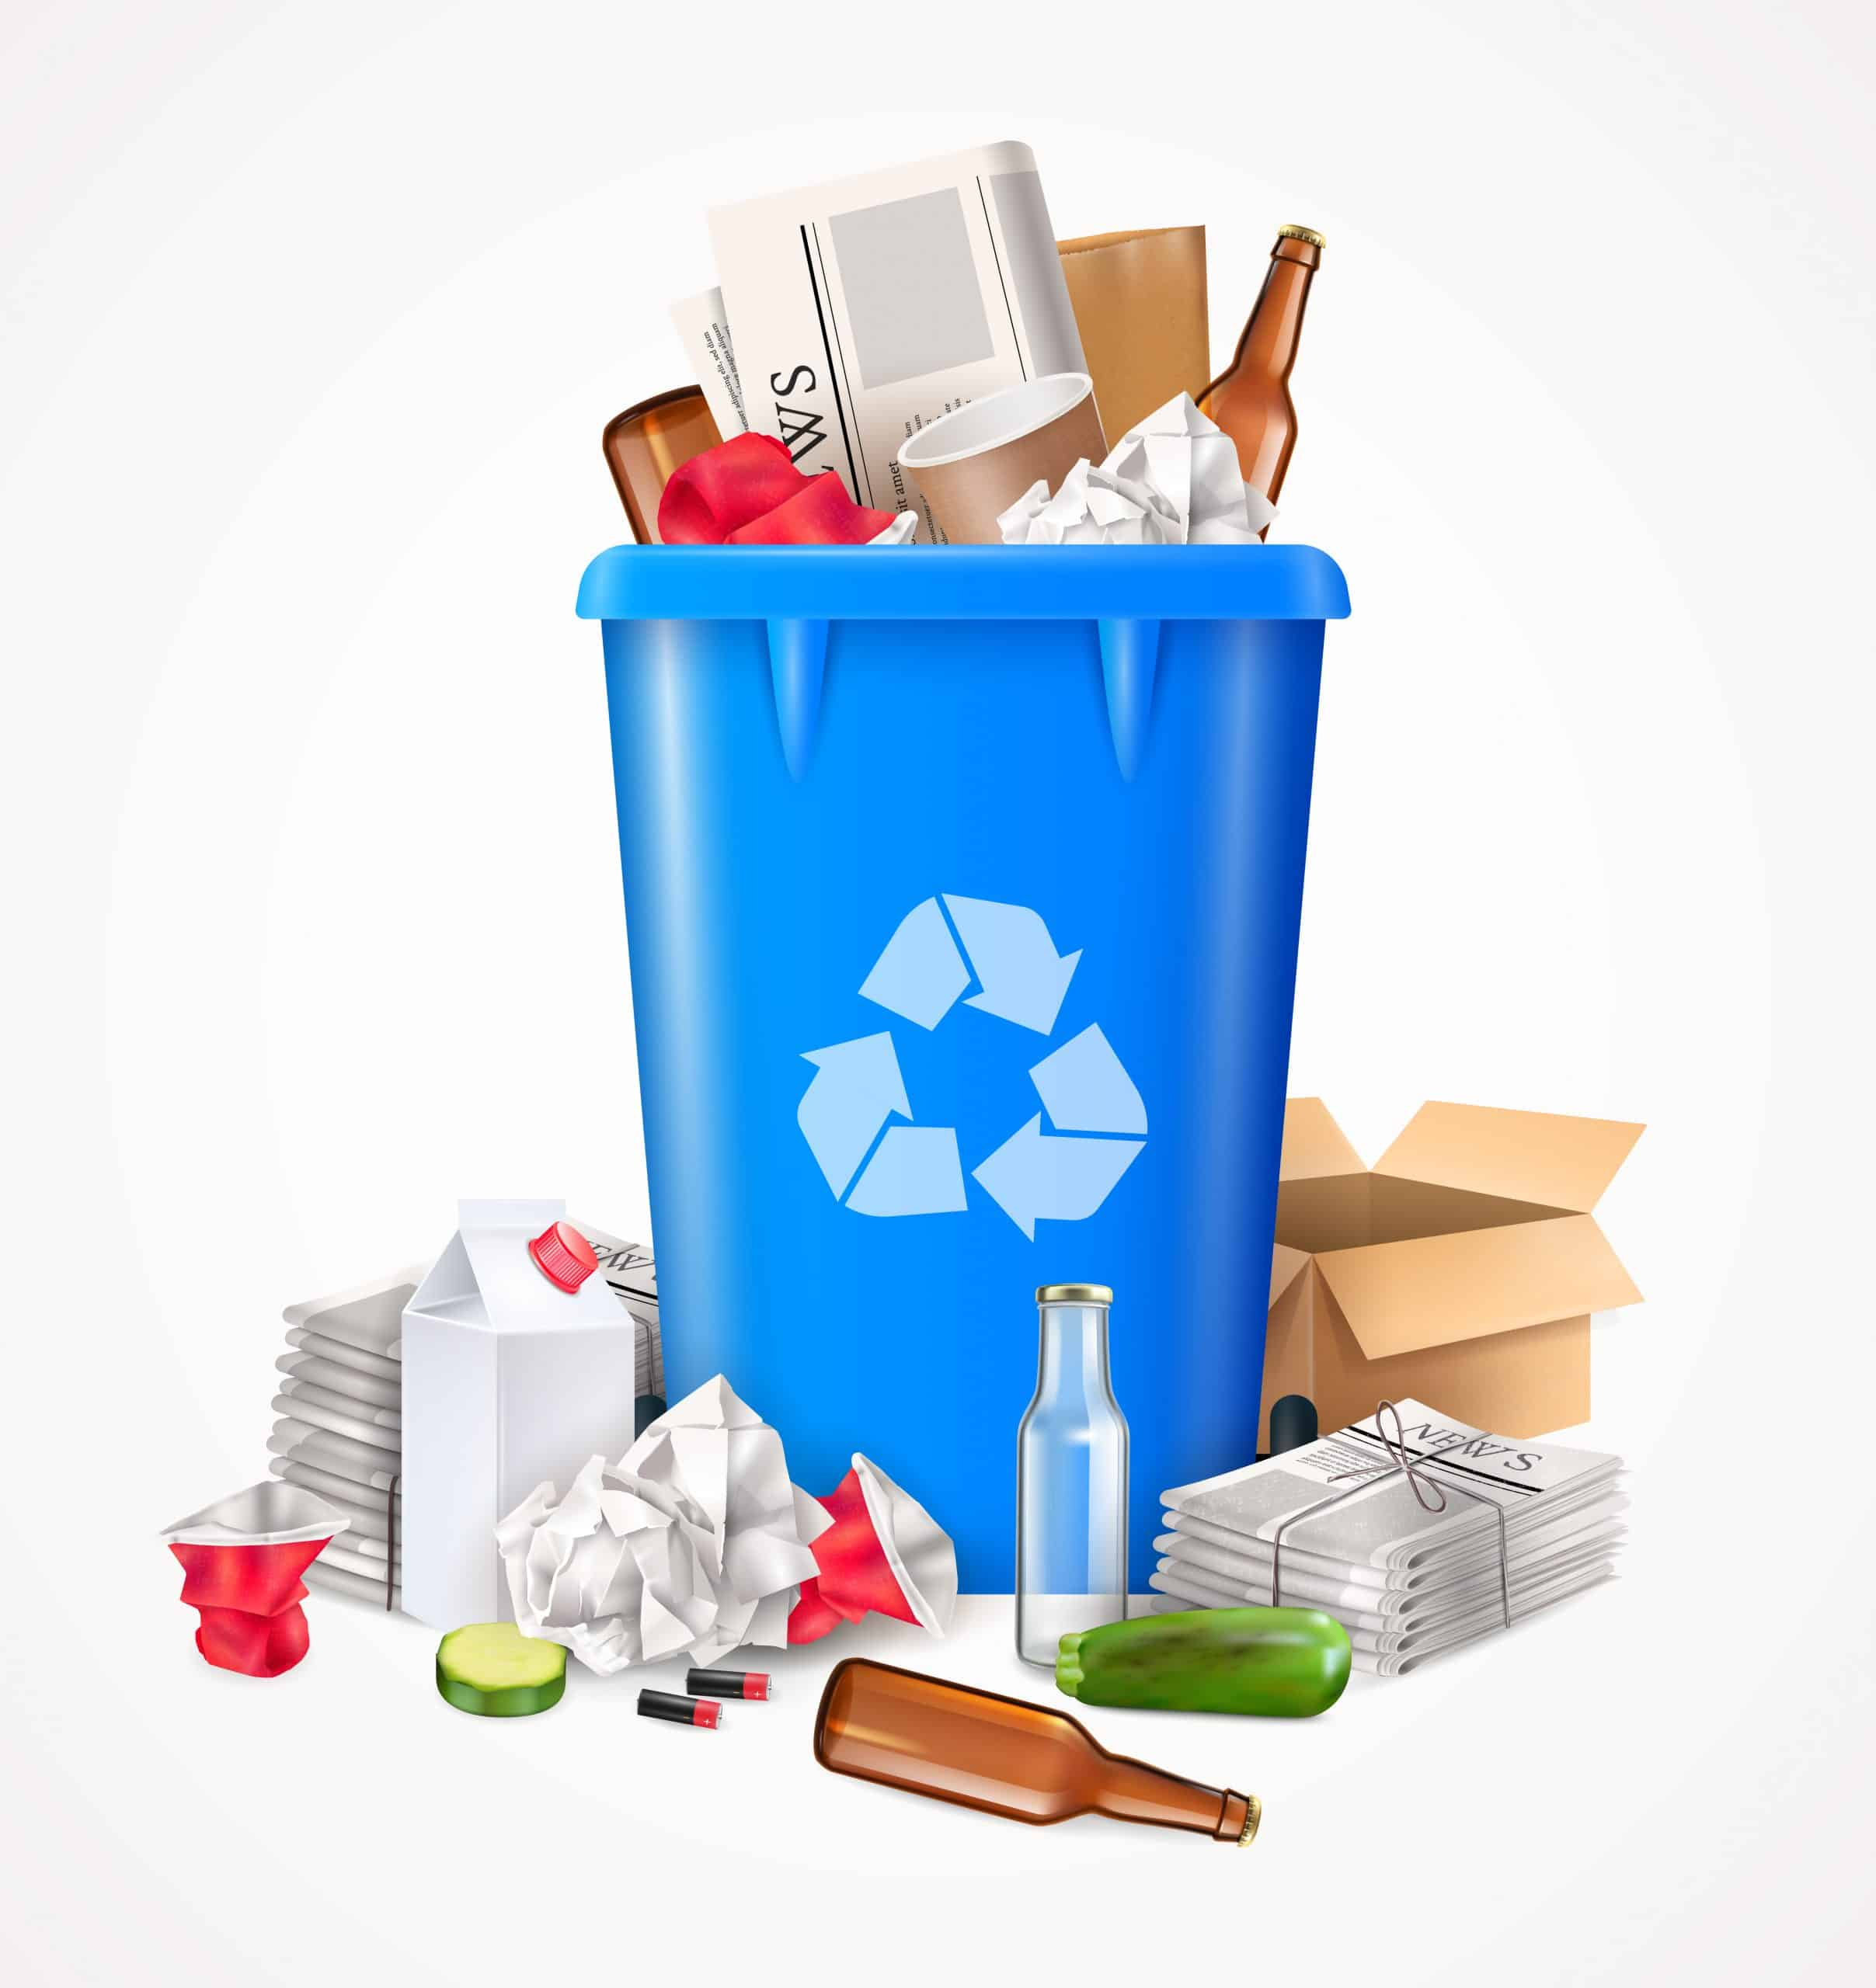
Definition
The trash heaps are usually left open to the environment and the elements. These seldom have a sparse covering which can often attract pests or vermin.
3
Notes:
SAY: Before we wrap up the course, let’s review what we have learned today.
During this course, we have
<READ the bullets from the slide.>
GO to next slide.

Slide 4
Introduction
Sometimes, wastes are illegally dumped into rivers and canals or used to fill land depressions without proper consultations.
These practices cause a lot of problems in the long run. These can range from the degradation of the soil quality to leaching toxic chemicals into underground water sources.
4
Notes:
SAY: Before we wrap up the course, let’s review what we have learned today.
During this course, we have
<READ the bullets from the slide.>
GO to next slide.

Slide 5
5
Notes:
SAY:
The purpose of epidemiology in public health practice is to
discover the agent, host, and environmental factors that affect health;
determine the relative importance of causes of illness, disability, and death;
identify those segments of the population that have the greatest risk from specific causes of ill health; and
evaluate the effectiveness of health programs and services in improving population health.
GO to next slide.

Slide 6
Types of Solid Waste Disposal
Landfill
In this process, the waste that cannot be reused or recycled are separated out and spread as a thin layer in low-lying areas across a city. A layer of soil is added after each layer of garbage.
However, once this process is complete, the area is declared unfit for construction of buildings for the next 20 years.
●●●
6
Notes:
SAY:
The purpose of epidemiology in public health practice is to
discover the agent, host, and environmental factors that affect health;
determine the relative importance of causes of illness, disability, and death;
identify those segments of the population that have the greatest risk from specific causes of ill health; and
evaluate the effectiveness of health programs and services in improving population health.
GO to next slide.

Slide 7
Types of Solid Waste Disposal
Incineration
Incineration is the process of controlled combustion of garbage to reduce it to incombustible matter such as ash and waste gas.
The exhaust gases from this process may be toxic, hence it is treated before being released into the environment.
This process reduces the volume of waste by 90 per cent and is considered as one of the most hygienic methods of waste disposal.
●●●
7
Notes:
SAY:
The purpose of epidemiology in public health practice is to
discover the agent, host, and environmental factors that affect health;
determine the relative importance of causes of illness, disability, and death;
identify those segments of the population that have the greatest risk from specific causes of ill health; and
evaluate the effectiveness of health programs and services in improving population health.
GO to next slide.

Slide 8
Types of Solid Waste Disposal
Waste Compaction
The waste materials such as cans and plastic bottles are compacted into blocks and sent for recycling.
This process prevents the oxidation of metals and reduces airspace need, thus making transportation and positioning easy.
●●●
8
Notes:
SAY:
The purpose of epidemiology in public health practice is to
discover the agent, host, and environmental factors that affect health;
determine the relative importance of causes of illness, disability, and death;
identify those segments of the population that have the greatest risk from specific causes of ill health; and
evaluate the effectiveness of health programs and services in improving population health.
GO to next slide.

Slide 9
Types of Solid Waste Disposal
Biogas Generation
Biodegradable waste, such as food items, animal waste or organic industrial waste from food packaging industries are sent to bio-degradation plants.
In bio-degradation plants, they are converted to biogas by degradation with the help of bacteria, fungi, or other microbes.
●●●
9
Notes:
SAY:
The purpose of epidemiology in public health practice is to
discover the agent, host, and environmental factors that affect health;
determine the relative importance of causes of illness, disability, and death;
identify those segments of the population that have the greatest risk from specific causes of ill health; and
evaluate the effectiveness of health programs and services in improving population health.
GO to next slide.

Slide 10
Types of Solid Waste Disposal
Composting
All organic materials decompose with time. Food scraps, yard waste, etc., make up for one of the major organic wastes we throw every day.
The process of composting starts with these organic wastes being buried under layers of soil and then, are left to decay under the action of microorganisms such as bacteria and fungi.
●●●
10
Notes:
SAY:
The purpose of epidemiology in public health practice is to
discover the agent, host, and environmental factors that affect health;
determine the relative importance of causes of illness, disability, and death;
identify those segments of the population that have the greatest risk from specific causes of ill health; and
evaluate the effectiveness of health programs and services in improving population health.
GO to next slide.

Slide 11
Types of Solid Waste Disposal
Vermicomposting
Vermicomposting is the process of using worms for the degradation of organic matter into nutrient-rich manure.
Worms consume and digest the organic matter. The by-products of digestion which are excreted out by the worms make the soil nutrient-rich, thus enhancing the growth of bacteria and fungi.
11
Notes:
SAY:
The purpose of epidemiology in public health practice is to
discover the agent, host, and environmental factors that affect health;
determine the relative importance of causes of illness, disability, and death;
identify those segments of the population that have the greatest risk from specific causes of ill health; and
evaluate the effectiveness of health programs and services in improving population health.
GO to next slide.

Slide 12
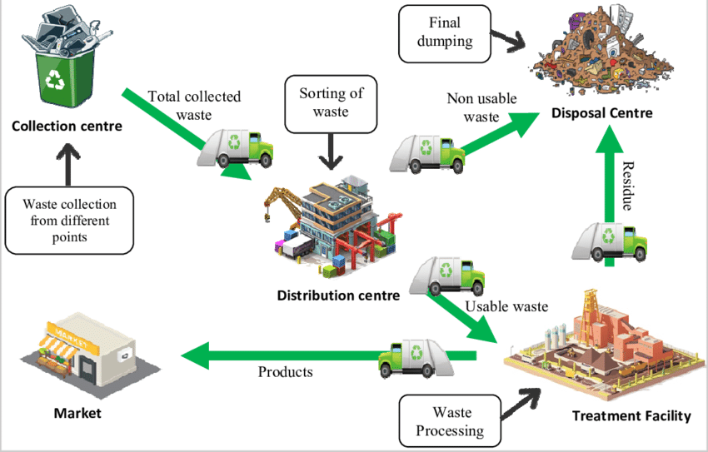

Slide 13
Conclusion
Solid waste disposal management is usually referred to the process of collecting and treating solid wastes. It provides solutions for recycling items that do not belong to garbage or trash.
Solid waste management can be described as how solid waste can be changed and used as a valuable resource.
13
Notes:
SAY:
The purpose of epidemiology in public health practice is to
discover the agent, host, and environmental factors that affect health;
determine the relative importance of causes of illness, disability, and death;
identify those segments of the population that have the greatest risk from specific causes of ill health; and
evaluate the effectiveness of health programs and services in improving population health.
GO to next slide.

Slide 14
References
Google.com
Wikipedia.org
Studymafia.org
Slidespanda.com

Slide 15
Thanks To StudyMafia.org

