Slide 1
StudyMafia.Org
Pure Culture
Techniques
Submitted To: Submitted By:
Studymafia.org Studymafia.org

Slide 2
Table Contents
Definition
Introduction
About Pure Culture
Pure Culture Collections
Assessment of Pure Collections
Importance of Pure Culture
Pure Collection Techniques
Conclusion
2
Notes:
SAY: Before we wrap up the course, let’s review what we have learned today.
During this course, we have
<READ the bullets from the slide.>
GO to next slide.

Slide 3
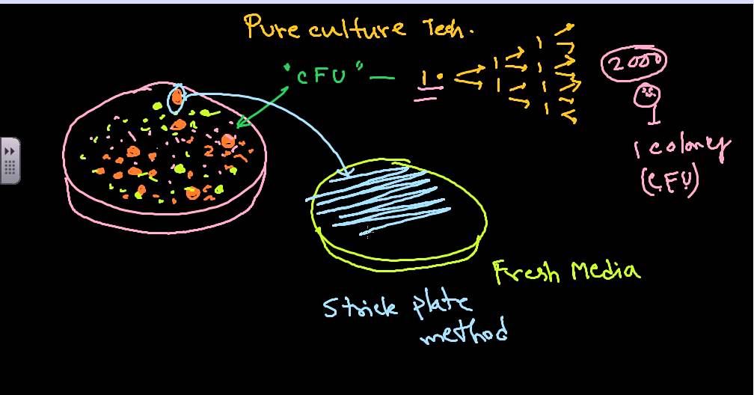
Definition
The term "Pure Culture" refers to a population or colony of cells growing in the absence of other species or types.
3
Notes:
SAY: Before we wrap up the course, let’s review what we have learned today.
During this course, we have
<READ the bullets from the slide.>
GO to next slide.

Slide 4
Introduction
​Pure culture technique allows us to isolate one species from a mixed culture is a useful tool that helps to obtain a single kind of organism from a mixed culture.
The idea that is if an agar plate is inoculated with only one species and there is no contamination, then each colony on a plate will consist of genetically identical cells have have come from a single progenitor or parent cell.
4
Notes:
SAY: Before we wrap up the course, let’s review what we have learned today.
During this course, we have
<READ the bullets from the slide.>
GO to next slide.

Slide 5
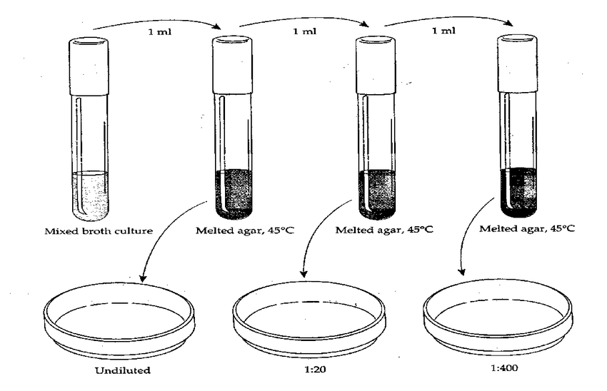
5
Notes:
SAY:
The purpose of epidemiology in public health practice is to
discover the agent, host, and environmental factors that affect health;
determine the relative importance of causes of illness, disability, and death;
identify those segments of the population that have the greatest risk from specific causes of ill health; and
evaluate the effectiveness of health programs and services in improving population health.
GO to next slide.

Slide 6
About Pure Culture
Pure culture is defined as a laboratory culture that contains just one species of organisms in microbiology.
Microbes are usually in mixed cultures. But, the pure culture can be derived from it through the transfer of a bit of its sample in the new and sterile growth medium.
●●●
6
Notes:
SAY:
The purpose of epidemiology in public health practice is to
discover the agent, host, and environmental factors that affect health;
determine the relative importance of causes of illness, disability, and death;
identify those segments of the population that have the greatest risk from specific causes of ill health; and
evaluate the effectiveness of health programs and services in improving population health.
GO to next slide.

Slide 7
About Pure Culture
The process of pure culture isolation usually takes place by the dispersion of cells across the surface medium. This mainly involves thinning of the sample before it is inoculated into a new medium.
There are several pure culture techniques utilized by scientists to carry out the process of the creation of discrete colonies of pure microbes.
●●●
7
Notes:
SAY:
The purpose of epidemiology in public health practice is to
discover the agent, host, and environmental factors that affect health;
determine the relative importance of causes of illness, disability, and death;
identify those segments of the population that have the greatest risk from specific causes of ill health; and
evaluate the effectiveness of health programs and services in improving population health.
GO to next slide.

Slide 8
About Pure Culture
Microbiologists of those times readily adopted these methods for the production of a single strain of the organism.
The inculcation of such techniques of pure culture led to bacterias characterization that was responsible for causing anthrax, tuberculosis, and such major diseases.
8
Notes:
SAY:
The purpose of epidemiology in public health practice is to
discover the agent, host, and environmental factors that affect health;
determine the relative importance of causes of illness, disability, and death;
identify those segments of the population that have the greatest risk from specific causes of ill health; and
evaluate the effectiveness of health programs and services in improving population health.
GO to next slide.

Slide 9
Pure Culture Collections
These are a resource and method of preserving the genetic resources of these organisms.
The collection of pure culture organisms varies widely depending on size and some specializations as well.
These have gained importance over the years due to their authenticity, reliability, and practical uses.
9
Notes:
SAY:
The purpose of epidemiology in public health practice is to
discover the agent, host, and environmental factors that affect health;
determine the relative importance of causes of illness, disability, and death;
identify those segments of the population that have the greatest risk from specific causes of ill health; and
evaluate the effectiveness of health programs and services in improving population health.
GO to next slide.

Slide 10
Assessment of Pure Culture
The assessment of the purity of culture is carried out through different methods. These are as follows:
The same cultural characteristics are shown on the media obtained in the isolated colonies of pure culture organisms.
●●●
10
Notes:
SAY:
The purpose of epidemiology in public health practice is to
discover the agent, host, and environmental factors that affect health;
determine the relative importance of causes of illness, disability, and death;
identify those segments of the population that have the greatest risk from specific causes of ill health; and
evaluate the effectiveness of health programs and services in improving population health.
GO to next slide.

Slide 11
Assessment of Pure Culture
The same culture organisms look alike when observed under the microorganisms. This means that they get the same stain and have the same morphology.
Just like similar biochemical results the isolated colonies of pure culture perform identically, i.e., separately.
11
Notes:
SAY:
The purpose of epidemiology in public health practice is to
discover the agent, host, and environmental factors that affect health;
determine the relative importance of causes of illness, disability, and death;
identify those segments of the population that have the greatest risk from specific causes of ill health; and
evaluate the effectiveness of health programs and services in improving population health.
GO to next slide.

Slide 12
Importance of Pure Culture
It is feasible to study the clinical aspects and physiology of pure culture organisms.
Irrespective of the number of times the test is done, the same results will be obtained for a particular culture of organisms during any sort of test.
●●●
12
Notes:
SAY:
The purpose of epidemiology in public health practice is to
discover the agent, host, and environmental factors that affect health;
determine the relative importance of causes of illness, disability, and death;
identify those segments of the population that have the greatest risk from specific causes of ill health; and
evaluate the effectiveness of health programs and services in improving population health.
GO to next slide.

Slide 13
Importance of Pure Culture
The organisms of pure culture can be grown, tested, characterized, and identified.
Spontaneous mutation occurs slowly in the case of pure culture, and the clone so formed is identical in all forms and aspects.
13
Notes:
SAY:
The purpose of epidemiology in public health practice is to
discover the agent, host, and environmental factors that affect health;
determine the relative importance of causes of illness, disability, and death;
identify those segments of the population that have the greatest risk from specific causes of ill health; and
evaluate the effectiveness of health programs and services in improving population health.
GO to next slide.

Slide 14
Pure Culture Techniques
Sterilization process for media and glassware
Dispersion of individual cells takes place across the medium
The thinning process of samples is carried out multiple times before the inoculation of fresh media takes place.
14
Notes:
SAY:
The purpose of epidemiology in public health practice is to
discover the agent, host, and environmental factors that affect health;
determine the relative importance of causes of illness, disability, and death;
identify those segments of the population that have the greatest risk from specific causes of ill health; and
evaluate the effectiveness of health programs and services in improving population health.
GO to next slide.

Slide 15
Conclusion
A pure culture is usually derived from a mixed culture (one containing many species) by transferring a small sample into new, sterile growth medium in such a manner as to disperse the individual cells across the medium surface or by thinning the sample manyfold before inoculating the new medium.
15
Notes:
SAY:
The purpose of epidemiology in public health practice is to
discover the agent, host, and environmental factors that affect health;
determine the relative importance of causes of illness, disability, and death;
identify those segments of the population that have the greatest risk from specific causes of ill health; and
evaluate the effectiveness of health programs and services in improving population health.
GO to next slide.

Slide 16
References
Google.com
Wikipedia.org
Studymafia.org
Slidespanda.com

Slide 17
Thanks To StudyMafia.org

