Slide 1
StudyMafia.Org
Patents
Submitted To: Submitted By:
Studymafia.org Studymafia.org

Slide 2
Table Contents
Definition
Introduction
Understanding Patents
Types of Patents
How to Apply for a Patent?
Examples of Patents
Conclusion
2
Notes:
SAY: Before we wrap up the course, let’s review what we have learned today.
During this course, we have
<READ the bullets from the slide.>
GO to next slide.

Slide 3
Definition
A patent is the granting of a property right by a sovereign authority to an inventor.
3
Notes:
SAY: Before we wrap up the course, let’s review what we have learned today.
During this course, we have
<READ the bullets from the slide.>
GO to next slide.

Slide 4
Introduction
This grant provides the inventor exclusive rights to the patented process, design, or invention for a designated period in exchange for a comprehensive disclosure of the invention.
Government agencies typically handle and approve applications for patents. In the United States, the U.S. Patent and Trademark Office (USPTO), which is part of the Department of Commerce, handles applications and grants approvals.
4
Notes:
SAY: Before we wrap up the course, let’s review what we have learned today.
During this course, we have
<READ the bullets from the slide.>
GO to next slide.

Slide 5
5
Notes:
SAY: Before we wrap up the course, let’s review what we have learned today.
During this course, we have
<READ the bullets from the slide.>
GO to next slide.

Slide 6
Understanding Patents
Most patents are valid for 20 years in the U.S. from the date the application was filed with the USPTO, although there are circumstances where exceptions are made to extend a patent's term.
U.S. patents are only valid in the United States and U.S. Territories.
6
Notes:
SAY:
The purpose of epidemiology in public health practice is to
discover the agent, host, and environmental factors that affect health;
determine the relative importance of causes of illness, disability, and death;
identify those segments of the population that have the greatest risk from specific causes of ill health; and
evaluate the effectiveness of health programs and services in improving population health.
GO to next slide.

Slide 7
Understanding Patents
If seeking protection outside of the United States, it is important to research the intellectual property rights of other nations and apply for protection with their governing authorities.
7
Notes:
SAY:
The purpose of epidemiology in public health practice is to
discover the agent, host, and environmental factors that affect health;
determine the relative importance of causes of illness, disability, and death;
identify those segments of the population that have the greatest risk from specific causes of ill health; and
evaluate the effectiveness of health programs and services in improving population health.
GO to next slide.

Slide 8
Types of Patents
Utility Patents
Utility patents, or patents for invention, issue legal protection to people who invent a new and useful process, an article of manufacture, a machine, or a composition of matter.
Utility patents are the most common type of patent, with more than 90% of patents issued by the U.S. government belonging to this category.
●●●
8
Notes:
SAY:
The purpose of epidemiology in public health practice is to
discover the agent, host, and environmental factors that affect health;
determine the relative importance of causes of illness, disability, and death;
identify those segments of the population that have the greatest risk from specific causes of ill health; and
evaluate the effectiveness of health programs and services in improving population health.
GO to next slide.

Slide 9
Types of Patents
Design Patents
Design patents are patents issued for original, new, and ornamental designs for manufactured products. Design patents protect the design or look of something.
They require the invention to which the design belongs to be original and useful. Design patents last for 15 years for applications filed after May 13, 2015.
●●●
9
Notes:
SAY:
The purpose of epidemiology in public health practice is to
discover the agent, host, and environmental factors that affect health;
determine the relative importance of causes of illness, disability, and death;
identify those segments of the population that have the greatest risk from specific causes of ill health; and
evaluate the effectiveness of health programs and services in improving population health.
GO to next slide.

Slide 10
Types of Patents
Plant Patents
Plant patents go to anyone who produces, discovers, and invents a new kind of plant capable of reproduction.
These patents are granted for 20 years from the date of filing and no maintenance fees apply.
10
Notes:
SAY:
The purpose of epidemiology in public health practice is to
discover the agent, host, and environmental factors that affect health;
determine the relative importance of causes of illness, disability, and death;
identify those segments of the population that have the greatest risk from specific causes of ill health; and
evaluate the effectiveness of health programs and services in improving population health.
GO to next slide.

Slide 11
How to Apply for a Patent
Before making a formal application, an applicant should research the Patent and Trademark Office's database to see if another person or institution has claimed a patent for a similar invention.
The invention must be different from or an improvement upon a previous design to be considered for a patent.
●●●
11
Notes:
SAY:
The purpose of epidemiology in public health practice is to
discover the agent, host, and environmental factors that affect health;
determine the relative importance of causes of illness, disability, and death;
identify those segments of the population that have the greatest risk from specific causes of ill health; and
evaluate the effectiveness of health programs and services in improving population health.
GO to next slide.

Slide 12
How to Apply for a Patent
Applicants need to take care to maintain accurate records of the design process and the steps taken to create the invention. Enforcing the patent is up to the person or entity that applied for the patent.
To apply for a patent in the United States, the applicant submits specific documents and pays associated fees.
●●●
12
Notes:
SAY:
The purpose of epidemiology in public health practice is to
discover the agent, host, and environmental factors that affect health;
determine the relative importance of causes of illness, disability, and death;
identify those segments of the population that have the greatest risk from specific causes of ill health; and
evaluate the effectiveness of health programs and services in improving population health.
GO to next slide.

Slide 13
How to Apply for a Patent
Written documentation includes drawings, descriptions, and claims of the item to be patented.
A formal oath or declaration confirming the authenticity of the invention or improvement of an existing invention must be signed and submitted by the inventor. After fee payment, the application is reviewed and either approved or denied.
13
Notes:
SAY:
The purpose of epidemiology in public health practice is to
discover the agent, host, and environmental factors that affect health;
determine the relative importance of causes of illness, disability, and death;
identify those segments of the population that have the greatest risk from specific causes of ill health; and
evaluate the effectiveness of health programs and services in improving population health.
GO to next slide.

Slide 14
Examples of Patents
One of the most notable patents in the past 40 years was the personal computer filed in 1980 by Steve Jobs and three other employees of Apple Inc.
King C. Gillette patented the razor in 1904 and was dubbed a "safety razor."
Garrett Morgan was granted a patent for the traffic light in 1923
●●●
14
Notes:
SAY:
The purpose of epidemiology in public health practice is to
discover the agent, host, and environmental factors that affect health;
determine the relative importance of causes of illness, disability, and death;
identify those segments of the population that have the greatest risk from specific causes of ill health; and
evaluate the effectiveness of health programs and services in improving population health.
GO to next slide.

Slide 15
Examples of Patents
The patent for the television was issued in 1930 to Philo Taylor Farnsworth for the "first television system."
At age 20, Farnsworth had created the first electric television image and went on to invent an early model of the electronic microscope.
15
Notes:
SAY:
The purpose of epidemiology in public health practice is to
discover the agent, host, and environmental factors that affect health;
determine the relative importance of causes of illness, disability, and death;
identify those segments of the population that have the greatest risk from specific causes of ill health; and
evaluate the effectiveness of health programs and services in improving population health.
GO to next slide.

Slide 16
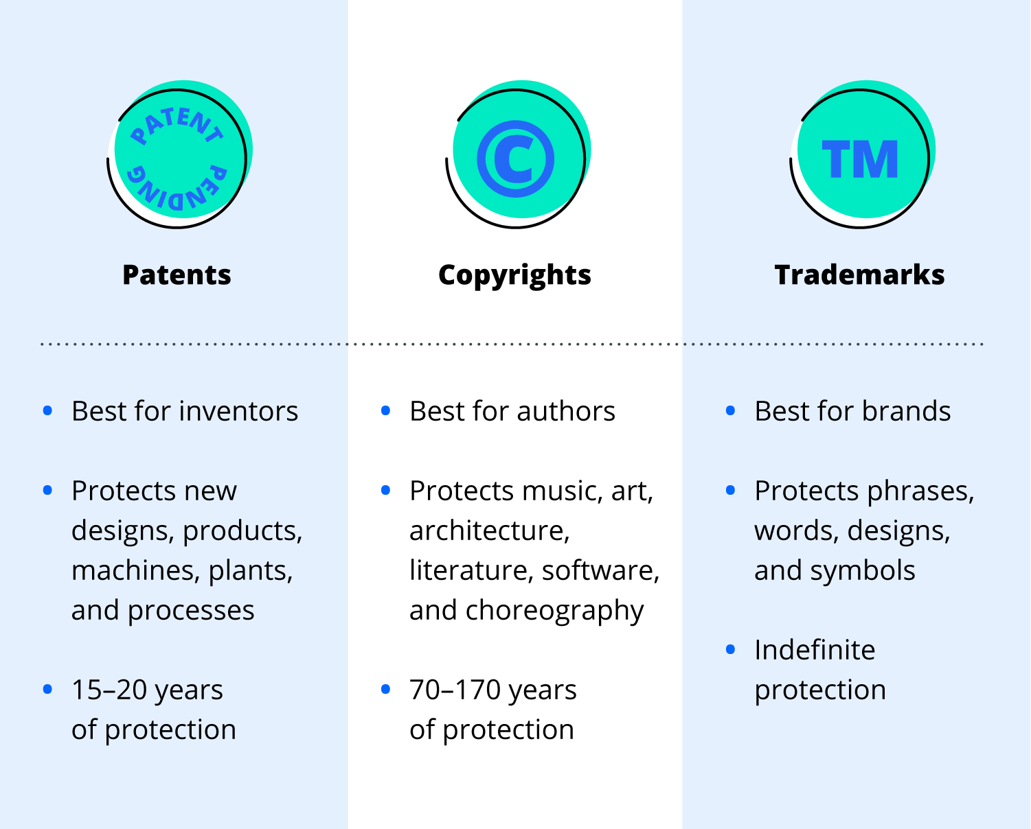

Slide 17
Conclusion
A patent is an exclusive right granted for an invention, which is a product or a process that provides, in general, a new way of doing something, or offers a new technical solution to a problem.
To get a patent, technical information about the invention must be disclosed to the public in a patent application.
17
Notes:
SAY:
The purpose of epidemiology in public health practice is to
discover the agent, host, and environmental factors that affect health;
determine the relative importance of causes of illness, disability, and death;
identify those segments of the population that have the greatest risk from specific causes of ill health; and
evaluate the effectiveness of health programs and services in improving population health.
GO to next slide.

Slide 18
References
Google.com
Wikipedia.org
Studymafia.org
Slidespanda.com

Slide 19
Thanks To StudyMafia.org

