Slide 1
StudyMafia.Org
Mental Healt
Act
Submitted To: Submitted By:
Studymafia.org Studymafia.org

Slide 2
Table Contents
Definition
Introduction
Stages of Mental Health Act 2017
Chapters in Mental Health Act 2017
Major Provisons
Conclusion
2
Notes:
SAY: Before we wrap up the course, let’s review what we have learned today.
During this course, we have
<READ the bullets from the slide.>
GO to next slide.

Slide 3
Definition
In India, the Mental Health Care Act 2017 was passed on 7 April 2017 and came into force from 29 May 2018
3
Notes:
SAY: Before we wrap up the course, let’s review what we have learned today.
During this course, we have
<READ the bullets from the slide.>
GO to next slide.

Slide 4
Introduction
The act effectively decriminalized attempted suicide which was punishable under Section 309 of the Indian Penal Code.
The law was described in its opening paragraph as "An Act to provide for mental healthcare and services for persons with mental illness and to protect, promote and fulfill the rights of such persons during delivery of mental healthcare and services and for matters connected therewith or incidental thereto."
4
Notes:
SAY: Before we wrap up the course, let’s review what we have learned today.
During this course, we have
<READ the bullets from the slide.>
GO to next slide.

Slide 6
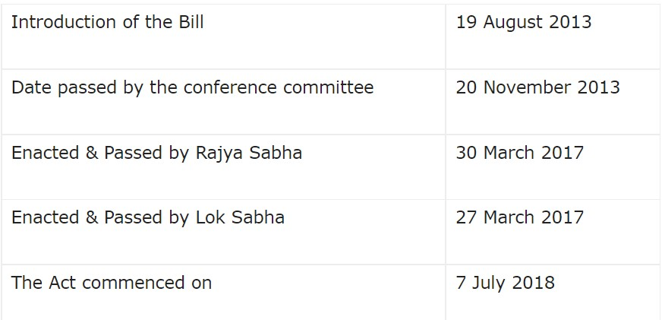
Stages of Mental Health Act, 2017
6
Notes:
SAY:
The purpose of epidemiology in public health practice is to
discover the agent, host, and environmental factors that affect health;
determine the relative importance of causes of illness, disability, and death;
identify those segments of the population that have the greatest risk from specific causes of ill health; and
evaluate the effectiveness of health programs and services in improving population health.
GO to next slide.

Slide 7
Chapters in Mental Heath Act 2017
Chapter I
It comprises the definitions & terms that are asserted in the Act.
Mental Illness gets a brand new & elaborative definition.
It involves post-graduate Ayush doctors as Mental Health Professionals.
●●●
7
Notes:
SAY:
The purpose of epidemiology in public health practice is to
discover the agent, host, and environmental factors that affect health;
determine the relative importance of causes of illness, disability, and death;
identify those segments of the population that have the greatest risk from specific causes of ill health; and
evaluate the effectiveness of health programs and services in improving population health.
GO to next slide.

Slide 8
Chapters in Mental Heath Act 2017
Chapter II
This chapter covers mental illness and the capacity to make mental health care and treatment decisions without any prejudice.
How mental health should be determined.
Capacity to make mental health care and treatment decisions.
●●●
8
Notes:
SAY:
The purpose of epidemiology in public health practice is to
discover the agent, host, and environmental factors that affect health;
determine the relative importance of causes of illness, disability, and death;
identify those segments of the population that have the greatest risk from specific causes of ill health; and
evaluate the effectiveness of health programs and services in improving population health.
GO to next slide.

Slide 9
Chapters in Mental Heath Act 2017
Chapter III
This chapter deals with the Advance directives.
Manner of making Advance Directives & maintaining it & its power, review & liability allocated to it.
●●●
9
Notes:
SAY:
The purpose of epidemiology in public health practice is to
discover the agent, host, and environmental factors that affect health;
determine the relative importance of causes of illness, disability, and death;
identify those segments of the population that have the greatest risk from specific causes of ill health; and
evaluate the effectiveness of health programs and services in improving population health.
GO to next slide.

Slide 10
Chapters in Mental Heath Act 2017
Chapter IV
It lies down the guidelines of determining a nominated representative.
Appointment & Revocation of NR & his Duties.
●●●
10
Notes:
SAY:
The purpose of epidemiology in public health practice is to
discover the agent, host, and environmental factors that affect health;
determine the relative importance of causes of illness, disability, and death;
identify those segments of the population that have the greatest risk from specific causes of ill health; and
evaluate the effectiveness of health programs and services in improving population health.
GO to next slide.

Slide 11
Chapters in Mental Heath Act 2017
Chapter V
Section 18 – Right to access mental healthcare.
Section 19 – Right to community living.
Section 20 – Right to protection from cruel, inhuman and degrading treatment.
Section 21 – Right to equality and non-discrimination.
Section 22 – Right to information.
●●●
11
Notes:
SAY:
The purpose of epidemiology in public health practice is to
discover the agent, host, and environmental factors that affect health;
determine the relative importance of causes of illness, disability, and death;
identify those segments of the population that have the greatest risk from specific causes of ill health; and
evaluate the effectiveness of health programs and services in improving population health.
GO to next slide.

Slide 12
Chapters in Mental Heath Act 2017
Chapter V
Section 23 – Right to confidentiality.
Section 24 – Restriction on the release of information in respect of Right to access medical records.
Section 25 – Right to personal contacts and communication.
Section 26 – Right to legal aid.
●●●
12
Notes:
SAY:
The purpose of epidemiology in public health practice is to
discover the agent, host, and environmental factors that affect health;
determine the relative importance of causes of illness, disability, and death;
identify those segments of the population that have the greatest risk from specific causes of ill health; and
evaluate the effectiveness of health programs and services in improving population health.
GO to next slide.

Slide 13
Chapters in Mental Heath Act 2017
Chapter VI
It gives direction to the government to execute the programme.
It also promotes mental health & preventive programs.
Chapter VII
Gives provisions for creating the Central Mental Health Authority.
Includes Establishment, Composition & Duties of CMHA.
●●●
13
Notes:
SAY:
The purpose of epidemiology in public health practice is to
discover the agent, host, and environmental factors that affect health;
determine the relative importance of causes of illness, disability, and death;
identify those segments of the population that have the greatest risk from specific causes of ill health; and
evaluate the effectiveness of health programs and services in improving population health.
GO to next slide.

Slide 14
Chapters in Mental Heath Act 2017
Chapter VIII
Gives provisions of creating the State Mental Health Authority.
Cover Establishment, Composition & Duties of SMHA.
Chapter IX
It comprises finance, accounts and audit.
Accounts, Audits & Annual Reports by Central & State Authority.
●●●
14
Notes:
SAY:
The purpose of epidemiology in public health practice is to
discover the agent, host, and environmental factors that affect health;
determine the relative importance of causes of illness, disability, and death;
identify those segments of the population that have the greatest risk from specific causes of ill health; and
evaluate the effectiveness of health programs and services in improving population health.
GO to next slide.

Slide 15
Chapters in Mental Heath Act 2017
Chapter X
This includes Mental Health Care establishments.
Chapter XI
Development of Mental Health Review Boards.
Registration, Audit, Inspection & Inquiry of mental health.
Chapter XII
Admission, treatment and discharge of mentally ill.
●●●
15
Notes:
SAY:
The purpose of epidemiology in public health practice is to
discover the agent, host, and environmental factors that affect health;
determine the relative importance of causes of illness, disability, and death;
identify those segments of the population that have the greatest risk from specific causes of ill health; and
evaluate the effectiveness of health programs and services in improving population health.
GO to next slide.

Slide 16
Chapters in Mental Heath Act 2017
Chapter XIII
This Chapter guarantees guidelines in terms of Duties of police officers concerning a mentally ill person.
Chapter XIV
It restricts unauthorized duty and medication.
Chapter XV
It deals with penalty and punishment.
Chapter XVI
This chapter talks about the Power of the Central Government to issue regulations.
16
Notes:
SAY:
The purpose of epidemiology in public health practice is to
discover the agent, host, and environmental factors that affect health;
determine the relative importance of causes of illness, disability, and death;
identify those segments of the population that have the greatest risk from specific causes of ill health; and
evaluate the effectiveness of health programs and services in improving population health.
GO to next slide.

Slide 17
Major Provisions
New definition of mental illness
Earlier, Mental illness was defined as any mental disorder and seldom as mental retardation but the new act provides a broader definition
●●●
17
Notes:
SAY:
The purpose of epidemiology in public health practice is to
discover the agent, host, and environmental factors that affect health;
determine the relative importance of causes of illness, disability, and death;
identify those segments of the population that have the greatest risk from specific causes of ill health; and
evaluate the effectiveness of health programs and services in improving population health.
GO to next slide.

Slide 18
Major Provisions
Various rights for persons with mental illness
Every person has a right to obtain mental health care and its treatment from mental health services run or financed by the appropriate government.
●●●
18
Notes:
SAY:
The purpose of epidemiology in public health practice is to
discover the agent, host, and environmental factors that affect health;
determine the relative importance of causes of illness, disability, and death;
identify those segments of the population that have the greatest risk from specific causes of ill health; and
evaluate the effectiveness of health programs and services in improving population health.
GO to next slide.

Slide 19
Major Provisions
Advance directive
A person with mental illness shall have the right to make an advance directive that states how he/she wants to be treated for the illness and who his/her nominated representative shall be.
The advance directive should be certified by a medical practitioner or registered with the Mental Health Board.
●●●
19
Notes:
SAY:
The purpose of epidemiology in public health practice is to
discover the agent, host, and environmental factors that affect health;
determine the relative importance of causes of illness, disability, and death;
identify those segments of the population that have the greatest risk from specific causes of ill health; and
evaluate the effectiveness of health programs and services in improving population health.
GO to next slide.

Slide 20
Major Provisions
Mental health authority
The Bill provides power to the government to set-up the Central Mental Health Authority at national-level and State Mental Health Authority in each State.
20
Notes:
SAY:
The purpose of epidemiology in public health practice is to
discover the agent, host, and environmental factors that affect health;
determine the relative importance of causes of illness, disability, and death;
identify those segments of the population that have the greatest risk from specific causes of ill health; and
evaluate the effectiveness of health programs and services in improving population health.
GO to next slide.

Slide 21
Conclusion
The Mental Healthcare Act of 2017 looks alien in nature but impractical in scope. There is no doubt that in the scope the act is a big leap from its predecessor 1987 Act.
However the present healthcare system seems to be incompetent and we suffer from lack of infrastructure and specialists in the field, resultant of this causes the degraded quality of living and healthcare of the mentally ill.
21
Notes:
SAY:
The purpose of epidemiology in public health practice is to
discover the agent, host, and environmental factors that affect health;
determine the relative importance of causes of illness, disability, and death;
identify those segments of the population that have the greatest risk from specific causes of ill health; and
evaluate the effectiveness of health programs and services in improving population health.
GO to next slide.

Slide 22
References
Google.com
Wikipedia.org
Studymafia.org
Slidespanda.com

Slide 23
Thanks To StudyMafia.org

