Slide 1
StudyMafia.Org
Educational Technology
Submitted To: Submitted By:
Studymafia.org Studymafia.org

Slide 2
Table Contents
Definition
Introduction
Theory of Educational Technology
Technologies in Education
Conclusion
2
Notes:
SAY: Before we wrap up the course, let’s review what we have learned today.
During this course, we have
<READ the bullets from the slide.>
GO to next slide.

Slide 3
Definition
Educational technology (commonly abbreviated as edutech, or edtech) is the combined use of computer hardware, software, and educational theory and practice to facilitate learning.
3
Notes:
SAY: Before we wrap up the course, let’s review what we have learned today.
During this course, we have
<READ the bullets from the slide.>
GO to next slide.

Slide 4
Introduction
In addition to the practical educational experience, educational technology is based on theoretical knowledge from various disciplines such as communication, education, psychology, sociology, artificial intelligence, and computer science.
It encompasses several domains including learning theory, computer-based training, online learning, and m-learning where mobile technologies are used.
4
Notes:
SAY: Before we wrap up the course, let’s review what we have learned today.
During this course, we have
<READ the bullets from the slide.>
GO to next slide.

Slide 5
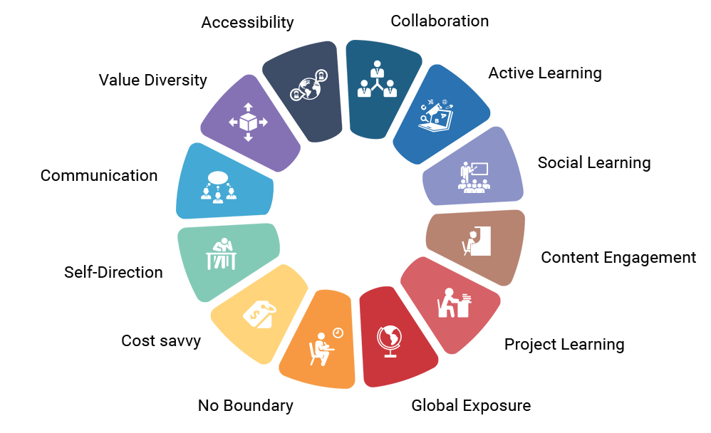
5
Notes:
SAY:
The purpose of epidemiology in public health practice is to
discover the agent, host, and environmental factors that affect health;
determine the relative importance of causes of illness, disability, and death;
identify those segments of the population that have the greatest risk from specific causes of ill health; and
evaluate the effectiveness of health programs and services in improving population health.
GO to next slide.

Slide 6
Theory of Educational Technology
Behaviorism
Teaching in behaviorism has been linked to training, emphasizing animal learning experiments. Since behaviorism consists of the view of teaching people how to do something with rewards and punishments, it is related to training people.
●●●
6
Notes:
SAY:
The purpose of epidemiology in public health practice is to
discover the agent, host, and environmental factors that affect health;
determine the relative importance of causes of illness, disability, and death;
identify those segments of the population that have the greatest risk from specific causes of ill health; and
evaluate the effectiveness of health programs and services in improving population health.
GO to next slide.

Slide 7
Theory of Educational Technology
Cognitivism
Cognitive science underwent significant change in the 1960s and 1970s to the point that some described the period as a "cognitive revolution", particularly in reaction to behaviorism.
While retaining the empirical framework of behaviorism, cognitive psychology theories look beyond behavior to explain brain-based learning by considering how human memory works to promote learning.
●●●
7
Notes:
SAY:
The purpose of epidemiology in public health practice is to
discover the agent, host, and environmental factors that affect health;
determine the relative importance of causes of illness, disability, and death;
identify those segments of the population that have the greatest risk from specific causes of ill health; and
evaluate the effectiveness of health programs and services in improving population health.
GO to next slide.

Slide 8
Theory of Educational Technology
Constructivism
Educational psychologists distinguish between several types of constructivism: individual (or psychological) constructivism, such as Piaget's theory of cognitive development, and social constructivism.
This form of constructivism has a primary focus on how learners construct their own meaning from new information, as they interact with reality and with other learners who bring different perspectives.
8
Notes:
SAY:
The purpose of epidemiology in public health practice is to
discover the agent, host, and environmental factors that affect health;
determine the relative importance of causes of illness, disability, and death;
identify those segments of the population that have the greatest risk from specific causes of ill health; and
evaluate the effectiveness of health programs and services in improving population health.
GO to next slide.

Slide 9
Technologies in Education
Audio and video
Video technology has included VHS tapes and DVDs, as well as on-demand and synchronous methods with digital video via server or web-based options such as streamed video and webcams.
Webcams and webcasting have enabled the creation of virtual classrooms and virtual learning environment.
●●●
9
Notes:
SAY:
The purpose of epidemiology in public health practice is to
discover the agent, host, and environmental factors that affect health;
determine the relative importance of causes of illness, disability, and death;
identify those segments of the population that have the greatest risk from specific causes of ill health; and
evaluate the effectiveness of health programs and services in improving population health.
GO to next slide.

Slide 10
Technologies in Education
Computers, tablets, and mobile devices
Collaborative learning is a group-based learning approach in which learners are mutually engaged in a coordinated fashion to achieve a learning goal or complete a learning task.
With recent developments in smartphone technology, the processing powers and storage capabilities of modern mobiles allow for advanced development and the use of apps.
●●●
10
Notes:
SAY:
The purpose of epidemiology in public health practice is to
discover the agent, host, and environmental factors that affect health;
determine the relative importance of causes of illness, disability, and death;
identify those segments of the population that have the greatest risk from specific causes of ill health; and
evaluate the effectiveness of health programs and services in improving population health.
GO to next slide.

Slide 11
Technologies in Education
Collaborative and social learning
Group webpages, blogs, wikis, and Twitter allow learners and educators to post thoughts, ideas, and comments on a website in an interactive learning environment.
Social networking sites are virtual communities for people interested in a particular subject to communicate by voice, chat, instant message, video conference, or blogs.
●●●
11
Notes:
SAY:
The purpose of epidemiology in public health practice is to
discover the agent, host, and environmental factors that affect health;
determine the relative importance of causes of illness, disability, and death;
identify those segments of the population that have the greatest risk from specific causes of ill health; and
evaluate the effectiveness of health programs and services in improving population health.
GO to next slide.

Slide 12
Technologies in Education
Whiteboards
There are three types of whiteboards.[118] The initial whiteboards, analogous to blackboards, date from the late 1950s.
The term whiteboard is also used metaphorically to refer to virtual whiteboards in which computer software applications simulate whiteboards by allowing writing or drawing.
●●●
12
Notes:
SAY:
The purpose of epidemiology in public health practice is to
discover the agent, host, and environmental factors that affect health;
determine the relative importance of causes of illness, disability, and death;
identify those segments of the population that have the greatest risk from specific causes of ill health; and
evaluate the effectiveness of health programs and services in improving population health.
GO to next slide.

Slide 13
Technologies in Education
Virtual classroom
A virtual learning environment (VLE), also known as a learning platform, simulates a virtual classroom or meetings by simultaneously mixing several communication technologies.
Web conferencing software enables students and instructors to communicate with each other via webcam, microphone, and real-time chatting in a group setting.
●●●
13
Notes:
SAY:
The purpose of epidemiology in public health practice is to
discover the agent, host, and environmental factors that affect health;
determine the relative importance of causes of illness, disability, and death;
identify those segments of the population that have the greatest risk from specific causes of ill health; and
evaluate the effectiveness of health programs and services in improving population health.
GO to next slide.

Slide 14
Technologies in Education
Learning management system
A learning management system (LMS) is software used for delivering, tracking, and managing training and education.
It tracks data about attendance, time on task, and student progress. Educators can post announcements, grade assignments, check on course activities, and participate in class discussions.
●●●
14
Notes:
SAY:
The purpose of epidemiology in public health practice is to
discover the agent, host, and environmental factors that affect health;
determine the relative importance of causes of illness, disability, and death;
identify those segments of the population that have the greatest risk from specific causes of ill health; and
evaluate the effectiveness of health programs and services in improving population health.
GO to next slide.

Slide 15
Technologies in Education
Learning content management system
A learning content management system (LCMS) is software for author content (courses, reusable content objects).
An LCMS may be solely dedicated to producing and publishing content that is hosted on an LMS, or it can host the content itself.
●●●
15
Notes:
SAY:
The purpose of epidemiology in public health practice is to
discover the agent, host, and environmental factors that affect health;
determine the relative importance of causes of illness, disability, and death;
identify those segments of the population that have the greatest risk from specific causes of ill health; and
evaluate the effectiveness of health programs and services in improving population health.
GO to next slide.

Slide 16
Technologies in Education
Computer-aided assessment
Computer-aided assessment (e-assessment) ranges from automated multiple-choice tests to more sophisticated systems.
With some systems, feedback can be geared towards a student's specific mistakes, or the computer can navigate the student through a series of questions adapting to what the student appears to have learned or not learned.
●●●
16
Notes:
SAY:
The purpose of epidemiology in public health practice is to
discover the agent, host, and environmental factors that affect health;
determine the relative importance of causes of illness, disability, and death;
identify those segments of the population that have the greatest risk from specific causes of ill health; and
evaluate the effectiveness of health programs and services in improving population health.
GO to next slide.

Slide 17
Technologies in Education
Training management system
A training management system or training resource management system is software designed to optimize instructor-led training management.
Similar to an enterprise resource planning (ERP), it is a back office tool that aims at streamlining every aspect of the training process: planning (training plan and budget forecasting), reporting, and sales for-profit training providers.
17
Notes:
SAY:
The purpose of epidemiology in public health practice is to
discover the agent, host, and environmental factors that affect health;
determine the relative importance of causes of illness, disability, and death;
identify those segments of the population that have the greatest risk from specific causes of ill health; and
evaluate the effectiveness of health programs and services in improving population health.
GO to next slide.

Slide 19
Conclusion
Educational Technology is the field of study that investigates the process of analyzing, designing, developing, implementing, and evaluating the instructional environment, learning materials, learners, and the learning process in order to improve teaching and learning.
19
Notes:
SAY:
The purpose of epidemiology in public health practice is to
discover the agent, host, and environmental factors that affect health;
determine the relative importance of causes of illness, disability, and death;
identify those segments of the population that have the greatest risk from specific causes of ill health; and
evaluate the effectiveness of health programs and services in improving population health.
GO to next slide.

Slide 20
References
Google.com
Wikipedia.org
Studymafia.org
Slidespanda.com

Slide 21
Thanks To StudyMafia.org

