Slide 1
StudyMafia.Org
Crash Cart
Submitted To: Submitted By:
Studymafia.org Studymafia.org

Slide 2
Table Contents
Definition
About Crash Cart
History in the United States
Crash Cart In Computing
Conclusion
2
Notes:
SAY: Before we wrap up the course, let’s review what we have learned today.
During this course, we have
<READ the bullets from the slide.>
GO to next slide.

Slide 3
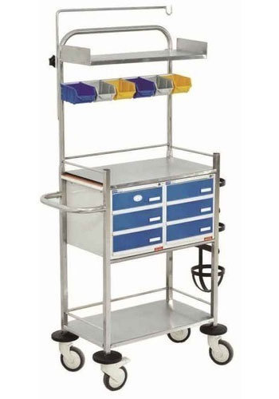
Definition
A cart stocked with emergency medical equipment, supplies, and drugs for use by medical personnel especially during efforts to resuscitate a patient experiencing cardiac arrest
3
Notes:
SAY: Before we wrap up the course, let’s review what we have learned today.
During this course, we have
<READ the bullets from the slide.>
GO to next slide.

Slide 4
About Crash Cart
A crash cart or code cart (crash trolley in UK medical jargon) or "MAX cart" is a set of trays/drawers/shelves on wheels used in hospitals for transportation and dispensing of emergency medication/equipment at site of medical/surgical emergency for life support protocols (ACLS/ALS) to potentially save someone's life.
●●●
4
Notes:
SAY:
The purpose of epidemiology in public health practice is to
discover the agent, host, and environmental factors that affect health;
determine the relative importance of causes of illness, disability, and death;
identify those segments of the population that have the greatest risk from specific causes of ill health; and
evaluate the effectiveness of health programs and services in improving population health.
GO to next slide.

Slide 5
About Crash Cart
The cart carries instruments for cardiopulmonary resuscitation and other medical supplies while also functioning as a support litter for the patient.
The crash cart was originally designed and patented by ECRI Institute founder, Joel J. Nobel, M.D., while a surgical resident at Philadelphia's Pennsylvania Hospital in 1965
●●●
5
Notes:
SAY:
The purpose of epidemiology in public health practice is to
discover the agent, host, and environmental factors that affect health;
determine the relative importance of causes of illness, disability, and death;
identify those segments of the population that have the greatest risk from specific causes of ill health; and
evaluate the effectiveness of health programs and services in improving population health.
GO to next slide.

Slide 6
About Crash Cart
MAX helped enhance hospital's efficiency in emergencies by enabling doctors and nurses to save time, thereby increasing the chances of saving a life.
The contents and organization of a crash cart vary from hospital to hospital, country to country, and specialty to specialty, but typically contain the tools and drugs needed to treat a person in or near cardiac arrest or another life-threatening condition.
6
Notes:
SAY:
The purpose of epidemiology in public health practice is to
discover the agent, host, and environmental factors that affect health;
determine the relative importance of causes of illness, disability, and death;
identify those segments of the population that have the greatest risk from specific causes of ill health; and
evaluate the effectiveness of health programs and services in improving population health.
GO to next slide.

Slide 7
Components of Crash Cart
Monitor/defibrillators, suction devices, and bag valve masks (BVMs) of different sizes
Advanced cardiac life support (ACLS) drugs such as epinephrine, atropine, amiodarone, lidocaine, sodium bicarbonate, dopamine, and vasopressin.
Drugs for peripheral and central venous access
●●●
7
Notes:
SAY:
The purpose of epidemiology in public health practice is to
discover the agent, host, and environmental factors that affect health;
determine the relative importance of causes of illness, disability, and death;
identify those segments of the population that have the greatest risk from specific causes of ill health; and
evaluate the effectiveness of health programs and services in improving population health.
GO to next slide.

Slide 8
Components of Crash Cart
First line drugs for treatment of common problems such as: adenosine, dextrose, epinephrine for IM use, naloxone, nitroglycerin, and others
Drugs for rapid sequence intubation: succinylcholine or another paralytic, and a sedative such as etomidate, propofol or midazolam; endotracheal tubes and other intubating equipment
8
Notes:
SAY:
The purpose of epidemiology in public health practice is to
discover the agent, host, and environmental factors that affect health;
determine the relative importance of causes of illness, disability, and death;
identify those segments of the population that have the greatest risk from specific causes of ill health; and
evaluate the effectiveness of health programs and services in improving population health.
GO to next slide.

Slide 9
History in the United States
The first cardiac crash cart was created in 1962 at Bethany Medical Center in Kansas City, Kansas, home to the first Cardiac Care Unit in the country.
The first crash cart was designed by a nurse and fabricated by the father of one of the doctors. It contained an Ambu bag, defibrillator paddles, a bed board and endotracheal tubes.
9
Notes:
SAY:
The purpose of epidemiology in public health practice is to
discover the agent, host, and environmental factors that affect health;
determine the relative importance of causes of illness, disability, and death;
identify those segments of the population that have the greatest risk from specific causes of ill health; and
evaluate the effectiveness of health programs and services in improving population health.
GO to next slide.

Slide 10
In computing
In the computer industry, the term crash cart is used, by analogy to its original meaning in medicine, to mean a cart that can be connected to a server that is malfunctioning so badly that remote access to it is impossible, the intention being to "resuscitate" the server to the point where remote administration works again.
●●●
10
Notes:
SAY:
The purpose of epidemiology in public health practice is to
discover the agent, host, and environmental factors that affect health;
determine the relative importance of causes of illness, disability, and death;
identify those segments of the population that have the greatest risk from specific causes of ill health; and
evaluate the effectiveness of health programs and services in improving population health.
GO to next slide.

Slide 11
In computing
Crash carts most commonly include a keyboard, mouse, and monitor, because most servers in a modern high-density environment do not have user input/output devices.
Crash carts are a method of last resort in data centers which employ various forms of out-of-band management.
●●●
11
Notes:
SAY:
The purpose of epidemiology in public health practice is to
discover the agent, host, and environmental factors that affect health;
determine the relative importance of causes of illness, disability, and death;
identify those segments of the population that have the greatest risk from specific causes of ill health; and
evaluate the effectiveness of health programs and services in improving population health.
GO to next slide.

Slide 12
In computing
In those cases it is used for equipment which does not support the requisite out-of-band infrastructure (OOBI) features or in cases where the OOBI devices (concentrators, switches, terminal servers, etc.) or services themselves have failed.
The term "crash cart" can also refer to a bootable removable medium containing an operating system and any relevant software used to recover computer equipment (such as a server or PC) from a state of failure.
●●●
12
Notes:
SAY:
The purpose of epidemiology in public health practice is to
discover the agent, host, and environmental factors that affect health;
determine the relative importance of causes of illness, disability, and death;
identify those segments of the population that have the greatest risk from specific causes of ill health; and
evaluate the effectiveness of health programs and services in improving population health.
GO to next slide.

Slide 13
In computing
This is done when such recovery is not possible using the computer's existing operating system and software.
Crash carts in this sense are historically tape cartridges ("carts") or more recently, external or removable hard drives.
13
Notes:
SAY:
The purpose of epidemiology in public health practice is to
discover the agent, host, and environmental factors that affect health;
determine the relative importance of causes of illness, disability, and death;
identify those segments of the population that have the greatest risk from specific causes of ill health; and
evaluate the effectiveness of health programs and services in improving population health.
GO to next slide.

Slide 14
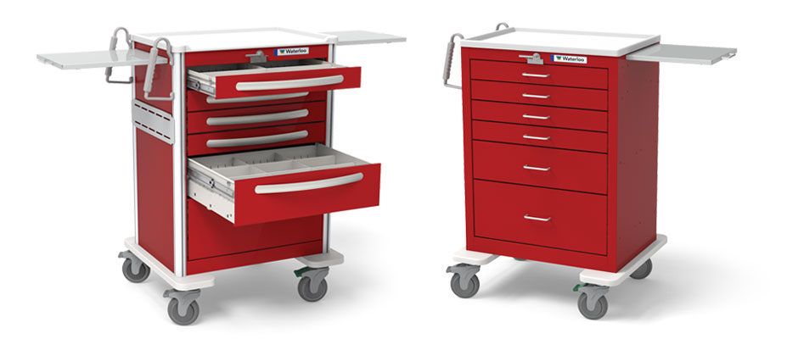
14
Notes:
SAY:
The purpose of epidemiology in public health practice is to
discover the agent, host, and environmental factors that affect health;
determine the relative importance of causes of illness, disability, and death;
identify those segments of the population that have the greatest risk from specific causes of ill health; and
evaluate the effectiveness of health programs and services in improving population health.
GO to next slide.

Slide 15
Conclusion
Crash cart is a hospital trolley which come in a variety of configurations like with wheels, numerous drawers, waist etc.
The medical crash cart is an essential hospital furniture in the medical field.
15
Notes:
SAY:
The purpose of epidemiology in public health practice is to
discover the agent, host, and environmental factors that affect health;
determine the relative importance of causes of illness, disability, and death;
identify those segments of the population that have the greatest risk from specific causes of ill health; and
evaluate the effectiveness of health programs and services in improving population health.
GO to next slide.

Slide 16
References
Google.com
Wikipedia.org
Studymafia.org
Slidespanda.com

Slide 17
Thanks To StudyMafia.org

