Slide 1
StudyMafia.Org
Chain Of
Infection
Submitted To: Submitted By:
Studymafia.org Studymafia.org

Slide 2
Table Contents
Definition
Introduction
Chain of Infection
Opportunities To Break the Chain of Infection
Conclusion
2
Notes:
SAY: Before we wrap up the course, let’s review what we have learned today.
During this course, we have
<READ the bullets from the slide.>
GO to next slide.

Slide 3
Definition
The chain of infection describes the complete process of an infection spreading from one host to the next.
3
Notes:
SAY: Before we wrap up the course, let’s review what we have learned today.
During this course, we have
<READ the bullets from the slide.>
GO to next slide.

Slide 4
Introduction
It is a six-step cycle that can be cut off at any step to break the transmission of infection. Studying and understanding this process can help societies fight and irradiate infectious diseases.
It can be helpful to think of the chain of infection as an actual chain, with each step making up a link in the chain.
4
Notes:
SAY: Before we wrap up the course, let’s review what we have learned today.
During this course, we have
<READ the bullets from the slide.>
GO to next slide.

Slide 5
5
Notes:
SAY:
The purpose of epidemiology in public health practice is to
discover the agent, host, and environmental factors that affect health;
determine the relative importance of causes of illness, disability, and death;
identify those segments of the population that have the greatest risk from specific causes of ill health; and
evaluate the effectiveness of health programs and services in improving population health.
GO to next slide.

Slide 6
Chain of Infection
The Infectious Agent – or the microorganism which has the ability to cause disease.
The Reservoir or source of infection where the microorganism can live and thrive. This may be a person, an animal, any object in the general environment, food or water.
●●●
6
Notes:
SAY:
The purpose of epidemiology in public health practice is to
discover the agent, host, and environmental factors that affect health;
determine the relative importance of causes of illness, disability, and death;
identify those segments of the population that have the greatest risk from specific causes of ill health; and
evaluate the effectiveness of health programs and services in improving population health.
GO to next slide.

Slide 7
Chain of Infection
The Portal of Exit from the reservoir.
This describes the way the microorganism leaves the reservoir. For example, in the case of a person with flu, this would include coughing and sneezing. In the case of someone with gastro-enteritis microorganisms would be transmitted in the faeces or vomit.
●●●
7
Notes:
SAY:
The purpose of epidemiology in public health practice is to
discover the agent, host, and environmental factors that affect health;
determine the relative importance of causes of illness, disability, and death;
identify those segments of the population that have the greatest risk from specific causes of ill health; and
evaluate the effectiveness of health programs and services in improving population health.
GO to next slide.

Slide 8
Chain of Infection
The Susceptible Host. This describes the person who is vulnerable to infection.Infection can be prevented by breaking the Chain of Infection. The chain of infection diagram illustrates and gives examples of actions that can be taken to break it.
●●●
8
Notes:
SAY:
The purpose of epidemiology in public health practice is to
discover the agent, host, and environmental factors that affect health;
determine the relative importance of causes of illness, disability, and death;
identify those segments of the population that have the greatest risk from specific causes of ill health; and
evaluate the effectiveness of health programs and services in improving population health.
GO to next slide.

Slide 9
Chain of Infection
Mode of Transmission. Since microorganisms cannot travel on their own, they require a vehicle to carry them to other persons and places.
Mode of Entry. The path for the microorganism to get into a new host (the reverse of the portal of exit). The mode of entry refers to the method by which the pathogens enters the person.
9
Notes:
SAY:
The purpose of epidemiology in public health practice is to
discover the agent, host, and environmental factors that affect health;
determine the relative importance of causes of illness, disability, and death;
identify those segments of the population that have the greatest risk from specific causes of ill health; and
evaluate the effectiveness of health programs and services in improving population health.
GO to next slide.

Slide 10
Opportunities To Break the
Chain of Infection
Transmission may be interrupted when:
the infectious agent is eliminated, inactivated or cannot exit the reservoir
the portals of exit are contained through safe infection control practices
the transmission between objects or people does not occur due to barriers
and safe infection control practices
the portals of entry are protected
other persons receiving health care are not susceptible.
●●●
10
Notes:
SAY:
The purpose of epidemiology in public health practice is to
discover the agent, host, and environmental factors that affect health;
determine the relative importance of causes of illness, disability, and death;
identify those segments of the population that have the greatest risk from specific causes of ill health; and
evaluate the effectiveness of health programs and services in improving population health.
GO to next slide.

Slide 11
Opportunities To Break the
Chain of Infection
To prevent and of viruses, WHO recommends employing basic hygiene principles through standard and transmission-based precaution.
Standard precautions include:
hand hygiene (5 Moments for Hand Hygiene);
use of personal protective equipment (PPE)
routine environment cleaning;
cough etiquette
aseptic technique
11
Notes:
SAY:
The purpose of epidemiology in public health practice is to
discover the agent, host, and environmental factors that affect health;
determine the relative importance of causes of illness, disability, and death;
identify those segments of the population that have the greatest risk from specific causes of ill health; and
evaluate the effectiveness of health programs and services in improving population health.
GO to next slide.

Slide 12
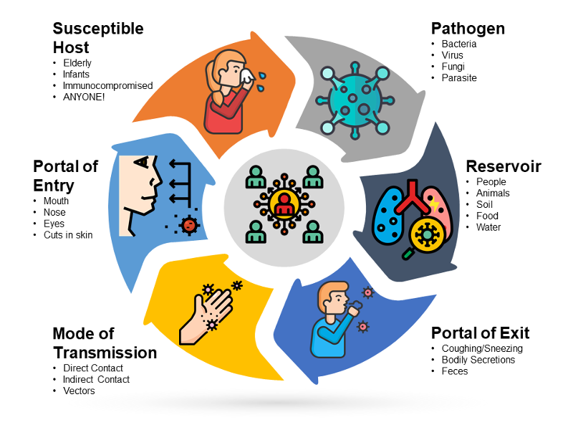

Slide 13
Conclusion
The six links include: the infectious agent, reservoir, portal of exit, mode of transmission, portal of entry, and susceptible host. The way to stop germs from spreading is by interrupting this chain at any link.
13
Notes:
SAY:
The purpose of epidemiology in public health practice is to
discover the agent, host, and environmental factors that affect health;
determine the relative importance of causes of illness, disability, and death;
identify those segments of the population that have the greatest risk from specific causes of ill health; and
evaluate the effectiveness of health programs and services in improving population health.
GO to next slide.

Slide 14
References
Google.com
Wikipedia.org
Studymafia.org
Slidespanda.com

Slide 15
Thanks To StudyMafia.org

