Slide 1
StudyMafia.Org
Brain Computer
Interfaces(BCI)
Submitted To: Submitted By:
Studymafia.org Studymafia.org

Slide 2
Table Contents
Definition
Introduction
Types of BCI
Components of BCI
Advantages of BCI
Disadvantages of BCI
Conclusion
2
Notes:
SAY: Before we wrap up the course, let’s review what we have learned today.
During this course, we have
<READ the bullets from the slide.>
GO to next slide.

Slide 3
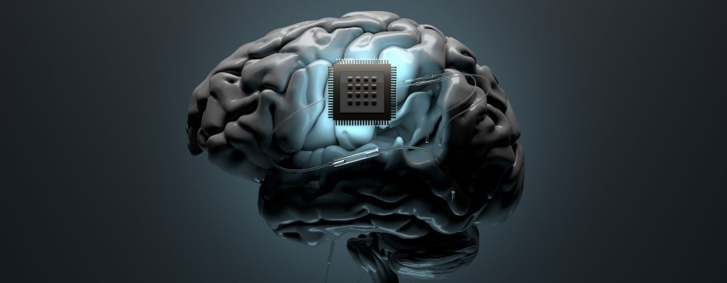
Definition
Brain-computer interfaces (BCI) are systems that allow communication between the brain and various machines.
3
Notes:
SAY: Before we wrap up the course, let’s review what we have learned today.
During this course, we have
<READ the bullets from the slide.>
GO to next slide.

Slide 4
Introduction
They work in three main steps: collecting brain signals, interpreting them and outputting commands to a connected machine according to the brain signal received.
BCI can be applied to a variety of tasks, including but not limited to neurofeedback, restoring motor function to paralyzed patients, allowing communication with locked in patients and improving sensory processing.
4
Notes:
SAY: Before we wrap up the course, let’s review what we have learned today.
During this course, we have
<READ the bullets from the slide.>
GO to next slide.

Slide 5
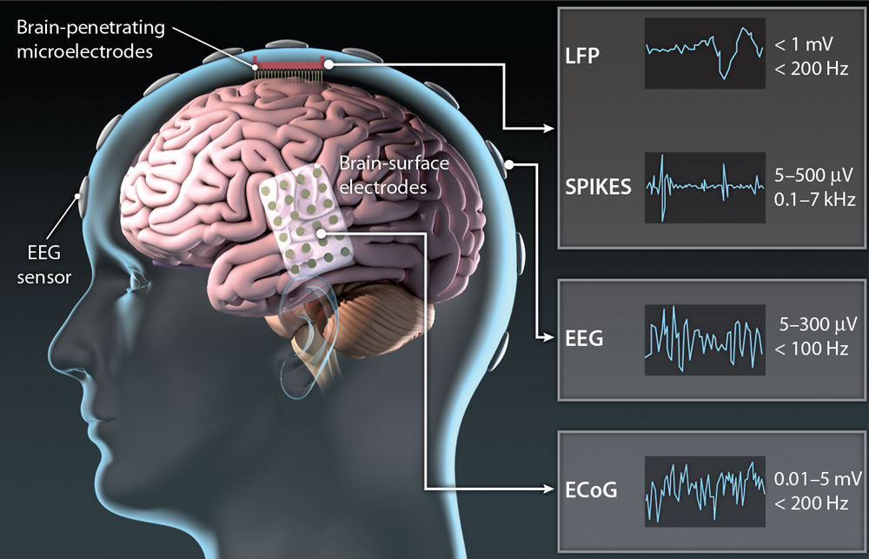
5
Notes:
SAY:
The purpose of epidemiology in public health practice is to
discover the agent, host, and environmental factors that affect health;
determine the relative importance of causes of illness, disability, and death;
identify those segments of the population that have the greatest risk from specific causes of ill health; and
evaluate the effectiveness of health programs and services in improving population health.
GO to next slide.

Slide 6
Types of BCI
Invasive
Invasive types of BCI are implanted directly into the brain during a neurosurgery. There are single unit BCIs, which detect the signal from a single area of brain cells, and multiunit BCIs which detect from multiple areas.
Electrodes have different lengths, for example, up to 1.5 mm (Utah, Blackrock Microsystems) or 10 mm (FMA, MicroProbes) in a MEA.
●●●
6
Notes:
SAY:
The purpose of epidemiology in public health practice is to
discover the agent, host, and environmental factors that affect health;
determine the relative importance of causes of illness, disability, and death;
identify those segments of the population that have the greatest risk from specific causes of ill health; and
evaluate the effectiveness of health programs and services in improving population health.
GO to next slide.

Slide 7
Types of BCI
Semi-Invasive
Electrocorticography uses electrodes placed on the exposed surface of the brain to measure electrical activity from the cerebral cortex. It has been used for the first time in the 1950s at the Montreal Neurological Institute.
It is called semi-invasive but it still requires a craniotomy to implant the electrodes. For this reason it is used only when surgery is necessary for medical reasons
●●●
7
Notes:
SAY:
The purpose of epidemiology in public health practice is to
discover the agent, host, and environmental factors that affect health;
determine the relative importance of causes of illness, disability, and death;
identify those segments of the population that have the greatest risk from specific causes of ill health; and
evaluate the effectiveness of health programs and services in improving population health.
GO to next slide.

Slide 8
Types of BCI
Non Invasive
There are several non-invasive techniques used to study the brain, where EEG is the most common used because of the cost and hardware portability.
MEG magnetoencephalography
PET positron emission tomography
fMRI functional magnetic resonance imaging
8
Notes:
SAY:
The purpose of epidemiology in public health practice is to
discover the agent, host, and environmental factors that affect health;
determine the relative importance of causes of illness, disability, and death;
identify those segments of the population that have the greatest risk from specific causes of ill health; and
evaluate the effectiveness of health programs and services in improving population health.
GO to next slide.

Slide 9
Components of BCI
Brain activity
The nervous system is composed by two main parts: the central nervous system and the peripheral nervous system.
The brain is the main organ of the central nervous system and it contains about 100 billions of neurons and trillions of cells called glia.
●●●
9
Notes:
SAY:
The purpose of epidemiology in public health practice is to
discover the agent, host, and environmental factors that affect health;
determine the relative importance of causes of illness, disability, and death;
identify those segments of the population that have the greatest risk from specific causes of ill health; and
evaluate the effectiveness of health programs and services in improving population health.
GO to next slide.

Slide 10
Components of BCI
Signal acquisition
In the case of EEG-BCI, the electric potential of the brain activity is measured through electrodes placed on the scalp.
Electrodes are metal discs placed on the scap in positions measured using the International 10/20 system.
●●●
10
Notes:
SAY:
The purpose of epidemiology in public health practice is to
discover the agent, host, and environmental factors that affect health;
determine the relative importance of causes of illness, disability, and death;
identify those segments of the population that have the greatest risk from specific causes of ill health; and
evaluate the effectiveness of health programs and services in improving population health.
GO to next slide.

Slide 11
Components of BCI
Preprocessing
The raw EEG data is often not clean because affected by noise and artifacts. There are four main sources of noise and artifacts, which are:
EEG equipment
Electrical interference external to the subject and recording system
The leads and electrodes
The subject: electrical activity from the heart, eye blinking, eyeball movements, muscles movements in general.
●●●
11
Notes:
SAY:
The purpose of epidemiology in public health practice is to
discover the agent, host, and environmental factors that affect health;
determine the relative importance of causes of illness, disability, and death;
identify those segments of the population that have the greatest risk from specific causes of ill health; and
evaluate the effectiveness of health programs and services in improving population health.
GO to next slide.

Slide 12
Components of BCI
Feature Extraction
The next step is feature extraction: the analysis of the signal and extraction of information. As the EEG signal is very complex, it is impossible to find meaningful information just looking at it.
It is needed then to apply processing algorithms which allows to find content (such as a person’s intent, for example) which would be hidden at a naked eye.
●●●
12
Notes:
SAY:
The purpose of epidemiology in public health practice is to
discover the agent, host, and environmental factors that affect health;
determine the relative importance of causes of illness, disability, and death;
identify those segments of the population that have the greatest risk from specific causes of ill health; and
evaluate the effectiveness of health programs and services in improving population health.
GO to next slide.

Slide 13
Components of BCI
Classification
Another step which can be applied to the signal, now mostly clean from artifacts, is to apply classification algorithms.
Using machine learning techniques it is possible to train a classifier to recognize which features, for example, belongs to one or another class.
●●●
13
Notes:
SAY:
The purpose of epidemiology in public health practice is to
discover the agent, host, and environmental factors that affect health;
determine the relative importance of causes of illness, disability, and death;
identify those segments of the population that have the greatest risk from specific causes of ill health; and
evaluate the effectiveness of health programs and services in improving population health.
GO to next slide.

Slide 14
Components of BCI
Translation
After the signal has been classified, the result is passed to the feature translation algorithm.
At this point the features need to be translated in the corresponding action required. “For example, a P3 potential could be translated into the selection of the letter that evoked it”
●●●
14
Notes:
SAY:
The purpose of epidemiology in public health practice is to
discover the agent, host, and environmental factors that affect health;
determine the relative importance of causes of illness, disability, and death;
identify those segments of the population that have the greatest risk from specific causes of ill health; and
evaluate the effectiveness of health programs and services in improving population health.
GO to next slide.

Slide 15
Components of BCI
Feedback device
The feedback device receives the command from the translation step.
For example it can be the computer, where the signal will be used to move a cursor, or it could
15
Notes:
SAY:
The purpose of epidemiology in public health practice is to
discover the agent, host, and environmental factors that affect health;
determine the relative importance of causes of illness, disability, and death;
identify those segments of the population that have the greatest risk from specific causes of ill health; and
evaluate the effectiveness of health programs and services in improving population health.
GO to next slide.

Slide 18
Conclusion
A brain-computer interface (BCI) is a computer-based system that acquires brain signals, analyzes them, and translates them into commands that are relayed to an output device to carry out a desired action.
18
Notes:
SAY:
The purpose of epidemiology in public health practice is to
discover the agent, host, and environmental factors that affect health;
determine the relative importance of causes of illness, disability, and death;
identify those segments of the population that have the greatest risk from specific causes of ill health; and
evaluate the effectiveness of health programs and services in improving population health.
GO to next slide.

Slide 19
References
Google.com
Wikipedia.org
Studymafia.org
Slidespanda.com

Slide 20
Thanks To StudyMafia.org

