Slide 1
StudyMafia.Org
Tonsillectomy
Submitted To: Submitted By:
Studymafia.org Studymafia.org

Slide 2
Table Contents
Definition
Introduction
About Tonsillitis
Symptoms of Tonsillectomy
Complications of Tonsillectomy
Risks of Tonsillectomy
Preaparation of Tonsillectomy
Procedure of Tonsillectomy
Conclusion
2
Notes:
SAY: Before we wrap up the course, let’s review what we have learned today.
During this course, we have
<READ the bullets from the slide.>
GO to next slide.

Slide 3
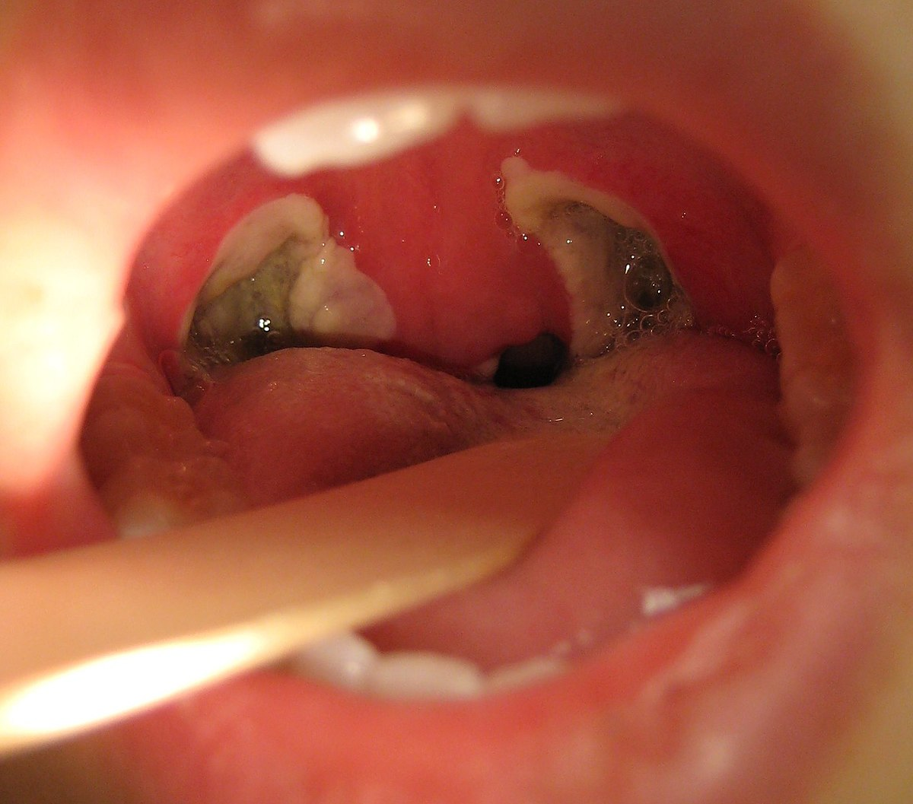
Definition
Tonsillectomy (ton-sih-LEK-tuh-me) is the surgical removal of the tonsils, two oval-shaped pads of tissue at the back of the throat — one tonsil on each side.
3
Notes:
SAY: Before we wrap up the course, let’s review what we have learned today.
During this course, we have
<READ the bullets from the slide.>
GO to next slide.

Slide 4
Introduction
A tonsillectomy was once a common procedure to treat infection and inflammation of the tonsils (tonsillitis).
Today, a tonsillectomy is usually performed for sleep-disordered breathing but may still be a treatment when tonsillitis occurs frequently or doesn't respond to other treatments.
A tonsillectomy may also be necessary to treat breathing and other problems related to enlarged tonsils and to treat rare diseases of the tonsils.
4
Notes:
SAY: Before we wrap up the course, let’s review what we have learned today.
During this course, we have
<READ the bullets from the slide.>
GO to next slide.

Slide 5
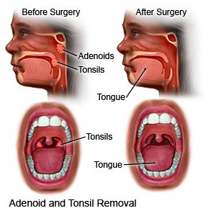
5
Notes:
SAY: Before we wrap up the course, let’s review what we have learned today.
During this course, we have
<READ the bullets from the slide.>
GO to next slide.

Slide 6
About Tonsillitis
The tonsils are the immune system's first line of defense against bacteria and viruses that enter your mouth.
This function may make the tonsils particularly vulnerable to infection and inflammation.
However, the tonsil's immune system function declines after puberty — a factor that may account for the rare cases of tonsillitis in adults.
●●●
6
Notes:
SAY:
The purpose of epidemiology in public health practice is to
discover the agent, host, and environmental factors that affect health;
determine the relative importance of causes of illness, disability, and death;
identify those segments of the population that have the greatest risk from specific causes of ill health; and
evaluate the effectiveness of health programs and services in improving population health.
GO to next slide.

Slide 7
About Tonsillitis
A tonsillectomy may be recommended to prevent frequent, recurring episodes of tonsillitis. Frequent tonsillitis is generally defined as:
At least seven episodes in the preceding year
At least five episodes a year in the past two years
At least three episodes a year in the past three years
7
Notes:
SAY:
The purpose of epidemiology in public health practice is to
discover the agent, host, and environmental factors that affect health;
determine the relative importance of causes of illness, disability, and death;
identify those segments of the population that have the greatest risk from specific causes of ill health; and
evaluate the effectiveness of health programs and services in improving population health.
GO to next slide.

Slide 8
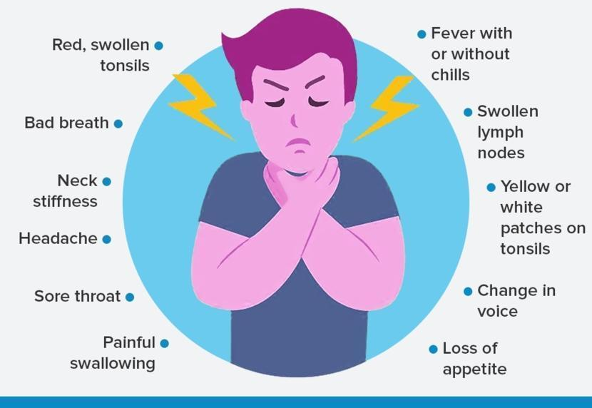
Symptoms of Tonsillitis
8
Notes:
SAY:
The purpose of epidemiology in public health practice is to
discover the agent, host, and environmental factors that affect health;
determine the relative importance of causes of illness, disability, and death;
identify those segments of the population that have the greatest risk from specific causes of ill health; and
evaluate the effectiveness of health programs and services in improving population health.
GO to next slide.

Slide 9
Complications of Tonsillectomy
Tonsils may become enlarged after frequent or persistent infections, or they may be naturally large. A tonsillectomy may be used to treat the following problems caused or complicated by enlarged tonsils:
Difficulty breathing
Disrupted breathing during sleep (obstructive sleep apnea)
●●●
9
Notes:
SAY:
The purpose of epidemiology in public health practice is to
discover the agent, host, and environmental factors that affect health;
determine the relative importance of causes of illness, disability, and death;
identify those segments of the population that have the greatest risk from specific causes of ill health; and
evaluate the effectiveness of health programs and services in improving population health.
GO to next slide.

Slide 10
Complications of Tonsillectomy
A tonsillectomy may also be used to treat other rare diseases or conditions of the tonsils, such as
Cancerous tissue (malignancy) in one or both tonsils or suspected malignancy
Recurrent bleeding from blood vessels near the surface of the tonsils
Severe bad breath (halitosis) related to debris in the crevices of tonsils
10
Notes:
SAY:
The purpose of epidemiology in public health practice is to
discover the agent, host, and environmental factors that affect health;
determine the relative importance of causes of illness, disability, and death;
identify those segments of the population that have the greatest risk from specific causes of ill health; and
evaluate the effectiveness of health programs and services in improving population health.
GO to next slide.

Slide 11
Risks of Tonsillectomy
Reactions to anesthetics:
to make you sleep during surgery often causes minor, short-term problems, such as headache, nausea, vomiting or muscle soreness.
Serious, long-term problems are rare, though general anesthesia is not without the risk of death.
●●●
11
Notes:
SAY:
The purpose of epidemiology in public health practice is to
discover the agent, host, and environmental factors that affect health;
determine the relative importance of causes of illness, disability, and death;
identify those segments of the population that have the greatest risk from specific causes of ill health; and
evaluate the effectiveness of health programs and services in improving population health.
GO to next slide.

Slide 12
Risks of Tonsillectomy
Swelling.
Swelling of the tongue and soft roof of the mouth (soft palate) can cause breathing problems, particularly during the first few hours after the procedure.
Bleeding during surgery.
In rare cases, severe bleeding occurs during surgery and requires additional treatment and a longer hospital stay.
●●●
12
Notes:
SAY:
The purpose of epidemiology in public health practice is to
discover the agent, host, and environmental factors that affect health;
determine the relative importance of causes of illness, disability, and death;
identify those segments of the population that have the greatest risk from specific causes of ill health; and
evaluate the effectiveness of health programs and services in improving population health.
GO to next slide.

Slide 13
Risks of Tonsillectomy
Bleeding during healing.
Bleeding can occur during the healing process, particularly if the scab from the wound is dislodged too soon.
Infection.
Rarely, surgery can lead to an infection that requires further treatment.
13
Notes:
SAY:
The purpose of epidemiology in public health practice is to
discover the agent, host, and environmental factors that affect health;
determine the relative importance of causes of illness, disability, and death;
identify those segments of the population that have the greatest risk from specific causes of ill health; and
evaluate the effectiveness of health programs and services in improving population health.
GO to next slide.

Slide 14
Preparation of Tonsillectomy
Information you'll likely be asked to provide includes:
All medications, including over-the-counter drugs and dietary supplements, taken regularly
Personal or family history of adverse reactions to anesthetics
Personal or family history of bleeding disorders
Known allergy or other negative reactions to medications, such as antibiotics
●●●
14
Notes:
SAY:
The purpose of epidemiology in public health practice is to
discover the agent, host, and environmental factors that affect health;
determine the relative importance of causes of illness, disability, and death;
identify those segments of the population that have the greatest risk from specific causes of ill health; and
evaluate the effectiveness of health programs and services in improving population health.
GO to next slide.

Slide 15
Preparation of Tonsillectomy
Instructions for preparing will include the following:
Your doctor may ask you to stop taking some medications or change dosages of medications several days before the surgery.
Don't eat anything after midnight before the scheduled surgery.
Make arrangements for a ride home.
Plan for 10 days to two weeks or more of recovery time. Adults may need more time than children do.
●●●
15
Notes:
SAY:
The purpose of epidemiology in public health practice is to
discover the agent, host, and environmental factors that affect health;
determine the relative importance of causes of illness, disability, and death;
identify those segments of the population that have the greatest risk from specific causes of ill health; and
evaluate the effectiveness of health programs and services in improving population health.
GO to next slide.

Slide 16
Preparation of Tonsillectomy
Questions to ask your doctor or the hospital staff for yourself or on behalf of your child include:
What are my dietary restrictions before surgery?
When should I arrive at the hospital?
Where do I need to check in?
What prescription medications can I take in the days before surgery? When can I take the last dose?
What is the expected recovery time?
What restrictions to activities or diet should I expect during recovery?
16
Notes:
SAY:
The purpose of epidemiology in public health practice is to
discover the agent, host, and environmental factors that affect health;
determine the relative importance of causes of illness, disability, and death;
identify those segments of the population that have the greatest risk from specific causes of ill health; and
evaluate the effectiveness of health programs and services in improving population health.
GO to next slide.

Slide 17
Procedure of Tonsillectomy
A tonsillectomy is used to treat:
Recurring, chronic or severe tonsillitis
Complications of enlarged tonsils
Bleeding of the tonsils
Other rare diseases of the tonsils
The procedure may also be recommended if:
A bacterial infection causing tonsillitis doesn't improve with antibiotic treatment
An infection that results in a collection of pus behind a tonsil.
●●●
17
Notes:
SAY:
The purpose of epidemiology in public health practice is to
discover the agent, host, and environmental factors that affect health;
determine the relative importance of causes of illness, disability, and death;
identify those segments of the population that have the greatest risk from specific causes of ill health; and
evaluate the effectiveness of health programs and services in improving population health.
GO to next slide.

Slide 18
Procedure of Tonsillectomy
Before the procedure
A nurse may use a pre-surgery checklist of questions, such as asking you to say your name and the reason for your surgery. This is a standard procedure to ensure the safety of patients.
●●●
18
Notes:
SAY:
The purpose of epidemiology in public health practice is to
discover the agent, host, and environmental factors that affect health;
determine the relative importance of causes of illness, disability, and death;
identify those segments of the population that have the greatest risk from specific causes of ill health; and
evaluate the effectiveness of health programs and services in improving population health.
GO to next slide.

Slide 19
Procedure of Tonsillectomy
During the procedure
Because a tonsillectomy is performed under general anesthesia, you or your child won't be aware of the procedure or experience pain during the surgery.
The surgeon may cut out the tonsils using a blade (scalpel) or a specialized surgical tool that uses heat or high-energy heat or sound waves to remove or destroy tissues and stop bleeding.
●●●
19
Notes:
SAY:
The purpose of epidemiology in public health practice is to
discover the agent, host, and environmental factors that affect health;
determine the relative importance of causes of illness, disability, and death;
identify those segments of the population that have the greatest risk from specific causes of ill health; and
evaluate the effectiveness of health programs and services in improving population health.
GO to next slide.

Slide 20
Procedure of Tonsillectomy
After the procedure
Common issues after a tonsillectomy include the following:
Moderate to severe pain in the throat for one to two weeks
Pain in the ears, neck or jaw
Nausea and vomiting for a few days
Mild fever for several days
Bad breath for up to two weeks
20
Notes:
SAY:
The purpose of epidemiology in public health practice is to
discover the agent, host, and environmental factors that affect health;
determine the relative importance of causes of illness, disability, and death;
identify those segments of the population that have the greatest risk from specific causes of ill health; and
evaluate the effectiveness of health programs and services in improving population health.
GO to next slide.

Slide 21
Conclusion
Tonsillectomies to treat recurring bacterial tonsillitis reduce the frequency and severity of strep throat and other bacterial infections. Tonsillectomies to treat viral tonsillitis have a smaller benefit.
Tonsillectomies to treat obstructive sleep apnea and other conditions not related to infections can improve outcomes when other treatment strategies have not been beneficial.
21
Notes:
SAY:
The purpose of epidemiology in public health practice is to
discover the agent, host, and environmental factors that affect health;
determine the relative importance of causes of illness, disability, and death;
identify those segments of the population that have the greatest risk from specific causes of ill health; and
evaluate the effectiveness of health programs and services in improving population health.
GO to next slide.

Slide 22
Thanks To StudyMafia.org

