Slide 1
StudyMafia.Org
Temporomandibular
Joint
Submitted To: Submitted By:
Studymafia.org Studymafia.org

Slide 2
Content
Introduction
Symptoms
When to see a Doctor?
Diagnosis
Treatment
Procedure
Conclusion

Slide 3
Introduction
The temporomandibular (tem-puh-roe-man-DIB-u-lur) joint (TMJ) acts like a sliding hinge, connecting your jawbone to your skull. You have one joint on each side of your jaw.
TMJ disorders — a type of temporomandibular disorder or TMD — can cause pain in your jaw joint and in the muscles that control jaw movement.

Slide 4
The exact cause of a person's TMJ disorder is often difficult to determine. Your pain may be due to a combination of factors, such as genetics, arthritis or jaw injury.
Some people who have jaw pain also tend to clench or grind their teeth (bruxism), although many people habitually clench or grind their teeth and never develop TMJ disorders.

Slide 5
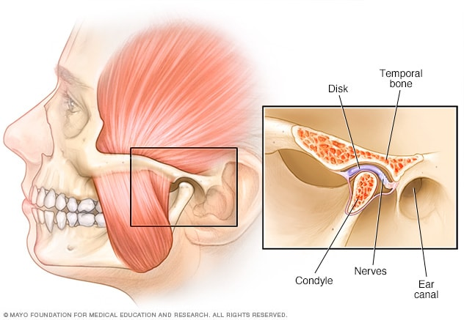
In most cases, the pain and discomfort associated with TMJ disorders is temporary and can be relieved with self-managed care or nonsurgical treatments.
Surgery is typically a last resort after conservative measures have failed, but some people with TMJ disorders may benefit from surgical treatments.

Slide 6
Symptoms
Signs and symptoms of TMJ disorders may include:
Pain or tenderness of your jaw
Pain in one or both of the temporomandibular joints
Aching pain in and around your ear
Difficulty chewing or pain while chewing
Aching facial pain

Slide 7
Locking of the joint, making it difficult to open or close your mouth
TMJ disorders can also cause a clicking sound or grating sensation when you open your mouth or chew.
But if there's no pain or limitation of movement associated with your jaw clicking, you probably don't need treatment for a TMJ disorder.

Slide 8
When to see a Doctor?
Seek medical attention if you have persistent pain or tenderness in your jaw, or if you can't open or close your jaw completely.
Your doctor, your dentist or a TMJ specialist can discuss possible causes and treatments for your problem.

Slide 9
Diagnosis
Your doctor or dentist will discuss your symptoms and examine your jaw. He or she will probably:
Listen to and feel your jaw when you open and close your mouth
Observe the range of motion in your jaw
Press on areas around your jaw to identify sites of pain or discomfort
If your doctor or dentist suspects a problem, you may need:

Slide 10
Dental X-rays to examine your teeth and jaw
CT scan to provide detailed images of the bones involved in the joint
MRI to reveal problems with the joint's disk or surrounding soft tissue
TMJ arthroscopy is sometimes used in the diagnosis of a TMJ disorder.
During TMJ arthroscopy, your doctor inserts a small thin tube (cannula) into the joint space, and a small camera (arthroscope) is then inserted to view the area and to help determine a diagnosis.

Slide 11
Treatment
In some cases, the symptoms of TMJ disorders may go away without treatment. If your symptoms persist, your doctor may recommend a variety of treatment options, often more than one to be done at the same time.
Medications
Therapies
Surgical or other procedures

Slide 12
Medications
Along with other nonsurgical treatments, these medication options may help relieve the pain associated with TMJ disorders:
Pain relievers and anti-inflammatories
If over-the-counter pain medications aren't enough to relieve TMJ pain, your doctor or dentist may prescribe stronger pain relievers for a limited time, such as prescription strength ibuprofen.
Tricyclic antidepressants
These medications, such as amitriptyline, are used mostly for depression, but in low doses, they're sometimes used for pain relief, bruxism control and sleeplessness.
Muscle relaxants
These types of drugs are sometimes used for a few days or weeks to help relieve pain caused by TMJ disorders created by muscle spasms.

Slide 13
Therapies
Oral splints or mouth guards (occlusal appliances)
Often, people with jaw pain will benefit from wearing a soft or firm device inserted over their teeth, but the reasons why these devices are beneficial are not well-understood.
Physical therapy
Along with exercises to stretch and strengthen jaw muscles, treatments might include ultrasound, moist heat and ice.
Counseling
Education and counseling can help you understand the factors and behaviors that may aggravate your pain, so you can avoid them. Examples include teeth clenching or grinding, leaning on your chin, or biting fingernails.

Slide 14
Surgical or other procedures
Arthrocentesis. Arthrocentesis (ahr-throe-sen-TEE-sis) is a minimally invasive procedure that involves the insertion of small needles into the joint so that fluid can be irrigated through the joint to remove debris and inflammatory byproducts.
Injections. In some people, corticosteroid injections into the joint may be helpful. Infrequently, injecting botulinum toxin type A (Botox, others) into the jaw muscles used for chewing may relieve pain associated with TMJ disorders.

Slide 15
TMJ arthroscopy. In some cases, arthroscopic surgery can be as effective for treating various types of TMJ disorders as open-joint surgery. A small thin tube (cannula) is placed into the joint space, an arthroscope is then inserted and small surgical instruments are used for surgery. TMJ arthroscopy has fewer risks and complications than open-joint surgery does, but it has some limitations as well.
Modified condylotomy. Modified condylotomy (kon-dih-LOT-uh-mee) addresses the TMJ indirectly, with surgery on the mandible, but not in the joint itself. It may be helpful for treatment of pain and if locking is experienced.

Slide 16
Open-joint surgery. If your jaw pain does not resolve with more-conservative treatments and it appears to be caused by a structural problem in the joint, your doctor or dentist may suggest open-joint surgery (arthrotomy) to repair or replace the joint. However, open-joint surgery involves more risks than other procedures do and should be considered very carefully, after discussing the pros and cons.
If your doctor recommends surgery or other procedures, be sure to discuss the potential benefits and risks, and ask what all your options are.

Slide 17
References
Google.com
Wikipedia.org
Studymafia.org
Slidespanda.com

Slide 18
Thanks To StudyMafia.org

