Slide 1
StudyMafia.Org
Plant Tissues
Submitted To: Submitted By:
Studymafia.org Studymafia.org

Slide 2
Plant Tissues: Overview
Meristems, Simple Tissues, & Complex Tissues

Slide 3
Meristematic tissues – localized regions of cell division
Apical Meristems
Primary or Transitional Meristem ➔ Primary growth
Protoderm ➔ gives rise to epidermis
Ground meristem ➔ gives rise to ground tissue
Procambium ➔ gives rise to 1º vascular tissue
Lateral Meristems
Vascular cambium ➔ 2º vascular tissue
Cork cambium or phellogen ➔ periderm
Intercalary Meristems (found in the nodes of grasses)

Slide 4
Cell Division: Mitosis (nuclear division) + Cytokinesis (cytoplasmic division)
Interphase
Prophase
Metaphase
Anaphase
Telophase
Cytokinesis
Illustration from: http://biology.nebrwesleyan.edu/benham/mitosis/

Slide 5
Shoot Apical Meristem

Slide 6
Root Apical Meristem
Root cap initials
Protoderm
Ground meristem
Procambium
Root cap

Slide 7
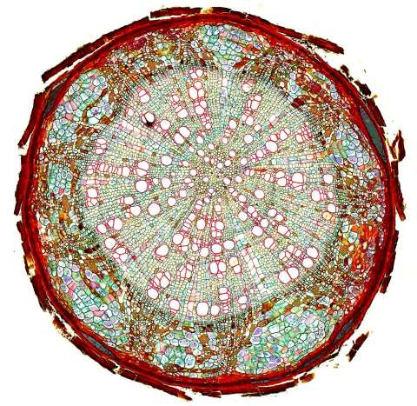
Lateral Meristems – secondary growth in woody plants
Basswood – stem in cross section; 1, 2, 3 year old stems
Basswood – root in cross section

Slide 8
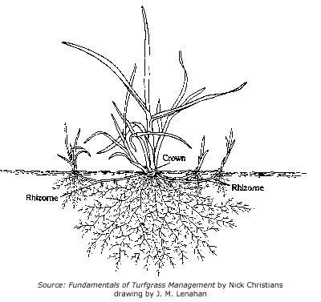
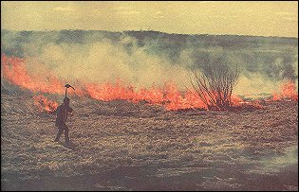
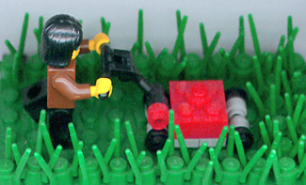
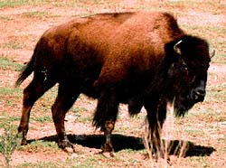
Intercalary Meristems in Grasses
http://www2.mcdaniel.edu/Biology/wildamerica/grasslands/graslandoutline.html

Slide 9
Simple Tissues – consisting of one cell type
Parenchyma – thin walled & alive at maturity; often multifaceted.
Collenchyma – thick walled & alive at maturity
Sclerenchyma – thick walled and dead at maturity
Sclerids or stone cells – cells as long as they are wide
Fibers – cells longer than they are wide
Epidermis – alive at maturity
Trichomes – “pubescence” or hairs on epidermis
Root Hairs – tubular extensions of epidermal cells

Slide 10
Parenchyma

Slide 11
Collenchyma

Slide 12
Sclerenchyma
SCLERIDS
FIBERS
Right-hand illustration modified from: Weier, Stocking & Barbour, 1974, Botany: An Introduction to Plant Biology, 5th Ed.

Slide 13
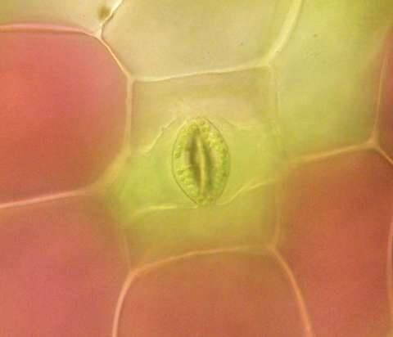
Epidermis – stoma, trichomes, & root hairs
http://www.ucd.ie/botany/Steer/hair/roothairs.html

Slide 14
Complex Tissue
Xylem – water conducting tissue; parenchyma, fibers, vessels and/or tracheids, and ray cells.
Phloem food conducting tissue; sieve-tube members (no nucleus at maturity, cytoplasm present), companion cells, fibers, parenchyma, and ray cells. In flowering plants, sieve-tube members and companion cells arise from the same mother cell.
Periderm – protective covering; composed of cork and parenchyma.
Secretory structures – responsible for making latex, resins, nectar and other substances produced and stored in channels inside the plant body.

Slide 15
Xylem

Slide 16
Phloem

Slide 17
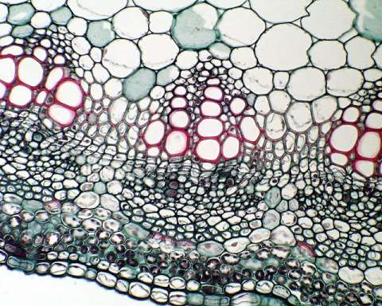
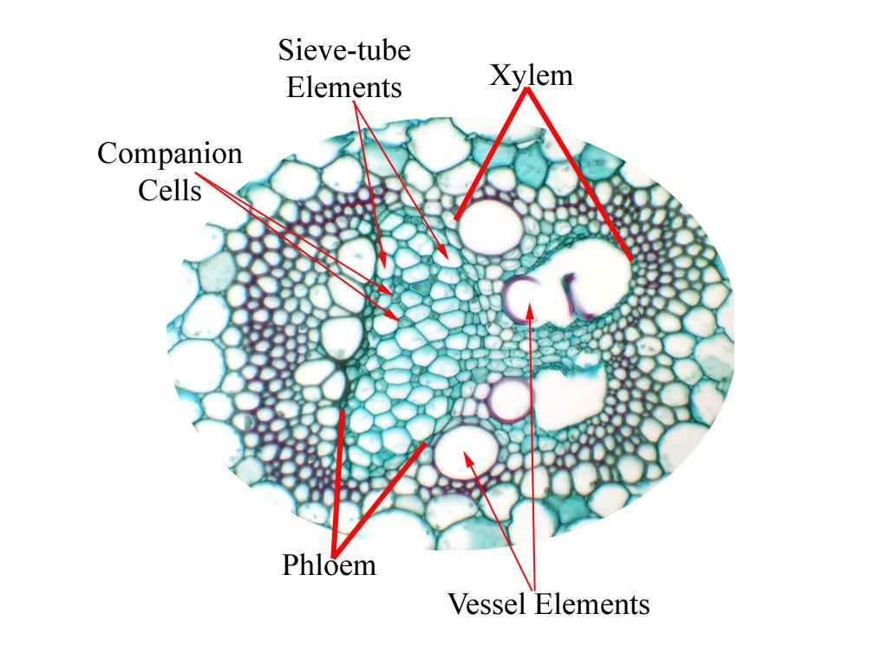
Vascular Bundles with xylem & phloem
Maize or Corn – vein in cross section
Alfalfa – vein in cross section

Slide 18
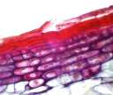
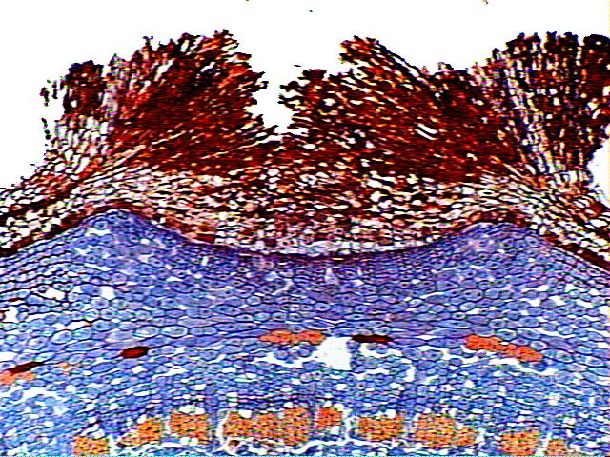
Periderm – cork & parenchyma
TWIG WITH LENTICELS

Slide 19
Secretory Structures
nectar (flowers) from nectaries
oils (peanuts, oranges, citrus) from accumulation of glands and elaioplasts.
resins (conifers) from resin canals
lacticifers (e.g., latex - milkweed, rubber plants, opium poppy)
hydathodes (openings for secretion of water)
digestive glands of carnivorous plants (enzymes)
salt glands that shed salt (especial in plants adapted to environments laden with salt).

Slide 20
References
Google.com
Wikipedia.org
Studymafia.org
Slidespanda.com

Slide 21
Thanks To StudyMafia.org

