Slide 1
StudyMafia.Org
Ophthalmia
Neonatorum
Submitted To: Submitted By:
Studymafia.org Studymafia.org

Slide 2
Table Contents
Definition
Introduction
Symptoms of Ophthalmia Neonatorum
Types of Ophthalmia Neonatorum
Causes of Ophthalmia Neonatorum
Risk-Factors of Ophthalmia Neonatorum
Diagnosis of Ophthalmia Neonatorum
Conclusion
2
Notes:
SAY: Before we wrap up the course, let’s review what we have learned today.
During this course, we have
<READ the bullets from the slide.>
GO to next slide.

Slide 3
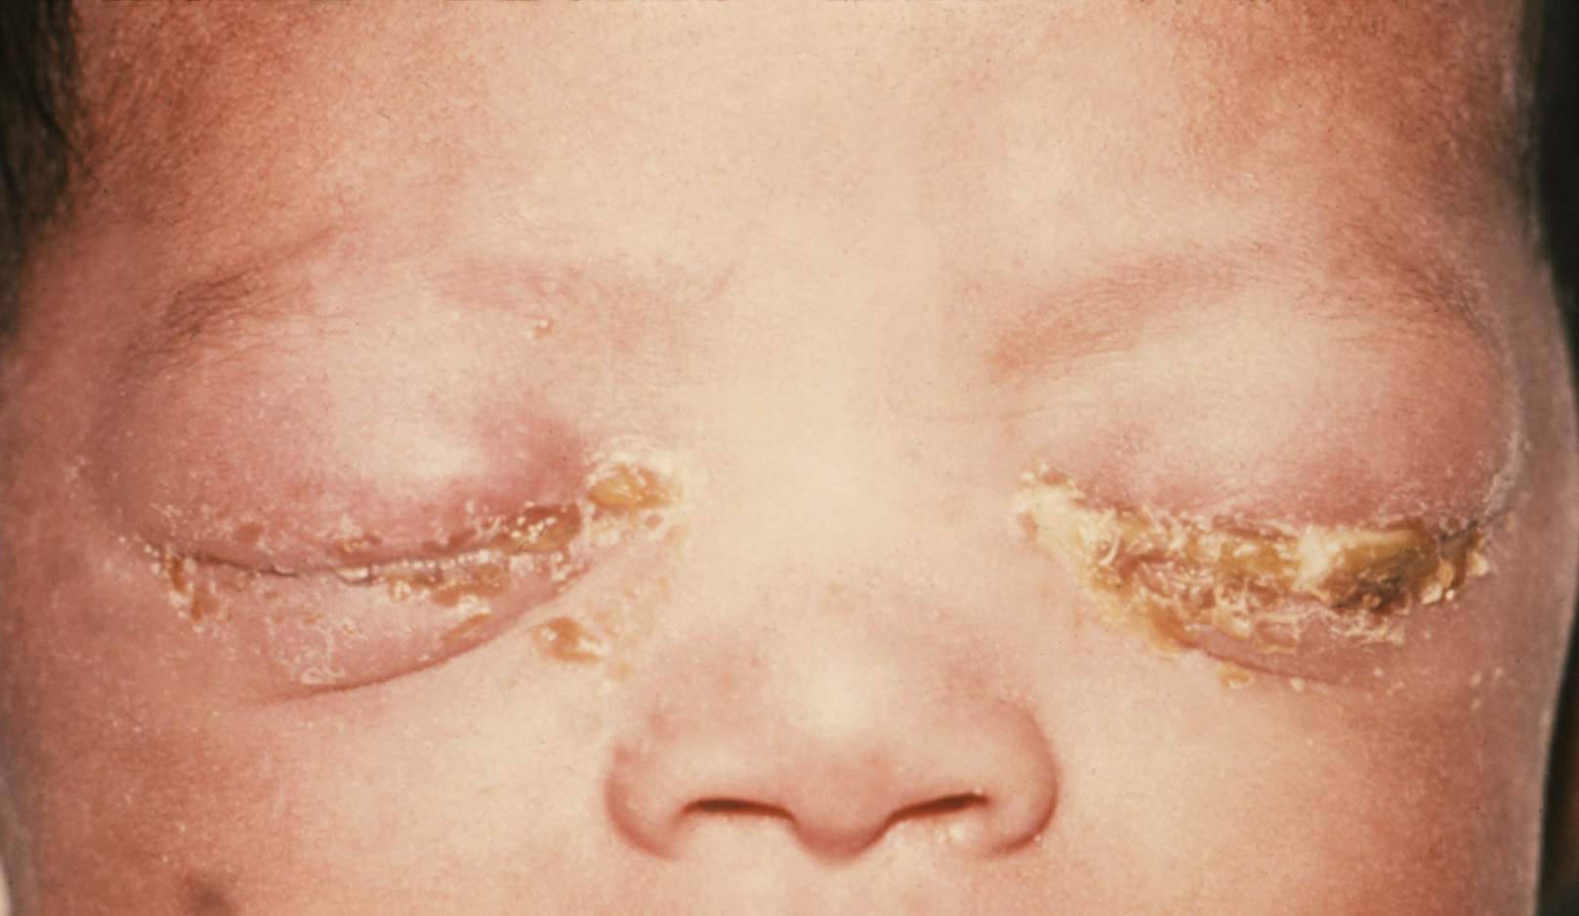
Definition
Neonatal conjunctivitis (Ophthalmia neonatorum) is defined as a conjunctival inflammation that occurs during first month of life after birth.
3
Notes:
SAY: Before we wrap up the course, let’s review what we have learned today.
During this course, we have
<READ the bullets from the slide.>
GO to next slide.

Slide 4
Introduction
Various causes have been implicated such as bacterial, viral including chemical conjunctivitis.
Complications may be mild such as hyperaemia with scant conjunctival discharge to permanent scarring leading to even blindness.
4
Notes:
SAY: Before we wrap up the course, let’s review what we have learned today.
During this course, we have
<READ the bullets from the slide.>
GO to next slide.

Slide 5
Symptoms of Ophthalmia Neonatorum
5
Notes:
SAY:
The purpose of epidemiology in public health practice is to
discover the agent, host, and environmental factors that affect health;
determine the relative importance of causes of illness, disability, and death;
identify those segments of the population that have the greatest risk from specific causes of ill health; and
evaluate the effectiveness of health programs and services in improving population health.
GO to next slide.

Slide 6
Types of Ophthalmia Neonatorum
Septic neonatal conjunctivitis:
Viral and bacterial infections are the leading causes of septic neonatal conjunctivitis. Chlamydial conjunctivitis (caused by Chlamydia trachomatis serotypes D-K) is the most common infective cause of neonatal conjunctivitis. Infective agents causing neonatal conjunctivitis may be transmitted to infant during delivery through birth canal.
●●●
6
Notes:
SAY:
The purpose of epidemiology in public health practice is to
discover the agent, host, and environmental factors that affect health;
determine the relative importance of causes of illness, disability, and death;
identify those segments of the population that have the greatest risk from specific causes of ill health; and
evaluate the effectiveness of health programs and services in improving population health.
GO to next slide.

Slide 7
Types of Ophthalmia Neonatorum
Chemical conjunctivitis:
Chemical conjunctivitis results in mild conjunctival congestion with watering. More concentrated solution of silver nitrate may result in severe response with lid oedema, chemosis of conjunctiva, exudates, membrane or pseudo-membrane (formed by deposition of fibrin rich exudates) formation and permanent scarring leading to damage to conjunctiva or cornea.
●●●
7
Notes:
SAY:
The purpose of epidemiology in public health practice is to
discover the agent, host, and environmental factors that affect health;
determine the relative importance of causes of illness, disability, and death;
identify those segments of the population that have the greatest risk from specific causes of ill health; and
evaluate the effectiveness of health programs and services in improving population health.
GO to next slide.

Slide 8
Types of Ophthalmia Neonatorum
Chlamydial conjunctivitis:
Presentation of chlamydial conjunctivitis may vary from mild hyperaemia with scant mucoid discharge to eyelid swelling, chemosis and even pseudo-membrane formation on conjunctiva.
Chlamydial conjunctivitis typically presents with unilateral or bilateral watery discharge, which later becomes copious and purulent with time.
●●●
8
Notes:
SAY:
The purpose of epidemiology in public health practice is to
discover the agent, host, and environmental factors that affect health;
determine the relative importance of causes of illness, disability, and death;
identify those segments of the population that have the greatest risk from specific causes of ill health; and
evaluate the effectiveness of health programs and services in improving population health.
GO to next slide.

Slide 9
Types of Ophthalmia Neonatorum
Gonococcal conjunctivitis:
Gonococcal conjunctivitis has rapid onset and produces most serious conjunctivitis than the other causes of neonatal conjunctivitis and may be associated with severe lid oedema (swelling), acute conjunctivitis and chemosis. A conjunctival membrane may be present.
●●●
9
Notes:
SAY:
The purpose of epidemiology in public health practice is to
discover the agent, host, and environmental factors that affect health;
determine the relative importance of causes of illness, disability, and death;
identify those segments of the population that have the greatest risk from specific causes of ill health; and
evaluate the effectiveness of health programs and services in improving population health.
GO to next slide.

Slide 10
Types of Ophthalmia Neonatorum
Aseptic conjunctivitis:
Silver nitrate solution (1 %) is used for prophylaxis (prevention) of infectious conjunctivitis (Credé’s method).
Aseptic neonatal conjunctivitis is commonly caused by the use of silver nitrate solution resulting in chemical conjunctivitis.
10
Notes:
SAY:
The purpose of epidemiology in public health practice is to
discover the agent, host, and environmental factors that affect health;
determine the relative importance of causes of illness, disability, and death;
identify those segments of the population that have the greatest risk from specific causes of ill health; and
evaluate the effectiveness of health programs and services in improving population health.
GO to next slide.

Slide 11
Causes of Ophthalmia Neonatorum
Chemical conjunctivitis:
Neonatal conjunctivitis is commonly caused due to post-delivery use of ophthalmic silver nitrate given for the prophylaxis of ocular infection.
Bacterial conjunctivitis:
Chlamydia trachomatis is the most common infectious cause of neonatal conjunctivitis.
11
Notes:
SAY:
The purpose of epidemiology in public health practice is to
discover the agent, host, and environmental factors that affect health;
determine the relative importance of causes of illness, disability, and death;
identify those segments of the population that have the greatest risk from specific causes of ill health; and
evaluate the effectiveness of health programs and services in improving population health.
GO to next slide.

Slide 12
Risk Factors of
Ophthalmia Neonatorum
Maternal infections carried in birth canal.
Exposure of infant to infections.
Human immunodeficiency virus (HIV) infected mothers.
Ocular injury during delivery.
Inadequate ocular prophylaxis immediately after birth.
Premature babies.
Poor antenatal care.
12
Notes:
SAY:
The purpose of epidemiology in public health practice is to
discover the agent, host, and environmental factors that affect health;
determine the relative importance of causes of illness, disability, and death;
identify those segments of the population that have the greatest risk from specific causes of ill health; and
evaluate the effectiveness of health programs and services in improving population health.
GO to next slide.

Slide 13
Diagnosis of
Ophthalmia Neonatorum
Diagnosis depends upon the clinical presentation and lab investigations.
Prompt diagnosis is necessary to institute appropriate treatment and thereby minimising potential serious complications of the disease.
Clinical manifestations of disease in newborn following birth, plays an important role in identifying the likely cause.
13
Notes:
SAY:
The purpose of epidemiology in public health practice is to
discover the agent, host, and environmental factors that affect health;
determine the relative importance of causes of illness, disability, and death;
identify those segments of the population that have the greatest risk from specific causes of ill health; and
evaluate the effectiveness of health programs and services in improving population health.
GO to next slide.

Slide 14
Conclusion
Ophthalmia neonatorum caused by Pseudomonas is rare but can present with eyelid edema, erythema, and purulent discharge causing corneal perforation, endophthalmitis, blindness, and possibly death.
14
Notes:
SAY:
The purpose of epidemiology in public health practice is to
discover the agent, host, and environmental factors that affect health;
determine the relative importance of causes of illness, disability, and death;
identify those segments of the population that have the greatest risk from specific causes of ill health; and
evaluate the effectiveness of health programs and services in improving population health.
GO to next slide.

Slide 15
References
Google.com
Wikipedia.org
Studymafia.org
Slidespanda.com

Slide 16
Thanks To StudyMafia.org

