Slide 1
StudyMafia.Org
Neural Network
Submitted To: Submitted By:
Studymafia.org Studymafia.org

Slide 2
Table Contents
Definition
Introduction
History of Neural Network
Types of Neural Network
Applications of Neural Network
Pros of Neural Network
Cons of Neural Network
Conclusion
2
Notes:
SAY: Before we wrap up the course, let’s review what we have learned today.
During this course, we have
<READ the bullets from the slide.>
GO to next slide.

Slide 3
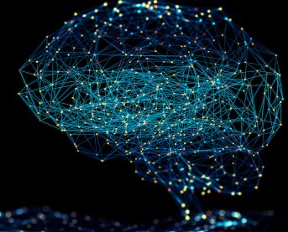
Definition
A neural network is a series of algorithms that endeavors to recognize underlying relationships in a set of data through a process that mimics the way the human brain operates
3
Notes:
SAY: Before we wrap up the course, let’s review what we have learned today.
During this course, we have
<READ the bullets from the slide.>
GO to next slide.

Slide 4
Introduction
In this sense, neural networks refer to systems of neurons, either organic or artificial in nature.
Neural networks can adapt to changing input; so the network generates the best possible result without needing to redesign the output criteria.
The concept of neural networks, which has its roots in artificial intelligence, is swiftly gaining popularity in the development of trading systems.
4
Notes:
SAY: Before we wrap up the course, let’s review what we have learned today.
During this course, we have
<READ the bullets from the slide.>
GO to next slide.

Slide 5
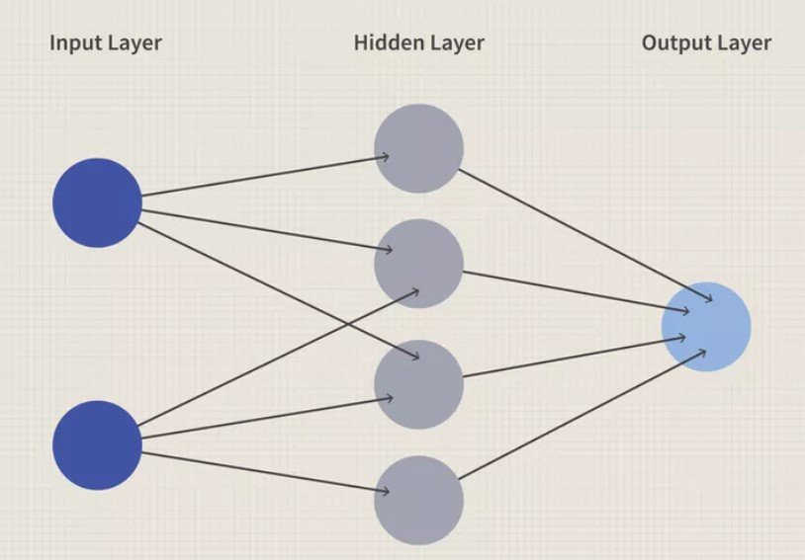
5
Notes:
SAY:
The purpose of epidemiology in public health practice is to
discover the agent, host, and environmental factors that affect health;
determine the relative importance of causes of illness, disability, and death;
identify those segments of the population that have the greatest risk from specific causes of ill health; and
evaluate the effectiveness of health programs and services in improving population health.
GO to next slide.

Slide 6
History of Neural Network
Though the concept of integrated machines that can think has existed for centuries, there have been the largest strides in neural networks in the past 100 years.
In 1943, Warren McCulloch and Walter Pitts from the University of Illinois and the University of Chicago published "A Logical Calculus of the Ideas Immanent in Nervous Activity".
●●●
6
Notes:
SAY:
The purpose of epidemiology in public health practice is to
discover the agent, host, and environmental factors that affect health;
determine the relative importance of causes of illness, disability, and death;
identify those segments of the population that have the greatest risk from specific causes of ill health; and
evaluate the effectiveness of health programs and services in improving population health.
GO to next slide.

Slide 7
History of Neural Network
The research analyzed how the brain could produce complex patterns and could be simplified down to a binary logic structure with only true/false connections.
Frank Rosenblatt from the Cornell Aeronautical Labratory was credited with the development of perceptron in 1958.
●●●
7
Notes:
SAY:
The purpose of epidemiology in public health practice is to
discover the agent, host, and environmental factors that affect health;
determine the relative importance of causes of illness, disability, and death;
identify those segments of the population that have the greatest risk from specific causes of ill health; and
evaluate the effectiveness of health programs and services in improving population health.
GO to next slide.

Slide 8
History of Neural Network
His research introduced weights to McColloch's and Pitt's work, and Rosenblatt leveraged his work to demonstrate how a computer could use neural networks to detect imagines and make inferences.
After a dry spell of research (largely due to a dry spell in funding) during the 1970's.
●●●
8
Notes:
SAY:
The purpose of epidemiology in public health practice is to
discover the agent, host, and environmental factors that affect health;
determine the relative importance of causes of illness, disability, and death;
identify those segments of the population that have the greatest risk from specific causes of ill health; and
evaluate the effectiveness of health programs and services in improving population health.
GO to next slide.

Slide 9
History of Neural Network
Then, Jon Hopfield presented Hopfield Net, a paper on recurrent neural networks in 1982.
In addition, the concept of backpropagation resurfaced, and many researchers began to understand its potential for neural nets.
Paul Werbos is often credited with the primary contribution during this time in his PhD thesis.
9
Notes:
SAY:
The purpose of epidemiology in public health practice is to
discover the agent, host, and environmental factors that affect health;
determine the relative importance of causes of illness, disability, and death;
identify those segments of the population that have the greatest risk from specific causes of ill health; and
evaluate the effectiveness of health programs and services in improving population health.
GO to next slide.

Slide 10
Types of Neural Network
Feed-Forward Neural Networks
Feed-forward neural networks are one of the more simple types of neural networks.
It conveys information in one direction through input nodes; this information continues to be processed in this single direction until it reaches the output mode.
●●●
10
Notes:
SAY:
The purpose of epidemiology in public health practice is to
discover the agent, host, and environmental factors that affect health;
determine the relative importance of causes of illness, disability, and death;
identify those segments of the population that have the greatest risk from specific causes of ill health; and
evaluate the effectiveness of health programs and services in improving population health.
GO to next slide.

Slide 11
Types of Neural Network
Recurrent Neural Networks
A more complex type of neural network, recurrent neural networks take the output of a processing node and transmit the information back into the network.
This results in theoretical "learning" and improvement of the network.
●●●
11
Notes:
SAY:
The purpose of epidemiology in public health practice is to
discover the agent, host, and environmental factors that affect health;
determine the relative importance of causes of illness, disability, and death;
identify those segments of the population that have the greatest risk from specific causes of ill health; and
evaluate the effectiveness of health programs and services in improving population health.
GO to next slide.

Slide 12
Types of Neural Network
Convolutional Neural Networks
Convolutional neural networks, also called ConvNets or CNNs, have several layers in which data is sorted into categories. These networks have an input layer, an output layer, and a hidden multitude of convolutional layers in between.
The layers create feature maps that record areas of an image that are broken down further until they generate valuable outputs.
●●●
12
Notes:
SAY:
The purpose of epidemiology in public health practice is to
discover the agent, host, and environmental factors that affect health;
determine the relative importance of causes of illness, disability, and death;
identify those segments of the population that have the greatest risk from specific causes of ill health; and
evaluate the effectiveness of health programs and services in improving population health.
GO to next slide.

Slide 13
Types of Neural Network
Deconvolutional Neural Networks
Deconvolutional neural networks simply work in reverse of convolutional neural networks.
The application of the network is to detect items that might have been recognized as important under a convolutional neural network.
●●●
13
Notes:
SAY:
The purpose of epidemiology in public health practice is to
discover the agent, host, and environmental factors that affect health;
determine the relative importance of causes of illness, disability, and death;
identify those segments of the population that have the greatest risk from specific causes of ill health; and
evaluate the effectiveness of health programs and services in improving population health.
GO to next slide.

Slide 14
Types of Neural Network
Modular Neural Networks
Modular neural networks contain several networks that work independently from one another. These networks do not interact with each other during an analysis process.
Instead, these processes are done to allow complex, elaborate computing processes to be done more efficiently.
14
Notes:
SAY:
The purpose of epidemiology in public health practice is to
discover the agent, host, and environmental factors that affect health;
determine the relative importance of causes of illness, disability, and death;
identify those segments of the population that have the greatest risk from specific causes of ill health; and
evaluate the effectiveness of health programs and services in improving population health.
GO to next slide.

Slide 15
Applications of Neural Network
Neural networks are broadly used, with applications for financial operations, enterprise planning, trading, business analytics, and product maintenance.
Neural networks have also gained widespread adoption in business applications such as forecasting and marketing research solutions, fraud detection, and risk assessment.
●●●
15
Notes:
SAY:
The purpose of epidemiology in public health practice is to
discover the agent, host, and environmental factors that affect health;
determine the relative importance of causes of illness, disability, and death;
identify those segments of the population that have the greatest risk from specific causes of ill health; and
evaluate the effectiveness of health programs and services in improving population health.
GO to next slide.

Slide 16
Applications of Neural Network
Some models predict the correct stock prices 50 to 60% of the time, while others are accurate in 70% of all instances.
Some have posited that a 10% improvement in efficiency is all an investor can ask for from a neural network.
Specific to finance, neural networks can process hundreds of thousands of bits of transaction data.
16
Notes:
SAY:
The purpose of epidemiology in public health practice is to
discover the agent, host, and environmental factors that affect health;
determine the relative importance of causes of illness, disability, and death;
identify those segments of the population that have the greatest risk from specific causes of ill health; and
evaluate the effectiveness of health programs and services in improving population health.
GO to next slide.

Slide 17
Pros of Neural Network
Can often work more efficiently and for longer than humans
Can be programmed to learn from prior outcomes to strive to make smarter future calculations
Often leverage online services that reduce (but do not eliminate) systematic risk
Are continually being expanded in new fields with more difficult problems
17
Notes:
SAY:
The purpose of epidemiology in public health practice is to
discover the agent, host, and environmental factors that affect health;
determine the relative importance of causes of illness, disability, and death;
identify those segments of the population that have the greatest risk from specific causes of ill health; and
evaluate the effectiveness of health programs and services in improving population health.
GO to next slide.

Slide 18
Cons of Neural Network
Still rely on hardware that may require labor and expertise to maintain
May take long periods of time to develop the code and algorithms
May be difficult to assess errors or adaptions to the assumptions if the system is self-learning but lacks transparency
Usually report an estimated range or estimated amount that may not actualize
18
Notes:
SAY:
The purpose of epidemiology in public health practice is to
discover the agent, host, and environmental factors that affect health;
determine the relative importance of causes of illness, disability, and death;
identify those segments of the population that have the greatest risk from specific causes of ill health; and
evaluate the effectiveness of health programs and services in improving population health.
GO to next slide.

Slide 19
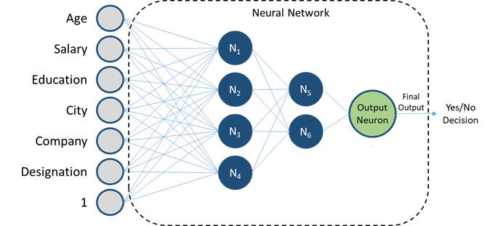

Slide 20
Conclusion
A neural network is a series of algorithms that endeavors to recognize underlying relationships in a set of data through a process that mimics the way the human brain operates.
In this sense, neural networks refer to systems of neurons, either organic or artificial in nature.
20
Notes:
SAY:
The purpose of epidemiology in public health practice is to
discover the agent, host, and environmental factors that affect health;
determine the relative importance of causes of illness, disability, and death;
identify those segments of the population that have the greatest risk from specific causes of ill health; and
evaluate the effectiveness of health programs and services in improving population health.
GO to next slide.

Slide 21
References
Google.com
Wikipedia.org
Studymafia.org
Slidespanda.com

Slide 22
Thanks To StudyMafia.org

