Slide 1
StudyMafia.Org
Haemorrhage
Submitted To: Submitted By:
Studymafia.org Studymafia.org

Slide 2
Table Contents
Definition
Introduction
Symptoms of Haemorrhage
Causes of Haemorrhage
Types of Haemorrhage
Treatment of Haemorrhage
Conclusion
2
Notes:
SAY: Before we wrap up the course, let’s review what we have learned today.
During this course, we have
<READ the bullets from the slide.>
GO to next slide.

Slide 3
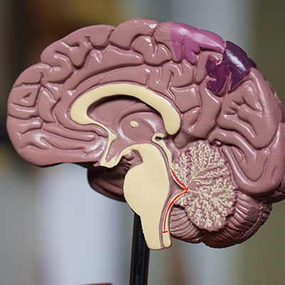
Definition
Bleeding, also called hemorrhage, is the name used to describe blood loss. It can refer to blood loss inside the body, called internal bleeding, or to blood loss outside of the body, called external bleeding.
3
Notes:
SAY: Before we wrap up the course, let’s review what we have learned today.
During this course, we have
<READ the bullets from the slide.>
GO to next slide.

Slide 4
Introduction
Blood loss can occur in almost any area of the body. Internal bleeding occurs when blood leaks out through a damaged blood vessel or organ.
External bleeding happens when blood exits through a break in the skin.
Blood loss from bleeding tissue can also be apparent when blood exits through a natural opening in the body,
4
Notes:
SAY: Before we wrap up the course, let’s review what we have learned today.
During this course, we have
<READ the bullets from the slide.>
GO to next slide.

Slide 5
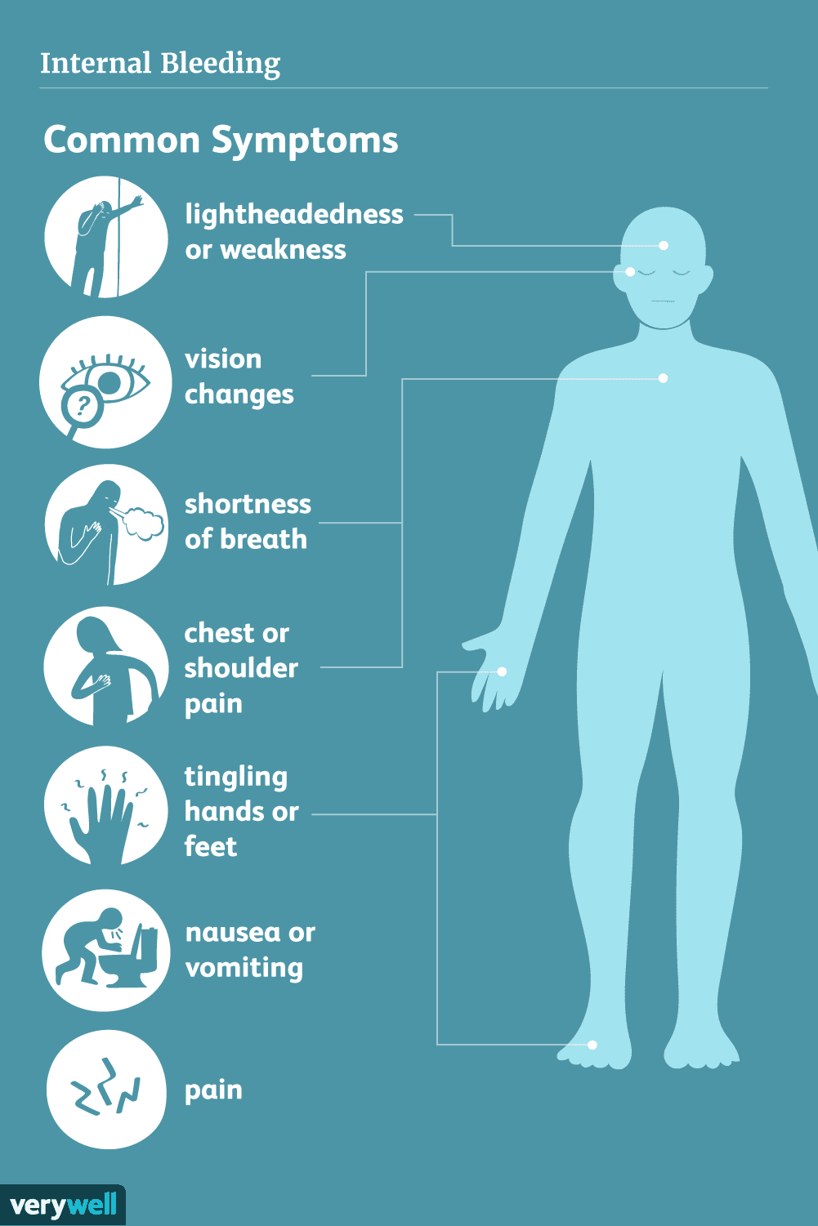
Symptoms of Haemorrhage
●●●
5
Notes:
SAY:
The purpose of epidemiology in public health practice is to
discover the agent, host, and environmental factors that affect health;
determine the relative importance of causes of illness, disability, and death;
identify those segments of the population that have the greatest risk from specific causes of ill health; and
evaluate the effectiveness of health programs and services in improving population health.
GO to next slide.

Slide 6
Causes of Haemorrhage
Traumatic bleeding
An injury can cause traumatic bleeding. Traumatic injuries vary in their severity.
Common types of traumatic injury include:
abrasions (scrapes) that don’t penetrate too far below the skin
hematoma or bruises
lacerations (cuts)
puncture wounds from items like needles, nails, or knives
●●●
6
Notes:
SAY:
The purpose of epidemiology in public health practice is to
discover the agent, host, and environmental factors that affect health;
determine the relative importance of causes of illness, disability, and death;
identify those segments of the population that have the greatest risk from specific causes of ill health; and
evaluate the effectiveness of health programs and services in improving population health.
GO to next slide.

Slide 7
Causes of Haemorrhage
Medical conditions
There are also some medical conditions that can cause bleeding. Bleeding due to a medical condition is less common than traumatic bleeding.
Conditions that can cause bleeding include:
hemophilia
leukemia
liver disease
menorrhagia
●●●
7
Notes:
SAY:
The purpose of epidemiology in public health practice is to
discover the agent, host, and environmental factors that affect health;
determine the relative importance of causes of illness, disability, and death;
identify those segments of the population that have the greatest risk from specific causes of ill health; and
evaluate the effectiveness of health programs and services in improving population health.
GO to next slide.

Slide 8
Causes of Haemorrhage
Alcohol, drug or tobacco use that is heavy or long-term (bleeding in the brain).
Blood clotting disorders.
Cancer.
Complications from medical procedures, such as surgery or childbirth.
Damage to an internal organ.
●●●
8
Notes:
SAY:
The purpose of epidemiology in public health practice is to
discover the agent, host, and environmental factors that affect health;
determine the relative importance of causes of illness, disability, and death;
identify those segments of the population that have the greatest risk from specific causes of ill health; and
evaluate the effectiveness of health programs and services in improving population health.
GO to next slide.

Slide 9
Causes of Haemorrhage
Hereditary (inherited) disorders, such as hemophilia and hereditary hemorrhagic telangiectasia.
Injuries, such as cuts or puncture wounds, bone fracture or traumatic brain injury.
Violence, such as a gunshot or knife wound, or physical abuse.
Viruses that attack the blood vessels, such as viral hemorrhagic fever.
●●●
9
Notes:
SAY:
The purpose of epidemiology in public health practice is to
discover the agent, host, and environmental factors that affect health;
determine the relative importance of causes of illness, disability, and death;
identify those segments of the population that have the greatest risk from specific causes of ill health; and
evaluate the effectiveness of health programs and services in improving population health.
GO to next slide.

Slide 10
Causes of Haemorrhage
Medicines
Some medicines and certain treatments can increase your chances of bleeding, or even cause bleeding.
Medications that may be responsible for bleeding include:
blood thinners
antibiotics, when used on a long-term basis
radiation therapy
10
Notes:
SAY:
The purpose of epidemiology in public health practice is to
discover the agent, host, and environmental factors that affect health;
determine the relative importance of causes of illness, disability, and death;
identify those segments of the population that have the greatest risk from specific causes of ill health; and
evaluate the effectiveness of health programs and services in improving population health.
GO to next slide.

Slide 11
Types of Haemorrhage
Epidural bleed.
This is when blood collects between your skull and the thick outer layer, called the dura mater.
Without treatment, it can make your blood pressure rise, give you trouble breathing, cause brain damage, or lead to death.
11
Notes:
SAY:
The purpose of epidemiology in public health practice is to
discover the agent, host, and environmental factors that affect health;
determine the relative importance of causes of illness, disability, and death;
identify those segments of the population that have the greatest risk from specific causes of ill health; and
evaluate the effectiveness of health programs and services in improving population health.
GO to next slide.

Slide 12
Types of Haemorrhage
Subdural bleed.
This is when blood leaks between your dura mater and the thin layer beneath it, called the arachnoid mater.
There are two main kinds of subdural bleeds: The “acute” type develops fast, and it’s linked to a death rate that ranges from about 37% to 90%. It’s common for people who survive one to have permanent brain damage.
12
Notes:
SAY:
The purpose of epidemiology in public health practice is to
discover the agent, host, and environmental factors that affect health;
determine the relative importance of causes of illness, disability, and death;
identify those segments of the population that have the greatest risk from specific causes of ill health; and
evaluate the effectiveness of health programs and services in improving population health.
GO to next slide.

Slide 13
Types of Haemorrhage
Subarachnoid bleed.
This is when blood collects below the arachnoid mater and above the delicate inner layer beneath it, the pia mater. Without treatment, it can lead to permanent brain damage and death.
13
Notes:
SAY:
The purpose of epidemiology in public health practice is to
discover the agent, host, and environmental factors that affect health;
determine the relative importance of causes of illness, disability, and death;
identify those segments of the population that have the greatest risk from specific causes of ill health; and
evaluate the effectiveness of health programs and services in improving population health.
GO to next slide.

Slide 14
Types of Haemorrhage
Intracerebral hemorrhage.
This is when blood pools in the tissue of your brain. It’s the second most common cause of stroke as well as the deadliest. It’s usually due to long-term, untreated high blood pressure.
14
Notes:
SAY:
The purpose of epidemiology in public health practice is to
discover the agent, host, and environmental factors that affect health;
determine the relative importance of causes of illness, disability, and death;
identify those segments of the population that have the greatest risk from specific causes of ill health; and
evaluate the effectiveness of health programs and services in improving population health.
GO to next slide.

Slide 15
Treatment of Haemorrhage
Treatment for hemorrhage depends on:
Where it is in the body.
How serious the hemorrhage is.
How much blood may have been lost.
How the person is feeling overall (for example, symptoms or other injuries).
Seek immediate medical attention for external bleeding that won’t stop, or for suspected internal bleeding.
●●●
15
Notes:
SAY:
The purpose of epidemiology in public health practice is to
discover the agent, host, and environmental factors that affect health;
determine the relative importance of causes of illness, disability, and death;
identify those segments of the population that have the greatest risk from specific causes of ill health; and
evaluate the effectiveness of health programs and services in improving population health.
GO to next slide.

Slide 16
Treatment of Haemorrhage
Sometimes, external bleeding can be stopped with first aid:
Apply pressure to the wound with your hands.
Find a dressing (clean cloth) and press on the wound.
Tie a tourniquet near the wound, but toward the heart. You can make a tourniquet from something tied very tightly, such as a stretchy band, cloth or belt.
Call 911.
●●●
16
Notes:
SAY:
The purpose of epidemiology in public health practice is to
discover the agent, host, and environmental factors that affect health;
determine the relative importance of causes of illness, disability, and death;
identify those segments of the population that have the greatest risk from specific causes of ill health; and
evaluate the effectiveness of health programs and services in improving population health.
GO to next slide.

Slide 17
Treatment of Haemorrhage
A person can bleed to death in 5 minutes. Bystanders may be able to save a life before emergency personnel can arrive.
There is a national campaign called Stop the Bleed to teach anyone how to stop bleeding. People in mass casualty events have died from blood loss even when their wounds shouldn’t have been fatal.
●●●
17
Notes:
SAY:
The purpose of epidemiology in public health practice is to
discover the agent, host, and environmental factors that affect health;
determine the relative importance of causes of illness, disability, and death;
identify those segments of the population that have the greatest risk from specific causes of ill health; and
evaluate the effectiveness of health programs and services in improving population health.
GO to next slide.

Slide 18
Treatment of Haemorrhage
First aid for traumatic bleeding
It’s possible to treat external traumatic bleeding. Seek emergency help if the person is having any of the emergency signs listed above and if you need help to stop the bleeding.
The person who’s bleeding should try to remain calm to keep their heart rate and blood pressure controlled. Either heart rate or blood pressure being too high will increase the speed of bleeding.
●●●
18
Notes:
SAY:
The purpose of epidemiology in public health practice is to
discover the agent, host, and environmental factors that affect health;
determine the relative importance of causes of illness, disability, and death;
identify those segments of the population that have the greatest risk from specific causes of ill health; and
evaluate the effectiveness of health programs and services in improving population health.
GO to next slide.

Slide 19
Treatment of Haemorrhage
Treat high blood pressure. Studies show that 80% of cerebral hemorrhage patients have a history of high blood pressure. The single most important thing you can do is control yours through diet, exercise, and medication.
Don’t smoke.
Don’t use drugs. Cocaine, for example, can increase the risk of bleeding in the brain.
Drive carefully, and wear your seat belt.
●●●
19
Notes:
SAY:
The purpose of epidemiology in public health practice is to
discover the agent, host, and environmental factors that affect health;
determine the relative importance of causes of illness, disability, and death;
identify those segments of the population that have the greatest risk from specific causes of ill health; and
evaluate the effectiveness of health programs and services in improving population health.
GO to next slide.

Slide 20
Treatment of Haemorrhage
If you ride a motorcycle, bicycle or skateboard, always wear a helmet.
Investigate corrective surgery. If you suffer from abnormalities, such as aneurysms, surgery may help to prevent future bleeding.
Be careful with warfarin (Coumadin). If you take this blood-thinning drug follow up regularly with your doctor to make sure your blood levels are in the correct range.
●●●
20
Notes:
SAY:
The purpose of epidemiology in public health practice is to
discover the agent, host, and environmental factors that affect health;
determine the relative importance of causes of illness, disability, and death;
identify those segments of the population that have the greatest risk from specific causes of ill health; and
evaluate the effectiveness of health programs and services in improving population health.
GO to next slide.

Slide 21
Conclusion
Hemorrhage is loss of blood from a damaged blood vessel. It can be minor such as a bruise or major such as damage to an internal organ. External bleeding is visible and may be easier to notice, but be aware of the signs of internal bleeding. Seek medical attention if you are unsure.
21
Notes:
SAY:
The purpose of epidemiology in public health practice is to
discover the agent, host, and environmental factors that affect health;
determine the relative importance of causes of illness, disability, and death;
identify those segments of the population that have the greatest risk from specific causes of ill health; and
evaluate the effectiveness of health programs and services in improving population health.
GO to next slide.

Slide 22
Thanks To StudyMafia.org

