Slide 1
StudyMafia.Org
Blepharitis
Submitted To: Submitted By:
Studymafia.org Studymafia.org

Slide 2
Table Contents
Definition
Introduction
Symptoms of Blepharitis
Causes of Blepharitis
Complications of Blepharitis
Treatment of Blepharitis
Conclusion
2
Notes:
SAY: Before we wrap up the course, let’s review what we have learned today.
During this course, we have
<READ the bullets from the slide.>
GO to next slide.

Slide 3
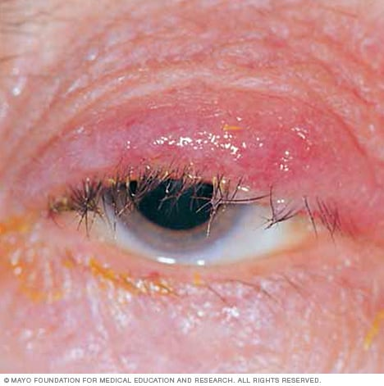
Definition
Blepharitis (blef-uh-RYE-tis) is inflammation of the eyelids. Blepharitis usually affects both eyes along the edges of the eyelids.
3
Notes:
SAY: Before we wrap up the course, let’s review what we have learned today.
During this course, we have
<READ the bullets from the slide.>
GO to next slide.

Slide 4
Introduction
Blepharitis commonly occurs when tiny oil glands near the base of the eyelashes become clogged, causing irritation and redness.
Blepharitis is often a chronic condition that's difficult to treat. Blepharitis can be uncomfortable and unsightly. But it usually doesn't cause permanent damage to your eyesight, and it's not contagious.
4
Notes:
SAY: Before we wrap up the course, let’s review what we have learned today.
During this course, we have
<READ the bullets from the slide.>
GO to next slide.

Slide 5
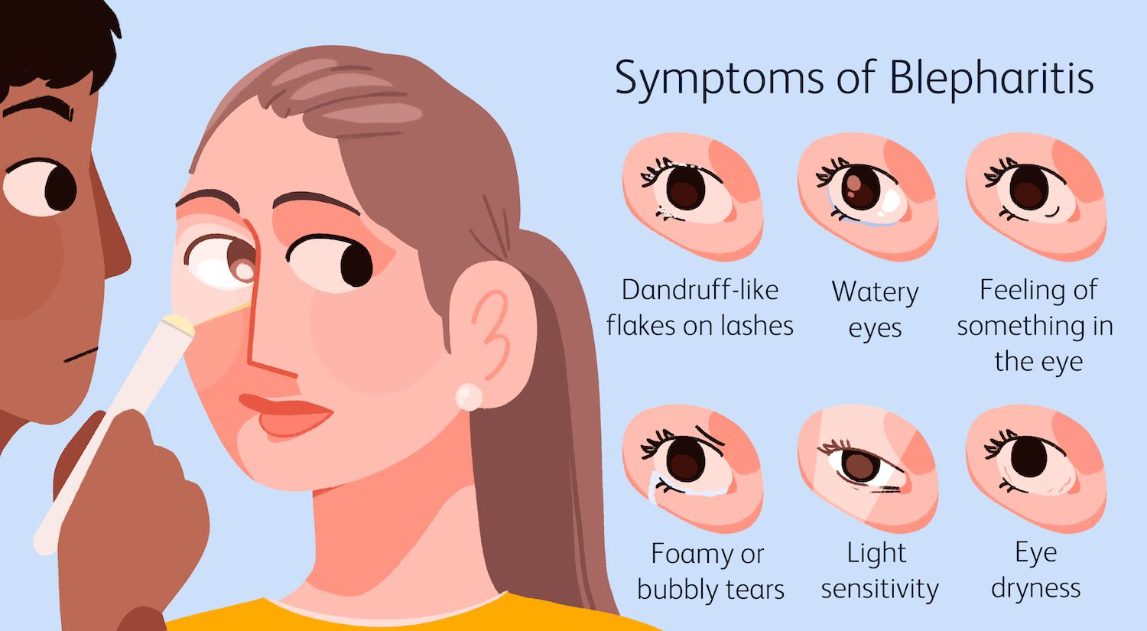
Symptoms of Blepharitis
5
Notes:
SAY:
The purpose of epidemiology in public health practice is to
discover the agent, host, and environmental factors that affect health;
determine the relative importance of causes of illness, disability, and death;
identify those segments of the population that have the greatest risk from specific causes of ill health; and
evaluate the effectiveness of health programs and services in improving population health.
GO to next slide.

Slide 6
Causes of Blepharitis
The exact cause of blepharitis isn't clear. It might be associated with one or more of the following:
Seborrheic dermatitis — dandruff of the scalp and eyebrows
Infection
Clogged or malfunctioning oil glands in your eyelids
●●●
6
Notes:
SAY:
The purpose of epidemiology in public health practice is to
discover the agent, host, and environmental factors that affect health;
determine the relative importance of causes of illness, disability, and death;
identify those segments of the population that have the greatest risk from specific causes of ill health; and
evaluate the effectiveness of health programs and services in improving population health.
GO to next slide.

Slide 7
Causes of Blepharitis
Rosacea — a skin condition characterized by facial redness
Allergies, including allergic reactions to eye medications, contact lens solutions or eye makeup
Eyelash mites or lice
Dry eyes
7
Notes:
SAY:
The purpose of epidemiology in public health practice is to
discover the agent, host, and environmental factors that affect health;
determine the relative importance of causes of illness, disability, and death;
identify those segments of the population that have the greatest risk from specific causes of ill health; and
evaluate the effectiveness of health programs and services in improving population health.
GO to next slide.

Slide 8
Complications of Blepharitis
Eyelash problems: Blepharitis can cause your eyelashes to fall out, grow abnormally (misdirected eyelashes) or lose color.
Eyelid skin problems: Scarring can develop on your eyelids from long-term blepharitis. Or the eyelid edges might turn inward or outward.
●●●
8
Notes:
SAY:
The purpose of epidemiology in public health practice is to
discover the agent, host, and environmental factors that affect health;
determine the relative importance of causes of illness, disability, and death;
identify those segments of the population that have the greatest risk from specific causes of ill health; and
evaluate the effectiveness of health programs and services in improving population health.
GO to next slide.

Slide 9
Complications of Blepharitis
Excess tearing or dry eyes: Abnormal oily secretions and other debris shed from the eyelids, such as flaking associated with dandruff, can build up in your tear film — the water, oil and mucus solution that forms tears.
●●●
9
Notes:
SAY:
The purpose of epidemiology in public health practice is to
discover the agent, host, and environmental factors that affect health;
determine the relative importance of causes of illness, disability, and death;
identify those segments of the population that have the greatest risk from specific causes of ill health; and
evaluate the effectiveness of health programs and services in improving population health.
GO to next slide.

Slide 10
Complications of Blepharitis
Stye: A stye is an infection that develops near the base of the eyelashes. The result is a painful lump on the edge of your eyelid. A stye is usually most visible on the surface of the eyelid.
●●●
10
Notes:
SAY:
The purpose of epidemiology in public health practice is to
discover the agent, host, and environmental factors that affect health;
determine the relative importance of causes of illness, disability, and death;
identify those segments of the population that have the greatest risk from specific causes of ill health; and
evaluate the effectiveness of health programs and services in improving population health.
GO to next slide.

Slide 11
Complications of Blepharitis
Chalazion: A chalazion occurs when there's a blockage in one of the small oil glands at the margin of the eyelid, just behind the eyelashes. This blockage causes inflammation of the gland, which makes the eyelid swell and redden. This can clear up or turn into a hard, nontender bump.
●●●
11
Notes:
SAY:
The purpose of epidemiology in public health practice is to
discover the agent, host, and environmental factors that affect health;
determine the relative importance of causes of illness, disability, and death;
identify those segments of the population that have the greatest risk from specific causes of ill health; and
evaluate the effectiveness of health programs and services in improving population health.
GO to next slide.

Slide 12
Complications of Blepharitis
Chronic pink eye: Blepharitis can lead to recurrent bouts of pink eye (conjunctivitis).
Injury to the cornea: Constant irritation from inflamed eyelids or misdirected eyelashes can cause a sore to develop on your cornea.
\
12
Notes:
SAY:
The purpose of epidemiology in public health practice is to
discover the agent, host, and environmental factors that affect health;
determine the relative importance of causes of illness, disability, and death;
identify those segments of the population that have the greatest risk from specific causes of ill health; and
evaluate the effectiveness of health programs and services in improving population health.
GO to next slide.

Slide 13
Treatment of Blepharitis
Medications that fight infection.
Antibiotics applied to the eyelid have been shown to provide relief of symptoms and resolve bacterial infection of the eyelids.
These are available in several forms, including eyedrops, creams and ointments.
●●●
13
Notes:
SAY:
The purpose of epidemiology in public health practice is to
discover the agent, host, and environmental factors that affect health;
determine the relative importance of causes of illness, disability, and death;
identify those segments of the population that have the greatest risk from specific causes of ill health; and
evaluate the effectiveness of health programs and services in improving population health.
GO to next slide.

Slide 14
Treatment of Blepharitis
Medications to control inflammation.
Steroid eyedrops or ointments are used for this, generally only for people who don't respond to other therapies.
Your doctor might prescribe both antibiotic and anti-inflammatory drugs.
●●●
14
Notes:
SAY:
The purpose of epidemiology in public health practice is to
discover the agent, host, and environmental factors that affect health;
determine the relative importance of causes of illness, disability, and death;
identify those segments of the population that have the greatest risk from specific causes of ill health; and
evaluate the effectiveness of health programs and services in improving population health.
GO to next slide.

Slide 15
Treatment of Blepharitis
Medications that affect the immune system.
Topical cyclosporine (Restasis) has been shown to offer relief of some signs and symptoms of blepharitis.
Treatments for underlying conditions.
Blepharitis caused by seborrheic dermatitis, rosacea or other diseases might be controlled by treating the underlying disease.
15
Notes:
SAY:
The purpose of epidemiology in public health practice is to
discover the agent, host, and environmental factors that affect health;
determine the relative importance of causes of illness, disability, and death;
identify those segments of the population that have the greatest risk from specific causes of ill health; and
evaluate the effectiveness of health programs and services in improving population health.
GO to next slide.

Slide 16
Conclusion
Blepharitis rarely disappears completely. Even with successful treatment, the condition frequently is chronic and requires daily attention with eyelid scrubs.
If you don't respond to treatment, or if you've also lost eyelashes or only one eye is affected, the condition could be caused by a localized eyelid cancer.
16
Notes:
SAY:
The purpose of epidemiology in public health practice is to
discover the agent, host, and environmental factors that affect health;
determine the relative importance of causes of illness, disability, and death;
identify those segments of the population that have the greatest risk from specific causes of ill health; and
evaluate the effectiveness of health programs and services in improving population health.
GO to next slide.

Slide 17
References
Google.com
Wikipedia.org
Studymafia.org
Slidespanda.com

Slide 18
Thanks To StudyMafia.org

