Slide 1
StudyMafia.Org
Antioxidant
Submitted To: Submitted By:
Studymafia.org Studymafia.org

Slide 2
Table Contents
Definition
Introduction
Antioxidants in Foods
Types of Dietary Antioxidants
About Antioxidant Supplements
Conclusion
2
Notes:
SAY: Before we wrap up the course, let’s review what we have learned today.
During this course, we have
<READ the bullets from the slide.>
GO to next slide.

Slide 3
Definition
Antioxidants are molecules that fight free radicals in your body.
3
Notes:
SAY: Before we wrap up the course, let’s review what we have learned today.
During this course, we have
<READ the bullets from the slide.>
GO to next slide.

Slide 4
Introduction
Free radicals are compounds that can cause harm if their levels become too high in your body. They’re linked to multiple illnesses, including diabetes, heart disease, and cancer.
Your body has its own antioxidant defenses to keep free radicals in check.
Antioxidant preservatives also play a crucial role in food production by increasing shelf life.
4
Notes:
SAY: Before we wrap up the course, let’s review what we have learned today.
During this course, we have
<READ the bullets from the slide.>
GO to next slide.

Slide 5
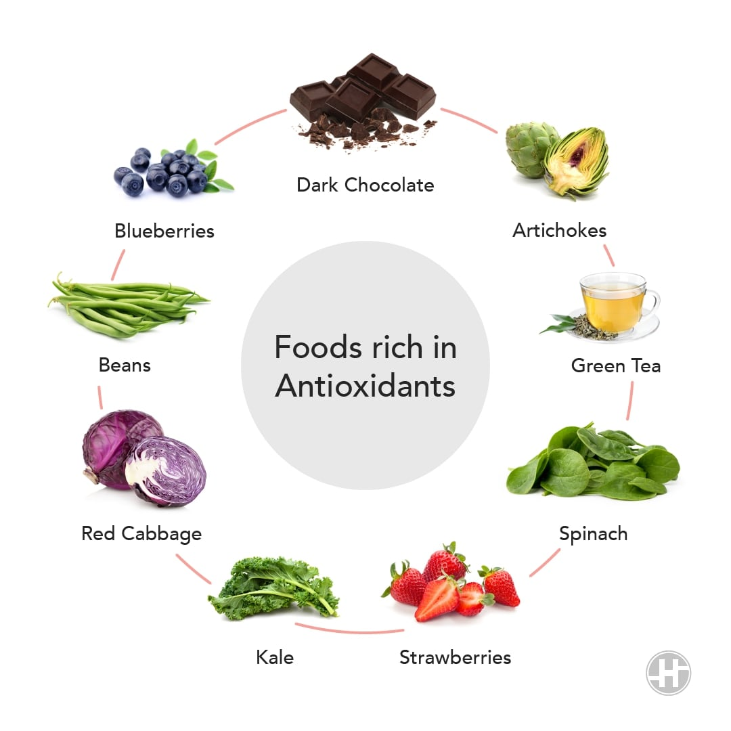
5
Notes:
SAY: Before we wrap up the course, let’s review what we have learned today.
During this course, we have
<READ the bullets from the slide.>
GO to next slide.

Slide 6
Antioxidants in Foods
Antioxidants are essential for the survival of all living things.
Your body generates its own antioxidants, such as the cellular antioxidant glutathione.
Plants and animals, as well as all other forms of life, have their own defenses against free radicals and oxidative damage.
Therefore, antioxidants are found in all whole foods of plant and animal origin.
●●●
6
Notes:
SAY:
The purpose of epidemiology in public health practice is to
discover the agent, host, and environmental factors that affect health;
determine the relative importance of causes of illness, disability, and death;
identify those segments of the population that have the greatest risk from specific causes of ill health; and
evaluate the effectiveness of health programs and services in improving population health.
GO to next slide.

Slide 7
Antioxidants in Foods
Adequate antioxidant intake is important. In fact, your life depends on the intake of certain antioxidants — namely, vitamins C and E.
However, many other non-essential antioxidants occur in food. While they’re unnecessary for your body, they play an important role in general health.
The health benefits associated with a diet rich in plants is at least partially due to the variety of antioxidants they provide.
●●●
7
Notes:
SAY:
The purpose of epidemiology in public health practice is to
discover the agent, host, and environmental factors that affect health;
determine the relative importance of causes of illness, disability, and death;
identify those segments of the population that have the greatest risk from specific causes of ill health; and
evaluate the effectiveness of health programs and services in improving population health.
GO to next slide.

Slide 8
Antioxidants in Foods
Berries, green tea, coffee, and dark chocolate are renowned for being good sources of antioxidants.
According to some studies, coffee is the single biggest source of antioxidants in the Western diet, but this is partly because the average individual doesn’t eat that many antioxidant-rich foods.
Meat products and fish also contain antioxidants, but to a lesser extent than fruits and vegetables
8
Notes:
SAY:
The purpose of epidemiology in public health practice is to
discover the agent, host, and environmental factors that affect health;
determine the relative importance of causes of illness, disability, and death;
identify those segments of the population that have the greatest risk from specific causes of ill health; and
evaluate the effectiveness of health programs and services in improving population health.
GO to next slide.

Slide 9
Types of Dietary Antioxidants
Antioxidants can be categorized as either water- or fat-soluble.
Water-soluble antioxidants perform their actions in the fluid inside and outside cells, whereas fat-soluble ones act primarily in cell membranes.
Important dietary antioxidants include:
Vitamin C. This water-soluble antioxidant is an essential dietary nutrient.
●●●
9
Notes:
SAY:
The purpose of epidemiology in public health practice is to
discover the agent, host, and environmental factors that affect health;
determine the relative importance of causes of illness, disability, and death;
identify those segments of the population that have the greatest risk from specific causes of ill health; and
evaluate the effectiveness of health programs and services in improving population health.
GO to next slide.

Slide 10
Types of Dietary Antioxidants
Vitamin E. This fat-soluble antioxidant plays a critical role in protecting cell membranes against oxidative damage.
Flavonoids. This group of plant antioxidants has many beneficial health effects.
Many substances that happen to be antioxidants also have other important functions.
10
Notes:
SAY:
The purpose of epidemiology in public health practice is to
discover the agent, host, and environmental factors that affect health;
determine the relative importance of causes of illness, disability, and death;
identify those segments of the population that have the greatest risk from specific causes of ill health; and
evaluate the effectiveness of health programs and services in improving population health.
GO to next slide.

Slide 11
About Antioxidant Supplements
Dietary intake of antioxidants is essential for optimal health, but more is not always better.
Excessive intake of isolated antioxidants can have toxic effects and may even promote rather than prevent oxidative damage — a phenomenon termed the “antioxidant paradox”.
●●●
11
Notes:
SAY:
The purpose of epidemiology in public health practice is to
discover the agent, host, and environmental factors that affect health;
determine the relative importance of causes of illness, disability, and death;
identify those segments of the population that have the greatest risk from specific causes of ill health; and
evaluate the effectiveness of health programs and services in improving population health.
GO to next slide.

Slide 12
About Antioxidant Supplements
Most health professionals advise people to avoid high-dose antioxidant supplements, although further studies are needed before solid conclusions can be reached.
Eating plenty of antioxidant-rich whole food is a much better idea. Studies indicate that foods reduce oxidative damage to a greater extent than supplements.
●●●
12
Notes:
SAY:
The purpose of epidemiology in public health practice is to
discover the agent, host, and environmental factors that affect health;
determine the relative importance of causes of illness, disability, and death;
identify those segments of the population that have the greatest risk from specific causes of ill health; and
evaluate the effectiveness of health programs and services in improving population health.
GO to next slide.

Slide 13
About Antioxidant Supplements
For example, one study compared the effects of drinking blood-orange juice and sugar water, both of which contained equal amounts of vitamin C. It found that the juice had significantly greater antioxidant power.
These results suggest that foods’ compounds work synergistically.
●●●
13
Notes:
SAY:
The purpose of epidemiology in public health practice is to
discover the agent, host, and environmental factors that affect health;
determine the relative importance of causes of illness, disability, and death;
identify those segments of the population that have the greatest risk from specific causes of ill health; and
evaluate the effectiveness of health programs and services in improving population health.
GO to next slide.

Slide 14
About Antioxidant Supplements
The best strategy to ensure adequate antioxidant intake is to follow a diet rich in various vegetables and fruits, alongside other healthy habits.
However, low-dose supplements, such as multivitamins, may be beneficial if you are deficient in certain nutrients or unable to follow a healthy diet.
14
Notes:
SAY:
The purpose of epidemiology in public health practice is to
discover the agent, host, and environmental factors that affect health;
determine the relative importance of causes of illness, disability, and death;
identify those segments of the population that have the greatest risk from specific causes of ill health; and
evaluate the effectiveness of health programs and services in improving population health.
GO to next slide.

Slide 15
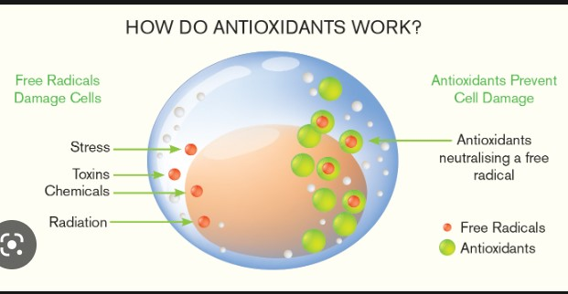

Slide 16
Conclusion
Adequate antioxidant intake is essential to a healthy diet, although some studies suggest that high-dose supplements may be harmful.
The best strategy is to get your daily dose of antioxidants from healthy plant foods, such as fruits and vegetables.
16
Notes:
SAY:
The purpose of epidemiology in public health practice is to
discover the agent, host, and environmental factors that affect health;
determine the relative importance of causes of illness, disability, and death;
identify those segments of the population that have the greatest risk from specific causes of ill health; and
evaluate the effectiveness of health programs and services in improving population health.
GO to next slide.

Slide 17
References
Google.com
Wikipedia.org
Studymafia.org
Slidespanda.com

Slide 18
Thanks To StudyMafia.org

