Slide 1
StudyMafia.Org
Stress Management
Submitted To: Submitted By:
Studymafia.org Studymafia.org

Slide 2
Table Contents
Definition
Introduction
Steps of Stress Management
Conclusion
2
Notes:
SAY: Before we wrap up the course, let’s review what we have learned today.
During this course, we have
<READ the bullets from the slide.>
GO to next slide.

Slide 3
Definition
Stress is part of being human, and it can help motivate you to get things done. Even high stress from serious illness, job loss, a death in the family, or a painful life event can be a natural part of life
3
Notes:
SAY: Before we wrap up the course, let’s review what we have learned today.
During this course, we have
<READ the bullets from the slide.>
GO to next slide.

Slide 4
Introduction
To Manage stress:
Keep a positive attitude.Accept that there are events that you cannot control.
Be assertive instead of aggressive. Assert your feelings, opinions, or beliefs instead of becoming angry, defensive, or passive.
Learn to manage your time more effectively.
Set limits appropriately and say no to requests that would create excessive stress in your life.
Make time for hobbies and interests.
4
Notes:
SAY: Before we wrap up the course, let’s review what we have learned today.
During this course, we have
<READ the bullets from the slide.>
GO to next slide.

Slide 5
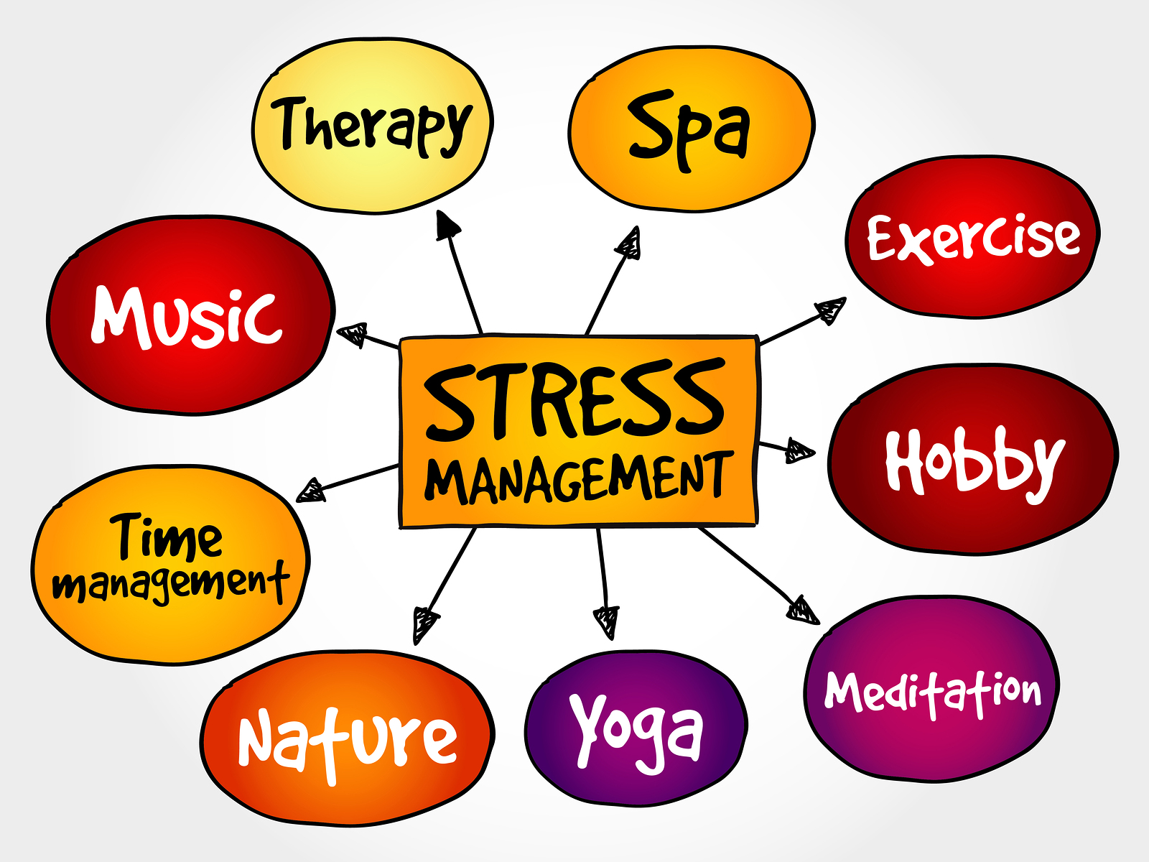
5
Notes:
SAY: Before we wrap up the course, let’s review what we have learned today.
During this course, we have
<READ the bullets from the slide.>
GO to next slide.

Slide 6
Steps of Stress Management
Exercise
To start with, physical activity can help improve your sleep. And better sleep means better stress management. Doctors don’t yet know exactly why, but people who exercise more tend to get better deep “slow wave” sleep that helps renew the brain and body.
Just take care not to exercise too close to bedtime, which disrupts sleep for some people.
●●●
6
Notes:
SAY:
The purpose of epidemiology in public health practice is to
discover the agent, host, and environmental factors that affect health;
determine the relative importance of causes of illness, disability, and death;
identify those segments of the population that have the greatest risk from specific causes of ill health; and
evaluate the effectiveness of health programs and services in improving population health.
GO to next slide.

Slide 7
Steps of Stress Management
Diet
The benefits of eating health foods extend beyond your waistline to your mental health. A healthy diet can lessen the effects of stress, build up your immune system, level your mood, and lower your blood pressure.
Lots of added sugar and fat can have the opposite effect. And junk food can seem even more appealing when you’re under a lot of stress.
●●●
7
Notes:
SAY:
The purpose of epidemiology in public health practice is to
discover the agent, host, and environmental factors that affect health;
determine the relative importance of causes of illness, disability, and death;
identify those segments of the population that have the greatest risk from specific causes of ill health; and
evaluate the effectiveness of health programs and services in improving population health.
GO to next slide.

Slide 8
Steps of Stress Management
Sleep
A common side effect of stress is that you may struggle to fall asleep. If this happens three times a week for at least 3 months, you may have insomnia, an inability to fall and stay asleep.
Lack of sleep can also add to your stress level and cause a cycle of stress and sleeplessness.
●●●
8
Notes:
SAY:
The purpose of epidemiology in public health practice is to
discover the agent, host, and environmental factors that affect health;
determine the relative importance of causes of illness, disability, and death;
identify those segments of the population that have the greatest risk from specific causes of ill health; and
evaluate the effectiveness of health programs and services in improving population health.
GO to next slide.

Slide 9
Steps of Stress Management
Yoga:
This is a form of exercise, but it can also be a meditation.
There are many types of yoga. The ones that focus on slow movement, stretching, and deep breathing are best for lowering your anxiety and stress.
●●●
9
Notes:
SAY:
The purpose of epidemiology in public health practice is to
discover the agent, host, and environmental factors that affect health;
determine the relative importance of causes of illness, disability, and death;
identify those segments of the population that have the greatest risk from specific causes of ill health; and
evaluate the effectiveness of health programs and services in improving population health.
GO to next slide.

Slide 10
Steps of Stress Management
Deep breathing:
When you practice deep breathing, you turn on your body’s natural ability to relax. This creates a state of deep rest that can change how your body responds to stress.
It sends more oxygen to your brain and calms the part of your nervous system that handles your ability to relax.
●●●
10
Notes:
SAY:
The purpose of epidemiology in public health practice is to
discover the agent, host, and environmental factors that affect health;
determine the relative importance of causes of illness, disability, and death;
identify those segments of the population that have the greatest risk from specific causes of ill health; and
evaluate the effectiveness of health programs and services in improving population health.
GO to next slide.

Slide 11
Steps of Stress Management
Connect with people:
Spend time with a friend or family member who will listen to you. It is a natural way to calm you and lower your stress.
When you connect with people in person, your body releases a hormone that stops your fight-or-flight response.
●●●
11
Notes:
SAY:
The purpose of epidemiology in public health practice is to
discover the agent, host, and environmental factors that affect health;
determine the relative importance of causes of illness, disability, and death;
identify those segments of the population that have the greatest risk from specific causes of ill health; and
evaluate the effectiveness of health programs and services in improving population health.
GO to next slide.

Slide 12
Steps of Stress Management
Inner voice:
Nothing affects your stress levels like the voice inside your head. The good news is you are in control. You can exchange negative thoughts for positive ones. There are more benefits to positive self-talk than reducing stress.
These include a longer life, lower levels of depression, greater resistance to the common cold and cardiovascular disease, and better coping skills for when hard times hit.
●●●
12
Notes:
SAY:
The purpose of epidemiology in public health practice is to
discover the agent, host, and environmental factors that affect health;
determine the relative importance of causes of illness, disability, and death;
identify those segments of the population that have the greatest risk from specific causes of ill health; and
evaluate the effectiveness of health programs and services in improving population health.
GO to next slide.

Slide 13
Steps of Stress Management
Laugh therapy:
When you laugh, you take in more oxygen. Your heart, lungs, and muscles get a boost and your body releases those feel-good hormones.
Laughter also improves your immune system, lessens pain, and improves your mood for long periods time.
●●●
13
Notes:
SAY:
The purpose of epidemiology in public health practice is to
discover the agent, host, and environmental factors that affect health;
determine the relative importance of causes of illness, disability, and death;
identify those segments of the population that have the greatest risk from specific causes of ill health; and
evaluate the effectiveness of health programs and services in improving population health.
GO to next slide.

Slide 14
Steps of Stress Management
Talk therapy:
Long-term talk therapy helps some people deal with stress. One approach, cognitive behavioral therapy, helps you change negative thought patterns.
Your therapist can guide you toward other approaches that might be helpful.
14
Notes:
SAY:
The purpose of epidemiology in public health practice is to
discover the agent, host, and environmental factors that affect health;
determine the relative importance of causes of illness, disability, and death;
identify those segments of the population that have the greatest risk from specific causes of ill health; and
evaluate the effectiveness of health programs and services in improving population health.
GO to next slide.

Slide 16
Conclusion
Preventing and managing long-term stress can lower your risk for other conditions — like heart disease, obesity, high blood pressure, and depression. You can prevent or reduce stress by: Planning ahead. Deciding which tasks to do first.
16
Notes:
SAY:
The purpose of epidemiology in public health practice is to
discover the agent, host, and environmental factors that affect health;
determine the relative importance of causes of illness, disability, and death;
identify those segments of the population that have the greatest risk from specific causes of ill health; and
evaluate the effectiveness of health programs and services in improving population health.
GO to next slide.

Slide 17
Thanks To StudyMafia.org

