Slide 1
StudyMafia.Org
Sources Of
Finances
Submitted To: Submitted By:
Studymafia.org Studymafia.org

Slide 2
Table Contents
Definition
Introduction
Sources of Finances
Conclusion
2
Notes:
SAY: Before we wrap up the course, let’s review what we have learned today.
During this course, we have
<READ the bullets from the slide.>
GO to next slide.

Slide 3
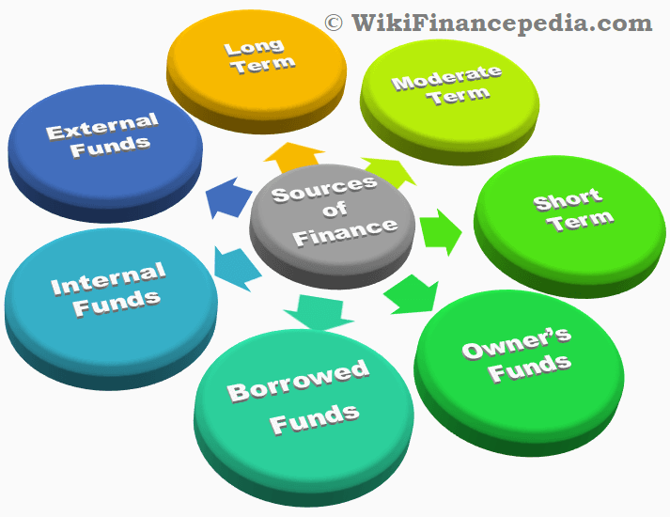
Definition
Business finance is the funds required to establish, operate business activities, and expand in the future.
3
Notes:
SAY: Before we wrap up the course, let’s review what we have learned today.
During this course, we have
<READ the bullets from the slide.>
GO to next slide.

Slide 4
Introduction
Funds are specifically required various purchase type of tangible assets such as furniture, machinery, buildings, offices, factories, or intangible assets like patents, technical expertise, and trademarks, etc.
Apart from the assets mentioned above, other things that require funding are the day-to-day operational activities of a business. This activity includes purchasing raw materials, paying salaries, bills, collecting money from clients, etc.
4
Notes:
SAY: Before we wrap up the course, let’s review what we have learned today.
During this course, we have
<READ the bullets from the slide.>
GO to next slide.

Slide 5
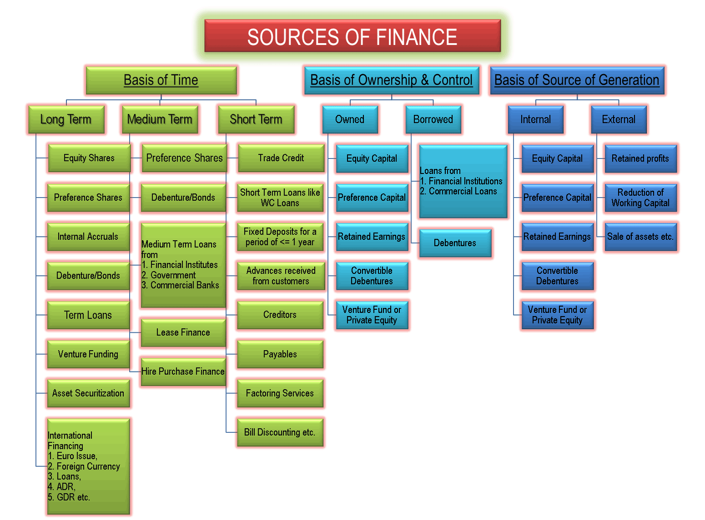
5
Notes:
SAY: Before we wrap up the course, let’s review what we have learned today.
During this course, we have
<READ the bullets from the slide.>
GO to next slide.

Slide 6
Sources of Finances
Based on Period – The period basis is further divided into three dub-division.
Long Term Source of Finance – This long term fund is utilized for more than five years. The fund is arranged through preference and equity shares and debentures etc. and is accumulated from the capital market.
●●●
6
Notes:
SAY:
The purpose of epidemiology in public health practice is to
discover the agent, host, and environmental factors that affect health;
determine the relative importance of causes of illness, disability, and death;
identify those segments of the population that have the greatest risk from specific causes of ill health; and
evaluate the effectiveness of health programs and services in improving population health.
GO to next slide.

Slide 7
Sources of Finances
Medium Term Source of Finance – These are short term funds that last more than one year but less than five years. The source includes borrowings from a public deposit, commercial banks, commercial paper, loans from a financial institute, and lease financing, etc.
Short Term Source of Finance – These are funds just required for a year. Working Capital Loans from Commercial bank and trade credit etc. are a few examples of these sources.
●●●
7
Notes:
SAY:
The purpose of epidemiology in public health practice is to
discover the agent, host, and environmental factors that affect health;
determine the relative importance of causes of illness, disability, and death;
identify those segments of the population that have the greatest risk from specific causes of ill health; and
evaluate the effectiveness of health programs and services in improving population health.
GO to next slide.

Slide 8
Sources of Finances
Based on Ownership – This sources of finance are divided into two categories.
Owner’s Fund – This fund is financed by the company owners, also known as owner’s capital. The capital is raised by issuing preference shares, retained earnings, equity shares, etc. These are for long term capital funds which form a base for owners to obtain their right to control the firm’s management and operations.
●●●
8
Notes:
SAY:
The purpose of epidemiology in public health practice is to
discover the agent, host, and environmental factors that affect health;
determine the relative importance of causes of illness, disability, and death;
identify those segments of the population that have the greatest risk from specific causes of ill health; and
evaluate the effectiveness of health programs and services in improving population health.
GO to next slide.

Slide 9
Sources of Finances
Burrowed Funds – These are the funds accumulated with the help of borrowings or loans for a particular period of time. This source of fund is the most common and popular amongst the businesses. For example, loans from commercial banks and other financial institutions.
●●●
9
Notes:
SAY:
The purpose of epidemiology in public health practice is to
discover the agent, host, and environmental factors that affect health;
determine the relative importance of causes of illness, disability, and death;
identify those segments of the population that have the greatest risk from specific causes of ill health; and
evaluate the effectiveness of health programs and services in improving population health.
GO to next slide.

Slide 10
Sources of Finances
Based on Generation – This source of income is categorized into two divisions.
Internal Sources – The owners generated the funds within the organization. The example for this reference includes selling off assets and retained earnings, etc.
External Source – The fund is arranged from outside the business. For instance, issuance of equity shares to public, debentures, commercial banks loan, etc.
10
Notes:
SAY:
The purpose of epidemiology in public health practice is to
discover the agent, host, and environmental factors that affect health;
determine the relative importance of causes of illness, disability, and death;
identify those segments of the population that have the greatest risk from specific causes of ill health; and
evaluate the effectiveness of health programs and services in improving population health.
GO to next slide.

Slide 11
Conclusion
There are several external methods a business can use, including family and friends, bank loans and overdrafts, venture capitalists and business angels, new partners, share issue, trade credit, leasing, hire purchase, and government grants.
11
Notes:
SAY:
The purpose of epidemiology in public health practice is to
discover the agent, host, and environmental factors that affect health;
determine the relative importance of causes of illness, disability, and death;
identify those segments of the population that have the greatest risk from specific causes of ill health; and
evaluate the effectiveness of health programs and services in improving population health.
GO to next slide.

Slide 12
Thanks To StudyMafia.org

