Slide 1
StudyMafia.Org
Social Media
Submitted To: Submitted By:
Studymafia.org Studymafia.org

Slide 2
Table Contents
Definition
Introduction
Advantages of Social Media
Disadvantages of Social Media
Social Media Platforms
Conclusion
2
Notes:
SAY: Before we wrap up the course, let’s review what we have learned today.
During this course, we have
<READ the bullets from the slide.>
GO to next slide.

Slide 3
Definition
The term social media refers to a computer-based technology that facilitates the sharing of ideas, thoughts, and information through virtual networks and communities.
3
Notes:
SAY: Before we wrap up the course, let’s review what we have learned today.
During this course, we have
<READ the bullets from the slide.>
GO to next slide.

Slide 4
Introduction
Social media is internet-based and gives users quick electronic communication of content, such as personal information, documents, videos, and photos.
Users engage with social media via a computer, tablet, or smartphone via web-based software or applications. While social media is ubiquitous in America and Europe, Asian countries like Indonesia lead the list of social media usage.
More than 4.5 billion people use social media, as of October 2021.
4
Notes:
SAY: Before we wrap up the course, let’s review what we have learned today.
During this course, we have
<READ the bullets from the slide.>
GO to next slide.

Slide 5
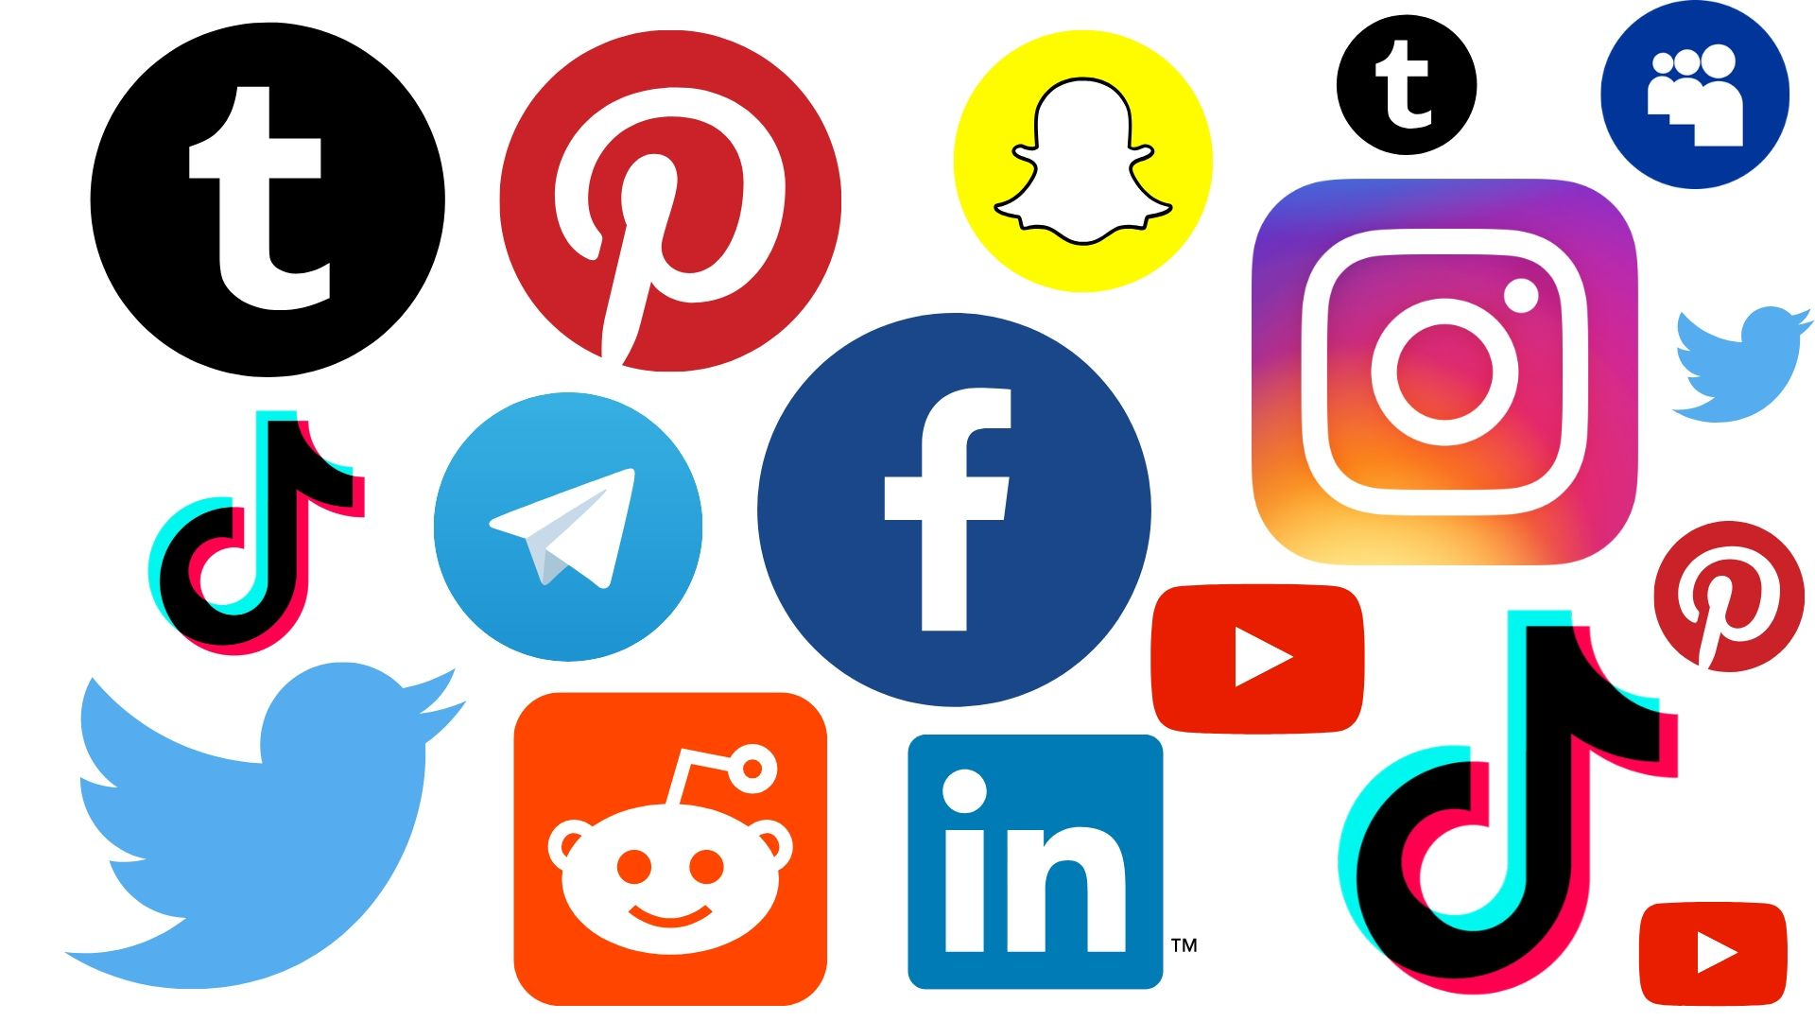
5
Notes:
SAY: Before we wrap up the course, let’s review what we have learned today.
During this course, we have
<READ the bullets from the slide.>
GO to next slide.

Slide 6
Advantages of Social Media
The most important being a great device for education. All the information one requires is just a click away. Students can educate themselves on various topics using social media.
Moreover, live lectures are now possible because of social media. You can attend a lecture happening in America while sitting in India.
●●●
6
Notes:
SAY:
The purpose of epidemiology in public health practice is to
discover the agent, host, and environmental factors that affect health;
determine the relative importance of causes of illness, disability, and death;
identify those segments of the population that have the greatest risk from specific causes of ill health; and
evaluate the effectiveness of health programs and services in improving population health.
GO to next slide.

Slide 7
Advantages of Social Media
Furthermore, as more and more people are distancing themselves from newspapers, they are depending on social media for news.
You are always updated on the latest happenings of the world through it.
A person becomes more socially aware of the issues of the world.
●●●
7
Notes:
SAY:
The purpose of epidemiology in public health practice is to
discover the agent, host, and environmental factors that affect health;
determine the relative importance of causes of illness, disability, and death;
identify those segments of the population that have the greatest risk from specific causes of ill health; and
evaluate the effectiveness of health programs and services in improving population health.
GO to next slide.

Slide 8
Advantages of Social Media
In addition, it strengthens bonds with your loved ones. Distance is not a barrier anymore because of social media.
For instance, you can easily communicate with your friends and relatives overseas.
Most importantly, it also provides a great platform for young budding artists to showcase their talent for free
●●●
8
Notes:
SAY:
The purpose of epidemiology in public health practice is to
discover the agent, host, and environmental factors that affect health;
determine the relative importance of causes of illness, disability, and death;
identify those segments of the population that have the greatest risk from specific causes of ill health; and
evaluate the effectiveness of health programs and services in improving population health.
GO to next slide.

Slide 9
Advantages of Social Media
You can get great opportunities for employment through social media too.
Another advantage definitely benefits companies who wish to promote their brands.
Social media has become a hub for advertising and offers you great opportunities for connecting with the customer.
9
Notes:
SAY:
The purpose of epidemiology in public health practice is to
discover the agent, host, and environmental factors that affect health;
determine the relative importance of causes of illness, disability, and death;
identify those segments of the population that have the greatest risk from specific causes of ill health; and
evaluate the effectiveness of health programs and services in improving population health.
GO to next slide.

Slide 10
Disadvantages of Social Media
Despite having such unique advantages, social media is considered to be one of the most harmful elements of society.
If the use of social media is not monitored, it can lead to grave consequences.
It is harmful because it invades your privacy like never before.
●●●
10
Notes:
SAY:
The purpose of epidemiology in public health practice is to
discover the agent, host, and environmental factors that affect health;
determine the relative importance of causes of illness, disability, and death;
identify those segments of the population that have the greatest risk from specific causes of ill health; and
evaluate the effectiveness of health programs and services in improving population health.
GO to next slide.

Slide 11
Disadvantages of Social Media
The oversharing happening on social media makes children a target for predators and hackers.
It also leads to cyberbullying which affects any person significantly.
Thus, the sharing on social media especially by children must be monitored at all times.
●●●
11
Notes:
SAY:
The purpose of epidemiology in public health practice is to
discover the agent, host, and environmental factors that affect health;
determine the relative importance of causes of illness, disability, and death;
identify those segments of the population that have the greatest risk from specific causes of ill health; and
evaluate the effectiveness of health programs and services in improving population health.
GO to next slide.

Slide 12
Disadvantages of Social Media
This addiction hampers with the academic performance of a student as they waste their time on social media instead of studying.
Social media also creates communal rifts. Fake news is spread with the use of it, which poisons the mind of peace-loving citizens.
●●●
12
Notes:
SAY:
The purpose of epidemiology in public health practice is to
discover the agent, host, and environmental factors that affect health;
determine the relative importance of causes of illness, disability, and death;
identify those segments of the population that have the greatest risk from specific causes of ill health; and
evaluate the effectiveness of health programs and services in improving population health.
GO to next slide.

Slide 13
Disadvantages of Social Media
Enables cheating in exams
Dropping of grades and performance of students
Lack of privacy
Users are vulnerable to cyber-crimes like hacking, identity theft, phishing crimes, etc.
●●●
13
Notes:
SAY:
The purpose of epidemiology in public health practice is to
discover the agent, host, and environmental factors that affect health;
determine the relative importance of causes of illness, disability, and death;
identify those segments of the population that have the greatest risk from specific causes of ill health; and
evaluate the effectiveness of health programs and services in improving population health.
GO to next slide.

Slide 14
Disadvantages of Social Media
In short, surely social media has both advantages and disadvantages. But, it all depends on the user at the end.
The youth must particularly create a balance between their academic performances, physical activities, and social media.
Excess use of anything is harmful and the same thing applies to social media.
14
Notes:
SAY:
The purpose of epidemiology in public health practice is to
discover the agent, host, and environmental factors that affect health;
determine the relative importance of causes of illness, disability, and death;
identify those segments of the population that have the greatest risk from specific causes of ill health; and
evaluate the effectiveness of health programs and services in improving population health.
GO to next slide.

Slide 15
Social Media Platform
Instagram
Instagram has well surpassed 1 billion monthly users, which is no surprise considering how the app blends the personal and professional with each new feature.
Long the home of influencers, artists, small and large brands, and everyone in between, Instagram has become one of the most popular social media platforms.
●●●
15
Notes:
SAY:
The purpose of epidemiology in public health practice is to
discover the agent, host, and environmental factors that affect health;
determine the relative importance of causes of illness, disability, and death;
identify those segments of the population that have the greatest risk from specific causes of ill health; and
evaluate the effectiveness of health programs and services in improving population health.
GO to next slide.

Slide 16
Social Media Platform
YouTube
YouTube holds the distinction of currently being the second most popular search engine in the world, right behind its parent company, Google.
If your business could benefit from producing brand tutorials, instructional content, product reviews, or guest interviews, then this social media platform is a must — especially if the payoff is reaching their more than 2 billion monthly users.
●●●
16
Notes:
SAY:
The purpose of epidemiology in public health practice is to
discover the agent, host, and environmental factors that affect health;
determine the relative importance of causes of illness, disability, and death;
identify those segments of the population that have the greatest risk from specific causes of ill health; and
evaluate the effectiveness of health programs and services in improving population health.
GO to next slide.

Slide 17
Social Media Platform
Facebook
With nearly 3 billion monthly users, Facebook is inarguably the largest and most popular social media platform in the world.
While that level of proliferation ensures at least some of your audience will regularly use this platform and take in your content, Facebook has developed a somewhat negative reputation among younger users who are increasingly turning to alternative sites.
●●●
17
Notes:
SAY:
The purpose of epidemiology in public health practice is to
discover the agent, host, and environmental factors that affect health;
determine the relative importance of causes of illness, disability, and death;
identify those segments of the population that have the greatest risk from specific causes of ill health; and
evaluate the effectiveness of health programs and services in improving population health.
GO to next slide.

Slide 18
Social Media Platform
Twitter
While Twitter’s monthly active user numbers have hovered consistently around 345 million for much of this year, 40% of those users are active on the site multiple times daily; basically, if your audience uses this platform, they’re likely very engaged.
The popularity of this social media site remains highest with tech-savvy users and is particularly popular in B2B verticals related to business, marketing, and politics.
●●●
18
Notes:
SAY:
The purpose of epidemiology in public health practice is to
discover the agent, host, and environmental factors that affect health;
determine the relative importance of causes of illness, disability, and death;
identify those segments of the population that have the greatest risk from specific causes of ill health; and
evaluate the effectiveness of health programs and services in improving population health.
GO to next slide.

Slide 19
Social Media Platform
Pinterest
Pinterest is a social media platform that acts as a bookmarking tool for saving ideas and finding creative inspiration for DIY home projects, recipes, sewing patterns, travel plans, interior design, brand marketing, and everything in between.
This platform is often cited as a crucial part of the product discovery journey for customers of many different brands.
19
Notes:
SAY:
The purpose of epidemiology in public health practice is to
discover the agent, host, and environmental factors that affect health;
determine the relative importance of causes of illness, disability, and death;
identify those segments of the population that have the greatest risk from specific causes of ill health; and
evaluate the effectiveness of health programs and services in improving population health.
GO to next slide.

Slide 20
Conclusion
Today platforms like Facebook, Twitter, LinkedIn, etc., are most widely used by( both) teachers, professors, and students, and they have become quite popular among them.
Social media plays a very important role for students as it makes it easier for them to access and share information, get answers and connect with teachers.
20
Notes:
SAY:
The purpose of epidemiology in public health practice is to
discover the agent, host, and environmental factors that affect health;
determine the relative importance of causes of illness, disability, and death;
identify those segments of the population that have the greatest risk from specific causes of ill health; and
evaluate the effectiveness of health programs and services in improving population health.
GO to next slide.

Slide 21
Thanks To StudyMafia.org

