Slide 1
StudyMafia.Org
Respiration
Regulation
Submitted To: Submitted By:
Studymafia.org Studymafia.org

Slide 2
Table Contents
Definition
Introduction
Components in Regulation of Respiration
Types of Respiration Regulation
Conclusion
2
Notes:
SAY: Before we wrap up the course, let’s review what we have learned today.
During this course, we have
<READ the bullets from the slide.>
GO to next slide.

Slide 3
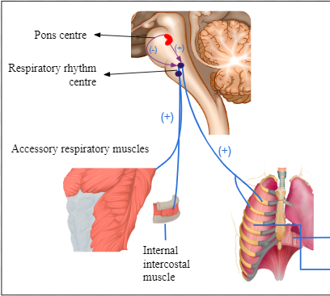
Definition
Breathing is an involuntary (not under our control) process. It is the process of exchange of oxygen from the atmosphere with carbon dioxide produced by the cells.
3
Notes:
SAY: Before we wrap up the course, let’s review what we have learned today.
During this course, we have
<READ the bullets from the slide.>
GO to next slide.

Slide 4
Introduction
A normal adult human breaths 12 -16 times/min and infant breaths about 44 times/min.
You know humans have the ability to regulate breathing rate according to the needs of the body. This regulation of respiration involves both neural and chemical control.
4
Notes:
SAY: Before we wrap up the course, let’s review what we have learned today.
During this course, we have
<READ the bullets from the slide.>
GO to next slide.

Slide 5
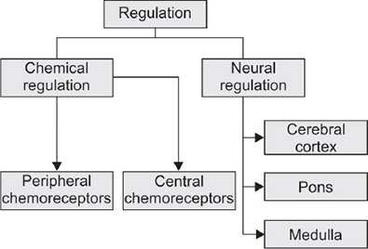
5
Notes:
SAY: Before we wrap up the course, let’s review what we have learned today.
During this course, we have
<READ the bullets from the slide.>
GO to next slide.

Slide 6
Components in Regulation of Respiration
Control centres
These are present in the brain stem (pons varolii and the medulla oblongata) and are responsible for the automaticity of breathing. Input for these centres comes from the higher brain centres to produce the required voluntary breathing efforts.
●●●
6
Notes:
SAY:
The purpose of epidemiology in public health practice is to
discover the agent, host, and environmental factors that affect health;
determine the relative importance of causes of illness, disability, and death;
identify those segments of the population that have the greatest risk from specific causes of ill health; and
evaluate the effectiveness of health programs and services in improving population health.
GO to next slide.

Slide 7
Components in Regulation of Respiration
Chemoreceptors
The chemoreceptors respond to changes in the blood carbon dioxide, oxygen, and hydrogen ion concentration by sending impulses to the control centres. This will alter the breathing pattern by affecting the effector organs.
●●●
7
Notes:
SAY:
The purpose of epidemiology in public health practice is to
discover the agent, host, and environmental factors that affect health;
determine the relative importance of causes of illness, disability, and death;
identify those segments of the population that have the greatest risk from specific causes of ill health; and
evaluate the effectiveness of health programs and services in improving population health.
GO to next slide.

Slide 8
Components in Regulation of Respiration
Sensors
These include chemoreceptors and sensory receptors.
Sensory receptors
The sensory receptors are located in the upper and lower airways, the lung, and the muscles of respiration.
●●●
8
Notes:
SAY:
The purpose of epidemiology in public health practice is to
discover the agent, host, and environmental factors that affect health;
determine the relative importance of causes of illness, disability, and death;
identify those segments of the population that have the greatest risk from specific causes of ill health; and
evaluate the effectiveness of health programs and services in improving population health.
GO to next slide.

Slide 9
Components in Regulation of Respiration
Effector organs
This includes the respiratory muscles like the diaphragm, the rib cage muscles (external intercostal muscles and internal intercostal muscles) and the abdominal muscles.
9
Notes:
SAY:
The purpose of epidemiology in public health practice is to
discover the agent, host, and environmental factors that affect health;
determine the relative importance of causes of illness, disability, and death;
identify those segments of the population that have the greatest risk from specific causes of ill health; and
evaluate the effectiveness of health programs and services in improving population health.
GO to next slide.

Slide 10
Types of Respiratory Regulations
Neural regulation
The respiratory rhythm is regulated by respiratory centres, which is composed of group neurons located in the hind part of the brain.
The rate and depth of breathing is regulated by these respiratory centres. There are two regions in the brain which mainly regulate respiration.
●●●
10
Notes:
SAY:
The purpose of epidemiology in public health practice is to
discover the agent, host, and environmental factors that affect health;
determine the relative importance of causes of illness, disability, and death;
identify those segments of the population that have the greatest risk from specific causes of ill health; and
evaluate the effectiveness of health programs and services in improving population health.
GO to next slide.

Slide 11
Types of Respiratory Regulations
Chemical regulation
Centres associated with chemical regulation of respiration. These are present in the medullary oblongata region around the inspiratory centre.
This area is sensitive to pCO2 and H+ ions concentration. Hence an increase in pCO2 and H+ ions activate these receptors, which in turn activate respiratory rhythm centre or the inspiratory centre.
11
Notes:
SAY:
The purpose of epidemiology in public health practice is to
discover the agent, host, and environmental factors that affect health;
determine the relative importance of causes of illness, disability, and death;
identify those segments of the population that have the greatest risk from specific causes of ill health; and
evaluate the effectiveness of health programs and services in improving population health.
GO to next slide.

Slide 12
Conclusion
The regulation of breathing is dependent on the complex interaction of three components of the respiratory system: 1) the control centers, 2) the sensors, and 3) the effector organs. The control centers reside in the brainstem and are responsible for the automaticity of breathing.
12
Notes:
SAY:
The purpose of epidemiology in public health practice is to
discover the agent, host, and environmental factors that affect health;
determine the relative importance of causes of illness, disability, and death;
identify those segments of the population that have the greatest risk from specific causes of ill health; and
evaluate the effectiveness of health programs and services in improving population health.
GO to next slide.

Slide 13
Thanks To StudyMafia.org

