Slide 1
StudyMafia.Org
Pollution
Submitted To: Submitted By:
Studymafia.org Studymafia.org

Slide 2
Table Contents
Definition
Introduction
Air pollution
Water Pollution
Soil Pollution
Noise Pollution
Prevention of Pollution
Conclusion
2
Notes:
SAY: Before we wrap up the course, let’s review what we have learned today.
During this course, we have
<READ the bullets from the slide.>
GO to next slide.

Slide 3
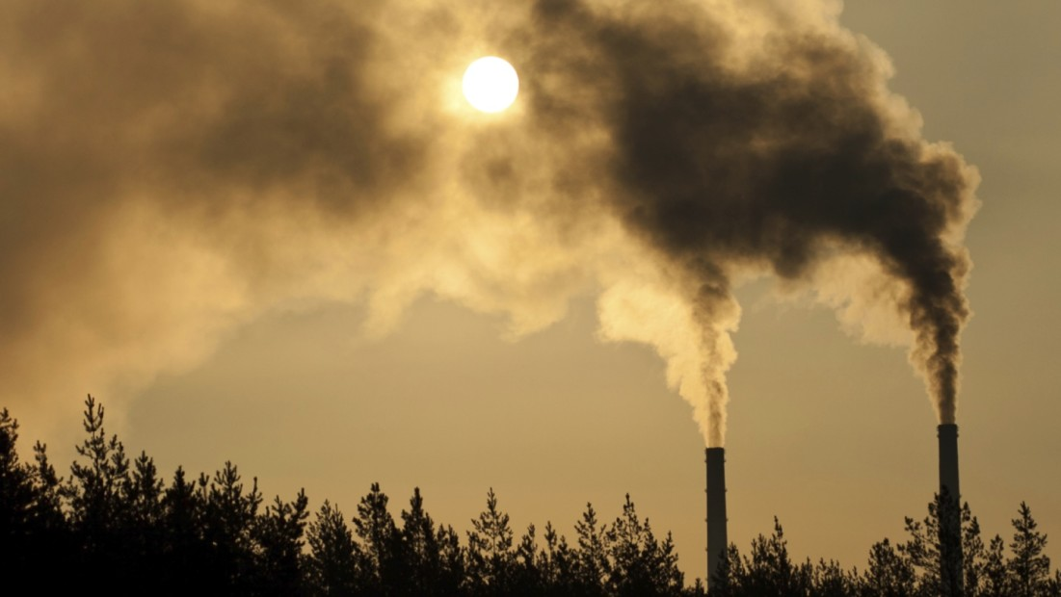
Definition
“Pollution is the introduction of substances (or energy) that cause adverse changes in the environment and living entities .”
3
Notes:
SAY: Before we wrap up the course, let’s review what we have learned today.
During this course, we have
<READ the bullets from the slide.>
GO to next slide.

Slide 4
Introduction
Pollution need not always be caused by chemical substances such as particulates (like smoke and dust). Forms of energy such as sound, heat or light can also cause pollution. These substances that cause pollution are called pollutants.
Pollution, even in minuscule amounts, impacts the ecological balance. Pollutants can make their way up the food chain and eventually find their way inside the human body.
4
Notes:
SAY: Before we wrap up the course, let’s review what we have learned today.
During this course, we have
<READ the bullets from the slide.>
GO to next slide.

Slide 5
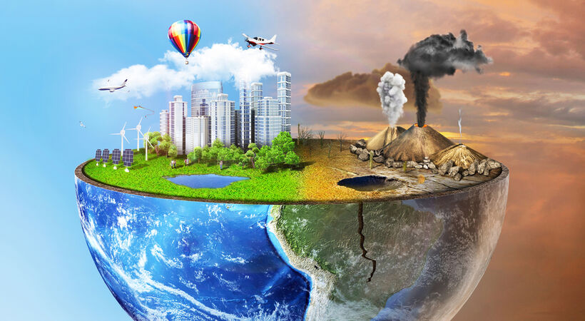
5
Notes:
SAY: Before we wrap up the course, let’s review what we have learned today.
During this course, we have
<READ the bullets from the slide.>
GO to next slide.

Slide 6
Air Pollution
Air pollution refers to the release of harmful contaminants (chemicals, toxic gases, particulates, biological molecules, etc.) into the earth’s atmosphere. These contaminants are quite detrimental and in some cases, pose serious health issues. Some causes that contribute to air pollution are:
Burning fossil fuels
Mining operations
Exhaust gases from industries and factories
●●●
6
Notes:
SAY:
The purpose of epidemiology in public health practice is to
discover the agent, host, and environmental factors that affect health;
determine the relative importance of causes of illness, disability, and death;
identify those segments of the population that have the greatest risk from specific causes of ill health; and
evaluate the effectiveness of health programs and services in improving population health.
GO to next slide.

Slide 7
Air Pollution
The effects of air pollution vary based on the kind of pollutant. But generally, the impact of air pollution ranges from:
Increased risk of respiratory illness and cardiovascular problems
Increased risk of skin diseases
May increase the risk of cancer
Global warming
Acid rain
Ozone depletion
●●●
7
Notes:
SAY:
The purpose of epidemiology in public health practice is to
discover the agent, host, and environmental factors that affect health;
determine the relative importance of causes of illness, disability, and death;
identify those segments of the population that have the greatest risk from specific causes of ill health; and
evaluate the effectiveness of health programs and services in improving population health.
GO to next slide.

Slide 8
Air Pollution
Among the other types of pollution, air pollution is theorized to have a planet-wide implication.
Scientists have even speculated an apocalypse-like scenario where air pollution if left unchecked, can bring about an extreme form of global warming called the runaway greenhouse effect.
Though this is purely speculative, it is a phenomenon that has already occurred on Venus.
8
Notes:
SAY:
The purpose of epidemiology in public health practice is to
discover the agent, host, and environmental factors that affect health;
determine the relative importance of causes of illness, disability, and death;
identify those segments of the population that have the greatest risk from specific causes of ill health; and
evaluate the effectiveness of health programs and services in improving population health.
GO to next slide.

Slide 9
Water Pollution
Water pollution is said to occur when toxic pollutants and particulate matter are introduced into water bodies such as lakes, rivers and seas.
These contaminants are generally introduced by human activities like improper sewage treatment and oil spills. However, even natural processes such as eutrophication can cause water pollution.
●●●
9
Notes:
SAY:
The purpose of epidemiology in public health practice is to
discover the agent, host, and environmental factors that affect health;
determine the relative importance of causes of illness, disability, and death;
identify those segments of the population that have the greatest risk from specific causes of ill health; and
evaluate the effectiveness of health programs and services in improving population health.
GO to next slide.

Slide 10
Water Pollution
Other significant causes of water pollution include:
Dumping solid wastes in water bodies
Disposing untreated industrial sewage into water bodies
Human and animal wastes
Agricultural runoff containing pesticides and fertilisers
●●●
10
Notes:
SAY:
The purpose of epidemiology in public health practice is to
discover the agent, host, and environmental factors that affect health;
determine the relative importance of causes of illness, disability, and death;
identify those segments of the population that have the greatest risk from specific causes of ill health; and
evaluate the effectiveness of health programs and services in improving population health.
GO to next slide.

Slide 11
Water Pollution
The effects of water pollution are very pronounced in our environment. Furthermore, toxic chemicals can bioaccumulate in living beings, and these chemicals can travel their way up the food chain, ultimately reaching humans.
Among the other types of pollution, water pollution has severe consequences on humans.
●●●
11
Notes:
SAY:
The purpose of epidemiology in public health practice is to
discover the agent, host, and environmental factors that affect health;
determine the relative importance of causes of illness, disability, and death;
identify those segments of the population that have the greatest risk from specific causes of ill health; and
evaluate the effectiveness of health programs and services in improving population health.
GO to next slide.

Slide 12
Water Pollution
Other consequences of water pollution include:
Disruption of the ecosystem
Threats to marine life
Increased risk of water-borne diseases
Increases toxic chemicals (such as mercury) in water bodies
Eutrophication
12
Notes:
SAY:
The purpose of epidemiology in public health practice is to
discover the agent, host, and environmental factors that affect health;
determine the relative importance of causes of illness, disability, and death;
identify those segments of the population that have the greatest risk from specific causes of ill health; and
evaluate the effectiveness of health programs and services in improving population health.
GO to next slide.

Slide 13
Soil Pollution
Soil pollution, also called soil contamination, refers to the degradation of land due to the presence of chemicals or other man-made substances in the soil.
The xenobiotic substances alter the natural composition of soil and affect it negatively. These can drastically impact life directly or indirectly.
●●●
13
Notes:
SAY:
The purpose of epidemiology in public health practice is to
discover the agent, host, and environmental factors that affect health;
determine the relative importance of causes of illness, disability, and death;
identify those segments of the population that have the greatest risk from specific causes of ill health; and
evaluate the effectiveness of health programs and services in improving population health.
GO to next slide.

Slide 14
Soil Pollution
For instance, any toxic chemicals present in the soil will get absorbed by the plants. Since plants are producers in an environment, it gets passed up through the food chain.
Compared to the other types of pollution, the effects of soil pollution are a little more obscured, but their implications are very noticeable.
●●●
14
Notes:
SAY:
The purpose of epidemiology in public health practice is to
discover the agent, host, and environmental factors that affect health;
determine the relative importance of causes of illness, disability, and death;
identify those segments of the population that have the greatest risk from specific causes of ill health; and
evaluate the effectiveness of health programs and services in improving population health.
GO to next slide.

Slide 15
Soil Pollution
Some of the common causes of soil pollution are:
Improper industrial waste disposal
Oil Spills
Acid rain which is caused by air pollution
Mining activities
Intensive farming and agrochemicals (like fertilisers and pesticides)
Industrial accidents
●●●
15
Notes:
SAY:
The purpose of epidemiology in public health practice is to
discover the agent, host, and environmental factors that affect health;
determine the relative importance of causes of illness, disability, and death;
identify those segments of the population that have the greatest risk from specific causes of ill health; and
evaluate the effectiveness of health programs and services in improving population health.
GO to next slide.

Slide 16
Soil Pollution
Other effects of soil pollution include:
Loss of soil nutrients, which renders the soil unfit for agriculture
Impacts the natural flora and fauna residing in the soil
Degrades vegetation due to the increase of salinity of the soil
Toxic dust (such as silica dust) can cause respiratory problems or even lung cancer
16
Notes:
SAY:
The purpose of epidemiology in public health practice is to
discover the agent, host, and environmental factors that affect health;
determine the relative importance of causes of illness, disability, and death;
identify those segments of the population that have the greatest risk from specific causes of ill health; and
evaluate the effectiveness of health programs and services in improving population health.
GO to next slide.

Slide 17
Noise Pollution
Noise pollution refers to the excessive amount of noise in the surrounding that disrupts the natural balance. Usually, it is man-made, though certain natural calamities like volcanoes can contribute to noise pollution.
In general, any sound which is over 85 decibels is considered to be detrimental. Also, the duration an individual is exposed plays an impact on their health.
●●●
17
Notes:
SAY:
The purpose of epidemiology in public health practice is to
discover the agent, host, and environmental factors that affect health;
determine the relative importance of causes of illness, disability, and death;
identify those segments of the population that have the greatest risk from specific causes of ill health; and
evaluate the effectiveness of health programs and services in improving population health.
GO to next slide.

Slide 18
Noise Pollution
Noise pollution has several contributors, which include:
Industry-oriented noises such as heavy machines, mills, factories, etc.
Transportation noises from vehicles, aeroplanes, etc.
Construction noises
Noise from social events (loudspeakers, firecrackers, etc.)
Household noises (such as mixers, TV, washing machines, etc.)
●●●
18
Notes:
SAY:
The purpose of epidemiology in public health practice is to
discover the agent, host, and environmental factors that affect health;
determine the relative importance of causes of illness, disability, and death;
identify those segments of the population that have the greatest risk from specific causes of ill health; and
evaluate the effectiveness of health programs and services in improving population health.
GO to next slide.

Slide 19
Noise Pollution
Noise pollution can bring about adverse effects such as :
Hearing loss
Tinnitus
Sleeping disorders
Hypertension (high BP)
Communication problems
19
Notes:
SAY:
The purpose of epidemiology in public health practice is to
discover the agent, host, and environmental factors that affect health;
determine the relative importance of causes of illness, disability, and death;
identify those segments of the population that have the greatest risk from specific causes of ill health; and
evaluate the effectiveness of health programs and services in improving population health.
GO to next slide.

Slide 20
Prevention of Pollution
Ventilate well the space you live in - ensure good air ventilation (with outside air) of your home and your office space, especially in the areas (rooms) where you spend more time.
Store your household chemicals (including cleaning products, paints, fuel canisters, etc.) as far away as possible from the living space and, if possible, in metal cabinets.
●●●
20
Notes:
SAY:
The purpose of epidemiology in public health practice is to
discover the agent, host, and environmental factors that affect health;
determine the relative importance of causes of illness, disability, and death;
identify those segments of the population that have the greatest risk from specific causes of ill health; and
evaluate the effectiveness of health programs and services in improving population health.
GO to next slide.

Slide 21
Prevention of Pollution
Ventilate your garage
Regularly vacuum, clean, and wipe the dust.
Avoid living (or spending most time) directly above an enclosed parking structure.
Evaluate the area before moving or buying real estate.
Drink water only from well monitored and trusted sources.
●●●
21
Notes:
SAY:
The purpose of epidemiology in public health practice is to
discover the agent, host, and environmental factors that affect health;
determine the relative importance of causes of illness, disability, and death;
identify those segments of the population that have the greatest risk from specific causes of ill health; and
evaluate the effectiveness of health programs and services in improving population health.
GO to next slide.

Slide 22
Prevention of Pollution
If you are in a risk category based on your home location, test the soil in your backyard before allowing your kids to play outside on the ground.
If you have a garden, irrigate your lawn on a regular basis.
Avoid using pesticides or herbicides in close proximity to your home.
●●●
22
Notes:
SAY:
The purpose of epidemiology in public health practice is to
discover the agent, host, and environmental factors that affect health;
determine the relative importance of causes of illness, disability, and death;
identify those segments of the population that have the greatest risk from specific causes of ill health; and
evaluate the effectiveness of health programs and services in improving population health.
GO to next slide.

Slide 23
Prevention of Pollution
Avoid using mothballs or other similar products.
Always ventilate well after using cleaning chemicals on your carpet, furniture, etc.
Always wear a mask when spraying chemicals or working with paints.
23
Notes:
SAY:
The purpose of epidemiology in public health practice is to
discover the agent, host, and environmental factors that affect health;
determine the relative importance of causes of illness, disability, and death;
identify those segments of the population that have the greatest risk from specific causes of ill health; and
evaluate the effectiveness of health programs and services in improving population health.
GO to next slide.

Slide 24
Conclusion
Pollution is the introduction of harmful materials into the environment. These harmful materials are called pollutants.
Pollutants can be natural, such as volcanic ash. They can also be created by human activity, such as trash or runoff produced by factories.
24
Notes:
SAY:
The purpose of epidemiology in public health practice is to
discover the agent, host, and environmental factors that affect health;
determine the relative importance of causes of illness, disability, and death;
identify those segments of the population that have the greatest risk from specific causes of ill health; and
evaluate the effectiveness of health programs and services in improving population health.
GO to next slide.

Slide 25
Thanks To StudyMafia.org

