Slide 1
StudyMafia.Org
Hydrocele
Submitted To: Submitted By:
Studymafia.org Studymafia.org

Slide 2
Table Contents
Definition
Introduction
Symptoms of Hydrocele
When to see a Doctor?
Causes of Hydrocele
Complications of Hydrocele
Risk-Factors of Hydrocele
Diagnosis of Hydrocele
Treatment of Hydrocele
Conclusion
2
Notes:
SAY: Before we wrap up the course, let’s review what we have learned today.
During this course, we have
<READ the bullets from the slide.>
GO to next slide.

Slide 3
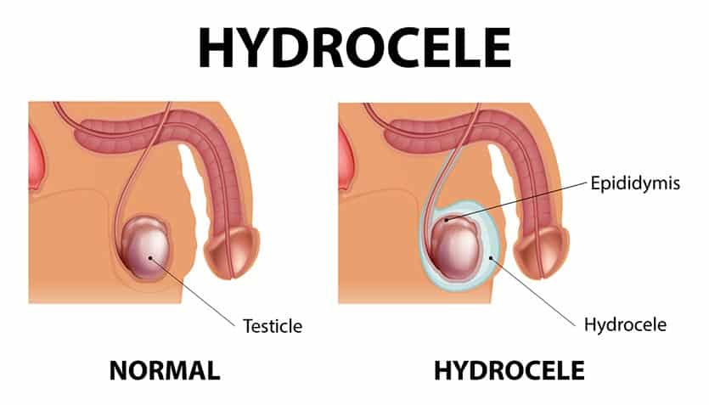
Definition
A hydrocele (HI-droe-seel) is a type of swelling in the scrotum that occurs when fluid collects in the thin sheath surrounding a testicle.
3
Notes:
SAY: Before we wrap up the course, let’s review what we have learned today.
During this course, we have
<READ the bullets from the slide.>
GO to next slide.

Slide 4
Introduction
Hydrocele is common in newborns and usually disappears without treatment by age 1. Older boys and adult men can develop a hydrocele due to inflammation or injury within the scrotum.
A hydrocele usually isn't painful or harmful and might not need any treatment. But if you have scrotal swelling, see your doctor to rule out other causes.
4
Notes:
SAY: Before we wrap up the course, let’s review what we have learned today.
During this course, we have
<READ the bullets from the slide.>
GO to next slide.

Slide 5
Symptoms of Hydrocele
Usually, the only indication of a hydrocele is a painless swelling of one or both testicles.
Adult men with a hydrocele might experience discomfort from the heaviness of a swollen scrotum. Pain generally increases with the size of the inflammation.
Sometimes, the swollen area might be smaller in the morning and larger later in the day.
5
Notes:
SAY: Before we wrap up the course, let’s review what we have learned today.
During this course, we have
<READ the bullets from the slide.>
GO to next slide.

Slide 6
When to see a doctor
It's important to rule out other causes of the swelling that might require treatment. For example, a hydrocele might be associated with a weak point in the abdominal wall that allows a loop of intestine to extend into the scrotum (inguinal hernia).
A baby's hydrocele typically disappears on its own. But if your baby's hydrocele doesn't disappear after a year or if it enlarges, ask your child's doctor to examine the hydrocele again.
6
Notes:
SAY: Before we wrap up the course, let’s review what we have learned today.
During this course, we have
<READ the bullets from the slide.>
GO to next slide.

Slide 7
Causes of Hydrocele
Baby boys
A hydrocele can develop before birth. Normally, the testicles descend from the developing baby's abdominal cavity into the scrotum. A sac accompanies each testicle, allowing fluid to surround the testicles.
●●●
7
Notes:
SAY:
The purpose of epidemiology in public health practice is to
discover the agent, host, and environmental factors that affect health;
determine the relative importance of causes of illness, disability, and death;
identify those segments of the population that have the greatest risk from specific causes of ill health; and
evaluate the effectiveness of health programs and services in improving population health.
GO to next slide.

Slide 8
Causes of Hydrocele
Older males
A hydrocele can develop as a result of injury or inflammation within the scrotum. Inflammation might be caused by an infection in the testicle or in the small, coiled tube at the back of each testicle (epididymitis).
8
Notes:
SAY:
The purpose of epidemiology in public health practice is to
discover the agent, host, and environmental factors that affect health;
determine the relative importance of causes of illness, disability, and death;
identify those segments of the population that have the greatest risk from specific causes of ill health; and
evaluate the effectiveness of health programs and services in improving population health.
GO to next slide.

Slide 9
Complications of Hydrocele
A hydrocele typically isn't dangerous and usually doesn't affect fertility.
Infection or tumor. Either might reduce sperm production or function.
Inguinal hernia. The loop of intestine trapped in the abdominal wall can lead to life-threatening complications.
9
Notes:
SAY:
The purpose of epidemiology in public health practice is to
discover the agent, host, and environmental factors that affect health;
determine the relative importance of causes of illness, disability, and death;
identify those segments of the population that have the greatest risk from specific causes of ill health; and
evaluate the effectiveness of health programs and services in improving population health.
GO to next slide.

Slide 10
Risk-Factors of Hydrocele
Most hydroceles are present at birth. At least 5 percent of newborn boys have a hydrocele. Babies who are born prematurely have a higher risk of having a hydrocele.
Risk factors for developing a hydrocele later in life include:
Injury or inflammation to the scrotum
Infection, including a sexually transmitted infection (STI)
10
Notes:
SAY:
The purpose of epidemiology in public health practice is to
discover the agent, host, and environmental factors that affect health;
determine the relative importance of causes of illness, disability, and death;
identify those segments of the population that have the greatest risk from specific causes of ill health; and
evaluate the effectiveness of health programs and services in improving population health.
GO to next slide.

Slide 11
Diagnosis of Hydrocele
Checking for tenderness in an enlarged scrotum.
Applying pressure to the abdomen and scrotum to check for inguinal hernia.
Shining a light through the scrotum (transillumination). If you or your child has a hydrocele, transillumination will show clear fluid surrounding the testicle.
●●●
11
Notes:
SAY:
The purpose of epidemiology in public health practice is to
discover the agent, host, and environmental factors that affect health;
determine the relative importance of causes of illness, disability, and death;
identify those segments of the population that have the greatest risk from specific causes of ill health; and
evaluate the effectiveness of health programs and services in improving population health.
GO to next slide.

Slide 12
Diagnosis of Hydrocele
Blood and urine tests to help determine if you or your child has an infection, such as epididymitis
Ultrasound to help rule out hernia, testicular tumor or other causes of scrotal swelling
12
Notes:
SAY:
The purpose of epidemiology in public health practice is to
discover the agent, host, and environmental factors that affect health;
determine the relative importance of causes of illness, disability, and death;
identify those segments of the population that have the greatest risk from specific causes of ill health; and
evaluate the effectiveness of health programs and services in improving population health.
GO to next slide.

Slide 13
Treatment of Hydrocele
In baby boys, a hydrocele sometimes disappears on its own. But for males of any age, it's important for a doctor to evaluate a hydrocele because it can be associated with an underlying testicular condition.
A hydrocele that doesn't disappear on its own might need to be surgically removed, typically as an outpatient procedure.
●●●
13
Notes:
SAY:
The purpose of epidemiology in public health practice is to
discover the agent, host, and environmental factors that affect health;
determine the relative importance of causes of illness, disability, and death;
identify those segments of the population that have the greatest risk from specific causes of ill health; and
evaluate the effectiveness of health programs and services in improving population health.
GO to next slide.

Slide 14
Treatment of Hydrocele
The surgery to remove a hydrocele (hydrocelectomy) can be done under general or regional anesthesia. An incision is made in the scrotum or lower abdomen to remove the hydrocele.
If a hydrocele is found during surgery to repair an inguinal hernia, the surgeon might remove the hydrocele even if it's causing no discomfort.
●●●
14
Notes:
SAY:
The purpose of epidemiology in public health practice is to
discover the agent, host, and environmental factors that affect health;
determine the relative importance of causes of illness, disability, and death;
identify those segments of the population that have the greatest risk from specific causes of ill health; and
evaluate the effectiveness of health programs and services in improving population health.
GO to next slide.

Slide 15
Treatment of Hydrocele
After hydrocelectomy, you might need a tube to drain fluid and a bulky dressing for a few days.
Your doctor is likely to recommend a follow-up exam because a hydrocele might recur.
15
Notes:
SAY:
The purpose of epidemiology in public health practice is to
discover the agent, host, and environmental factors that affect health;
determine the relative importance of causes of illness, disability, and death;
identify those segments of the population that have the greatest risk from specific causes of ill health; and
evaluate the effectiveness of health programs and services in improving population health.
GO to next slide.

Slide 16
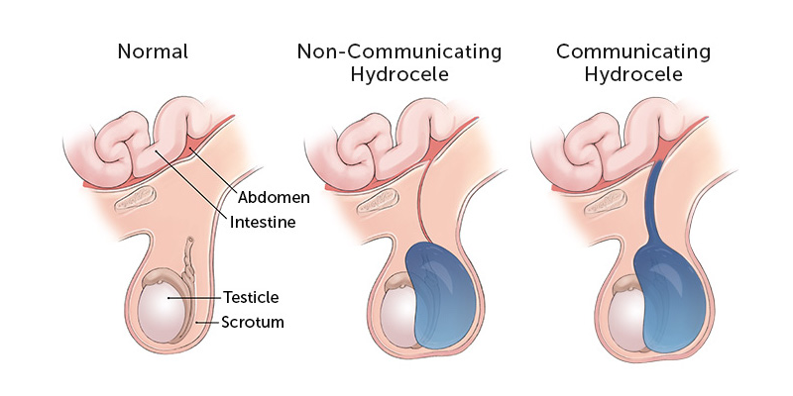

Slide 17
Conclusion
A hydrocele (HI-droe-seel) is a type of swelling in the scrotum that occurs when fluid collects in the thin sheath surrounding a testicle.
Hydrocele is common in newborns and usually disappears without treatment by age 1.
17
Notes:
SAY:
The purpose of epidemiology in public health practice is to
discover the agent, host, and environmental factors that affect health;
determine the relative importance of causes of illness, disability, and death;
identify those segments of the population that have the greatest risk from specific causes of ill health; and
evaluate the effectiveness of health programs and services in improving population health.
GO to next slide.

Slide 18
References
Google.com
Wikipedia.org
Studymafia.org
Slidespanda.com

Slide 19
Thanks To StudyMafia.org

