Slide 1
StudyMafia.Org
Harmones
Submitted To: Submitted By:
Studymafia.org Studymafia.org

Slide 2
Table Contents
Definition
Introduction
Types of Harmones
How Do You Know Which Method To Use?
Where to get contraception?
Conclusion
2
Notes:
SAY: Before we wrap up the course, let’s review what we have learned today.
During this course, we have
<READ the bullets from the slide.>
GO to next slide.

Slide 3
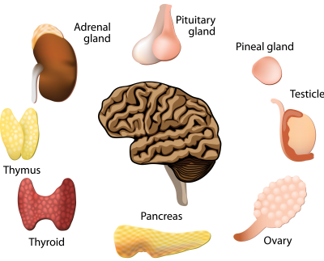
Definition
“Hormones are chemicals synthesized and produced by the specialized glands to control and regulate the activity of certain cells and organs. These specialized glands are known as endocrine glands.”
3
Notes:
SAY: Before we wrap up the course, let’s review what we have learned today.
During this course, we have
<READ the bullets from the slide.>
GO to next slide.

Slide 4
Introduction
As stated above, hormones are chemicals that essentially function as messengers of the body. These chemicals are secreted by special glands known as the endocrine glands.
These endocrine glands are distributed throughout the body. These messengers control many physiological functions as well as psychological health.
They are also quite important in maintaining homeostasis in the body.
4
Notes:
SAY: Before we wrap up the course, let’s review what we have learned today.
During this course, we have
<READ the bullets from the slide.>
GO to next slide.

Slide 5
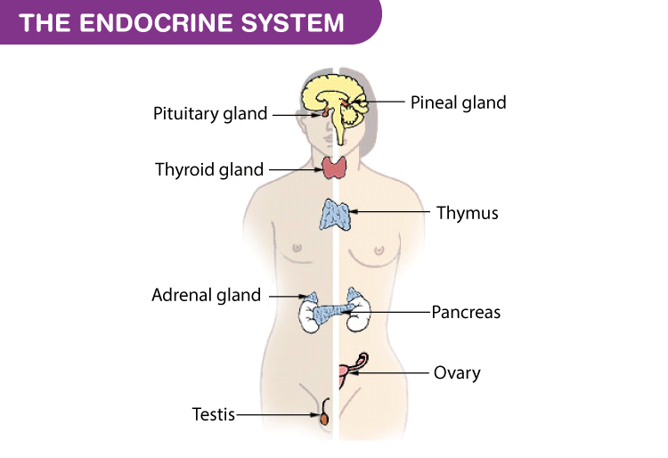
5
Notes:
SAY: Before we wrap up the course, let’s review what we have learned today.
During this course, we have
<READ the bullets from the slide.>
GO to next slide.

Slide 6
Effects of Harmones
The effects of hormones depend on how they are released. Hence, signalling effects can be classified into the following:
Autocrine: The hormone act on the cell that secreted it.
Paracrine: The hormone act on a nearby cell without having to enter the blood circulation.
●●●
6
Notes:
SAY:
The purpose of epidemiology in public health practice is to
discover the agent, host, and environmental factors that affect health;
determine the relative importance of causes of illness, disability, and death;
identify those segments of the population that have the greatest risk from specific causes of ill health; and
evaluate the effectiveness of health programs and services in improving population health.
GO to next slide.

Slide 7
Effects of Harmones
Intracrine: The hormone is produced in the cell and acts intracellularly means inside the cell.
Endocrine: The hormone act on the target cells once it is released from the respective glands into the bloodstream.
7
Notes:
SAY:
The purpose of epidemiology in public health practice is to
discover the agent, host, and environmental factors that affect health;
determine the relative importance of causes of illness, disability, and death;
identify those segments of the population that have the greatest risk from specific causes of ill health; and
evaluate the effectiveness of health programs and services in improving population health.
GO to next slide.

Slide 8
Types of Harmones
Peptide Hormones
Peptide hormones are composed of amino acids and are soluble in water. Peptide hormones are unable to pass through the cell membrane as it contains a phospholipid bilayer that stops any fat-insoluble molecules from diffusing into the cell. Insulin is an important peptide hormone produced by the pancreas.
●●●
8
Notes:
SAY:
The purpose of epidemiology in public health practice is to
discover the agent, host, and environmental factors that affect health;
determine the relative importance of causes of illness, disability, and death;
identify those segments of the population that have the greatest risk from specific causes of ill health; and
evaluate the effectiveness of health programs and services in improving population health.
GO to next slide.

Slide 9
Types of Harmones
Steroid Hormones
Unlike peptide hormones, steroid hormones are fat-soluble and are able to pass through a cell membrane. Sex hormones such as testosterone, estrogen and progesterone are examples of steroid hormones.
9
Notes:
SAY:
The purpose of epidemiology in public health practice is to
discover the agent, host, and environmental factors that affect health;
determine the relative importance of causes of illness, disability, and death;
identify those segments of the population that have the greatest risk from specific causes of ill health; and
evaluate the effectiveness of health programs and services in improving population health.
GO to next slide.

Slide 10
Harmones Secreted
Hypothalamus: It controls the body temperature, regulates emotions, hunger, thirst, sleep, moods and allow the production of hormones.
Pineal: Pineal is also known as the thalamus. It produces serotonin derivatives of melatonin, which affects sleep patterns.
●●●
10
Notes:
SAY:
The purpose of epidemiology in public health practice is to
discover the agent, host, and environmental factors that affect health;
determine the relative importance of causes of illness, disability, and death;
identify those segments of the population that have the greatest risk from specific causes of ill health; and
evaluate the effectiveness of health programs and services in improving population health.
GO to next slide.

Slide 11
Harmones Secreted
Parathyroid: This gland helps in controlling the amount of calcium present in the body.
Thymus: It helps in the production of T-cells, functioning of the adaptive immune system and maturity of the thymus.
Thyroid: It produces hormones that affect the heart rate and how calories are burnt.
●●●
11
Notes:
SAY:
The purpose of epidemiology in public health practice is to
discover the agent, host, and environmental factors that affect health;
determine the relative importance of causes of illness, disability, and death;
identify those segments of the population that have the greatest risk from specific causes of ill health; and
evaluate the effectiveness of health programs and services in improving population health.
GO to next slide.

Slide 12
Harmones Secreted
Adrenal: This gland produces the hormones that control the sex drive, cortisol and stress hormone.
Pituitary: It is also termed as the “master control gland,”. This is because the pituitary gland helps in controlling other glands. Moreover, it develops the hormones that trigger growth and development.
●●●
12
Notes:
SAY:
The purpose of epidemiology in public health practice is to
discover the agent, host, and environmental factors that affect health;
determine the relative importance of causes of illness, disability, and death;
identify those segments of the population that have the greatest risk from specific causes of ill health; and
evaluate the effectiveness of health programs and services in improving population health.
GO to next slide.

Slide 13
Harmones Secreted
Pancreas: This gland is involved in the production of insulin hormones, which plays a crucial role in maintaining blood sugar levels.
Testes: In men, the testes secrete the male sex hormone, testosterone. It also produces sperm.
Ovaries: In the female reproductive system, the ovaries release estrogen, progesterone, testosterone and other female sex hormones.
13
Notes:
SAY:
The purpose of epidemiology in public health practice is to
discover the agent, host, and environmental factors that affect health;
determine the relative importance of causes of illness, disability, and death;
identify those segments of the population that have the greatest risk from specific causes of ill health; and
evaluate the effectiveness of health programs and services in improving population health.
GO to next slide.

Slide 14
Important Harmones
Cortisol – It has been named as the “stress hormone” as it helps the body in responding to stress. This is done by increasing the heart rate, elevating blood sugar levels etc.
Melatonin – It primarily controls the circadian rhythm or sleep cycles.
●●●
14
Notes:
SAY:
The purpose of epidemiology in public health practice is to
discover the agent, host, and environmental factors that affect health;
determine the relative importance of causes of illness, disability, and death;
identify those segments of the population that have the greatest risk from specific causes of ill health; and
evaluate the effectiveness of health programs and services in improving population health.
GO to next slide.

Slide 15
Important Harmones
Estrogen-This is the main sex hormone present in women which bring about puberty, prepares the uterus and body for pregnancy and even regulates the menstrual cycle. Estrogen level changes during menopause because of which women experience many uncomfortable symptoms.
●●●
15
Notes:
SAY:
The purpose of epidemiology in public health practice is to
discover the agent, host, and environmental factors that affect health;
determine the relative importance of causes of illness, disability, and death;
identify those segments of the population that have the greatest risk from specific causes of ill health; and
evaluate the effectiveness of health programs and services in improving population health.
GO to next slide.

Slide 16
Important Harmones
Progesterone – It is a female sex hormone also responsible for menstrual cycle, pregnancy and embryogenesis.
Testosterone – This is the most important sex hormone synthesized in men, which cause puberty, muscle mass growth, and strengthen the bones and muscles, increase bone density and controls facial hair growth.
16
Notes:
SAY:
The purpose of epidemiology in public health practice is to
discover the agent, host, and environmental factors that affect health;
determine the relative importance of causes of illness, disability, and death;
identify those segments of the population that have the greatest risk from specific causes of ill health; and
evaluate the effectiveness of health programs and services in improving population health.
GO to next slide.

Slide 17
Functions of Harmones
Food metabolism.
Growth and development.
Controlling thirst and hunger.
Maintaining body temperature.
Regulating mood and cognitive functions.
Initiating and maintaining sexual development and reproduction.
17
Notes:
SAY:
The purpose of epidemiology in public health practice is to
discover the agent, host, and environmental factors that affect health;
determine the relative importance of causes of illness, disability, and death;
identify those segments of the population that have the greatest risk from specific causes of ill health; and
evaluate the effectiveness of health programs and services in improving population health.
GO to next slide.

Slide 18
Harmonal Diseases
Several hormonal diseases occur when there is a malfunctioning of the endocrine glands. Common hormonal issues are associated with hypothalamus, adrenal and pituitary glands.
An increase or decrease in the secretion of these hormones can severely affect growth, metabolism and development.
●●●
18
Notes:
SAY:
The purpose of epidemiology in public health practice is to
discover the agent, host, and environmental factors that affect health;
determine the relative importance of causes of illness, disability, and death;
identify those segments of the population that have the greatest risk from specific causes of ill health; and
evaluate the effectiveness of health programs and services in improving population health.
GO to next slide.

Slide 19
Harmonal Diseases
Diseases such as hyperthyroidism, osteoporosis, and diabetes are caused due to hormonal imbalance.
The factors responsible for hormonal diseases can be genetic, environmental, or related to diet.
19
Notes:
SAY:
The purpose of epidemiology in public health practice is to
discover the agent, host, and environmental factors that affect health;
determine the relative importance of causes of illness, disability, and death;
identify those segments of the population that have the greatest risk from specific causes of ill health; and
evaluate the effectiveness of health programs and services in improving population health.
GO to next slide.

Slide 20
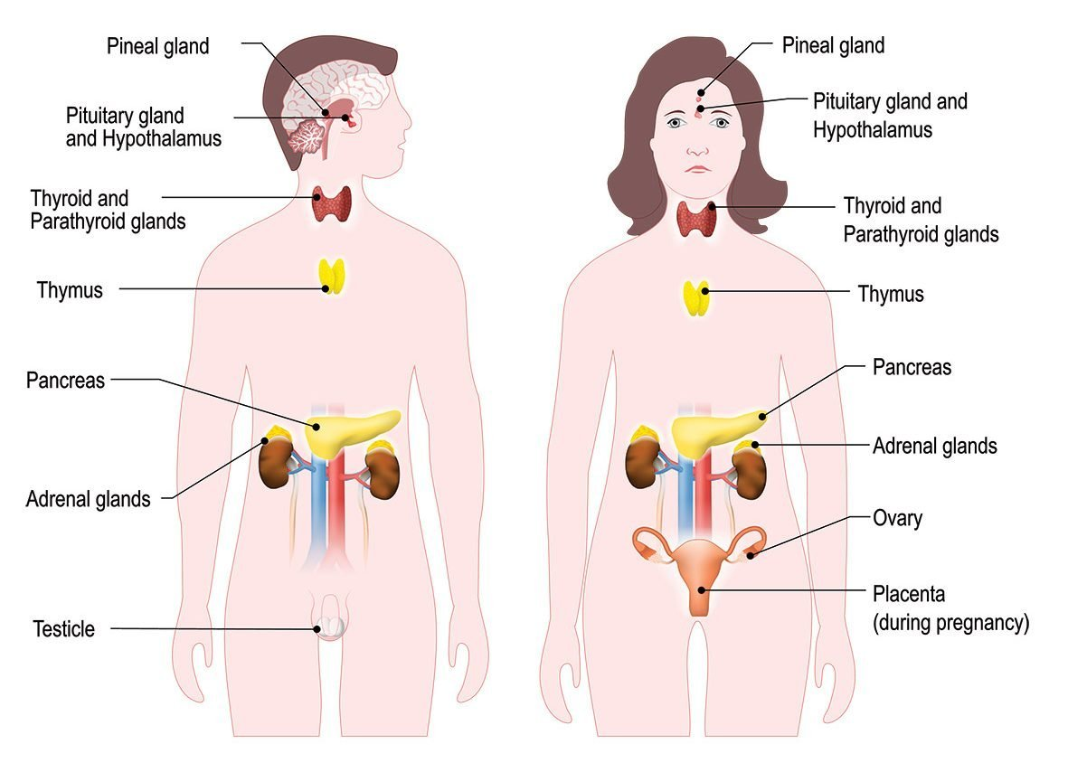

Slide 21
Conclusion
Hormones are the chemicals that are responsible for controlling and regulating the activities of certain cells and organs.
These hormones are secreted by ductless glands known as endocrine glands.
21
Notes:
SAY:
The purpose of epidemiology in public health practice is to
discover the agent, host, and environmental factors that affect health;
determine the relative importance of causes of illness, disability, and death;
identify those segments of the population that have the greatest risk from specific causes of ill health; and
evaluate the effectiveness of health programs and services in improving population health.
GO to next slide.

Slide 22
Thanks To StudyMafia.org

