Slide 1
StudyMafia.Org
Energy Flow In Ecosystem
Submitted To: Submitted By:
Studymafia.org Studymafia.org

Slide 2
Table Contents
Definition
Introduction
Energy Flow in Ecosystem
Trophic Level
Food Chain in Ecosystem
Conclusion
2
Notes:
SAY: Before we wrap up the course, let’s review what we have learned today.
During this course, we have
<READ the bullets from the slide.>
GO to next slide.

Slide 3
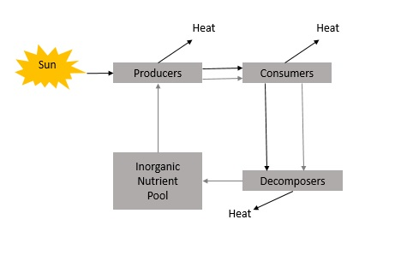
Definition
The energy flow in the ecosystem is one of the major factors that support the survival of such a great number of organisms.
3
Notes:
SAY: Before we wrap up the course, let’s review what we have learned today.
During this course, we have
<READ the bullets from the slide.>
GO to next slide.

Slide 4
Introduction
For almost all organisms on earth, the primary source of energy is solar energy. It is amusing to find that we receive less than 50 per cent of the sun’s effective radiation on earth.
When we say effective radiation, we mean the radiation, which can be used by plants to carry out photosynthesis.
4
Notes:
SAY: Before we wrap up the course, let’s review what we have learned today.
During this course, we have
<READ the bullets from the slide.>
GO to next slide.

Slide 5
Energy Flow in Ecosystem
The chemical energy of food is the main source of energy required by all living organisms.
This energy is transmitted to different trophic levels along the food chain. This energy flow is based on two different laws of thermodynamics
●●●
5
Notes:
SAY:
The purpose of epidemiology in public health practice is to
discover the agent, host, and environmental factors that affect health;
determine the relative importance of causes of illness, disability, and death;
identify those segments of the population that have the greatest risk from specific causes of ill health; and
evaluate the effectiveness of health programs and services in improving population health.
GO to next slide.

Slide 6
Energy Flow in Ecosystem
First law of thermodynamics, that states that energy can neither be created nor destroyed, it can only change from one form to another.
Second law of thermodynamics, that states that as energy is transferred more and more of it is wasted.
●●●
6
Notes:
SAY:
The purpose of epidemiology in public health practice is to
discover the agent, host, and environmental factors that affect health;
determine the relative importance of causes of illness, disability, and death;
identify those segments of the population that have the greatest risk from specific causes of ill health; and
evaluate the effectiveness of health programs and services in improving population health.
GO to next slide.

Slide 7
Energy Flow in Ecosystem
The energy flow in the ecosystem is one of the major factors that support the survival of such a great number of organisms.
For almost all organisms on earth, the primary source of energy is solar energy.
It is amusing to find that we receive less than 50 per cent of the sun’s effective radiation on earth.
●●●
7
Notes:
SAY:
The purpose of epidemiology in public health practice is to
discover the agent, host, and environmental factors that affect health;
determine the relative importance of causes of illness, disability, and death;
identify those segments of the population that have the greatest risk from specific causes of ill health; and
evaluate the effectiveness of health programs and services in improving population health.
GO to next slide.

Slide 8
Energy Flow in Ecosystem
When we say effective radiation, we mean the radiation, which can be used by plants to carry out photosynthesis.
Most of the sun’s radiation that falls on the earth is usually reflected back into space by the earth’s atmosphere.
This effective radiation is termed as the Photosynthetically Active Radiation (PAR).
●●●
8
Notes:
SAY:
The purpose of epidemiology in public health practice is to
discover the agent, host, and environmental factors that affect health;
determine the relative importance of causes of illness, disability, and death;
identify those segments of the population that have the greatest risk from specific causes of ill health; and
evaluate the effectiveness of health programs and services in improving population health.
GO to next slide.

Slide 9
Energy Flow in Ecosystem
Overall, we receive about 40 to 50 percent of the energy having Photosynthetically Active Radiation and only around 2-10 percent of it is used by plants for the process of photosynthesis.
Thus, this percent of PAR supports the entire world as plants are the producers in the ecosystem and all the other organisms are either directly or indirectly dependent on them for their survival.
●●●
9
Notes:
SAY:
The purpose of epidemiology in public health practice is to
discover the agent, host, and environmental factors that affect health;
determine the relative importance of causes of illness, disability, and death;
identify those segments of the population that have the greatest risk from specific causes of ill health; and
evaluate the effectiveness of health programs and services in improving population health.
GO to next slide.

Slide 10
Energy Flow in Ecosystem
The energy flow takes place via the food chain and food web.
During the process of energy flow in the ecosystem, plants being the producers absorb sunlight with the help of the chloroplasts and a part of it is transformed into chemical energy in the process of photosynthesis.
●●●
10
Notes:
SAY:
The purpose of epidemiology in public health practice is to
discover the agent, host, and environmental factors that affect health;
determine the relative importance of causes of illness, disability, and death;
identify those segments of the population that have the greatest risk from specific causes of ill health; and
evaluate the effectiveness of health programs and services in improving population health.
GO to next slide.

Slide 11
Energy Flow in Ecosystem
This energy is stored in various organic products in the plants and passed on to the primary consumers in the food chain when the herbivores consume (primary consumers) the plants as food.
Then conversion of chemical energy stored in plant products into kinetic energy occurs, degradation of energy will occur through its conversion into heat.
●●●
11
Notes:
SAY:
The purpose of epidemiology in public health practice is to
discover the agent, host, and environmental factors that affect health;
determine the relative importance of causes of illness, disability, and death;
identify those segments of the population that have the greatest risk from specific causes of ill health; and
evaluate the effectiveness of health programs and services in improving population health.
GO to next slide.

Slide 12
Energy Flow in Ecosystem
Then followed by the secondary consumers. When these herbivores are ingested by carnivores of the first order (secondary consumers) further degradation will occur.
Finally, when tertiary consumers consume the carnivores, energy will again be degraded. Thus, the energy flow is unidirectional in nature.
●●●
12
Notes:
SAY:
The purpose of epidemiology in public health practice is to
discover the agent, host, and environmental factors that affect health;
determine the relative importance of causes of illness, disability, and death;
identify those segments of the population that have the greatest risk from specific causes of ill health; and
evaluate the effectiveness of health programs and services in improving population health.
GO to next slide.

Slide 13
Energy Flow in Ecosystem
Moreover, in a food chain, the energy flow follows the 10 percent law. According to this law, only 10 percent of energy is transferred from one trophic level to the other; rest is lost into the atmosphere.
This is clearly explained in the following figure and is represented as an energy pyramid.
13
Notes:
SAY:
The purpose of epidemiology in public health practice is to
discover the agent, host, and environmental factors that affect health;
determine the relative importance of causes of illness, disability, and death;
identify those segments of the population that have the greatest risk from specific causes of ill health; and
evaluate the effectiveness of health programs and services in improving population health.
GO to next slide.

Slide 14
Trophic level
The producers and consumers in the ecosystem can be arranged into different feeding groups and are known as trophic level or the feeding level.
The producers (plants) represent the first trophic level.
Herbivores (primary consumers) present the second trophic level.
Primary carnivores (secondary consumers) represent the third trophic level
Top carnivores (tertiary consumers) represent the last level.
14
Notes:
SAY:
The purpose of epidemiology in public health practice is to
discover the agent, host, and environmental factors that affect health;
determine the relative importance of causes of illness, disability, and death;
identify those segments of the population that have the greatest risk from specific causes of ill health; and
evaluate the effectiveness of health programs and services in improving population health.
GO to next slide.

Slide 15
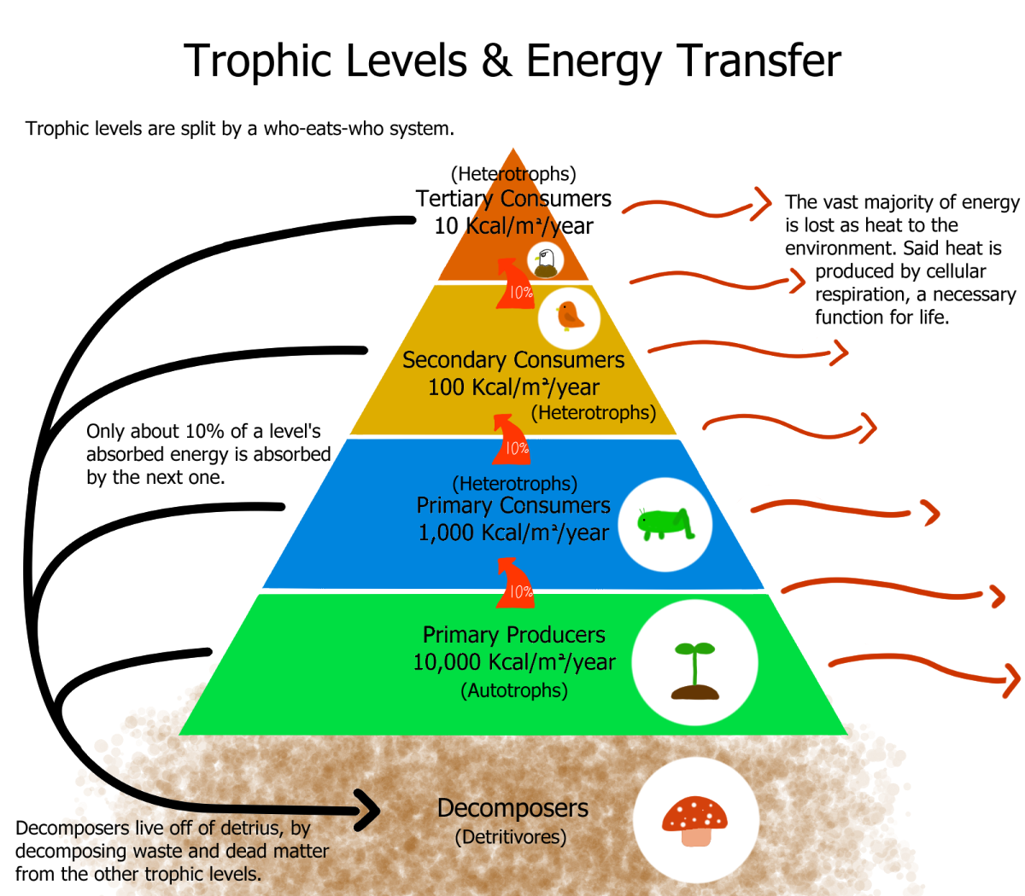
15
Notes:
SAY: Before we wrap up the course, let’s review what we have learned today.
During this course, we have
<READ the bullets from the slide.>
GO to next slide.

Slide 16
Food Chain
Grazing food chain (GFC) –
This is the normal food chain that we observe in which plants are the producers and the energy flows from the producers to the herbivores (primary consumers), then to carnivores (secondary consumers) and so on.
●●●
16
Notes:
SAY:
The purpose of epidemiology in public health practice is to
discover the agent, host, and environmental factors that affect health;
determine the relative importance of causes of illness, disability, and death;
identify those segments of the population that have the greatest risk from specific causes of ill health; and
evaluate the effectiveness of health programs and services in improving population health.
GO to next slide.

Slide 17
Food Chain
Saprophytic or Detritus food chain (DFC) –
In this type of food chain, the dead organic matter occupies the lowermost level of the food chain, followed by the decomposers and so on.
Parasitic food chain (PFC) –
In this type of food chain, large organisms either the producer or the consumer is exploited and therefore the food passes to the smaller organism.
17
Notes:
SAY:
The purpose of epidemiology in public health practice is to
discover the agent, host, and environmental factors that affect health;
determine the relative importance of causes of illness, disability, and death;
identify those segments of the population that have the greatest risk from specific causes of ill health; and
evaluate the effectiveness of health programs and services in improving population health.
GO to next slide.

Slide 18
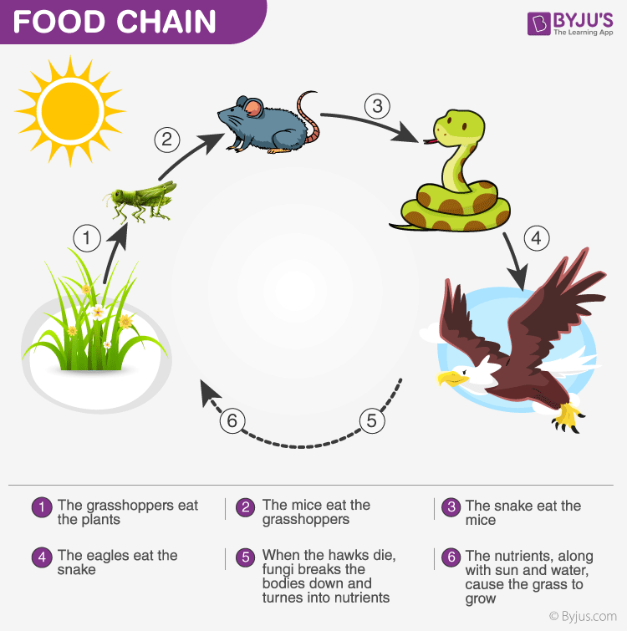

Slide 19
Conclusion
The energy flow takes place via the food chain and food web. During the process of energy flow in the ecosystem, plants being the producers absorb sunlight with the help of the chloroplasts and a part of it is transformed into chemical energy in the process of photosynthesis.
19
Notes:
SAY:
The purpose of epidemiology in public health practice is to
discover the agent, host, and environmental factors that affect health;
determine the relative importance of causes of illness, disability, and death;
identify those segments of the population that have the greatest risk from specific causes of ill health; and
evaluate the effectiveness of health programs and services in improving population health.
GO to next slide.

Slide 20
Thanks To StudyMafia.org

