Slide 1
StudyMafia.Org
Complement
System
Submitted To: Submitted By:
Studymafia.org Studymafia.org

Slide 2
Table Contents
Definition
Introduction
Main functions of the Complement System
Pathways
Complement Regulation
Diseases
Conclusion
2
Notes:
SAY: Before we wrap up the course, let’s review what we have learned today.
During this course, we have
<READ the bullets from the slide.>
GO to next slide.

Slide 3
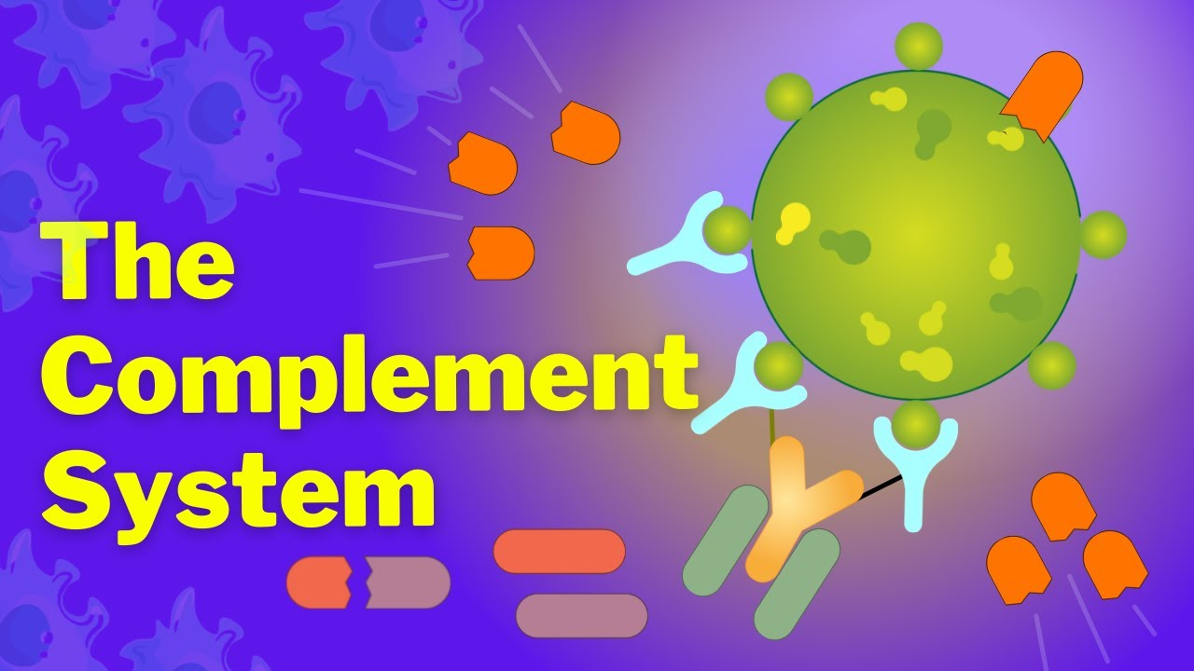
Definition
The complement system helps or “complements” the ability of antibodies and phagocytic cells to clear pathogens from an organism. It is part of the innate immune system.
3
Notes:
SAY: Before we wrap up the course, let’s review what we have learned today.
During this course, we have
<READ the bullets from the slide.>
GO to next slide.

Slide 4
Introduction
The complement system consists of a number of small proteins found in the blood, made by the liver. Normally they circulate as inactive precursors. When stimulated by a trigger, proteases split these small proteins to release active cytokines. This starts a series (a cascade) of further cleavages which release more cytokines.
This amplifies the response. So, if the original stimulus was an invading bacterium, the cytokines disrupt the phospholipid bilayer cell membrane of the target, which kills it
4
Notes:
SAY: Before we wrap up the course, let’s review what we have learned today.
During this course, we have
<READ the bullets from the slide.>
GO to next slide.

Slide 5
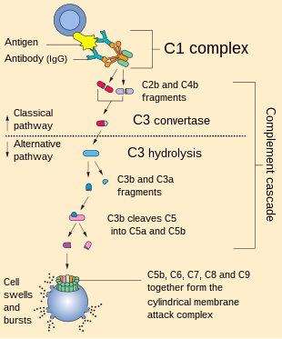
5
Notes:
SAY: Before we wrap up the course, let’s review what we have learned today.
During this course, we have
<READ the bullets from the slide.>
GO to next slide.

Slide 6
Main functions of the
Complement System
Opsonization: Increases phagocytosis by opsonins (C4b and C3b) binding to foreign organisms Image 2: Phagocytosis.
Chemotaxis: Attracts macrophages and neutrophils via inflammation by inflammatory mediators; C5a, and to a lesser extent C3a and C4a
●●●
●●●
6
Notes:
SAY:
The purpose of epidemiology in public health practice is to
discover the agent, host, and environmental factors that affect health;
determine the relative importance of causes of illness, disability, and death;
identify those segments of the population that have the greatest risk from specific causes of ill health; and
evaluate the effectiveness of health programs and services in improving population health.
GO to next slide.

Slide 7
Main functions of the
Complement System
Cell lysis: Ruptures membranes due to formation of a membrane attack complex (MAC).
Agglutination: Causes clustering and binding of pathogens
●●●
●●●
7
Notes:
SAY:
The purpose of epidemiology in public health practice is to
discover the agent, host, and environmental factors that affect health;
determine the relative importance of causes of illness, disability, and death;
identify those segments of the population that have the greatest risk from specific causes of ill health; and
evaluate the effectiveness of health programs and services in improving population health.
GO to next slide.

Slide 8
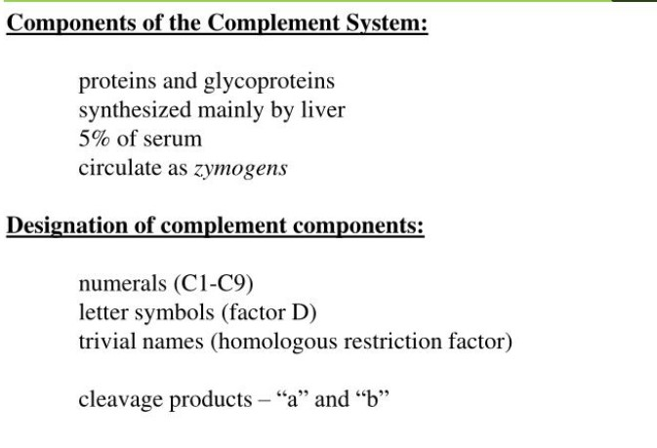

Slide 9
Pathways
Image:
A schematic representation of activation of 3 intrinsic pathways (classical, alternative, and mannose-binding lectin) to activate the complement cascade ie key-players C3 and C5 triggering the terminal pathway to constitute the Terminal Complement Complex (also known as MAC).
●●●
●●●
9
Notes:
SAY:
The purpose of epidemiology in public health practice is to
discover the agent, host, and environmental factors that affect health;
determine the relative importance of causes of illness, disability, and death;
identify those segments of the population that have the greatest risk from specific causes of ill health; and
evaluate the effectiveness of health programs and services in improving population health.
GO to next slide.

Slide 10
Pathways
Complement activation is a cascading event like the falling of a row of dominoes. It must follow a specific order if the end result is to be achieved.
The circulating proteins have been grouped into three activation pathways, based on the types of substances and proteins that initiate the activation ie Classical; Lectin; Alternative
●●●
10
●●●
Notes:
SAY:
The purpose of epidemiology in public health practice is to
discover the agent, host, and environmental factors that affect health;
determine the relative importance of causes of illness, disability, and death;
identify those segments of the population that have the greatest risk from specific causes of ill health; and
evaluate the effectiveness of health programs and services in improving population health.
GO to next slide.

Slide 11
Pathways
If you visualize a trident, the three tines represent the different initiation routes, while the handle represents the lytic mechanism by which this cascade ultimately destroys the threat, no matter which activation pathway started the response (all pathways converge to activate the pivotal protein of the complement system, called C3).
●●●
11
●●●
Notes:
SAY:
The purpose of epidemiology in public health practice is to
discover the agent, host, and environmental factors that affect health;
determine the relative importance of causes of illness, disability, and death;
identify those segments of the population that have the greatest risk from specific causes of ill health; and
evaluate the effectiveness of health programs and services in improving population health.
GO to next slide.

Slide 12
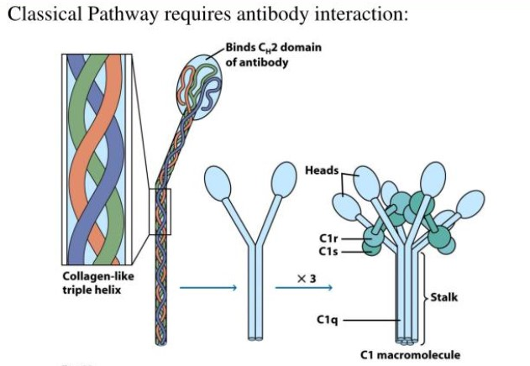

Slide 13
Complement Regulation
The complement system has the potential to be extremely damaging to host tissues; hence regulatory mechanisms are required to restrict the complement pathway.
Various plasma and cell membrane proteins regulate complement activation by inhibiting different steps in the cascade
●●●
13
Notes:
SAY:
The purpose of epidemiology in public health practice is to
discover the agent, host, and environmental factors that affect health;
determine the relative importance of causes of illness, disability, and death;
identify those segments of the population that have the greatest risk from specific causes of ill health; and
evaluate the effectiveness of health programs and services in improving population health.
GO to next slide.

Slide 14
Diseases
The complement system is diffusely active within the body, and deficiencies or dysregulation results in immune system deficiencies, autoimmune disorders, or bleeding disorders.
The complement system plays a critical role in inflammation and defence against some bacterial infections.
●●●
14
Notes:
SAY:
The purpose of epidemiology in public health practice is to
discover the agent, host, and environmental factors that affect health;
determine the relative importance of causes of illness, disability, and death;
identify those segments of the population that have the greatest risk from specific causes of ill health; and
evaluate the effectiveness of health programs and services in improving population health.
GO to next slide.

Slide 15
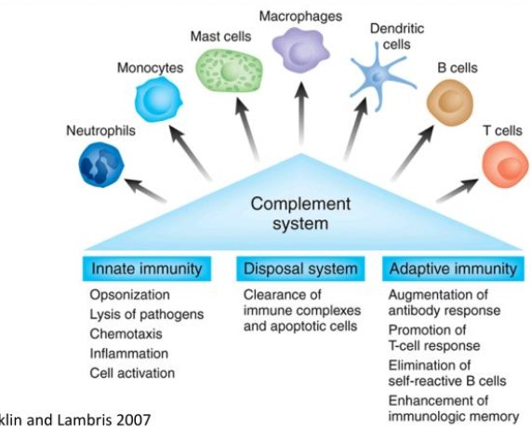

Slide 16
Conclusion
The complement system is made up of a large number of distinct plasma proteins that react with one another to opsonize pathogens and induce a series of inflammatory responses that help to fight infection.
A number of complement proteins are proteases that are themselves activated by proteolytic cleavage.
16
Notes:
SAY:
The purpose of epidemiology in public health practice is to
discover the agent, host, and environmental factors that affect health;
determine the relative importance of causes of illness, disability, and death;
identify those segments of the population that have the greatest risk from specific causes of ill health; and
evaluate the effectiveness of health programs and services in improving population health.
GO to next slide.

Slide 17
Thanks To StudyMafia.org

