Slide 1
StudyMafia.Org
Cell
Submitted To: Submitted By:
Studymafia.org Studymafia.org

Slide 2
Table Contents
Definition
Introduction
Types of Cell
Characterstics of Cell
Structure of Cell
Conclusion
2
Notes:
SAY: Before we wrap up the course, let’s review what we have learned today.
During this course, we have
<READ the bullets from the slide.>
GO to next slide.

Slide 3
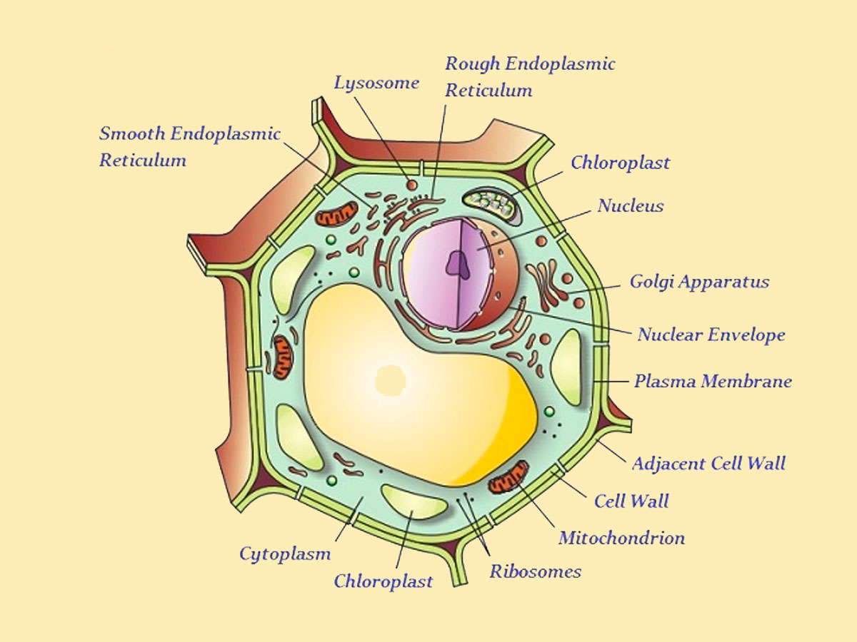
Definition
The fundamental unit of life is cell.
Cell was first discovered by Robert Hooke in 1665 in a simple microscope.
3
Notes:
SAY: Before we wrap up the course, let’s review what we have learned today.
During this course, we have
<READ the bullets from the slide.>
GO to next slide.

Slide 4
Introduction
In 1674, Leeuwenhoek, with the help of developed microscope, discovered the free living cells in pond water.
In 1831, Robert Brown had discovered the nucleus in the cell.
In 1839, Purkinje used the term ‘protoplasm’ for the fluid substance found in the cell.
The cell theory was proposed by Schleiden (1838) and Schwann (1839).
●●●
4
Notes:
SAY: Before we wrap up the course, let’s review what we have learned today.
During this course, we have
<READ the bullets from the slide.>
GO to next slide.

Slide 5
Introduction
According to the cell theory, all the plants and animals are composed of cells and that the cell is the basic unit of life.
In 1855, Virchow further expanded the cell theory and suggested that all cells arise from pre-existing cells.
In 1940, the discovery of electron microscope made possible to observe and understand the complex structure of the cell.
5
Notes:
SAY: Before we wrap up the course, let’s review what we have learned today.
During this course, we have
<READ the bullets from the slide.>
GO to next slide.

Slide 6
6
Notes:
SAY: Before we wrap up the course, let’s review what we have learned today.
During this course, we have
<READ the bullets from the slide.>
GO to next slide.

Slide 7
Types of Cell
Unicellular Organisms
The single cellular organisms, such as Amoeba, Chlamydomonas, Paramoecium, and bacteria, are known as unicellular organisms.
Multicellular Organisms
The organisms consisting of many cells are known as multicellular organisms. E.g. human being, animals, birds, etc.
7
Notes:
SAY:
The purpose of epidemiology in public health practice is to
discover the agent, host, and environmental factors that affect health;
determine the relative importance of causes of illness, disability, and death;
identify those segments of the population that have the greatest risk from specific causes of ill health; and
evaluate the effectiveness of health programs and services in improving population health.
GO to next slide.

Slide 8
Characterstics of Cell
Each living cell has the aptitude to perform certain basic functions that are characteristic of all living forms.
Each such cell has certain specific components within it known as cell organelles.
These organelles collectively constitute the basic unit of life known as cell.
●●●
8
Notes:
SAY:
The purpose of epidemiology in public health practice is to
discover the agent, host, and environmental factors that affect health;
determine the relative importance of causes of illness, disability, and death;
identify those segments of the population that have the greatest risk from specific causes of ill health; and
evaluate the effectiveness of health programs and services in improving population health.
GO to next slide.

Slide 9
Characterstics of Cell
Different types of cells have different function and each cell organelle performs a special function.
All cells are found to have the same organelles, irrespective of their different functions and the organism they found in.
9
Notes:
SAY:
The purpose of epidemiology in public health practice is to
discover the agent, host, and environmental factors that affect health;
determine the relative importance of causes of illness, disability, and death;
identify those segments of the population that have the greatest risk from specific causes of ill health; and
evaluate the effectiveness of health programs and services in improving population health.
GO to next slide.

Slide 10
Structure of Cell
Plasma Membrane/Cell Membrane
Plasma membrane is the outermost covering layer of the cell
Plasma membrane allows certain materials to enter inside the cell and come out from the cell; therefore, it is known as selectively permeable membrane.
●●●
10
Notes:
SAY:
The purpose of epidemiology in public health practice is to
discover the agent, host, and environmental factors that affect health;
determine the relative importance of causes of illness, disability, and death;
identify those segments of the population that have the greatest risk from specific causes of ill health; and
evaluate the effectiveness of health programs and services in improving population health.
GO to next slide.

Slide 11
Structure of Cell
Nucleus
Nucleus or nuculeus is a Latin term and its meaning is kernel or seed.
The nucleus has a double layered covering, which is known as nuclear membrane.
The nuclear membrane has some pores, which allow certain materials come inside (in nucleus) and go outside (in the cytoplasm).
The most significant feature of nucleus is – it contains chromosomes.
●●●
11
Notes:
SAY:
The purpose of epidemiology in public health practice is to
discover the agent, host, and environmental factors that affect health;
determine the relative importance of causes of illness, disability, and death;
identify those segments of the population that have the greatest risk from specific causes of ill health; and
evaluate the effectiveness of health programs and services in improving population health.
GO to next slide.

Slide 12
Structure of Cell
Cell wall (Protective wall):
Plants cells, in addition to the plasma membrane have another rigid outer covering called cell wall.
The cell wall lies outside the plasma membrane. The plant cell wall is mainly composed of cellulose. It is a complex substance and provides structural strength to plant cells.
●●●
12
Notes:
SAY:
The purpose of epidemiology in public health practice is to
discover the agent, host, and environmental factors that affect health;
determine the relative importance of causes of illness, disability, and death;
identify those segments of the population that have the greatest risk from specific causes of ill health; and
evaluate the effectiveness of health programs and services in improving population health.
GO to next slide.

Slide 13
Structure of Cell
Prokaryotic Cells:
In some organisms like bacteria, the nuclear material is not enclosed by nuclear membrane and membrane bound cell organelle are absent.
Such nucleus is called nucleoid and such cells are known as prokaryotic cell. Such cells have single chromosome.
●●●
13
Notes:
SAY:
The purpose of epidemiology in public health practice is to
discover the agent, host, and environmental factors that affect health;
determine the relative importance of causes of illness, disability, and death;
identify those segments of the population that have the greatest risk from specific causes of ill health; and
evaluate the effectiveness of health programs and services in improving population health.
GO to next slide.

Slide 14
Structure of Cell
Eukaryotic Cells:
Cells having well defined nucleus and having membrane bound cell organelle is termed as eukaryotic cell.
Such cells have more than one chromosomes.
●●●
14
Notes:
SAY:
The purpose of epidemiology in public health practice is to
discover the agent, host, and environmental factors that affect health;
determine the relative importance of causes of illness, disability, and death;
identify those segments of the population that have the greatest risk from specific causes of ill health; and
evaluate the effectiveness of health programs and services in improving population health.
GO to next slide.

Slide 15
Structure of Cell
Cytoplasm:
The cytoplasm is the fluid content inside the plasma membrane. It also contains many specialised cell organelles.
Cell Organelles:
Every cell has a membrane around it to keep its content separate from the external environment. The different components of cell perform different function and these components are called cell organelles.
●●●
15
Notes:
SAY:
The purpose of epidemiology in public health practice is to
discover the agent, host, and environmental factors that affect health;
determine the relative importance of causes of illness, disability, and death;
identify those segments of the population that have the greatest risk from specific causes of ill health; and
evaluate the effectiveness of health programs and services in improving population health.
GO to next slide.

Slide 16
Structure of Cell
Endoplasmic Reticulum (ER) (Channels, Network for transport):
The ER is a large network of membrane-bound tubes and sheets. It looks like long tubules or round or oblong bags.
There are two types of ER-Rough endoplasmic reticulum [RER] and smooth endoplasmic reticulum [SER].
●●●
16
Notes:
SAY:
The purpose of epidemiology in public health practice is to
discover the agent, host, and environmental factors that affect health;
determine the relative importance of causes of illness, disability, and death;
identify those segments of the population that have the greatest risk from specific causes of ill health; and
evaluate the effectiveness of health programs and services in improving population health.
GO to next slide.

Slide 17
Structure of Cell
Golgi Apparatus (Packaging):
The golgi apparatus, first described by Camillo Golgi, consists of a system of membrane-bound vesicles arranged approximately, parallel to each other in stacks called cisterns.
The material synthesised near the ER is packaged and dispatched to various targets inside and outside the cell through the Golgi apparatus.
●●●
17
Notes:
SAY:
The purpose of epidemiology in public health practice is to
discover the agent, host, and environmental factors that affect health;
determine the relative importance of causes of illness, disability, and death;
identify those segments of the population that have the greatest risk from specific causes of ill health; and
evaluate the effectiveness of health programs and services in improving population health.
GO to next slide.

Slide 18
Structure of Cell
Lysosomes [Suicide bags] (Cleanliness of cell):
Lysosomes are a kind of waste dispatch and disposal system of the cell. Lysosome help to keep the cell clean by digesting any foreign material as well as worn-out cell organelles.
Foreign materials entering the cells such as bacteria or food, as well as old organelles, end up in the lysosome, which break them up into small pieces.
●●●
18
Notes:
SAY:
The purpose of epidemiology in public health practice is to
discover the agent, host, and environmental factors that affect health;
determine the relative importance of causes of illness, disability, and death;
identify those segments of the population that have the greatest risk from specific causes of ill health; and
evaluate the effectiveness of health programs and services in improving population health.
GO to next slide.

Slide 19
Structure of Cell
Mitochondria (Powerhouse, Energy provider):
Mitochondria are known as powerhouses of the cell. The energy required for various chemical activities needed for life is released by mitochondria in the form of ATP [Adenosine Triphosphate] molecules.
ATP is known as energy currency of the cell. Mitochondria have two membrane coverings instead of just one.
●●●
19
Notes:
SAY:
The purpose of epidemiology in public health practice is to
discover the agent, host, and environmental factors that affect health;
determine the relative importance of causes of illness, disability, and death;
identify those segments of the population that have the greatest risk from specific causes of ill health; and
evaluate the effectiveness of health programs and services in improving population health.
GO to next slide.

Slide 20
Structure of Cell
Plastids:
Plastids are present only in plant cells. There are two types of plastids chromoplasts and leucoplasts. Chromoplasts are the coloured plastids present in leaves, flowers and fruits. Plastids containing the pigment chlorophyll are known as chloroplasts.
They are important for photosynthesis in plants. Chloroplasts also contain various yellow or orange pigments in addition to chlorophyll.
●●●
20
Notes:
SAY:
The purpose of epidemiology in public health practice is to
discover the agent, host, and environmental factors that affect health;
determine the relative importance of causes of illness, disability, and death;
identify those segments of the population that have the greatest risk from specific causes of ill health; and
evaluate the effectiveness of health programs and services in improving population health.
GO to next slide.

Slide 21
Structure of Cell
Vacuoles (Storage):
Vacuoles are storage sacs for solid or liquid contents. Vacuoles are small-sized in animal cells while plant cells have very large vacuoles [50% to 90% cell volume].
In Amoeba, the food vacuole contain the food items that is consumed by it and contractile vacuoles expels excess water and some wastes from the cell.
21
Notes:
SAY:
The purpose of epidemiology in public health practice is to
discover the agent, host, and environmental factors that affect health;
determine the relative importance of causes of illness, disability, and death;
identify those segments of the population that have the greatest risk from specific causes of ill health; and
evaluate the effectiveness of health programs and services in improving population health.
GO to next slide.

Slide 22
Conclusion
A cell is the smallest and basic unit of life. A cell is not visible to the naked eye because of its minute size.
A cell can have different shapes and sizes within the same organism. Every organism possesses different types of cells.
22
Notes:
SAY:
The purpose of epidemiology in public health practice is to
discover the agent, host, and environmental factors that affect health;
determine the relative importance of causes of illness, disability, and death;
identify those segments of the population that have the greatest risk from specific causes of ill health; and
evaluate the effectiveness of health programs and services in improving population health.
GO to next slide.

Slide 23
Thanks To StudyMafia.org

