Slide 1
StudyMafia.Org
BSC
Submitted To: Submitted By:
Studymafia.org Studymafia.org

Slide 2
Table Contents
Definition
Introduction
Characterstics of BSC
Benefits of BSC
Examples of BSC
How BSC Works?
Conclusion
2
Notes:
SAY: Before we wrap up the course, let’s review what we have learned today.
During this course, we have
<READ the bullets from the slide.>
GO to next slide.

Slide 3
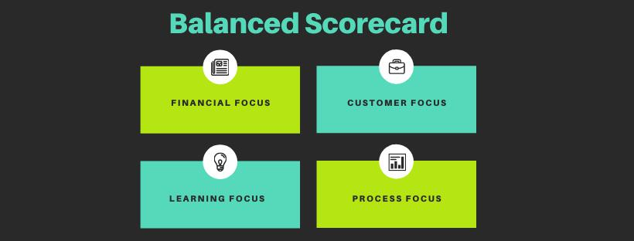
Definition
The BSC is used to gather important information, such as objectives, measurements, initiatives, and goals, that result from these four primary functions of a business.
3
Notes:
SAY: Before we wrap up the course, let’s review what we have learned today.
During this course, we have
<READ the bullets from the slide.>
GO to next slide.

Slide 4
Introduction
The scorecard can provide information about the firm as a whole when viewing company objectives. An organization may use the balanced scorecard model to implement strategy mapping to see where value is added within an organization.
This can be done by assigning tasks and projects to different areas of the company in order to boost financial and operational efficiencies, thus improving the company's bottom line.
4
Notes:
SAY: Before we wrap up the course, let’s review what we have learned today.
During this course, we have
<READ the bullets from the slide.>
GO to next slide.

Slide 5
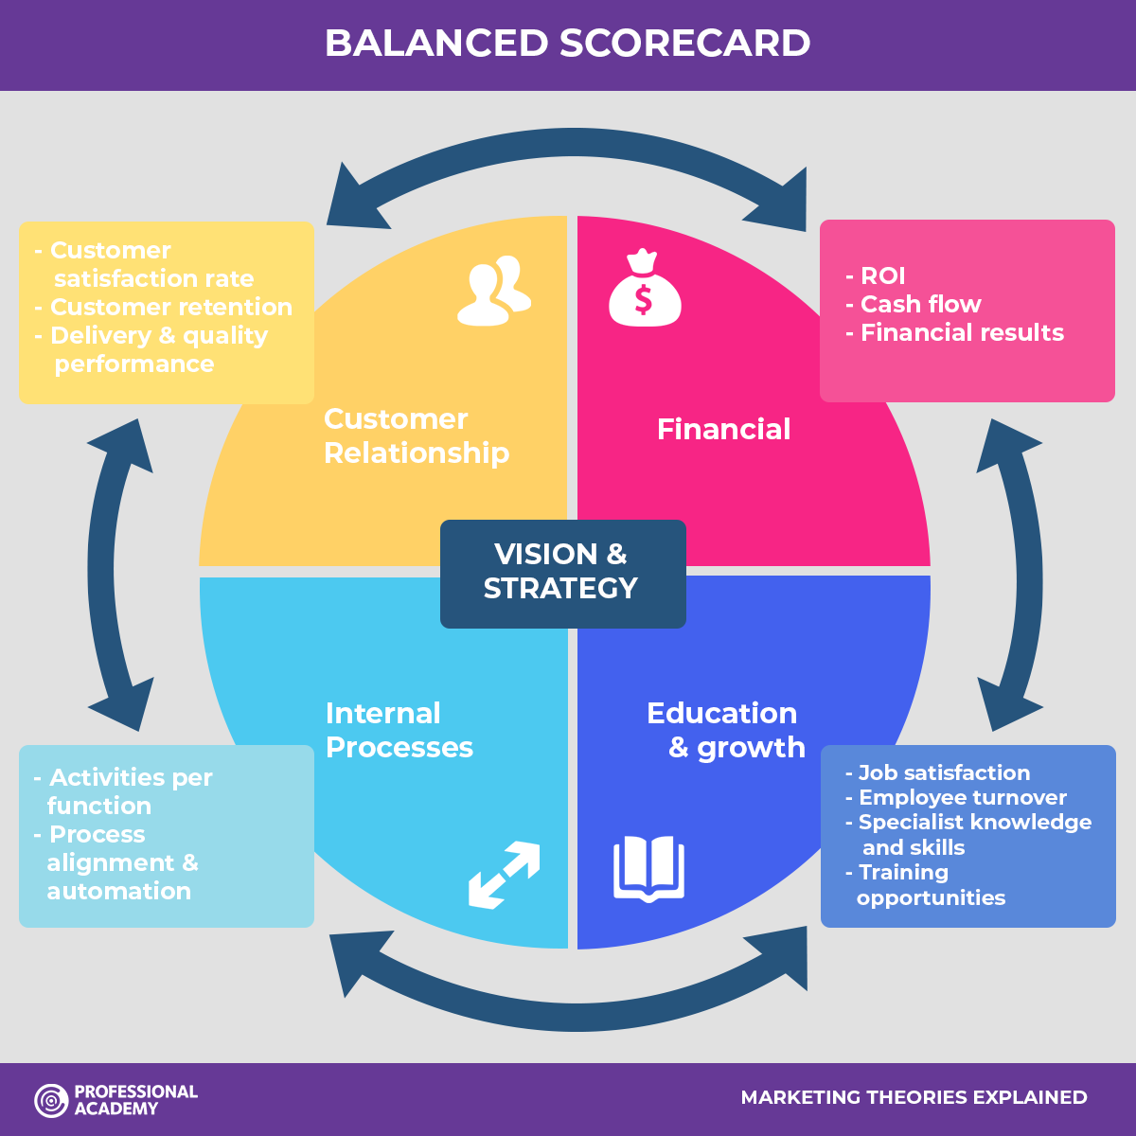
5
Notes:
SAY: Before we wrap up the course, let’s review what we have learned today.
During this course, we have
<READ the bullets from the slide.>
GO to next slide.

Slide 6
Characterstics of BSC
Learning and growth are analyzed through the investigation of training and knowledge resources.
This first leg handles how well information is captured and how effectively employees use that information to convert it to a competitive advantage within the industry.
●●●
6
Notes:
SAY:
The purpose of epidemiology in public health practice is to
discover the agent, host, and environmental factors that affect health;
determine the relative importance of causes of illness, disability, and death;
identify those segments of the population that have the greatest risk from specific causes of ill health; and
evaluate the effectiveness of health programs and services in improving population health.
GO to next slide.

Slide 7
Characterstics of BSC
Business processes are evaluated by investigating how well products are manufactured.
Operational management is analyzed to track any gaps, delays, bottlenecks, shortages, or waste.
●●●
7
Notes:
SAY:
The purpose of epidemiology in public health practice is to
discover the agent, host, and environmental factors that affect health;
determine the relative importance of causes of illness, disability, and death;
identify those segments of the population that have the greatest risk from specific causes of ill health; and
evaluate the effectiveness of health programs and services in improving population health.
GO to next slide.

Slide 8
Characterstics of BSC
Customer perspectives are collected to gauge customer satisfaction with the quality, price, and availability of products or services.
Customers provide feedback about their satisfaction with current products.
●●●
8
Notes:
SAY:
The purpose of epidemiology in public health practice is to
discover the agent, host, and environmental factors that affect health;
determine the relative importance of causes of illness, disability, and death;
identify those segments of the population that have the greatest risk from specific causes of ill health; and
evaluate the effectiveness of health programs and services in improving population health.
GO to next slide.

Slide 9
Characterstics of BSC
Financial data, such as sales, expenditures, and income are used to understand financial performance.
These financial metrics may include dollar amounts, financial ratios, budget variances, or income targets.
9
Notes:
SAY:
The purpose of epidemiology in public health practice is to
discover the agent, host, and environmental factors that affect health;
determine the relative importance of causes of illness, disability, and death;
identify those segments of the population that have the greatest risk from specific causes of ill health; and
evaluate the effectiveness of health programs and services in improving population health.
GO to next slide.

Slide 10
Benefits of BSC
For instance, the BSC allows businesses to pool together information and data into a single report rather than having to deal with multiple tools.
This allows management to save time, money, and resources when they need to execute reviews to improve procedures and operations.
●●●
10
Notes:
SAY:
The purpose of epidemiology in public health practice is to
discover the agent, host, and environmental factors that affect health;
determine the relative importance of causes of illness, disability, and death;
identify those segments of the population that have the greatest risk from specific causes of ill health; and
evaluate the effectiveness of health programs and services in improving population health.
GO to next slide.

Slide 11
Benefits of BSC
Another key benefit of BSCs is how it helps companies reduce their reliance on inefficiencies in their processes. This is referred to as suboptimization.
This often results in reduced productivity or output, which can lead to higher costs, lower revenue, and a breakdown in company brand names and their reputations.
11
Notes:
SAY:
The purpose of epidemiology in public health practice is to
discover the agent, host, and environmental factors that affect health;
determine the relative importance of causes of illness, disability, and death;
identify those segments of the population that have the greatest risk from specific causes of ill health; and
evaluate the effectiveness of health programs and services in improving population health.
GO to next slide.

Slide 12
Examples of BSC
For example, banks often contact customers and conduct surveys to gauge how well they do in their customer service. These surveys include rating recent banking visits, with questions ranging from wait times, interactions with bank staff, and overall satisfaction.
●●●
12
Notes:
SAY:
The purpose of epidemiology in public health practice is to
discover the agent, host, and environmental factors that affect health;
determine the relative importance of causes of illness, disability, and death;
identify those segments of the population that have the greatest risk from specific causes of ill health; and
evaluate the effectiveness of health programs and services in improving population health.
GO to next slide.

Slide 13
Examples of BSC
For instance, the J.D. Power survey is one of the most common examples of a balanced scorecard.
This firm provides data, insights, and advisory services to help companies identify problems in their operations and make improvements for the future.
13
Notes:
SAY:
The purpose of epidemiology in public health practice is to
discover the agent, host, and environmental factors that affect health;
determine the relative importance of causes of illness, disability, and death;
identify those segments of the population that have the greatest risk from specific causes of ill health; and
evaluate the effectiveness of health programs and services in improving population health.
GO to next slide.

Slide 14
How BSC Works?
A balanced scorecard is a strategic management performance metric that helps companies identify and improve their internal operations to help their external outcomes.
It measures past performance data and provides organizations with feedback on how to make better decisions in the future.
●●●
14
Notes:
SAY:
The purpose of epidemiology in public health practice is to
discover the agent, host, and environmental factors that affect health;
determine the relative importance of causes of illness, disability, and death;
identify those segments of the population that have the greatest risk from specific causes of ill health; and
evaluate the effectiveness of health programs and services in improving population health.
GO to next slide.

Slide 15
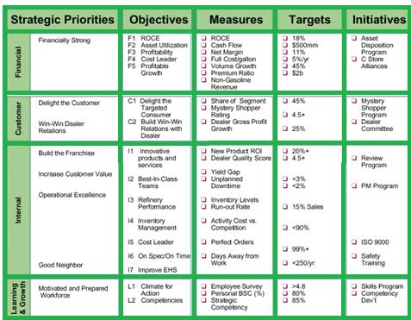

Slide 16
Conclusion
Companies have a number of options available to help identify and resolve issues with their internal processes so they can improve their financial success.
Balanced scorecards allow companies to collect and study data from four key areas, including learning and growth, business processes, customers, and finance
16
Notes:
SAY:
The purpose of epidemiology in public health practice is to
discover the agent, host, and environmental factors that affect health;
determine the relative importance of causes of illness, disability, and death;
identify those segments of the population that have the greatest risk from specific causes of ill health; and
evaluate the effectiveness of health programs and services in improving population health.
GO to next slide.

Slide 17
Thanks To StudyMafia.org

