Slide 1
StudyMafia.Org
Typhoid Fever
Submitted To: Submitted By:
Studymafia.org Studymafia.org

Slide 2
Table Contents
Definition
Introduction
Symptoms of Typhoid Fever
Causes of Typhoid Fever
Risk-Factors of Typhoid Fever
Prevention of Typhoid Fever
Diagnosis of Typhoid Fever
Treatment of Typhoid Fever
Conclusion
2
Notes:
SAY: Before we wrap up the course, let’s review what we have learned today.
During this course, we have
<READ the bullets from the slide.>
GO to next slide.

Slide 3
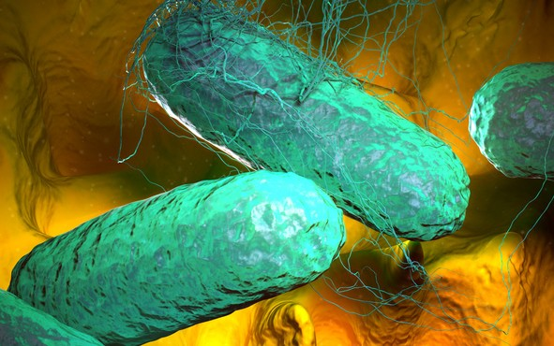
Definition
Typhoid fever is caused by Salmonella typhi bacteria. Typhoid fever is rare in developed countries. It is still a serious health threat in the developing world, especially for children.
3
Notes:
SAY: Before we wrap up the course, let’s review what we have learned today.
During this course, we have
<READ the bullets from the slide.>
GO to next slide.

Slide 4
Introduction
Most people who have typhoid fever feel better a few days after they start antibiotic treatment, but a small number of them may die of complications. Vaccines against typhoid fever are only partially effective.
Vaccines usually are reserved for those who may be exposed to the disease or who are traveling to areas where typhoid fever is common.
4
Notes:
SAY: Before we wrap up the course, let’s review what we have learned today.
During this course, we have
<READ the bullets from the slide.>
GO to next slide.

Slide 5
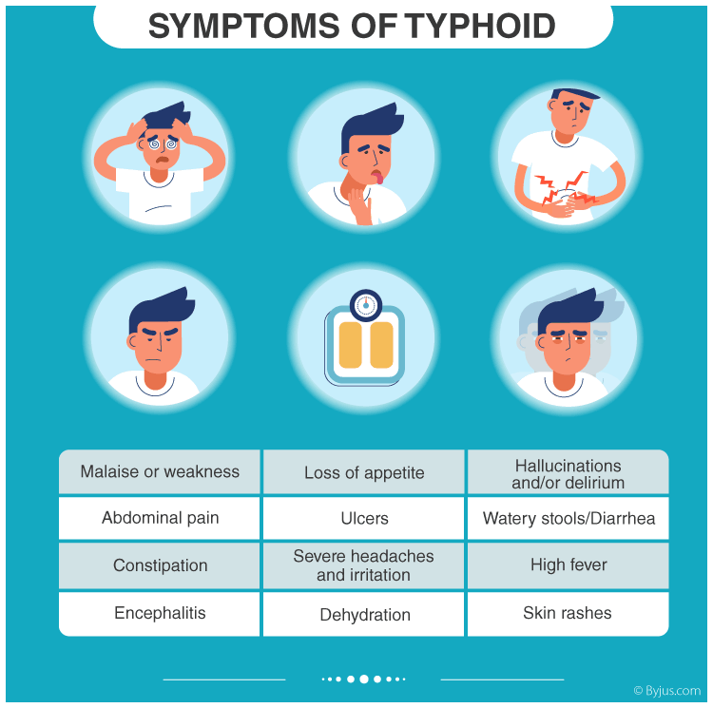
Symptoms of Typhoid Fever
5
Notes:
SAY: Before we wrap up the course, let’s review what we have learned today.
During this course, we have
<READ the bullets from the slide.>
GO to next slide.

Slide 6
Causes of Typhoid Fever
Fecal-oral transmission route
Most people in developed countries pick up typhoid bacteria while they're traveling. Once they have been infected, they can spread it to others through the fecal-oral route.
This means that Salmonella typhi is passed in the feces and sometimes in the urine of infected people
●●●
6
Notes:
SAY:
The purpose of epidemiology in public health practice is to
discover the agent, host, and environmental factors that affect health;
determine the relative importance of causes of illness, disability, and death;
identify those segments of the population that have the greatest risk from specific causes of ill health; and
evaluate the effectiveness of health programs and services in improving population health.
GO to next slide.

Slide 7
Causes of Typhoid Fever
Typhoid carriers
Even after antibiotic treatment, a small number of people who recover from typhoid fever continue to harbor the bacteria. These people, known as chronic carriers, no longer have signs or symptoms of the disease themselves.
7
Notes:
SAY:
The purpose of epidemiology in public health practice is to
discover the agent, host, and environmental factors that affect health;
determine the relative importance of causes of illness, disability, and death;
identify those segments of the population that have the greatest risk from specific causes of ill health; and
evaluate the effectiveness of health programs and services in improving population health.
GO to next slide.

Slide 8
Risk-Factors of Typhoid Fever
Typhoid fever is a serious worldwide threat and affects about 27 million or more people each year. The disease is established in India, Southeast Asia, Africa, South America and many other areas.
Worldwide, children are at greatest risk of getting the disease, although they generally have milder symptoms than adults do.
●●●
8
Notes:
SAY:
The purpose of epidemiology in public health practice is to
discover the agent, host, and environmental factors that affect health;
determine the relative importance of causes of illness, disability, and death;
identify those segments of the population that have the greatest risk from specific causes of ill health; and
evaluate the effectiveness of health programs and services in improving population health.
GO to next slide.

Slide 9
Risk-Factors of Typhoid Fever
Inflammation of the heart muscle (myocarditis)
Inflammation of the lining of the heart and valves (endocarditis)
Infection of major blood vessels (mycotic aneurysm)
Pneumonia
Inflammation of the pancreas (pancreatitis)
●●●
9
Notes:
SAY:
The purpose of epidemiology in public health practice is to
discover the agent, host, and environmental factors that affect health;
determine the relative importance of causes of illness, disability, and death;
identify those segments of the population that have the greatest risk from specific causes of ill health; and
evaluate the effectiveness of health programs and services in improving population health.
GO to next slide.

Slide 10
Risk-Factors of Typhoid Fever
Work in or travel to areas where typhoid fever is established
Work as a clinical microbiologist handling Salmonella typhi bacteria
Have close contact with someone who is infected or has recently been infected with typhoid fever
Drink water polluted by sewage that contains Salmonella typhi
10
Notes:
SAY:
The purpose of epidemiology in public health practice is to
discover the agent, host, and environmental factors that affect health;
determine the relative importance of causes of illness, disability, and death;
identify those segments of the population that have the greatest risk from specific causes of ill health; and
evaluate the effectiveness of health programs and services in improving population health.
GO to next slide.

Slide 11
Prevention of Typhoid Fever
Safe drinking water, improved sanitation and adequate medical care can help prevent and control typhoid fever.
Unfortunately, in many developing nations, these may be difficult to achieve. For this reason, some experts believe that vaccines are the best way to control typhoid fever.
●●●
11
Notes:
SAY:
The purpose of epidemiology in public health practice is to
discover the agent, host, and environmental factors that affect health;
determine the relative importance of causes of illness, disability, and death;
identify those segments of the population that have the greatest risk from specific causes of ill health; and
evaluate the effectiveness of health programs and services in improving population health.
GO to next slide.

Slide 12
Prevention of Typhoid Fever
Vaccines
Two vaccines are available.
One is given as a single shot at least one week before travel.
One is given orally in four capsules, with one capsule to be taken every other day.
●●●
12
Notes:
SAY:
The purpose of epidemiology in public health practice is to
discover the agent, host, and environmental factors that affect health;
determine the relative importance of causes of illness, disability, and death;
identify those segments of the population that have the greatest risk from specific causes of ill health; and
evaluate the effectiveness of health programs and services in improving population health.
GO to next slide.

Slide 13
Prevention of Typhoid Fever
Wash your hands. Frequent hand-washing in hot, soapy water is the best way to control infection. Wash before eating or preparing food and after using the toilet.
Avoid drinking untreated water. Contaminated drinking water is a particular problem in areas where typhoid fever is endemic
●●●
13
Notes:
SAY:
The purpose of epidemiology in public health practice is to
discover the agent, host, and environmental factors that affect health;
determine the relative importance of causes of illness, disability, and death;
identify those segments of the population that have the greatest risk from specific causes of ill health; and
evaluate the effectiveness of health programs and services in improving population health.
GO to next slide.

Slide 14
Prevention of Typhoid Fever
Avoid raw fruits and vegetables. Because raw produce may have been washed in contaminated water, avoid fruits and vegetables that you can't peel, especially lettuce.
Choose hot foods. Avoid food that's stored or served at room temperature. Steaming hot foods are best
●●●
14
Notes:
SAY:
The purpose of epidemiology in public health practice is to
discover the agent, host, and environmental factors that affect health;
determine the relative importance of causes of illness, disability, and death;
identify those segments of the population that have the greatest risk from specific causes of ill health; and
evaluate the effectiveness of health programs and services in improving population health.
GO to next slide.

Slide 15
Prevention of Typhoid Fever
Take your antibiotics. Follow your doctor's instructions for taking your antibiotics, and be sure to finish the entire prescription.
Wash your hands often. This is the single most important thing you can do to keep from spreading the infection to others.
15
Notes:
SAY:
The purpose of epidemiology in public health practice is to
discover the agent, host, and environmental factors that affect health;
determine the relative importance of causes of illness, disability, and death;
identify those segments of the population that have the greatest risk from specific causes of ill health; and
evaluate the effectiveness of health programs and services in improving population health.
GO to next slide.

Slide 16
Diagnosis of Typhoid Fever
Body fluid or tissue culture
For the culture, a small sample of your blood, stool, urine or bone marrow is placed on a special medium that encourages the growth of bacteria. The culture is checked under a microscope for the presence of typhoid bacteria. A bone marrow culture often is the most sensitive test for Salmonella typhi.
●●●
16
Notes:
SAY:
The purpose of epidemiology in public health practice is to
discover the agent, host, and environmental factors that affect health;
determine the relative importance of causes of illness, disability, and death;
identify those segments of the population that have the greatest risk from specific causes of ill health; and
evaluate the effectiveness of health programs and services in improving population health.
GO to next slide.

Slide 17
Treatment of Typhoid Fever
Ciprofloxacin (Cipro). In the United States, doctors often prescribe this for adults who aren't pregnant.
Azithromycin (Zithromax). This may be used if a person is unable to take ciprofloxacin or the bacteria are resistant to ciprofloxacin.
●●●
17
Notes:
SAY:
The purpose of epidemiology in public health practice is to
discover the agent, host, and environmental factors that affect health;
determine the relative importance of causes of illness, disability, and death;
identify those segments of the population that have the greatest risk from specific causes of ill health; and
evaluate the effectiveness of health programs and services in improving population health.
GO to next slide.

Slide 18
Treatment of Typhoid Fever
Doctors no longer commonly use it because of side effects, a high rate of health deterioration after a period of improvement (relapse) and widespread bacterial resistance.
In fact, antibiotic-resistant bacteria are becoming more common, especially in the developing world.
●●●
18
Notes:
SAY:
The purpose of epidemiology in public health practice is to
discover the agent, host, and environmental factors that affect health;
determine the relative importance of causes of illness, disability, and death;
identify those segments of the population that have the greatest risk from specific causes of ill health; and
evaluate the effectiveness of health programs and services in improving population health.
GO to next slide.

Slide 19
Treatment of Typhoid Fever
Drinking fluids. This helps prevent the dehydration that results from a prolonged fever and diarrhea. If you're severely dehydrated, you may need to receive fluids through a vein (intravenously).
Surgery. If your intestines become torn, you'll need surgery to repair the hole.
19
Notes:
SAY:
The purpose of epidemiology in public health practice is to
discover the agent, host, and environmental factors that affect health;
determine the relative importance of causes of illness, disability, and death;
identify those segments of the population that have the greatest risk from specific causes of ill health; and
evaluate the effectiveness of health programs and services in improving population health.
GO to next slide.

Slide 21
Conclusion
Typhoid fever is a bacterial infection that can spread throughout the body, affecting many organs. Without prompt treatment, it can cause serious complications and can be fatal.
It's caused by a bacterium called Salmonella typhi, which is related to the bacteria that cause salmonella food poisoning.
21
Notes:
SAY:
The purpose of epidemiology in public health practice is to
discover the agent, host, and environmental factors that affect health;
determine the relative importance of causes of illness, disability, and death;
identify those segments of the population that have the greatest risk from specific causes of ill health; and
evaluate the effectiveness of health programs and services in improving population health.
GO to next slide.

Slide 22
References
Google.com
Wikipedia.org
Studymafia.org
Slidespanda.com

Slide 23
Thanks To StudyMafia.org

