Slide 1
StudyMafia.Org
Type Of Fractures
Submitted To: Submitted By:
Studymafia.org Studymafia.org

Slide 2
Table Contents
Definition
Introduction
Symptoms of Fractures
Types of Fractures
Recovery of Fractures
Prevention of Fractures
Conclusion
2
Notes:
SAY: Before we wrap up the course, let’s review what we have learned today.
During this course, we have
<READ the bullets from the slide.>
GO to next slide.

Slide 3
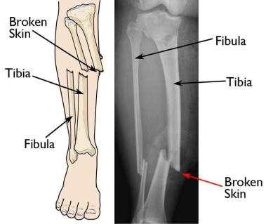
Definition
A fracture is a broken bone, the same as a crack or a break. A bone may be completely fractured or partially fractured in any number of ways (crosswise, lengthwise, in multiple pieces).
3
Notes:
SAY: Before we wrap up the course, let’s review what we have learned today.
During this course, we have
<READ the bullets from the slide.>
GO to next slide.

Slide 4
Introduction
If the force is extreme, such as that caused by an automobile crash or gunshot, the bone may shatter
The severity of a fracture usually depends on the force that caused the break. If the bone's breaking point has been exceeded only slightly, the bone may crack rather than break all the way through..
●●●
4
Notes:
SAY: Before we wrap up the course, let’s review what we have learned today.
During this course, we have
<READ the bullets from the slide.>
GO to next slide.

Slide 5
Introduction
If the bone breaks in such a way that bone fragments stick out through the skin, or a wound penetrates down to the broken bone, the fracture is called an open fracture.
This type of fracture is particularly serious because once the skin is broken, infection in both the wound and the bone can occur.
5
Notes:
SAY: Before we wrap up the course, let’s review what we have learned today.
During this course, we have
<READ the bullets from the slide.>
GO to next slide.

Slide 6
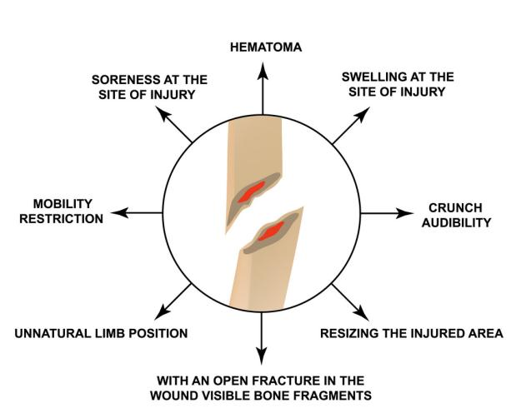
Symptoms of Fractures
6
Notes:
SAY: Before we wrap up the course, let’s review what we have learned today.
During this course, we have
<READ the bullets from the slide.>
GO to next slide.

Slide 7
Types of Fractures
Transverse Fracture
Transverse fractures are breaks that are in a straight line across the bone. This type of fracture may be caused by traumatic events like falls or automobile accidents.
●●●
7
Notes:
SAY:
The purpose of epidemiology in public health practice is to
discover the agent, host, and environmental factors that affect health;
determine the relative importance of causes of illness, disability, and death;
identify those segments of the population that have the greatest risk from specific causes of ill health; and
evaluate the effectiveness of health programs and services in improving population health.
GO to next slide.

Slide 8
Types of Fractures
2. Spiral Fracture
As the name suggests, this is a kind of fracture that spirals around the bone. Spiral fractures occur in long bones in the body, usually in the femur, tibia, or fibula in the legs. However, they can occur in the long bones of the arms.
●●●
8
Notes:
SAY:
The purpose of epidemiology in public health practice is to
discover the agent, host, and environmental factors that affect health;
determine the relative importance of causes of illness, disability, and death;
identify those segments of the population that have the greatest risk from specific causes of ill health; and
evaluate the effectiveness of health programs and services in improving population health.
GO to next slide.

Slide 9
Types of Fractures
3. Greenstick Fracture
This is a partial fracture that occurs mostly in children. The bone bends and breaks but does not separate into two separate pieces. Children are most likely to experience this type of fracture because their bones are softer and more flexible.
●●●
9
Notes:
SAY:
The purpose of epidemiology in public health practice is to
discover the agent, host, and environmental factors that affect health;
determine the relative importance of causes of illness, disability, and death;
identify those segments of the population that have the greatest risk from specific causes of ill health; and
evaluate the effectiveness of health programs and services in improving population health.
GO to next slide.

Slide 10
Types of Fractures
4. Stress Fracture
Stress fractures are also called hairline fractures. This type of fracture looks like a crack and can be difficult to diagnose with a regular X-rays. Stress fractures are often caused by repetitive motions such as running.
●●●
10
Notes:
SAY:
The purpose of epidemiology in public health practice is to
discover the agent, host, and environmental factors that affect health;
determine the relative importance of causes of illness, disability, and death;
identify those segments of the population that have the greatest risk from specific causes of ill health; and
evaluate the effectiveness of health programs and services in improving population health.
GO to next slide.

Slide 11
Types of Fractures
5. Compression Fracture
When bones are crushed it is called a compression fracture. The broken bone will be wider and flatter in appearance than it was before the injury. Compression fractures occur most often in the spine and can cause your vertebrae to collapse.
●●●
11
Notes:
SAY:
The purpose of epidemiology in public health practice is to
discover the agent, host, and environmental factors that affect health;
determine the relative importance of causes of illness, disability, and death;
identify those segments of the population that have the greatest risk from specific causes of ill health; and
evaluate the effectiveness of health programs and services in improving population health.
GO to next slide.

Slide 12
Types of Fractures
6. Oblique Fracture
An oblique fracture is when the break is diagonal across the bone. This kind of fracture occurs most often in long bones. Oblique fractures may be the result of a sharp blow that comes from an angle due to a fall or other trauma.
●●●
12
Notes:
SAY:
The purpose of epidemiology in public health practice is to
discover the agent, host, and environmental factors that affect health;
determine the relative importance of causes of illness, disability, and death;
identify those segments of the population that have the greatest risk from specific causes of ill health; and
evaluate the effectiveness of health programs and services in improving population health.
GO to next slide.

Slide 13
Types of Fractures
7. Impacted Fracture
An impacted fracture occurs when the broken ends of the bone are driven together. The pieces are jammed together by the force of the injury that caused the fracture.
●●●
13
Notes:
SAY:
The purpose of epidemiology in public health practice is to
discover the agent, host, and environmental factors that affect health;
determine the relative importance of causes of illness, disability, and death;
identify those segments of the population that have the greatest risk from specific causes of ill health; and
evaluate the effectiveness of health programs and services in improving population health.
GO to next slide.

Slide 14
Types of Fractures
8. Segmental Fracture
The same bone is fractured in two places, leaving a “floating” segment of bone between the two breaks. These fractures usually occur in long bones such as those in the legs. This type of bone fracture may take longer to heal or cause complications.
●●●
14
Notes:
SAY:
The purpose of epidemiology in public health practice is to
discover the agent, host, and environmental factors that affect health;
determine the relative importance of causes of illness, disability, and death;
identify those segments of the population that have the greatest risk from specific causes of ill health; and
evaluate the effectiveness of health programs and services in improving population health.
GO to next slide.

Slide 15
Types of Fractures
9. Comminuted Fracture
A comminuted fracture is one in which the bone is broken into 3 or more pieces. There are also bone fragments present at the fracture site. These types of bone fractures occur when there is a high-impact trauma, such as an automobile accident.
●●●
15
Notes:
SAY:
The purpose of epidemiology in public health practice is to
discover the agent, host, and environmental factors that affect health;
determine the relative importance of causes of illness, disability, and death;
identify those segments of the population that have the greatest risk from specific causes of ill health; and
evaluate the effectiveness of health programs and services in improving population health.
GO to next slide.

Slide 16
Types of Fractures
10. Avulsion Fracture
An avulsion fracture occurs when a fragment is pulled off the bone by a tendon or ligament. These types of bone fractures are more common in children than adults. Sometimes a child’s ligaments can pull hard enough to cause a growth plate to fracture
16
Notes:
SAY:
The purpose of epidemiology in public health practice is to
discover the agent, host, and environmental factors that affect health;
determine the relative importance of causes of illness, disability, and death;
identify those segments of the population that have the greatest risk from specific causes of ill health; and
evaluate the effectiveness of health programs and services in improving population health.
GO to next slide.

Slide 17
Recovery of Fractures
Fractures take several weeks to several months to heal, depending on the extent of the injury and how well you follow your doctor's advice.
Pain usually stops long before the fracture is solid enough to handle the stresses of normal activity.
●●●
17
Notes:
SAY:
The purpose of epidemiology in public health practice is to
discover the agent, host, and environmental factors that affect health;
determine the relative importance of causes of illness, disability, and death;
identify those segments of the population that have the greatest risk from specific causes of ill health; and
evaluate the effectiveness of health programs and services in improving population health.
GO to next slide.

Slide 18
Recovery of Fractures
Even after your cast or brace is removed, you may need to continue limiting your movement until the bone is solid enough for normal activity.
During your recovery you will likely lose muscle strength and range of motion in the injured area. Specific exercises will help you restore normal muscle strength, joint motion, and flexibility.
18
Notes:
SAY:
The purpose of epidemiology in public health practice is to
discover the agent, host, and environmental factors that affect health;
determine the relative importance of causes of illness, disability, and death;
identify those segments of the population that have the greatest risk from specific causes of ill health; and
evaluate the effectiveness of health programs and services in improving population health.
GO to next slide.

Slide 19
Prevention of Fractures
Proper diet and exercise may help prevent some fractures.
A diet rich in calcium and Vitamin D will promote bone strength.
Weightbearing exercise also helps keep bones strong.
●●●
19
Notes:
SAY:
The purpose of epidemiology in public health practice is to
discover the agent, host, and environmental factors that affect health;
determine the relative importance of causes of illness, disability, and death;
identify those segments of the population that have the greatest risk from specific causes of ill health; and
evaluate the effectiveness of health programs and services in improving population health.
GO to next slide.

Slide 21
Conclusion
The break goes completely through the bone, separating it in two.
Displaced fractures: A gap forms where the bone breaks. Often, this injury requires surgery to fix.
Partial fractures: The break doesn't go all the way through the bone.
21
Notes:
SAY:
The purpose of epidemiology in public health practice is to
discover the agent, host, and environmental factors that affect health;
determine the relative importance of causes of illness, disability, and death;
identify those segments of the population that have the greatest risk from specific causes of ill health; and
evaluate the effectiveness of health programs and services in improving population health.
GO to next slide.

Slide 22
References
Google.com
Wikipedia.org
Studymafia.org
Slidespanda.com

Slide 23
Thanks To StudyMafia.org

