Slide 1
StudyMafia.Org
Trigonometry
Submitted To: Submitted By:
Studymafia.org Studymafia.org

Slide 2
Table Contents
Definition
Introduction
Trigonometric Functions
TrigonometryAngles
TrigonometryTable
TrigonometryFormulas
TrigonometryBasics
Trigonometry Examples
Application of Trigonometry
Conclusion
2
Notes:
SAY: Before we wrap up the course, let’s review what we have learned today.
During this course, we have
<READ the bullets from the slide.>
GO to next slide.

Slide 3
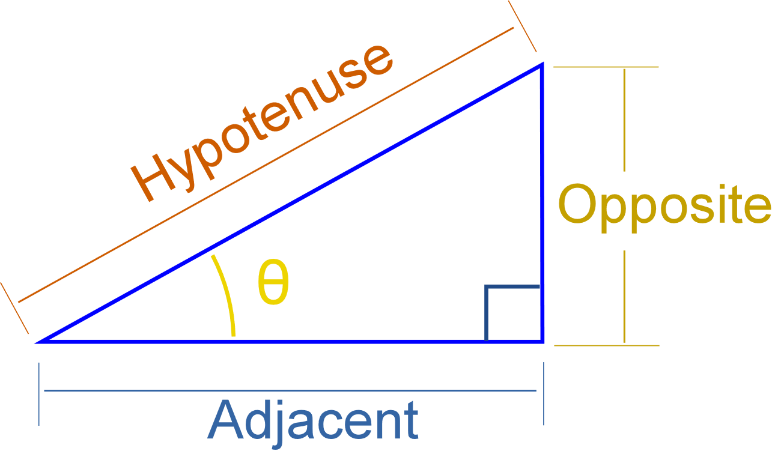
Definition
Trigonometry is one of the important branches in the history of mathematics that deals with the study of the relationship between the sides and angles of a right-angled triangle.
3
Notes:
SAY: Before we wrap up the course, let’s review what we have learned today.
During this course, we have
<READ the bullets from the slide.>
GO to next slide.

Slide 4
Introduction
The branch called “Trigonometry” basically deals with the study of the relationship between the sides and angles of the right-angle triangle.
Hence, it helps to find the missing or unknown angles or sides of a right triangle using the trigonometric formulas, functions or trigonometric identities.
Some of the most commonly used trigonometric angles for calculations are 0°, 30°, 45°, 60° and 90°.
4
Notes:
SAY: Before we wrap up the course, let’s review what we have learned today.
During this course, we have
<READ the bullets from the slide.>
GO to next slide.

Slide 5
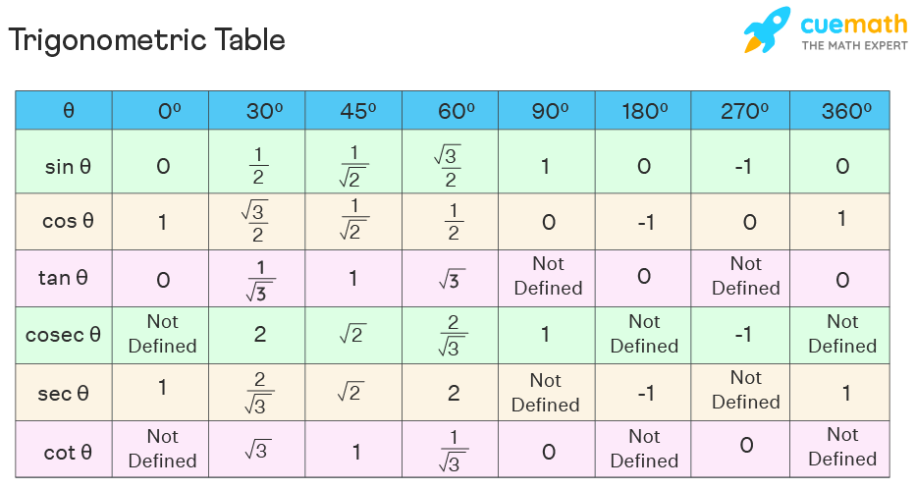
5
Notes:
SAY: Before we wrap up the course, let’s review what we have learned today.
During this course, we have
<READ the bullets from the slide.>
GO to next slide.

Slide 6
Trigonometric Functions
The six important trigonometric functions (trigonometric ratios) are calculated using the below formulas and considering the above figure.
It is necessary to get knowledge about the sides of the right triangle because it defines the set of important trigonometric functions.
●●●
6
Notes:
SAY:
The purpose of epidemiology in public health practice is to
discover the agent, host, and environmental factors that affect health;
determine the relative importance of causes of illness, disability, and death;
identify those segments of the population that have the greatest risk from specific causes of ill health; and
evaluate the effectiveness of health programs and services in improving population health.
GO to next slide.

Slide 7
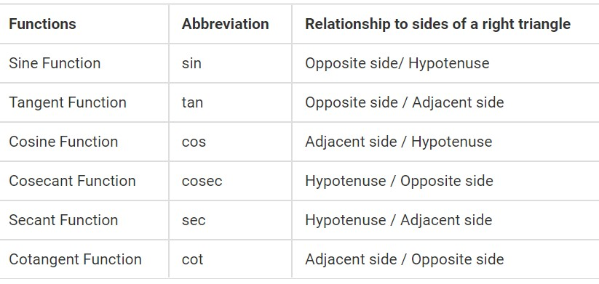
Trigonometric Functions
●●●
7
Notes:
SAY:
The purpose of epidemiology in public health practice is to
discover the agent, host, and environmental factors that affect health;
determine the relative importance of causes of illness, disability, and death;
identify those segments of the population that have the greatest risk from specific causes of ill health; and
evaluate the effectiveness of health programs and services in improving population health.
GO to next slide.

Slide 8
Trigonometric Functions
Odd trigonometric functions: A trigonometric function is said to be an odd function if f(-x) = -f(x) and symmetric with respect to the origin.
Even trigonometric functions: A trigonometric function is said to be an even function, if f(-x) = f(x) and symmetric to the y-axis.
●●●
8
Notes:
SAY:
The purpose of epidemiology in public health practice is to
discover the agent, host, and environmental factors that affect health;
determine the relative importance of causes of illness, disability, and death;
identify those segments of the population that have the greatest risk from specific causes of ill health; and
evaluate the effectiveness of health programs and services in improving population health.
GO to next slide.

Slide 9
Trigonometric Functions
Sin (-x) = – Sin x
Cos (-x) = Cos x
Tan (-x) = -Tan x
Csc (-x) = – Csc x
Sec (-x) = Sec x
Cot (-x) = -Cot x
Therefore, cosine and secant are the even trigonometric functions, whereas sine, tangent, cosecant and cotangent are the odd trigonometric functions.
9
Notes:
SAY:
The purpose of epidemiology in public health practice is to
discover the agent, host, and environmental factors that affect health;
determine the relative importance of causes of illness, disability, and death;
identify those segments of the population that have the greatest risk from specific causes of ill health; and
evaluate the effectiveness of health programs and services in improving population health.
GO to next slide.

Slide 10
Trigonometry Angles
The trigonometry angles which are commonly used in trigonometry problems are 0°, 30°, 45°, 60° and 90°.
The trigonometric ratios such as sine, cosine and tangent of these angles are easy to memorize.
To find these angles we have to draw a right-angled triangle, in which one of the acute angles will be the corresponding trigonometry angle. These angles will be defined with respect to the ratio associated with it.
●●●
10
Notes:
SAY:
The purpose of epidemiology in public health practice is to
discover the agent, host, and environmental factors that affect health;
determine the relative importance of causes of illness, disability, and death;
identify those segments of the population that have the greatest risk from specific causes of ill health; and
evaluate the effectiveness of health programs and services in improving population health.
GO to next slide.

Slide 11
Trigonometry Angles
For example, in a right-angled triangle,
Sin θ = Perpendicular/Hypotenuse
or θ = sin-1 (P/H)
Similarly,
θ = cos-1 (Base/Hypotenuse)
θ = tan-1 (Perpendicular/Base)
11
Notes:
SAY:
The purpose of epidemiology in public health practice is to
discover the agent, host, and environmental factors that affect health;
determine the relative importance of causes of illness, disability, and death;
identify those segments of the population that have the greatest risk from specific causes of ill health; and
evaluate the effectiveness of health programs and services in improving population health.
GO to next slide.

Slide 12
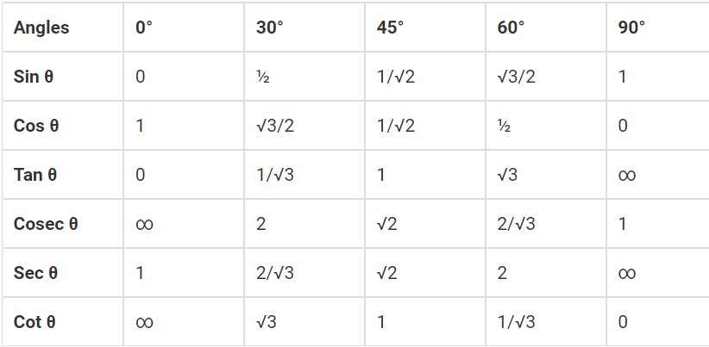
Trigonometry Table
12
Notes:
SAY:
The purpose of epidemiology in public health practice is to
discover the agent, host, and environmental factors that affect health;
determine the relative importance of causes of illness, disability, and death;
identify those segments of the population that have the greatest risk from specific causes of ill health; and
evaluate the effectiveness of health programs and services in improving population health.
GO to next slide.

Slide 13
Trigonometry Formulas
Pythagorean Identities
sin²θ + cos²θ = 1
tan2θ + 1 = sec2θ
cot2θ + 1 = cosec2θ
sin 2θ = 2 sin θ cos θ
cos 2θ = cos²θ – sin²θ
tan 2θ = 2 tan θ / (1 – tan²θ)
cot 2θ = (cot²θ – 1) / 2 cot θ
●●●
13
Notes:
SAY:
The purpose of epidemiology in public health practice is to
discover the agent, host, and environmental factors that affect health;
determine the relative importance of causes of illness, disability, and death;
identify those segments of the population that have the greatest risk from specific causes of ill health; and
evaluate the effectiveness of health programs and services in improving population health.
GO to next slide.

Slide 14
Trigonometry Formulas
●●●
14
Notes:
SAY:
The purpose of epidemiology in public health practice is to
discover the agent, host, and environmental factors that affect health;
determine the relative importance of causes of illness, disability, and death;
identify those segments of the population that have the greatest risk from specific causes of ill health; and
evaluate the effectiveness of health programs and services in improving population health.
GO to next slide.

Slide 15
Trigonometry Formulas
If A, B and C are angles and a, b and c are the sides of a triangle, then,
Sine Laws
a/sinA = b/sinB = c/sinC
Cosine Laws
c2 = a2 + b2 – 2ab cos C
a2 = b2 + c2 – 2bc cos A
b2 = a2 + c2 – 2ac cos B
●●●
15
Notes:
SAY:
The purpose of epidemiology in public health practice is to
discover the agent, host, and environmental factors that affect health;
determine the relative importance of causes of illness, disability, and death;
identify those segments of the population that have the greatest risk from specific causes of ill health; and
evaluate the effectiveness of health programs and services in improving population health.
GO to next slide.

Slide 16
Trigonometry Formulas
The three important trigonometric identities are:
sin²θ + cos²θ = 1
tan²θ + 1 = sec²θ
cot²θ + 1 = cosec²θ
●●●
16
Notes:
SAY:
The purpose of epidemiology in public health practice is to
discover the agent, host, and environmental factors that affect health;
determine the relative importance of causes of illness, disability, and death;
identify those segments of the population that have the greatest risk from specific causes of ill health; and
evaluate the effectiveness of health programs and services in improving population health.
GO to next slide.

Slide 17
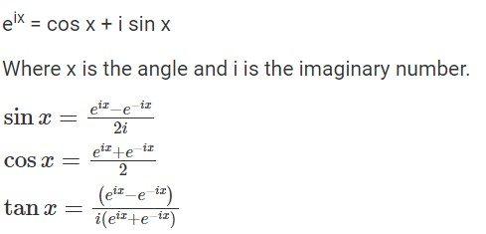
Trigonometry Formulas
Euler’s Formula for trigonometry
As per the euler’s formula,
17
Notes:
SAY:
The purpose of epidemiology in public health practice is to
discover the agent, host, and environmental factors that affect health;
determine the relative importance of causes of illness, disability, and death;
identify those segments of the population that have the greatest risk from specific causes of ill health; and
evaluate the effectiveness of health programs and services in improving population health.
GO to next slide.

Slide 18
Trigonometry Basics
The three basic functions in trigonometry are sine, cosine and tangent.
Based on these three functions the other three functions that are cotangent, secant and cosecant are derived.
All the trigonometrical concepts are based on these functions.
●●●
18
Notes:
SAY:
The purpose of epidemiology in public health practice is to
discover the agent, host, and environmental factors that affect health;
determine the relative importance of causes of illness, disability, and death;
identify those segments of the population that have the greatest risk from specific causes of ill health; and
evaluate the effectiveness of health programs and services in improving population health.
GO to next slide.

Slide 19
Trigonometry Basics
If θ is the angle in a right-angled triangle, then
Sin θ = Perpendicular/Hypotenuse
Cos θ = Base/Hypotenuse
Tan θ = Perpendicular/Base
Perpendicular is the side opposite to the angle θ.
The base is the adjacent side to the angle θ.
●●●
19
Notes:
SAY:
The purpose of epidemiology in public health practice is to
discover the agent, host, and environmental factors that affect health;
determine the relative importance of causes of illness, disability, and death;
identify those segments of the population that have the greatest risk from specific causes of ill health; and
evaluate the effectiveness of health programs and services in improving population health.
GO to next slide.

Slide 20
Trigonometry Basics
The hypotenuse is the side opposite to the right angle
Cot θ = 1/tan θ
Sec θ = 1/cos θ
Cosec θ = 1/sin θ
Hence,
Cot θ = Base/Perpendicular
Sec θ = Hypotenuse/Base
Cosec θ = Hypotenuse/Perpendicular
20
Notes:
SAY:
The purpose of epidemiology in public health practice is to
discover the agent, host, and environmental factors that affect health;
determine the relative importance of causes of illness, disability, and death;
identify those segments of the population that have the greatest risk from specific causes of ill health; and
evaluate the effectiveness of health programs and services in improving population health.
GO to next slide.

Slide 21
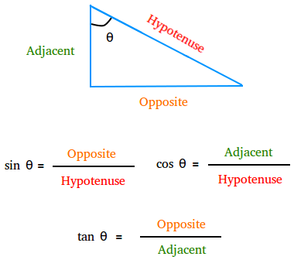

Slide 22
Trigonometry Examples
There are many real-life examples where trigonometry is used broadly.
If we have been given with height of the building and the angle formed when an object is seen from the top of the building, then the distance between object and bottom of the building can be determined by using the tangent function, such as tan of angle is equal to the ratio of the height of the building and the distance.
●●●
22
Notes:
SAY:
The purpose of epidemiology in public health practice is to
discover the agent, host, and environmental factors that affect health;
determine the relative importance of causes of illness, disability, and death;
identify those segments of the population that have the greatest risk from specific causes of ill health; and
evaluate the effectiveness of health programs and services in improving population health.
GO to next slide.

Slide 23
Trigonometry Examples
Let us say the angle is ∝, then
Tan ∝ = Height/Distance between object & building
Distance = Height/Tan ∝
Let us assume that height is 20m and the angle formed is 45 degrees, then
Distance = 20/Tan 45°
Since, tan 45° = 1
So, Distance = 20 m
23
Notes:
SAY:
The purpose of epidemiology in public health practice is to
discover the agent, host, and environmental factors that affect health;
determine the relative importance of causes of illness, disability, and death;
identify those segments of the population that have the greatest risk from specific causes of ill health; and
evaluate the effectiveness of health programs and services in improving population health.
GO to next slide.

Slide 24
Applications of Trigonometry
Its applications are in various fields like oceanography, seismology, meteorology, physical sciences, astronomy, acoustics, navigation, electronics, etc.
It is also helpful to measure the height of the mountain, find the distance of long rivers, etc.
24
Notes:
SAY:
The purpose of epidemiology in public health practice is to
discover the agent, host, and environmental factors that affect health;
determine the relative importance of causes of illness, disability, and death;
identify those segments of the population that have the greatest risk from specific causes of ill health; and
evaluate the effectiveness of health programs and services in improving population health.
GO to next slide.

Slide 25
Conclusion
Trigonometry (from Ancient Greek τρίγωνον (trígōnon) 'triangle', and μέτρον (métron) 'measure') is a branch of mathematics that studies relationships between side lengths and angles of triangles.
25
Notes:
SAY:
The purpose of epidemiology in public health practice is to
discover the agent, host, and environmental factors that affect health;
determine the relative importance of causes of illness, disability, and death;
identify those segments of the population that have the greatest risk from specific causes of ill health; and
evaluate the effectiveness of health programs and services in improving population health.
GO to next slide.

Slide 26
Thanks To StudyMafia.org

