Slide 1
StudyMafia.Org
Sepsis
Submitted To: Submitted By:
Studymafia.org Studymafia.org

Slide 2
Table Contents
Definition
Introduction
When to See a Doctor?
Symptoms of Sepsis
Causes of Sepsis
Risk-Factors of Sepsis
Complications of Sepsis
Diagnosis of Sepsis
Treatment of Sepsis
Conclusion
2
Notes:
SAY: Before we wrap up the course, let’s review what we have learned today.
During this course, we have
<READ the bullets from the slide.>
GO to next slide.

Slide 3
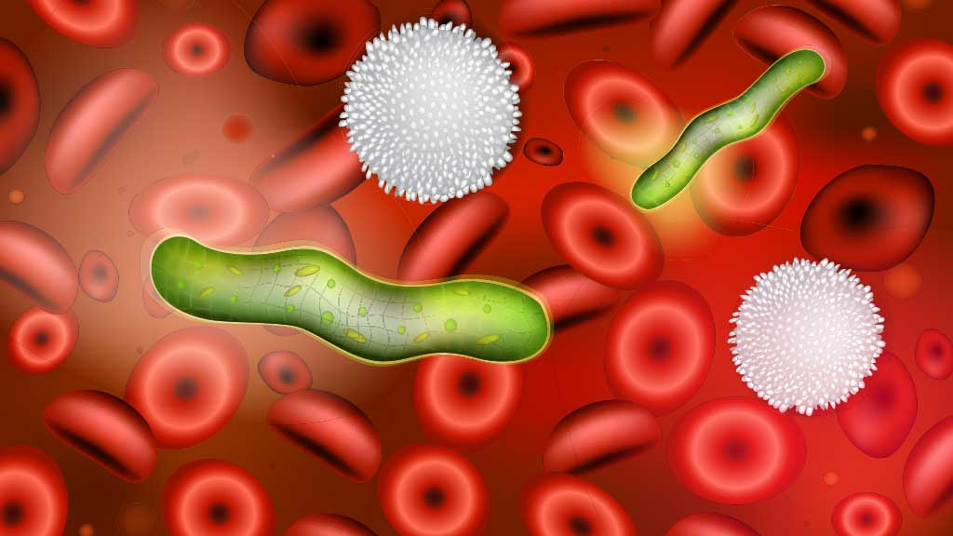
Definition
Sepsis is a potentially life-threatening condition that occurs when the body's response to an infection damages its own tissues.
3
Notes:
SAY: Before we wrap up the course, let’s review what we have learned today.
During this course, we have
<READ the bullets from the slide.>
GO to next slide.

Slide 4
Introduction
When the infection-fighting processes turn on the body, they cause organs to function poorly and abnormally.
Sepsis may progress to septic shock. This is a dramatic drop in blood pressure that can lead to severe organ problems and death.
Early treatment with antibiotics and intravenous fluids improves chances for survival.
4
Notes:
SAY: Before we wrap up the course, let’s review what we have learned today.
During this course, we have
<READ the bullets from the slide.>
GO to next slide.

Slide 5
When to See a Doctor?
Most often, sepsis occurs in people who are hospitalized or who have recently been hospitalized.
People in an intensive care unit are more likely to develop infections that can then lead to sepsis.
●●●
5
Notes:
SAY:
The purpose of epidemiology in public health practice is to
discover the agent, host, and environmental factors that affect health;
determine the relative importance of causes of illness, disability, and death;
identify those segments of the population that have the greatest risk from specific causes of ill health; and
evaluate the effectiveness of health programs and services in improving population health.
GO to next slide.

Slide 6
When to See a Doctor?
Any infection, however, could lead to sepsis.
See your doctor about an infection or wound that hasn't responded to treatment.
Signs or symptoms, such as confusion or rapid breathing, require emergency care.
6
Notes:
SAY:
The purpose of epidemiology in public health practice is to
discover the agent, host, and environmental factors that affect health;
determine the relative importance of causes of illness, disability, and death;
identify those segments of the population that have the greatest risk from specific causes of ill health; and
evaluate the effectiveness of health programs and services in improving population health.
GO to next slide.

Slide 7
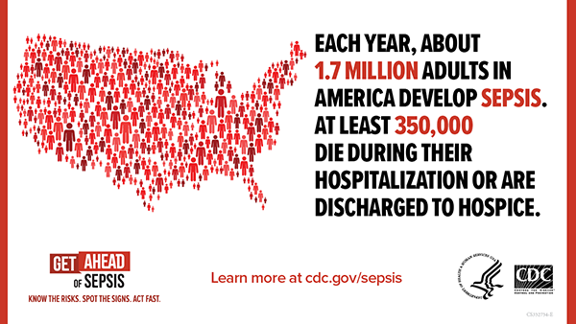

Slide 8
Symptoms of Sepsis
The need for medication to maintain systolic blood pressure greater than or equal to 65 mm Hg.
High levels of lactic acid in your blood (serum lactate).
Having too much lactic acid in your blood means that your cells aren't using oxygen properly.
●●●
8
Notes:
SAY:
The purpose of epidemiology in public health practice is to
discover the agent, host, and environmental factors that affect health;
determine the relative importance of causes of illness, disability, and death;
identify those segments of the population that have the greatest risk from specific causes of ill health; and
evaluate the effectiveness of health programs and services in improving population health.
GO to next slide.

Slide 9
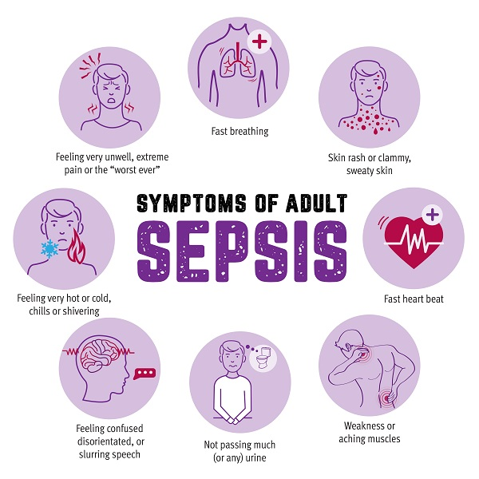
Symptoms of Sepsis
9
Notes:
SAY:
The purpose of epidemiology in public health practice is to
discover the agent, host, and environmental factors that affect health;
determine the relative importance of causes of illness, disability, and death;
identify those segments of the population that have the greatest risk from specific causes of ill health; and
evaluate the effectiveness of health programs and services in improving population health.
GO to next slide.

Slide 10
Causes of Sepsis
Lungs, such as pneumonia
Kidney, bladder and other parts of the urinary system
Digestive system
Bloodstream (bacteremia)
Catheter sites
Wounds or burns
10
Notes:
SAY:
The purpose of epidemiology in public health practice is to
discover the agent, host, and environmental factors that affect health;
determine the relative importance of causes of illness, disability, and death;
identify those segments of the population that have the greatest risk from specific causes of ill health; and
evaluate the effectiveness of health programs and services in improving population health.
GO to next slide.

Slide 11
Risk - Factors of Sepsis
Older age
Infancy
Compromised immune system
Diabetes
Chronic kidney or liver disease
Admission to intensive care unit or longer hospital stays
Invasive devices, such as intravenous catheters or breathing tubes
Previous use of antibiotics or corticosteroids
11
Notes:
SAY:
The purpose of epidemiology in public health practice is to
discover the agent, host, and environmental factors that affect health;
determine the relative importance of causes of illness, disability, and death;
identify those segments of the population that have the greatest risk from specific causes of ill health; and
evaluate the effectiveness of health programs and services in improving population health.
GO to next slide.

Slide 12
Complications of Sepsis
As sepsis worsens, blood flow to vital organs, such as your brain, heart and kidneys, becomes impaired.
Sepsis may cause abnormal blood clotting that results in small clots or burst blood vessels that damage or destroy tissues.
●●●
12
Notes:
SAY:
The purpose of epidemiology in public health practice is to
discover the agent, host, and environmental factors that affect health;
determine the relative importance of causes of illness, disability, and death;
identify those segments of the population that have the greatest risk from specific causes of ill health; and
evaluate the effectiveness of health programs and services in improving population health.
GO to next slide.

Slide 13
Complications of Sepsis
Most people recover from mild sepsis, but the mortality rate for septic shock is about 40%.
Also, an episode of severe sepsis places you at higher risk of future infections.
13
Notes:
SAY:
The purpose of epidemiology in public health practice is to
discover the agent, host, and environmental factors that affect health;
determine the relative importance of causes of illness, disability, and death;
identify those segments of the population that have the greatest risk from specific causes of ill health; and
evaluate the effectiveness of health programs and services in improving population health.
GO to next slide.

Slide 14
Diagnosis of Sepsis
Blood tests
Blood samples are used to test for:
Evidence of infection
Clotting problems
Abnormal liver or kidney function
Impaired oxygen availability
Electrolyte imbalances
●●●
14
Notes:
SAY:
The purpose of epidemiology in public health practice is to
discover the agent, host, and environmental factors that affect health;
determine the relative importance of causes of illness, disability, and death;
identify those segments of the population that have the greatest risk from specific causes of ill health; and
evaluate the effectiveness of health programs and services in improving population health.
GO to next slide.

Slide 15
Diagnosis of Sepsis
X-ray: X-rays can identify infections in your lungs.
Ultrasound: This technology uses sound waves to produce real-time images on a video monitor. Ultrasound may be particularly useful to check for infections in your gallbladder and kidneys.
15
Notes:
SAY:
The purpose of epidemiology in public health practice is to
discover the agent, host, and environmental factors that affect health;
determine the relative importance of causes of illness, disability, and death;
identify those segments of the population that have the greatest risk from specific causes of ill health; and
evaluate the effectiveness of health programs and services in improving population health.
GO to next slide.

Slide 16
Treatment of Sepsis
Early, aggressive treatment increases the likelihood of recovery.
People who have sepsis require close monitoring and treatment in a hospital intensive care unit.
Lifesaving measures may be needed to stabilize breathing and heart function.
●●●
16
Notes:
SAY:
The purpose of epidemiology in public health practice is to
discover the agent, host, and environmental factors that affect health;
determine the relative importance of causes of illness, disability, and death;
identify those segments of the population that have the greatest risk from specific causes of ill health; and
evaluate the effectiveness of health programs and services in improving population health.
GO to next slide.

Slide 17
Treatment of Sepsis
Medications: A number of medications are used in treating sepsis and septic shock.
Supportive care: People who have sepsis often receive supportive care that includes oxygen.
Surgery: Surgery may be needed to remove sources of infection, such as collections of pus (abscesses), infected tissues or dead tissues (gangrene).
17
Notes:
SAY:
The purpose of epidemiology in public health practice is to
discover the agent, host, and environmental factors that affect health;
determine the relative importance of causes of illness, disability, and death;
identify those segments of the population that have the greatest risk from specific causes of ill health; and
evaluate the effectiveness of health programs and services in improving population health.
GO to next slide.

Slide 19
Conclusion
Sepsis is the body's extreme response to an infection. It is a life-threatening medical emergency.
Sepsis happens when an infection you already have triggers a chain reaction throughout your body. Infections that lead to sepsis most often start in the lung, urinary tract, skin, or gastrointestinal tract.
19
Notes:
SAY:
The purpose of epidemiology in public health practice is to
discover the agent, host, and environmental factors that affect health;
determine the relative importance of causes of illness, disability, and death;
identify those segments of the population that have the greatest risk from specific causes of ill health; and
evaluate the effectiveness of health programs and services in improving population health.
GO to next slide.

Slide 20
Thanks To StudyMafia.org

