Slide 1
StudyMafia.Org
Roles Of HR
Manager
Submitted To: Submitted By:
Studymafia.org Studymafia.org

Slide 2
Table Contents
Definition
Introduction
Roles of HR Manager
Conclusion
2
Notes:
SAY: Before we wrap up the course, let’s review what we have learned today.
During this course, we have
<READ the bullets from the slide.>
GO to next slide.

Slide 3
Definition
The strength and involvement of a company’s personnel are directly related to human resources, which are crucial to both large and small enterprises.
3
Notes:
SAY: Before we wrap up the course, let’s review what we have learned today.
During this course, we have
<READ the bullets from the slide.>
GO to next slide.

Slide 4
Introduction
HR departments oversee all aspects of employee interactions, including salary and benefit negotiations, employing new employees, and recruitment.
Additionally, HR departments serve as a vital link between staff members and upper management by mediating problems at work, ensuring compliance with employment rules and regulations, and collaborating with executives on long-term strategic planning.
4
Notes:
SAY: Before we wrap up the course, let’s review what we have learned today.
During this course, we have
<READ the bullets from the slide.>
GO to next slide.

Slide 5
Introduction
HR experts have been increasingly important to an organization’s capacity to retain top personnel and maintain a solid business culture as technology has developed and the workforce has become more diverse.
Today, many aspects of HR including hiring, talent management, and staff management, make use of internet tools and platforms. Therefore, HR workers must also become more technologically adept.
5
Notes:
SAY: Before we wrap up the course, let’s review what we have learned today.
During this course, we have
<READ the bullets from the slide.>
GO to next slide.

Slide 6
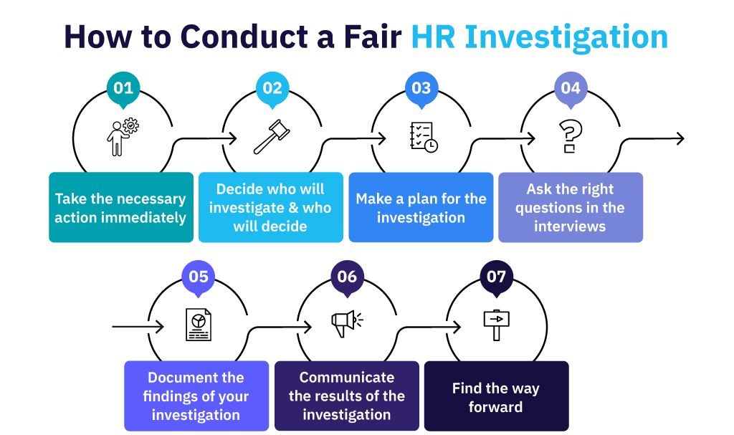
6
Notes:
SAY: Before we wrap up the course, let’s review what we have learned today.
During this course, we have
<READ the bullets from the slide.>
GO to next slide.

Slide 7
Roles of HR Manager
An HR manager’s job description should include the following obligations. However, while an HR manager’s daily duties will vary from company to company, the following are the roles and responsibilities of an HR manager:
Create and put into action HR initiatives and strategies that are in line with the overall business plan.
●●●
7
Notes:
SAY:
The purpose of epidemiology in public health practice is to
discover the agent, host, and environmental factors that affect health;
determine the relative importance of causes of illness, disability, and death;
identify those segments of the population that have the greatest risk from specific causes of ill health; and
evaluate the effectiveness of health programs and services in improving population health.
GO to next slide.

Slide 8
Roles of HR Manager
Improve ties between management and employees by responding to requests, grievances, or other issues.
Control the hiring and hiring process.
Support present and future company demands through growing, involving, inspiring, and preserving human capital.
●●●
8
Notes:
SAY:
The purpose of epidemiology in public health practice is to
discover the agent, host, and environmental factors that affect health;
determine the relative importance of causes of illness, disability, and death;
identify those segments of the population that have the greatest risk from specific causes of ill health; and
evaluate the effectiveness of health programs and services in improving population health.
GO to next slide.

Slide 9
Roles of HR Manager
Create and keep track of the organization’s overall HR strategies, methods, tactics, and procedures.
Cultivate a supportive workplace.
Managing and maintaining a setup that promotes optimum performance.
Maintain the benefits and pay schedule.
●●●
9
Notes:
SAY:
The purpose of epidemiology in public health practice is to
discover the agent, host, and environmental factors that affect health;
determine the relative importance of causes of illness, disability, and death;
identify those segments of the population that have the greatest risk from specific causes of ill health; and
evaluate the effectiveness of health programs and services in improving population health.
GO to next slide.

Slide 10
Roles of HR Manager
Analyze the training requirements for a programme and keep an eye on it.
Report to management and use HR indicators to assist in decision-making
Always maintain legal compliance while managing human resources.
●●●
10
Notes:
SAY:
The purpose of epidemiology in public health practice is to
discover the agent, host, and environmental factors that affect health;
determine the relative importance of causes of illness, disability, and death;
identify those segments of the population that have the greatest risk from specific causes of ill health; and
evaluate the effectiveness of health programs and services in improving population health.
GO to next slide.

Slide 11
Roles of HR Manager
Human Resource Planning
HR managers are responsible for planning and achieving organizational objectives. They usually identify, prepare, and execute business goals with top-level executives.
●●●
11
Notes:
SAY:
The purpose of epidemiology in public health practice is to
discover the agent, host, and environmental factors that affect health;
determine the relative importance of causes of illness, disability, and death;
identify those segments of the population that have the greatest risk from specific causes of ill health; and
evaluate the effectiveness of health programs and services in improving population health.
GO to next slide.

Slide 12
Roles of HR Manager
Job Analysis and Design
As mentioned above, human resource planning requires assigning the right resources to the right project. And if the right person is not in the organization, HR managers are responsible for designing the job analysis to hire them.
●●●
12
Notes:
SAY:
The purpose of epidemiology in public health practice is to
discover the agent, host, and environmental factors that affect health;
determine the relative importance of causes of illness, disability, and death;
identify those segments of the population that have the greatest risk from specific causes of ill health; and
evaluate the effectiveness of health programs and services in improving population health.
GO to next slide.

Slide 13
Roles of HR Manager
Hiring Candidates
Finding and hiring the right talent is a very complex process. Modern human resources departments do more than just post job requirements in portals to fill open positions.
They develop strategic solutions to attract suitable candidates to fulfill the demands of the business.
●●●
13
Notes:
SAY:
The purpose of epidemiology in public health practice is to
discover the agent, host, and environmental factors that affect health;
determine the relative importance of causes of illness, disability, and death;
identify those segments of the population that have the greatest risk from specific causes of ill health; and
evaluate the effectiveness of health programs and services in improving population health.
GO to next slide.

Slide 14
Roles of HR Manager
Training and Development
Hiring the best candidates is just half the job. First, the HR team must train and upskill them to maximize their return on investment.
The Human Resources department is responsible for developing and administering training and development programs.
●●●
14
Notes:
SAY:
The purpose of epidemiology in public health practice is to
discover the agent, host, and environmental factors that affect health;
determine the relative importance of causes of illness, disability, and death;
identify those segments of the population that have the greatest risk from specific causes of ill health; and
evaluate the effectiveness of health programs and services in improving population health.
GO to next slide.

Slide 15
Roles of HR Manager
Design Workplace Policies
HR manager roles and responsibilities also include designing workplace policies to reduce conflicts and legal issues and improve employee productivity.
These policies are designed to protect the interests of both employees and employers alike.
●●●
15
Notes:
SAY:
The purpose of epidemiology in public health practice is to
discover the agent, host, and environmental factors that affect health;
determine the relative importance of causes of illness, disability, and death;
identify those segments of the population that have the greatest risk from specific causes of ill health; and
evaluate the effectiveness of health programs and services in improving population health.
GO to next slide.

Slide 16
Roles of HR Manager
Monitor Performance
General HR roles and responsibilities closely related to training include examining employee performance records to identify the scopes of improvement and arranging training workshops to upskill them.
●●●
16
Notes:
SAY:
The purpose of epidemiology in public health practice is to
discover the agent, host, and environmental factors that affect health;
determine the relative importance of causes of illness, disability, and death;
identify those segments of the population that have the greatest risk from specific causes of ill health; and
evaluate the effectiveness of health programs and services in improving population health.
GO to next slide.

Slide 17
Roles of HR Manager
Maintaining Work Culture
HR roles & responsibilities shape and maintain organizational culture. Therefore, it is essential to create a positive impression of the company from day one, so the new employees know what to expect.
●●●
17
Notes:
SAY:
The purpose of epidemiology in public health practice is to
discover the agent, host, and environmental factors that affect health;
determine the relative importance of causes of illness, disability, and death;
identify those segments of the population that have the greatest risk from specific causes of ill health; and
evaluate the effectiveness of health programs and services in improving population health.
GO to next slide.

Slide 18
Roles of HR Manager
Resolve Conflict
In every organization, employees come from diverse backgrounds. And when people with opposite opinions meet, the conflict chances rise significantly.
Whether the issue is between two employees or an employee and the management, the human resources management has to be the mediator for conflict resolution.
●●●
18
Notes:
SAY:
The purpose of epidemiology in public health practice is to
discover the agent, host, and environmental factors that affect health;
determine the relative importance of causes of illness, disability, and death;
identify those segments of the population that have the greatest risk from specific causes of ill health; and
evaluate the effectiveness of health programs and services in improving population health.
GO to next slide.

Slide 19
Roles of HR Manager
Ensure the Health and Safety of Employees
Employees are an important asset of the organization. Unless they are safe and healthy, they won’t be able to give their best to the company. Thus, HR managers need to ensure the health and safety of employees.
●●●
19
Notes:
SAY:
The purpose of epidemiology in public health practice is to
discover the agent, host, and environmental factors that affect health;
determine the relative importance of causes of illness, disability, and death;
identify those segments of the population that have the greatest risk from specific causes of ill health; and
evaluate the effectiveness of health programs and services in improving population health.
GO to next slide.

Slide 20
Roles of HR Manager
Rewards and Incentives
Lastly, HR managers must reward employees based on their performance and other factors like punctuality.
The biggest benefit of rewarding workers is that it creates a desire for other employees to excel at their job in the hope of getting incentives.
●●●
20
Notes:
SAY:
The purpose of epidemiology in public health practice is to
discover the agent, host, and environmental factors that affect health;
determine the relative importance of causes of illness, disability, and death;
identify those segments of the population that have the greatest risk from specific causes of ill health; and
evaluate the effectiveness of health programs and services in improving population health.
GO to next slide.

Slide 21
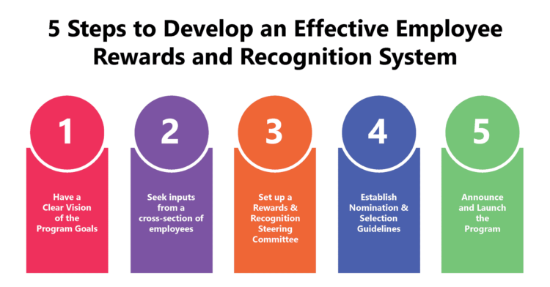

Slide 22
Conclusion
HR managers are responsible for creating and managing a solid team. Whether it is human resource planning, job analysis, hiring the right talent, or resolving conflicts within the organization, the HR manager handles these tasks.
22
Notes:
SAY:
The purpose of epidemiology in public health practice is to
discover the agent, host, and environmental factors that affect health;
determine the relative importance of causes of illness, disability, and death;
identify those segments of the population that have the greatest risk from specific causes of ill health; and
evaluate the effectiveness of health programs and services in improving population health.
GO to next slide.

Slide 23
Thanks To StudyMafia.org

