Slide 1
StudyMafia.Org
Rentinal Detachment
Submitted To: Submitted By:
Studymafia.org Studymafia.org

Slide 2
Table Contents
Definition
Introduction
Symptoms of Retinal Detachment
Causes of Retinal Detachment
Risk-Factors of Retinal Detachment
Diagnosis of Retinal Detachment
Treatment of Retinal Detachment
Conclusion
2
Notes:
SAY: Before we wrap up the course, let’s review what we have learned today.
During this course, we have
<READ the bullets from the slide.>
GO to next slide.

Slide 3
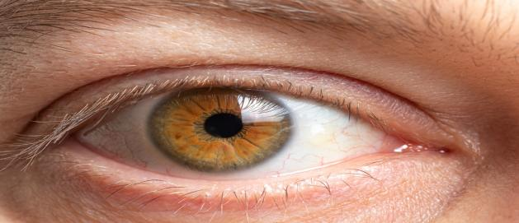
Definition
Retinal detachment describes an emergency situation in which a thin layer of tissue (the retina) at the back of the eye pulls away from its normal position.
3
Notes:
SAY: Before we wrap up the course, let’s review what we have learned today.
During this course, we have
<READ the bullets from the slide.>
GO to next slide.

Slide 4
Introduction
Retinal detachment separates the retinal cells from the layer of blood vessels that provides oxygen and nourishment. The longer retinal detachment goes untreated, the greater your risk of permanent vision loss in the affected eye.
Warning signs of retinal detachment may include one or all of the following: the sudden appearance of floaters and flashes and reduced vision.
4
Notes:
SAY: Before we wrap up the course, let’s review what we have learned today.
During this course, we have
<READ the bullets from the slide.>
GO to next slide.

Slide 5
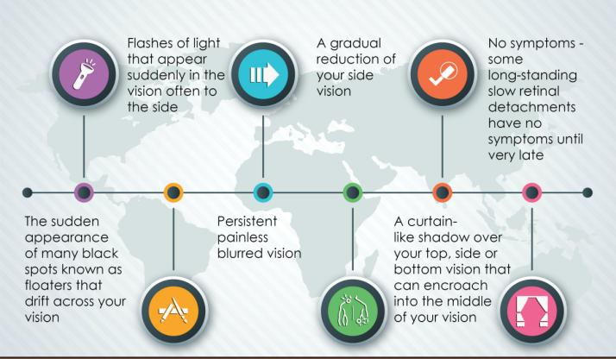
Symptoms of Retinal Detachment
5
Notes:
SAY: Before we wrap up the course, let’s review what we have learned today.
During this course, we have
<READ the bullets from the slide.>
GO to next slide.

Slide 6
Causes of Retinal Detachment
Rhegmatogenous (reg-ma-TODGE-uh-nus). These types of retinal detachments are the most common. Rhegmatogenous detachments are caused by a hole or tear in the retina that allows fluid to pass through and collect underneath the retina, pulling the retina away from underlying tissues.
●●●
6
Notes:
SAY:
The purpose of epidemiology in public health practice is to
discover the agent, host, and environmental factors that affect health;
determine the relative importance of causes of illness, disability, and death;
identify those segments of the population that have the greatest risk from specific causes of ill health; and
evaluate the effectiveness of health programs and services in improving population health.
GO to next slide.

Slide 7
Causes of Retinal Detachment
Tractional. This type of detachment can occur when scar tissue grows on the retina's surface, causing the retina to pull away from the back of the eye.
Exudative. In this type of detachment, fluid accumulates beneath the retina, but there are no holes or tears in the retina.
7
Notes:
SAY:
The purpose of epidemiology in public health practice is to
discover the agent, host, and environmental factors that affect health;
determine the relative importance of causes of illness, disability, and death;
identify those segments of the population that have the greatest risk from specific causes of ill health; and
evaluate the effectiveness of health programs and services in improving population health.
GO to next slide.

Slide 8
Risk-Factors of Retinal Detachment
The following factors increase your risk of retinal detachment:
Aging — retinal detachment is more common in people over age 50
Previous retinal detachment in one eye
Family history of retinal detachment
●●●
8
Notes:
SAY:
The purpose of epidemiology in public health practice is to
discover the agent, host, and environmental factors that affect health;
determine the relative importance of causes of illness, disability, and death;
identify those segments of the population that have the greatest risk from specific causes of ill health; and
evaluate the effectiveness of health programs and services in improving population health.
GO to next slide.

Slide 9
Risk-Factors of Retinal Detachment
Extreme nearsightedness (myopia)
Previous eye surgery, such as cataract removal
Previous severe eye injury
Previous other eye disease or disorder, including retinoschisis, uveitis or thinning of the peripheral retina (lattice degeneration)
9
Notes:
SAY:
The purpose of epidemiology in public health practice is to
discover the agent, host, and environmental factors that affect health;
determine the relative importance of causes of illness, disability, and death;
identify those segments of the population that have the greatest risk from specific causes of ill health; and
evaluate the effectiveness of health programs and services in improving population health.
GO to next slide.

Slide 10
Diagnosis of Retinal Detachment
Retinal examination.
The doctor may use an instrument with a bright light and special lenses to examine the back of your eye, including the retina. This type of device provides a highly detailed view of your whole eye, allowing the doctor to see any retinal holes, tears or detachments.
●●●
10
Notes:
SAY:
The purpose of epidemiology in public health practice is to
discover the agent, host, and environmental factors that affect health;
determine the relative importance of causes of illness, disability, and death;
identify those segments of the population that have the greatest risk from specific causes of ill health; and
evaluate the effectiveness of health programs and services in improving population health.
GO to next slide.

Slide 11
Diagnosis of Retinal Detachment
Ultrasound imaging. Your doctor may use this test if bleeding has occurred in the eye, making it difficult to see your retina.
Your doctor will likely examine both eyes even if you have symptoms in just one
11
Notes:
SAY:
The purpose of epidemiology in public health practice is to
discover the agent, host, and environmental factors that affect health;
determine the relative importance of causes of illness, disability, and death;
identify those segments of the population that have the greatest risk from specific causes of ill health; and
evaluate the effectiveness of health programs and services in improving population health.
GO to next slide.

Slide 12
Treatment of Retinal Detachment
Laser surgery (photocoagulation). The surgeon directs a laser beam into the eye through the pupil.
Freezing (cryopexy). After giving you a local anesthetic to numb your eye, the surgeon applies a freezing probe to the outer surface of the eye directly over the tear.
●●●
12
Notes:
SAY:
The purpose of epidemiology in public health practice is to
discover the agent, host, and environmental factors that affect health;
determine the relative importance of causes of illness, disability, and death;
identify those segments of the population that have the greatest risk from specific causes of ill health; and
evaluate the effectiveness of health programs and services in improving population health.
GO to next slide.

Slide 13
Treatment of Retinal Detachment
Injecting air or gas into your eye. In this procedure, called pneumatic retinopexy (RET-ih-no-pek-see), the surgeon injects a bubble of air or gas into the center part of the eye (the vitreous cavity).
●●●
13
Notes:
SAY:
The purpose of epidemiology in public health practice is to
discover the agent, host, and environmental factors that affect health;
determine the relative importance of causes of illness, disability, and death;
identify those segments of the population that have the greatest risk from specific causes of ill health; and
evaluate the effectiveness of health programs and services in improving population health.
GO to next slide.

Slide 14
Treatment of Retinal Detachment
Indenting the surface of your eye. This procedure, called scleral (SKLAIR-ul) buckling, involves the surgeon sewing (suturing) a piece of silicone material to the white of your eye (sclera) over the affected area.
●●●
14
Notes:
SAY:
The purpose of epidemiology in public health practice is to
discover the agent, host, and environmental factors that affect health;
determine the relative importance of causes of illness, disability, and death;
identify those segments of the population that have the greatest risk from specific causes of ill health; and
evaluate the effectiveness of health programs and services in improving population health.
GO to next slide.

Slide 15
Treatment of Retinal Detachment
Draining and replacing the fluid in the eye. In this procedure, called vitrectomy (vih-TREK-tuh-me), the surgeon removes the vitreous along with any tissue that is tugging on the retina.
15
Notes:
SAY:
The purpose of epidemiology in public health practice is to
discover the agent, host, and environmental factors that affect health;
determine the relative importance of causes of illness, disability, and death;
identify those segments of the population that have the greatest risk from specific causes of ill health; and
evaluate the effectiveness of health programs and services in improving population health.
GO to next slide.

Slide 16
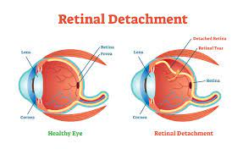

Slide 17
Conclusion
Retinal detachments can cause significant visual loss.
Treatments are effective at reattaching the retina in most cases, although in some patients, additional procedures may be required.
17
Notes:
SAY:
The purpose of epidemiology in public health practice is to
discover the agent, host, and environmental factors that affect health;
determine the relative importance of causes of illness, disability, and death;
identify those segments of the population that have the greatest risk from specific causes of ill health; and
evaluate the effectiveness of health programs and services in improving population health.
GO to next slide.

Slide 18
References
Google.com
Wikipedia.org
Studymafia.org
Slidespanda.com

Slide 19
Thanks To StudyMafia.org

