Slide 1
StudyMafia.Org
Rectal
Suppository
Submitted To: Submitted By:
Studymafia.org Studymafia.org

Slide 2
Table Contents
Definition
Introduction
Why Rectal Suppository?
Side Effects of Rectal Suppository
How Rectal Suppository?
Rectal Suppository Positions
Conclusion
2
Notes:
SAY: Before we wrap up the course, let’s review what we have learned today.
During this course, we have
<READ the bullets from the slide.>
GO to next slide.

Slide 3
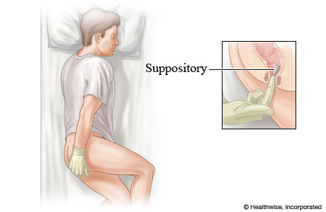
Definition
Rectal suppositories are forms of medication that are inserted into the rectum. They come in different shapes and sizes but are usually narrowed at one end.
3
Notes:
SAY: Before we wrap up the course, let’s review what we have learned today.
During this course, we have
<READ the bullets from the slide.>
GO to next slide.

Slide 4
Introduction
Rectal suppositories can deliver many types of medication. For instance, they may contain glycerin to treat constipation or acetaminophen to treat a fever.
Medication from a rectal suppository tends to work quickly. This is because the suppository melts inside the body and is absorbed directly into the bloodstream.
4
Notes:
SAY: Before we wrap up the course, let’s review what we have learned today.
During this course, we have
<READ the bullets from the slide.>
GO to next slide.

Slide 5
Why Rectal Suppositories?
Rectal suppositories are used for administering medications when you cannot do so orally.
Such methods may be especially helpful for young children and older adults who cannot take medications by mouth, according to a 2021 review.
●●●
5
Notes:
SAY:
The purpose of epidemiology in public health practice is to
discover the agent, host, and environmental factors that affect health;
determine the relative importance of causes of illness, disability, and death;
identify those segments of the population that have the greatest risk from specific causes of ill health; and
evaluate the effectiveness of health programs and services in improving population health.
GO to next slide.

Slide 6
Why Rectal Suppositories?
For example, fever-reducing medications such as acetaminophen may be administered rectally if you cannot take the oral versions due to vomiting or other issues that might otherwise prevent you from swallowing liquids or tablets.
Taking fever-reducing drugs rectally can also reduce possible adverse effects on the stomach and small intestine.
6
Notes:
SAY:
The purpose of epidemiology in public health practice is to
discover the agent, host, and environmental factors that affect health;
determine the relative importance of causes of illness, disability, and death;
identify those segments of the population that have the greatest risk from specific causes of ill health; and
evaluate the effectiveness of health programs and services in improving population health.
GO to next slide.

Slide 7
Side Effects of Rectal Suppository
Leakage of the medication, as well as personal pain and discomfort, are all possible side effects associated with rectal suppositories.
Proper insertion and following post-administration instructions may help reduce these effects.
●●●
7
Notes:
SAY:
The purpose of epidemiology in public health practice is to
discover the agent, host, and environmental factors that affect health;
determine the relative importance of causes of illness, disability, and death;
identify those segments of the population that have the greatest risk from specific causes of ill health; and
evaluate the effectiveness of health programs and services in improving population health.
GO to next slide.

Slide 8
Side Effects of Rectal Suppository
According to a 2019 review of research, certain health conditions that affect the gastrointestinal (GI) tract may also reduce the effectiveness of the drugs being administered rectally, and even increase the risk of pain.
Talk with a doctor about any history of IBD, irritable bowel syndrome (IBS), or other GI conditions before using rectal suppositories.
8
Notes:
SAY:
The purpose of epidemiology in public health practice is to
discover the agent, host, and environmental factors that affect health;
determine the relative importance of causes of illness, disability, and death;
identify those segments of the population that have the greatest risk from specific causes of ill health; and
evaluate the effectiveness of health programs and services in improving population health.
GO to next slide.

Slide 9
How Rectal Suppository?
You can use these instructions to use a rectal suppository by yourself.
To insert a rectal suppository, you’ll first need soap and water or hand sanitizer to clean your hands.
You may also need a clean, single-edge razor blade and lubricating jelly.
●●●
9
Notes:
SAY:
The purpose of epidemiology in public health practice is to
discover the agent, host, and environmental factors that affect health;
determine the relative importance of causes of illness, disability, and death;
identify those segments of the population that have the greatest risk from specific causes of ill health; and
evaluate the effectiveness of health programs and services in improving population health.
GO to next slide.

Slide 10
How Rectal Suppository?
Before
If possible, go to the bathroom and empty your bowels.
Wash your hands with soap and water. If soap and water are not available, use hand sanitizer instead. Dry your hands with a clean towel or a paper towel.
●●●
10
Notes:
SAY:
The purpose of epidemiology in public health practice is to
discover the agent, host, and environmental factors that affect health;
determine the relative importance of causes of illness, disability, and death;
identify those segments of the population that have the greatest risk from specific causes of ill health; and
evaluate the effectiveness of health programs and services in improving population health.
GO to next slide.

Slide 11
How Rectal Suppository?
Gently squeeze the suppository to check if it is firm enough to insert. If it’s not, let it harden by holding it under cold water while it’s still in the wrapper. You can also place it in the refrigerator for a few minutes.
Remove your clothing to expose your buttocks.
●●●
11
Notes:
SAY:
The purpose of epidemiology in public health practice is to
discover the agent, host, and environmental factors that affect health;
determine the relative importance of causes of illness, disability, and death;
identify those segments of the population that have the greatest risk from specific causes of ill health; and
evaluate the effectiveness of health programs and services in improving population health.
GO to next slide.

Slide 12
How Rectal Suppository?
Remove any wrapping from the suppository. If you need to cut the suppository, carefully cut it lengthwise with a clean, single-edge razor blade.
To moisten the tip of the suppository, apply a lubricating jelly such as K-Y Jelly. If you do not have lubricating jelly, apply a small amount of water to your rectal area.
●●●
12
Notes:
SAY:
The purpose of epidemiology in public health practice is to
discover the agent, host, and environmental factors that affect health;
determine the relative importance of causes of illness, disability, and death;
identify those segments of the population that have the greatest risk from specific causes of ill health; and
evaluate the effectiveness of health programs and services in improving population health.
GO to next slide.

Slide 13
How Rectal Suppository?
During
Get into position. You can either stand with one foot up on a chair, or you can lie down on your side with your top leg slightly bent toward your stomach and your bottom leg straight.
If you’re giving the suppository to someone else, you may want to place them in this second position.
●●●
13
Notes:
SAY:
The purpose of epidemiology in public health practice is to
discover the agent, host, and environmental factors that affect health;
determine the relative importance of causes of illness, disability, and death;
identify those segments of the population that have the greatest risk from specific causes of ill health; and
evaluate the effectiveness of health programs and services in improving population health.
GO to next slide.

Slide 14
How Rectal Suppository?
Insert the suppository into the rectum, narrow end first. Gently but firmly, push the suppository past the sphincter.
The sphincter is the muscular opening of the rectum. For adults, push it in about 3 inches or far enough in so that it will not pop out.
For children, depending on their size, push it in about 2 inches. And for smaller children or infants, push it in about a half-inch.
●●●
14
Notes:
SAY:
The purpose of epidemiology in public health practice is to
discover the agent, host, and environmental factors that affect health;
determine the relative importance of causes of illness, disability, and death;
identify those segments of the population that have the greatest risk from specific causes of ill health; and
evaluate the effectiveness of health programs and services in improving population health.
GO to next slide.

Slide 15
How Rectal Suppository?
Sit or lie with your legs closed for a few minutes. If you’re giving the suppository to a child, you may need to gently hold their buttocks closed during this time.
Throw away all used material in a trash can.
Wash your hands right away with soap and warm water.
15
Notes:
SAY:
The purpose of epidemiology in public health practice is to
discover the agent, host, and environmental factors that affect health;
determine the relative importance of causes of illness, disability, and death;
identify those segments of the population that have the greatest risk from specific causes of ill health; and
evaluate the effectiveness of health programs and services in improving population health.
GO to next slide.

Slide 16
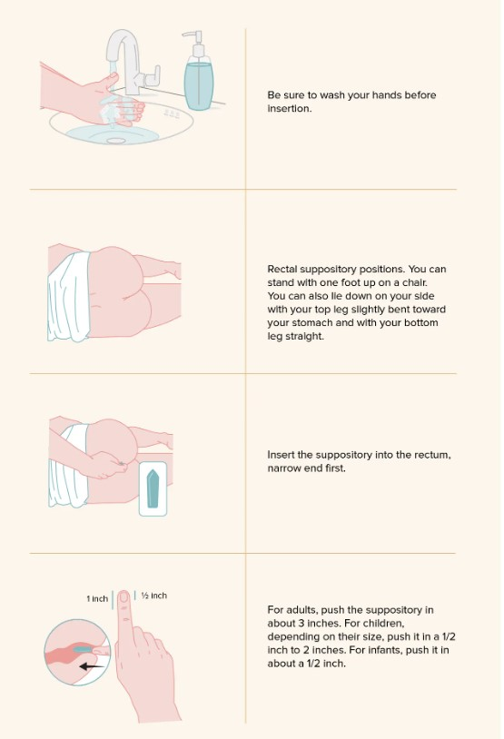

Slide 17
Rectal Suppository Positions
Overall, the recommended position for rectal suppository administration is on your side.
This allows for easy access to the buttocks during self-administration but can also be easier for giving the suppository to someone else.
●●●
17
Notes:
SAY:
The purpose of epidemiology in public health practice is to
discover the agent, host, and environmental factors that affect health;
determine the relative importance of causes of illness, disability, and death;
identify those segments of the population that have the greatest risk from specific causes of ill health; and
evaluate the effectiveness of health programs and services in improving population health.
GO to next slide.

Slide 18
Rectal Suppository Positions
For best results, lie on your left side and bend your knees toward your chest.
If the first position is not comfortable, or if you’re having difficulties inserting the suppository, you can also try kneeling face down with your hips lifted, and your head toward the floor.
18
Notes:
SAY:
The purpose of epidemiology in public health practice is to
discover the agent, host, and environmental factors that affect health;
determine the relative importance of causes of illness, disability, and death;
identify those segments of the population that have the greatest risk from specific causes of ill health; and
evaluate the effectiveness of health programs and services in improving population health.
GO to next slide.

Slide 19
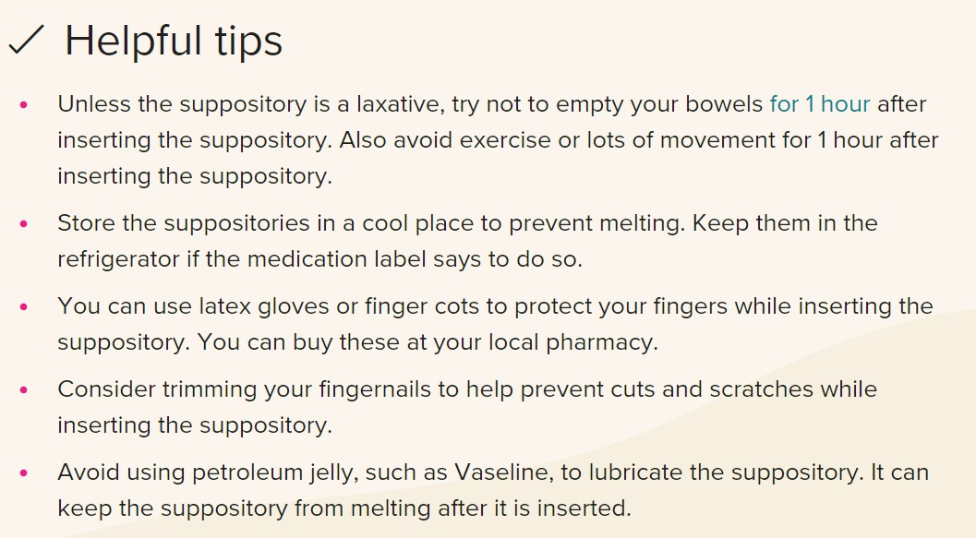

Slide 20
Conclusion
Rectal suppositories are alternatives to taking oral medications. This method may be preferable if you or your child cannot take medications by mouth.
Be sure to follow the instructions given for proper rectal suppository insertion. This will help ensure the medication is administered properly, and will also reduce the risk of pain and other side effects.
20
Notes:
SAY:
The purpose of epidemiology in public health practice is to
discover the agent, host, and environmental factors that affect health;
determine the relative importance of causes of illness, disability, and death;
identify those segments of the population that have the greatest risk from specific causes of ill health; and
evaluate the effectiveness of health programs and services in improving population health.
GO to next slide.

Slide 21
Thanks To StudyMafia.org

