Slide 1
StudyMafia.Org
Postnatal Diet
Submitted To: Submitted By:
Studymafia.org Studymafia.org

Slide 2
Table Contents
Definition
Introduction
Tips of Postnatal Diet
Avoid These Food During Postnatal
Exercises During Postnatal
Conclusion
2
Notes:
SAY: Before we wrap up the course, let’s review what we have learned today.
During this course, we have
<READ the bullets from the slide.>
GO to next slide.

Slide 3
Definition
It’s no secret that the food we eat fuels our daily activities — an especially important point when those daily activities include caring for a newborn and breastfeeding.
3
Notes:
SAY: Before we wrap up the course, let’s review what we have learned today.
During this course, we have
<READ the bullets from the slide.>
GO to next slide.

Slide 4
Introduction
But for many new mamas, the desire to lose the baby weight may take precedence over nourishing their body with the right foods to support recovery, milk production, rest, and all the other tasks required to get through the day.
Significantly reducing overall carbohydrate intake — the go-to weight loss strategy for many women — is not your best bet postpartum. Carbohydrates are necessary for new moms — not just for breast milk production, but also for mental health, hormone regulation and more.
4
Notes:
SAY: Before we wrap up the course, let’s review what we have learned today.
During this course, we have
<READ the bullets from the slide.>
GO to next slide.

Slide 5
5
Notes:
SAY: Before we wrap up the course, let’s review what we have learned today.
During this course, we have
<READ the bullets from the slide.>
GO to next slide.

Slide 6
Tips of Postnatal Diet
Eat a variety of foods: Try to eat a balanced diet of fruit, vegetables, grains, protein foods and diary each day.
Drink plenty of liquids: Your body needs lot of fluid (about 6-10 glasses a day) especially if you are breastfeeding your baby. Drink mostly water, milk, and fruit juice.
●●●
6
Notes:
SAY:
The purpose of epidemiology in public health practice is to
discover the agent, host, and environmental factors that affect health;
determine the relative importance of causes of illness, disability, and death;
identify those segments of the population that have the greatest risk from specific causes of ill health; and
evaluate the effectiveness of health programs and services in improving population health.
GO to next slide.

Slide 7
Tips of Postnatal Diet
Eat foods that have protein such as milk, cheese, yogurt, meat, fish and beans:
Protein rich foods are important to help you recover from childbirth and keep your body strong. If you are under 18, or were underweight prior to pregnancy, you need to eat more protein.
●●●
7
Notes:
SAY:
The purpose of epidemiology in public health practice is to
discover the agent, host, and environmental factors that affect health;
determine the relative importance of causes of illness, disability, and death;
identify those segments of the population that have the greatest risk from specific causes of ill health; and
evaluate the effectiveness of health programs and services in improving population health.
GO to next slide.

Slide 8
Tips of Postnatal Diet
Eat your fruits and vegetables:
Try to make half your plate fruits and vegetables. Fruits and vegetables have vitamins and minerals that keep you healthy. They also have fiber, which helps prevent constipation. Make sure to wash fruits and vegetables under running cold water before eating them.
●●●
8
Notes:
SAY:
The purpose of epidemiology in public health practice is to
discover the agent, host, and environmental factors that affect health;
determine the relative importance of causes of illness, disability, and death;
identify those segments of the population that have the greatest risk from specific causes of ill health; and
evaluate the effectiveness of health programs and services in improving population health.
GO to next slide.

Slide 9
Tips of Postnatal Diet
Lose weight safely:
Talk to your doctor about safely losing weight after your baby is born. Losing weight too quickly can affect your breast milk supply. Do not take diet pills. They contain harmful drugs that can be passed to your baby through breast milk.
●●●
9
Notes:
SAY:
The purpose of epidemiology in public health practice is to
discover the agent, host, and environmental factors that affect health;
determine the relative importance of causes of illness, disability, and death;
identify those segments of the population that have the greatest risk from specific causes of ill health; and
evaluate the effectiveness of health programs and services in improving population health.
GO to next slide.

Slide 10
Tips of Postnatal Diet
Take prenatal vitamins:
If you are breastfeeding, it is a good idea to continue to take your prenatal vitamins. Your doctor can prescribe these pills so that your health insurance will cover a portion of the cost.
●●●
10
Notes:
SAY:
The purpose of epidemiology in public health practice is to
discover the agent, host, and environmental factors that affect health;
determine the relative importance of causes of illness, disability, and death;
identify those segments of the population that have the greatest risk from specific causes of ill health; and
evaluate the effectiveness of health programs and services in improving population health.
GO to next slide.

Slide 11
Tips of Postnatal Diet
Limit junk foods:
Soda pop, cookies, donuts, potato chips and french fries are okay sometimes, but don’t let them take the place of healthy foods!
11
Notes:
SAY:
The purpose of epidemiology in public health practice is to
discover the agent, host, and environmental factors that affect health;
determine the relative importance of causes of illness, disability, and death;
identify those segments of the population that have the greatest risk from specific causes of ill health; and
evaluate the effectiveness of health programs and services in improving population health.
GO to next slide.

Slide 12
Avoid These Food During Postnatal
Alcohol:
Wine, wine coolers, beer, drinks like hard lemonade and other malt liquor beverages, shots and mixed drinks contain alcohol that passes to your baby through your breastmilk and can harm your baby’s brain and body development.
●●●
12
Notes:
SAY:
The purpose of epidemiology in public health practice is to
discover the agent, host, and environmental factors that affect health;
determine the relative importance of causes of illness, disability, and death;
identify those segments of the population that have the greatest risk from specific causes of ill health; and
evaluate the effectiveness of health programs and services in improving population health.
GO to next slide.

Slide 13
Avoid These Food During Postnatal
Caffeine:
Caffeine is a stimulant that passes through breast milk to the baby and may affect growth. Caffeine is found in tea, coffee, chocolate, many soft drinks and over-the-counter medicines.
13
Notes:
SAY:
The purpose of epidemiology in public health practice is to
discover the agent, host, and environmental factors that affect health;
determine the relative importance of causes of illness, disability, and death;
identify those segments of the population that have the greatest risk from specific causes of ill health; and
evaluate the effectiveness of health programs and services in improving population health.
GO to next slide.

Slide 14
Exercises During Postnatal
Walking is a great way to exercise because it puts very little stress on your body. Your baby will probably enjoy being walked in a stroller too. Try walking briskly for 20-30 minutes every day or at least 3 times per week.
Meet with a friend or other new moms to go walking. It’s good to get out of the house and connect with friends or other new mothers. You will enjoy the chance to talk about your baby or to just be with other adults!
14
Notes:
SAY:
The purpose of epidemiology in public health practice is to
discover the agent, host, and environmental factors that affect health;
determine the relative importance of causes of illness, disability, and death;
identify those segments of the population that have the greatest risk from specific causes of ill health; and
evaluate the effectiveness of health programs and services in improving population health.
GO to next slide.

Slide 15
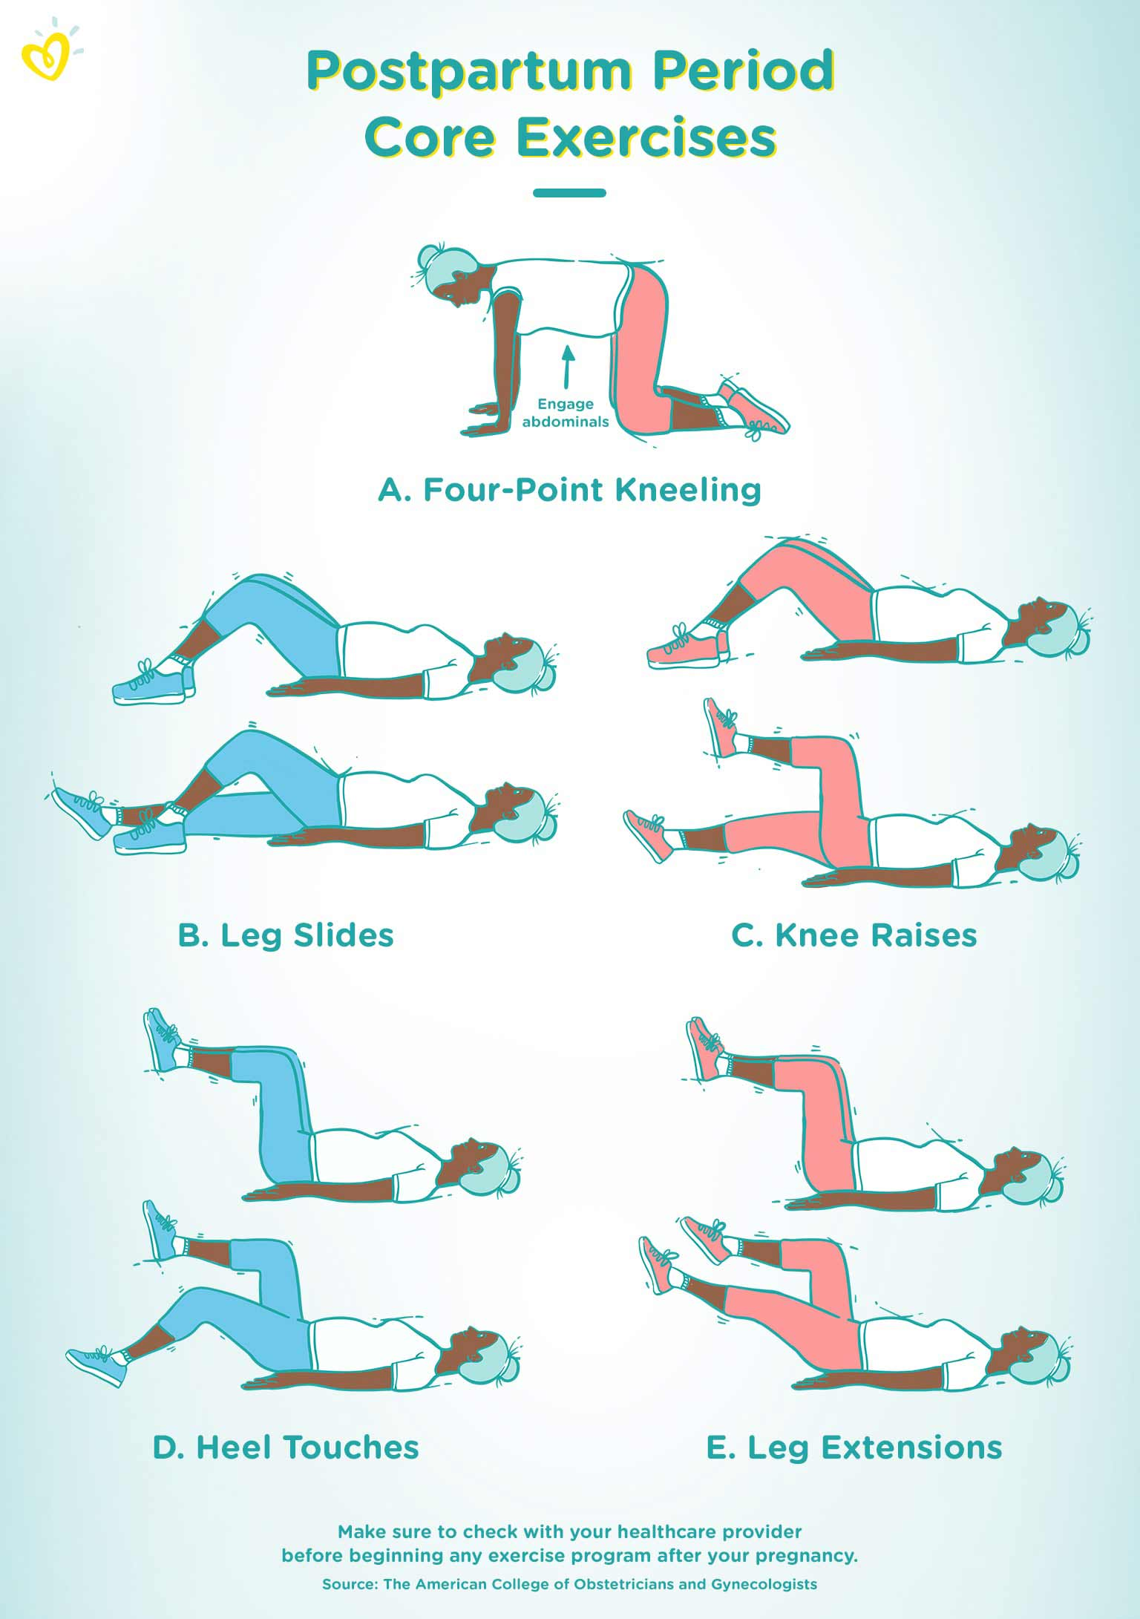

Slide 16
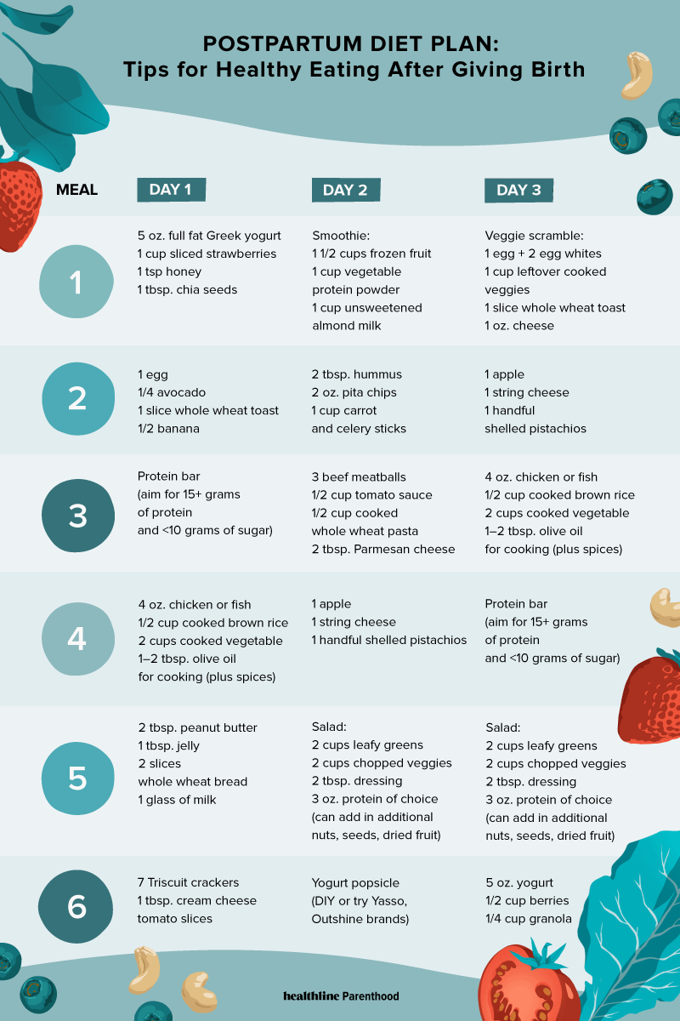

Slide 17
Conclusion
The right postpartum diet helps you bring those hormones back on track, provides your body with the essential nutrients required to recover post childbirth, and also boosts your baby's health if you choose to breastfeed!
17
Notes:
SAY:
The purpose of epidemiology in public health practice is to
discover the agent, host, and environmental factors that affect health;
determine the relative importance of causes of illness, disability, and death;
identify those segments of the population that have the greatest risk from specific causes of ill health; and
evaluate the effectiveness of health programs and services in improving population health.
GO to next slide.

Slide 18
Thanks To StudyMafia.org

