Slide 1
StudyMafia.Org
Peripheral Vascular Disease(PVD)
Submitted To: Submitted By:
Studymafia.org Studymafia.org

Slide 2
Table Contents
Definition
Introduction
Symptoms of PVD
Types of PVD
Causes of PVD
Risk-Factors of PVD
Complications of PVD
Diagnosis of PVD
Treatment of PVD
Conclusion
2
Notes:
SAY: Before we wrap up the course, let’s review what we have learned today.
During this course, we have
<READ the bullets from the slide.>
GO to next slide.

Slide 3
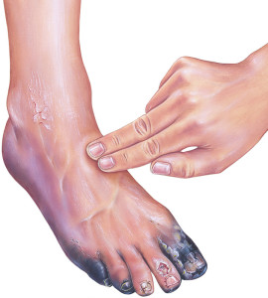
Definition
Peripheral vascular disease (PVD) is a blood circulation disorder that causes the blood vessels outside of your heart and brain to narrow, block, or spasm. This can happen in your arteries or veins.
3
Notes:
SAY: Before we wrap up the course, let’s review what we have learned today.
During this course, we have
<READ the bullets from the slide.>
GO to next slide.

Slide 4
Introduction
In PVD, blood vessels become narrowed and blood flow decreases. This can be due to arteriosclerosis, or “hardening of the arteries,” or it can be caused by blood vessel spasms
As plaque growth progresses, clots may develop and completely block the artery. This can lead to organ damage and loss of fingers, toes, or limbs, if left untreated.
4
Notes:
SAY: Before we wrap up the course, let’s review what we have learned today.
During this course, we have
<READ the bullets from the slide.>
GO to next slide.

Slide 5
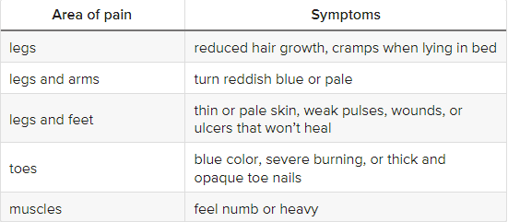
Symptoms of P\VD
5
Notes:
SAY: Before we wrap up the course, let’s review what we have learned today.
During this course, we have
<READ the bullets from the slide.>
GO to next slide.

Slide 6
Types of PVD
Functional PVD means there’s no physical damage to your blood vessels’ structure. Instead, your vessels widen and narrow in response other factors like brain signals and temperature changes.
Organic PVD involves changes in blood vessel structure like inflammation, plaques, and tissue damage.
6
Notes:
SAY:
The purpose of epidemiology in public health practice is to
discover the agent, host, and environmental factors that affect health;
determine the relative importance of causes of illness, disability, and death;
identify those segments of the population that have the greatest risk from specific causes of ill health; and
evaluate the effectiveness of health programs and services in improving population health.
GO to next slide.

Slide 7
Causes of PVD
The most common causes of functional PVD are:
Emotional stress
Cold temperatures
Operating vibrating machinery or tools
Drugs
●●●
7
Notes:
SAY:
The purpose of epidemiology in public health practice is to
discover the agent, host, and environmental factors that affect health;
determine the relative importance of causes of illness, disability, and death;
identify those segments of the population that have the greatest risk from specific causes of ill health; and
evaluate the effectiveness of health programs and services in improving population health.
GO to next slide.

Slide 8
Causes of PVD
The primary causes of organic PVD are:
Smoking
High blood pressure
Diabetes
High cholesterol
8
Notes:
SAY:
The purpose of epidemiology in public health practice is to
discover the agent, host, and environmental factors that affect health;
determine the relative importance of causes of illness, disability, and death;
identify those segments of the population that have the greatest risk from specific causes of ill health; and
evaluate the effectiveness of health programs and services in improving population health.
GO to next slide.

Slide 9
Risk-Factors of PVD
You’re at higher risk for PVD if you:
Are over age 50
Are overweight
Have abnormal cholesterol
Have a history of cerebrovascular disease or stroke
Have heart disease
Have diabetes
Have a family history of high cholesterol, high blood pressure, or PVD
●●●
9
Notes:
SAY:
The purpose of epidemiology in public health practice is to
discover the agent, host, and environmental factors that affect health;
determine the relative importance of causes of illness, disability, and death;
identify those segments of the population that have the greatest risk from specific causes of ill health; and
evaluate the effectiveness of health programs and services in improving population health.
GO to next slide.

Slide 10
Risk-Factors of PVD
have high blood pressure
have kidney disease on hemodialysis
Lifestyle choices that can increase your risk of developing PVD include:
Not engaging in physical exercise
Poor eating habits
Smoking
Drug use
10
Notes:
SAY:
The purpose of epidemiology in public health practice is to
discover the agent, host, and environmental factors that affect health;
determine the relative importance of causes of illness, disability, and death;
identify those segments of the population that have the greatest risk from specific causes of ill health; and
evaluate the effectiveness of health programs and services in improving population health.
GO to next slide.

Slide 11
Complication of PVD
Complications of PVD can include:
Tissue death, which can lead to limb amputation
Impotence
Pale skin
Pain at rest and with movement
Severe pain that restricts mobility
Wounds that don’t heal
11
Notes:
SAY:
The purpose of epidemiology in public health practice is to
discover the agent, host, and environmental factors that affect health;
determine the relative importance of causes of illness, disability, and death;
identify those segments of the population that have the greatest risk from specific causes of ill health; and
evaluate the effectiveness of health programs and services in improving population health.
GO to next slide.

Slide 12
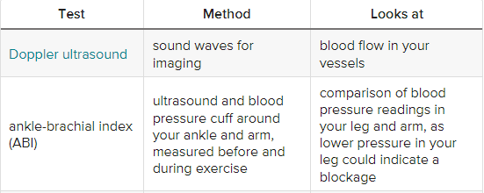
Diagnosis of PVD
●●●
12
Notes:
SAY:
The purpose of epidemiology in public health practice is to
discover the agent, host, and environmental factors that affect health;
determine the relative importance of causes of illness, disability, and death;
identify those segments of the population that have the greatest risk from specific causes of ill health; and
evaluate the effectiveness of health programs and services in improving population health.
GO to next slide.

Slide 13
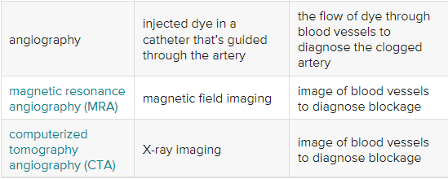
Diagnosis of PVD
13
Notes:
SAY:
The purpose of epidemiology in public health practice is to
discover the agent, host, and environmental factors that affect health;
determine the relative importance of causes of illness, disability, and death;
identify those segments of the population that have the greatest risk from specific causes of ill health; and
evaluate the effectiveness of health programs and services in improving population health.
GO to next slide.

Slide 14
Treatment of PVD
The two main goals of PVD treatment is to stop the disease from progressing and to help you manage your pain and symptoms so you can remain active.
First-line treatment typically involves lifestyle modifications. Your doctor will suggest a regular exercise program that includes walking, a balanced diet, and losing weight.
●●●
14
Notes:
SAY:
The purpose of epidemiology in public health practice is to
discover the agent, host, and environmental factors that affect health;
determine the relative importance of causes of illness, disability, and death;
identify those segments of the population that have the greatest risk from specific causes of ill health; and
evaluate the effectiveness of health programs and services in improving population health.
GO to next slide.

Slide 15
Treatment of PVD
Cilostazol or pentoxifylline to increase blood flow and relieve symptoms of claudication
Clopidogrel or daily aspirin to reduce blood clotting
Atorvastatin, simvastatin, or other statins to lower high cholesterol
●●●
15
Notes:
SAY:
The purpose of epidemiology in public health practice is to
discover the agent, host, and environmental factors that affect health;
determine the relative importance of causes of illness, disability, and death;
identify those segments of the population that have the greatest risk from specific causes of ill health; and
evaluate the effectiveness of health programs and services in improving population health.
GO to next slide.

Slide 16
Treatment of PVD
Significant artery blockages may require surgery like angioplasty or vascular surgery. Angioplasty is when your doctor inserts a catheter or long tube into your artery. A balloon on the tip of the catheter inflates and opens up the artery.
16
Notes:
SAY:
The purpose of epidemiology in public health practice is to
discover the agent, host, and environmental factors that affect health;
determine the relative importance of causes of illness, disability, and death;
identify those segments of the population that have the greatest risk from specific causes of ill health; and
evaluate the effectiveness of health programs and services in improving population health.
GO to next slide.

Slide 18
Conclusion
If diagnosed early, many cases of PVD will respond to lifestyle treatments. One way to measure improvement is to measure how far you can walk without pain.
With effective treatment, you should be able to gradually increase the distance.
18
Notes:
SAY:
The purpose of epidemiology in public health practice is to
discover the agent, host, and environmental factors that affect health;
determine the relative importance of causes of illness, disability, and death;
identify those segments of the population that have the greatest risk from specific causes of ill health; and
evaluate the effectiveness of health programs and services in improving population health.
GO to next slide.

Slide 19
References
Google.com
Wikipedia.org
Studymafia.org
Slidespanda.com

Slide 20
Thanks To StudyMafia.org

