Slide 1
StudyMafia.Org
Polycystic Ovary Syndrome(PCOS)
Submitted To: Submitted By:
Studymafia.org Studymafia.org

Slide 2
Table Contents
Definition
Introduction
Symptoms of PCOS
Causes of PCOS
Complications of PCOS
Diagnosis of PCOS
Treatment of PCOS
Conclusion
2
Notes:
SAY: Before we wrap up the course, let’s review what we have learned today.
During this course, we have
<READ the bullets from the slide.>
GO to next slide.

Slide 3
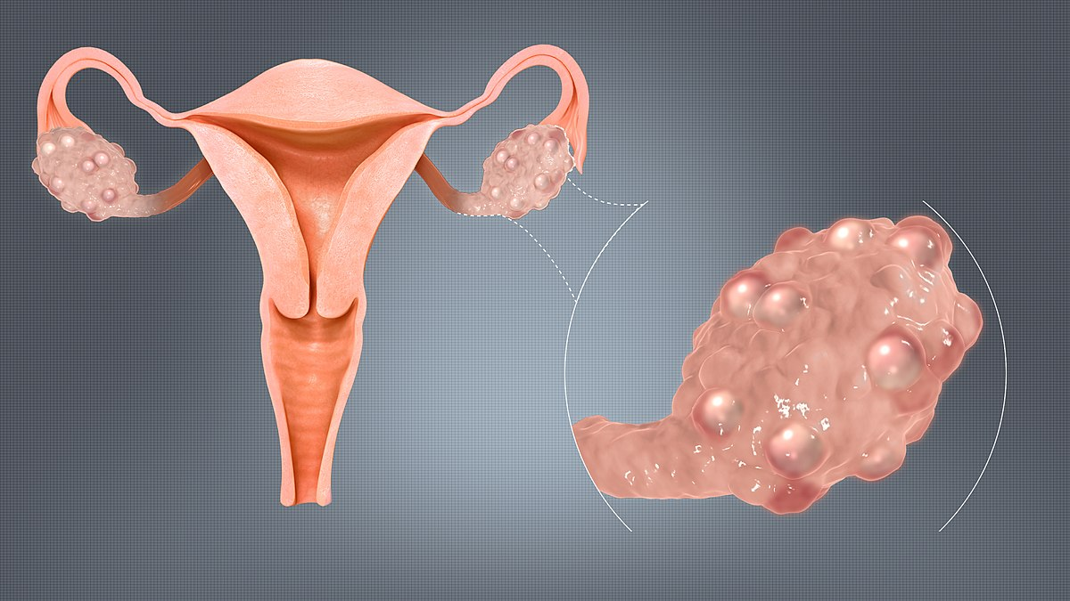
Definition
Polycystic ovary syndrome (PCOS) is a hormonal disorder common among women of reproductive age.
3
Notes:
SAY: Before we wrap up the course, let’s review what we have learned today.
During this course, we have
<READ the bullets from the slide.>
GO to next slide.

Slide 4
Introduction
Women with PCOS may have infrequent or prolonged menstrual periods or excess male hormone (androgen) levels. The ovaries may develop numerous small collections of fluid (follicles) and fail to regularly release eggs.
The exact cause of PCOS is unknown. Early diagnosis and treatment along with weight loss may reduce the risk of long-term complications such as type 2 diabetes and heart disease.
4
Notes:
SAY: Before we wrap up the course, let’s review what we have learned today.
During this course, we have
<READ the bullets from the slide.>
GO to next slide.

Slide 5
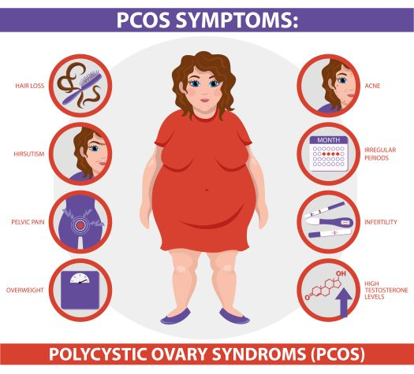
Symptoms of PCOS
5
Notes:
SAY: Before we wrap up the course, let’s review what we have learned today.
During this course, we have
<READ the bullets from the slide.>
GO to next slide.

Slide 6
Causes of PCOS
Excess insulin. Insulin is the hormone produced in the pancreas that allows cells to use sugar, your body's primary energy supply. If your cells become resistant to the action of insulin, then your blood sugar levels can rise and your body might produce more insulin.
Heredity. Research suggests that certain genes might be linked to PCOS.
●●●
6
Notes:
SAY:
The purpose of epidemiology in public health practice is to
discover the agent, host, and environmental factors that affect health;
determine the relative importance of causes of illness, disability, and death;
identify those segments of the population that have the greatest risk from specific causes of ill health; and
evaluate the effectiveness of health programs and services in improving population health.
GO to next slide.

Slide 7
Causes of PCOS
Low-grade inflammation. This term is used to describe white blood cells' production of substances to fight infection. Research has shown that women with PCOS have a type of low-grade inflammation
Excess androgen. The ovaries produce abnormally high levels of androgen, resulting in hirsutism and acne.
7
Notes:
SAY:
The purpose of epidemiology in public health practice is to
discover the agent, host, and environmental factors that affect health;
determine the relative importance of causes of illness, disability, and death;
identify those segments of the population that have the greatest risk from specific causes of ill health; and
evaluate the effectiveness of health programs and services in improving population health.
GO to next slide.

Slide 8
Complications of PCOS
Complications of PCOS can include:
Infertility
Gestational diabetes or pregnancy-induced high blood pressure
Miscarriage or premature birth
Nonalcoholic steatohepatitis — a severe liver inflammation caused by fat accumulation in the liver
Cancer of the uterine lining (endometrial cancer)
●●●
8
Notes:
SAY:
The purpose of epidemiology in public health practice is to
discover the agent, host, and environmental factors that affect health;
determine the relative importance of causes of illness, disability, and death;
identify those segments of the population that have the greatest risk from specific causes of ill health; and
evaluate the effectiveness of health programs and services in improving population health.
GO to next slide.

Slide 9
Complications of PCOS
Metabolic syndrome — a cluster of conditions including high blood pressure, high blood sugar, and abnormal cholesterol or triglyceride levels that significantly increase your risk of cardiovascular disease
Type 2 diabetes or prediabetes
Sleep apnea
Depression, anxiety and eating disorders
Abnormal uterine bleeding
9
Notes:
SAY:
The purpose of epidemiology in public health practice is to
discover the agent, host, and environmental factors that affect health;
determine the relative importance of causes of illness, disability, and death;
identify those segments of the population that have the greatest risk from specific causes of ill health; and
evaluate the effectiveness of health programs and services in improving population health.
GO to next slide.

Slide 10
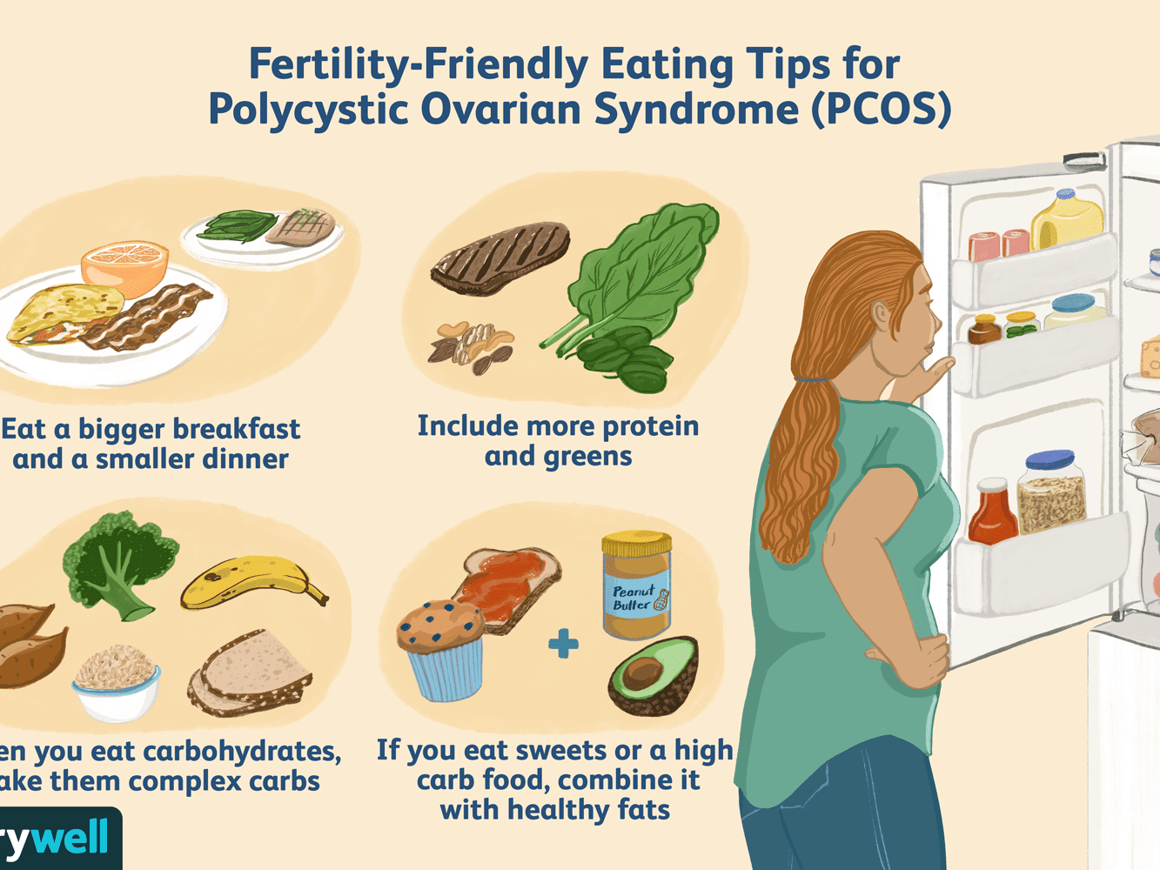

Slide 11
Diagnosis of PCOS
A pelvic exam. The doctor visually and manually inspects your reproductive organs for masses, growths or other abnormalities.
Blood tests. Your blood may be analyzed to measure hormone levels. This testing can exclude possible causes of menstrual abnormalities or androgen excess that mimics PCOS
●●●
11
Notes:
SAY:
The purpose of epidemiology in public health practice is to
discover the agent, host, and environmental factors that affect health;
determine the relative importance of causes of illness, disability, and death;
identify those segments of the population that have the greatest risk from specific causes of ill health; and
evaluate the effectiveness of health programs and services in improving population health.
GO to next slide.

Slide 12
Diagnosis of PCOS
An ultrasound. Your doctor checks the appearance of your ovaries and the thickness of the lining of your uterus. A wandlike device (transducer) is placed in your vagina (transvaginal ultrasound).
Periodic checks of blood pressure, glucose tolerance, and cholesterol and triglyceride levels
Screening for depression and anxiety
Screening for obstructive sleep apnea
12
Notes:
SAY:
The purpose of epidemiology in public health practice is to
discover the agent, host, and environmental factors that affect health;
determine the relative importance of causes of illness, disability, and death;
identify those segments of the population that have the greatest risk from specific causes of ill health; and
evaluate the effectiveness of health programs and services in improving population health.
GO to next slide.

Slide 13
Treatment of PCOS
Lifestyle changes
Your doctor may recommend weight loss through a low-calorie diet combined with moderate exercise activities. Even a modest reduction in your weight — for example, losing 5 percent of your body weight — might improve your condition.
●●●
13
Notes:
SAY:
The purpose of epidemiology in public health practice is to
discover the agent, host, and environmental factors that affect health;
determine the relative importance of causes of illness, disability, and death;
identify those segments of the population that have the greatest risk from specific causes of ill health; and
evaluate the effectiveness of health programs and services in improving population health.
GO to next slide.

Slide 14
Treatment of PCOS
Clomiphene. This oral anti-estrogen medication is taken during the first part of your menstrual cycle.
Letrozole (Femara). This breast cancer treatment can work to stimulate the ovaries.
Metformin. This oral medication for type 2 diabetes improves insulin resistance and lowers insulin levels.
Gonadotropins. These hormone medications are given by injection.
14
Notes:
SAY:
The purpose of epidemiology in public health practice is to
discover the agent, host, and environmental factors that affect health;
determine the relative importance of causes of illness, disability, and death;
identify those segments of the population that have the greatest risk from specific causes of ill health; and
evaluate the effectiveness of health programs and services in improving population health.
GO to next slide.

Slide 16
Conclusion
Polycystic ovary syndrome (PCOS) is a hormonal disorder common among women of reproductive age.
Women with PCOS may have infrequent or prolonged menstrual periods or excess male hormone (androgen) levels.
16
Notes:
SAY:
The purpose of epidemiology in public health practice is to
discover the agent, host, and environmental factors that affect health;
determine the relative importance of causes of illness, disability, and death;
identify those segments of the population that have the greatest risk from specific causes of ill health; and
evaluate the effectiveness of health programs and services in improving population health.
GO to next slide.

Slide 17
References
Google.com
Wikipedia.org
Studymafia.org
Slidespanda.com

Slide 18
Thanks To StudyMafia.org

